Slide 1

ECE382
Lesson 13
1

Slide 2
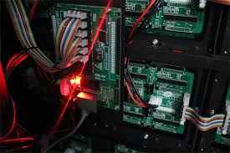
Overview
Lesson Outline
Peripherals
Memory-Mapped IO
Ports
GPIO
Multiplexing
In order to be useful, micro controllers need to be able to talk with sensors and other processors/hardware

Slide 3
Peripherals
What are Peripherals?
MSP430G2xx Peripherals?
MSP430 wikipedia:
Watchdog Timer
Universal Serial Communication Interface (USCI)
Implements UART, SPI, and I2C protocols
Pulse Width Modulation (PWM)
Temperature Sensor
Multiplexers
Too many capabilities, not enough pings
Capacitive Touch I/O
For working with touch screens, etc

Slide 4

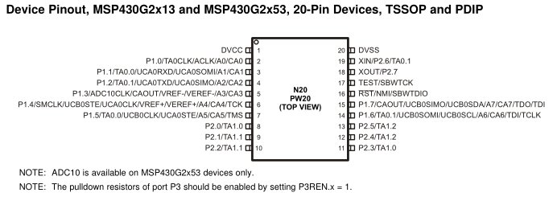
Ports (like with ships)
What are Ports?
Your LaunchPad Board has…
Port 1, Pin 0 to Pin 7
Port 2, Pin 0 to Pin 5
External
World
Ship
(uC)
Goods
(Data)

Slide 5
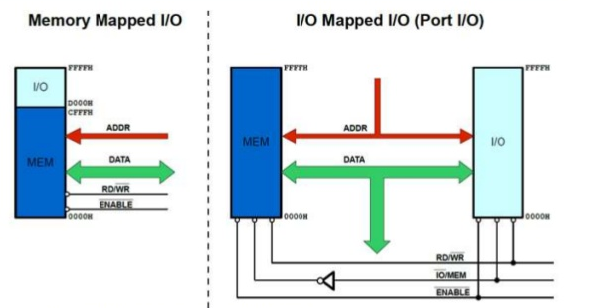
Ports
Motorola
I/O and memory share
Intel
I/O and memory have separate space
Memory-Mapped I/O
Advantage
Fewer instructions
Can use all addressing modes
Disadvantage
Lose memory to IO
Programmer mistakes
Port-Mapped I/O
Advantage
Don't lose memory for IO.
Protects coder from mistakes.
Disadvantage
Need More Instructions (like In/Out)
More restrictive addressing modes

Slide 6
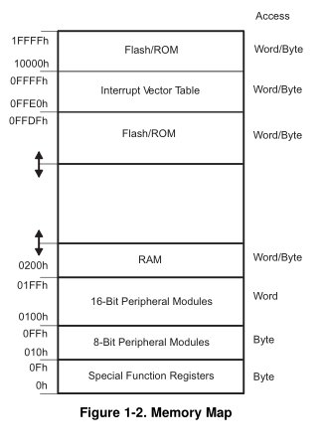
MSP430
MSP430 has Memory-Mapped I/O
How to use
mov #0x55, &P1OUT
mov #0x55, &0x0021
Why does the address have &?
User’s Guide p 333, Table 8-2

Slide 7
Multiplexing
Only 20 Pins !!! But want access to many more signals
Therefore, each pin shares several signals → multiplexing
You learned about multiplexers in ECE281
Use PxSEL1 and PxSEL2 to select signal for each pin
The details are in the MSP430G2x53 2x13 Mixed Signal MCU Datasheet.

Slide 8
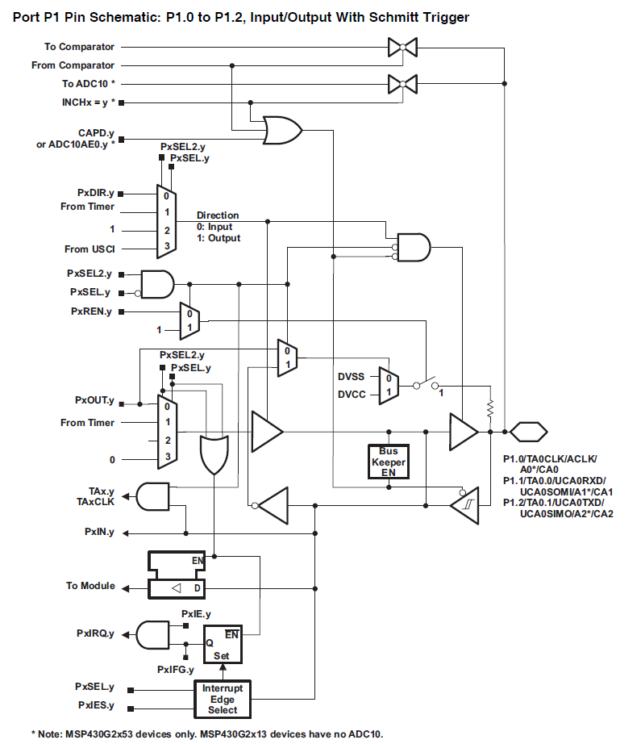
Port HW
Pull-up or pull-down resistor
Actual Pin
Only showing the HW setup for Port 1, pins 0-2. Different pins have different HW
MSP430 device specific guide, pg42

Slide 9
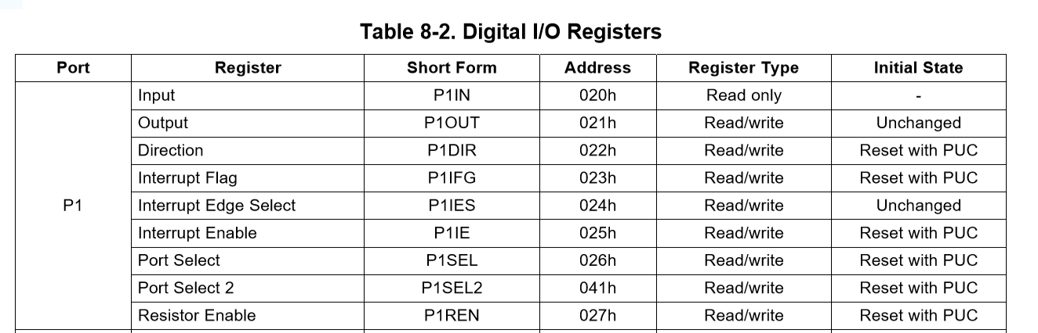
GPIO Port Control
The registers used to configure GPIO are PxDIR, PxREN, PxOUT, and PxIN
PxDIR configures a pin as an input (0) or an output (1)
bis.b #BIT0, &P1DIR ; port 1, pin 0 is output
bic.b #BIT1, &P1DIR ; port 1, pin 1 is input
PxREN enables pull up / pull down resistors to avoid floating inputs.
Writing to PxOUT:
Output: sets the output of each pin either high or low
Input: sets the input resistor as a pull-up (1) or a pull-down(0)
bis.b #BIT1, &P1REN ; port 1, resistor enabled
bis.b #BIT1, &P1OUT ; port 1, resistor is pull-up
PxIN allows you to read the values on these pins
PxSEL and PSEL2 are the MUX pins to select different pin modes
GPIO Regs
PxSEL
PxSEL2
PxIN
PxOUT
PxREN
PxDIR
Port 1 or 2
Family Users Guide p 328

Slide 10
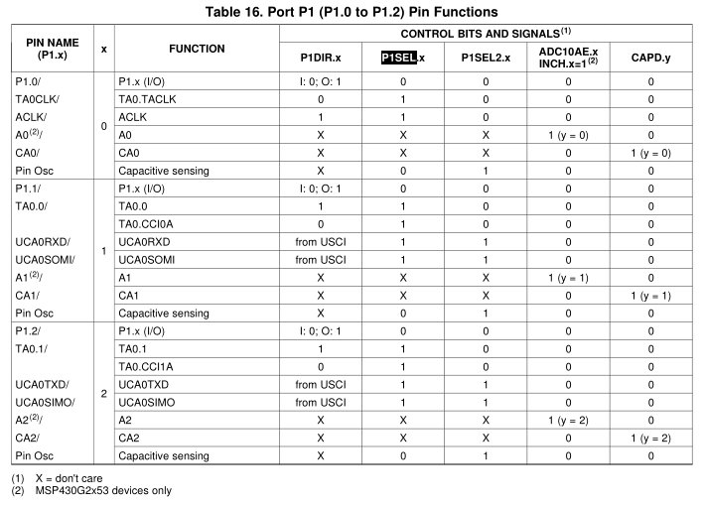
GPIO Pin Setup (MUXes!)
P1.x
Pin 0-7
Let’s setup UCA0SOMI on port 1, pin 1
PxDIR
Port 1 or 2
bis.b #BIT1, &P1SEL bis.b #BIT1, &P1SEL2

Slide 11
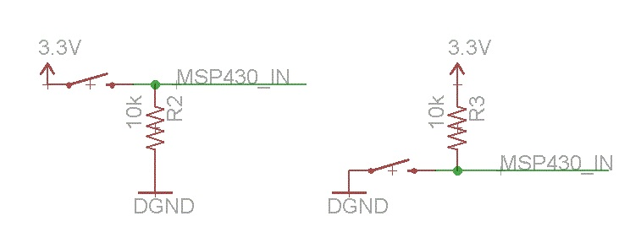
Avoiding Floating Inputs
Pull-up and pull-down resistors
You should know this from ECE231/ECE315 ☺
When a system starts up, there is a period where inputs could have random states (floating) because external HW hasn’t initialized things yet
You may not want your uC to act on that random input
Pull-up/down always keep your inputs in a known state
Pull-up
Input is always HIGH
Why do I need a resistor?
Pull-down
Input is always LOW

Slide 12
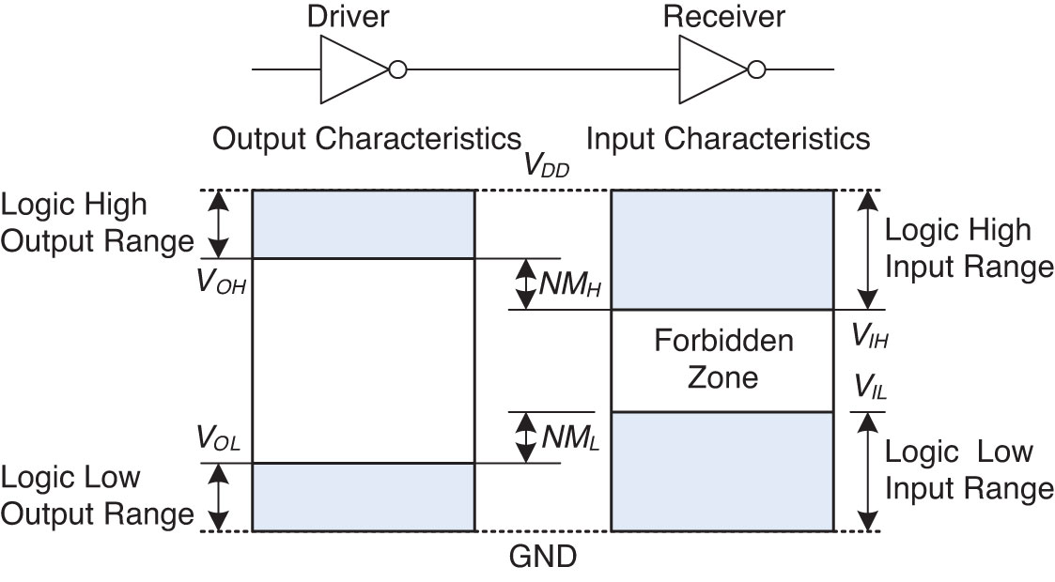
Floating
Voltage Levels and Noise Margins
Invalid Logic Levels
Remember this from ECE281?

Slide 13
Floating Inputs
If a floating input could be any value (valid or invalid), is this bad?
YES!
Imagine the input is tied to a pilot’s ejection seat
Imagine the uC “sees” for 1 usec a valid, fire the ejection seat
Imagine another uC does NOT “see” a valid eject canopy
In the end, we work the for the government … beside the contractor is the one who really gets in trouble! ☺
Ok, a more real Engineering answer is:
Maybe, it depends on the situation ☺

Slide 14
Example Program
bis.b #BIT0|BIT6, &P1DIR ; output pin dir (see next slide)
bic.b #BIT3, &P1DIR ; what is on pin 3? Input or output?
bis.b #BIT3, &P1REN ; enable pin 3’s resistor
bis.b #BIT3, &P1OUT ; pull-up or pull-down?
check_btn: bit.b #BIT3, &P1IN
jz set_lights
bic.b #BIT0|BIT6, &P1OUT
jmp check_btn
set_lights: bis.b #BIT0|BIT6, &P1OUT
jmp check_btn
What is going on here?
Time permitting, let’s run this on your processor

Slide 15
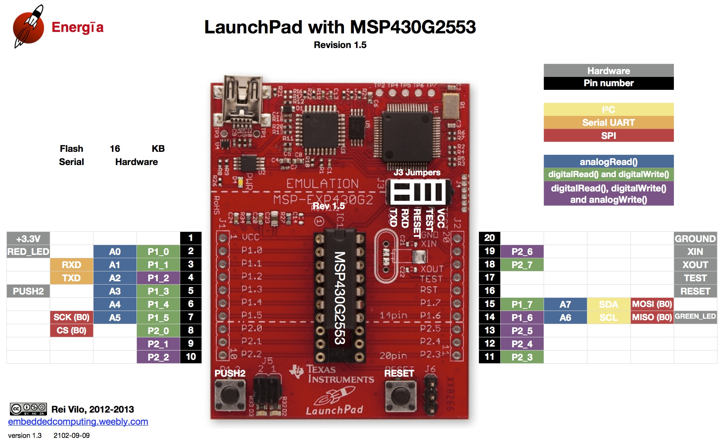
Toggle LED
Let's write a program that controls the 2 onboard LEDs with the onboard push button
bis.b #BIT0|BIT6, &P1DIR ; ???? See next slide
bic.b #BIT3, &P1DIR
check_btn: bit.b #BIT3, &P1IN ;push button is LOW on push
jz set_lights
bic.b #BIT0|BIT6, &P1OUT
jmp check_btn
set_lights: bis.b #BIT0|BIT6, &P1OUT
jmp check_btn
bit0
bit3
bit6

Slide 16
BACKUPS

Slide 17
Toggle LED
Let's write a program that controls the 2 onboard LEDs with the onboard push button
bis.b #BIT0|BIT6, &P1DIR ; ???? See next slide
bic.b #BIT3, &P1DIR
check_btn: bit.b #BIT3, &P1IN ;push button is LOW on push
jz set_lights
bic.b #BIT0|BIT6, &P1OUT
jmp check_btn
set_lights: bis.b #BIT0|BIT6, &P1OUT
jmp check_btn

