Slide 1

ECE382
Lesson 19
1

Slide 2
Overview
Lesson Outline
Review GR1
High Level Languages (HLL)
Why are we using C?

Slide 3
HLL vs ASM
Advantages of HLL
Ease of development
Develop code faster (which means cheaper)
Portability
HLL code can be made to run on many different machines, whereas assembly is architecture-specific
Readability
HLL code is generally easier to read / understand than assembly
Optimization
Humans typically aren't that great at writing assembly code
HLLs can offer optimization techniques / restrictions that can improve poorly-written code
Disadvantages of HLL
HLL consumes more memory/CPU time/storage space, etc
You cannot put python on an MSP430

Slide 4
Compiler
Native Development
(Ex: x86 to x86)
Cross Platform Development
(what we do: x86 to MSP430)
High Level Language Program
High Level Language Program
Compiler
Cross-Compiler
Assembly Code
Assembly Code
Assembler
Cross-Assembler
Relocatable Object Code
Relocatable Object Code
Linker
Linker
Executable Code
Executable Code

Slide 5
Compiler
Compiled Language versus Interpreted?
Examples:
Fast ←→ Portable
Compiled | Both | Interpreted
C | Java | Python
C++ | C# | Prolog
Ada |  | Matlab
 |  | Scheme
 |  | Ruby
Interpreted languages typically have an interpreter coded in C/C++ for every architecture the language will run on

Slide 6
Why C?
One of the most widely used programming languages of all time
Examples of projects coded in C:
Kernel / OS: Linux, GNU
Version Control: git
Web Server: Apache, nginx
Interpreter: Ruby, Python
Databases: mysql, postgresql, redis
Virtualization: vmware
Almost anything embedded, device drivers
C is like a portable, higher-level assembly

Slide 7

CCS
Code Composer Studio
GCC v6.4 released July 2017
Supports C11 standard released 2011
gcc is the most common uC compiler used in the world

Slide 8
BACKUPS

Slide 9
C Language: Comments
// Single line comment
/* block comment that can span
multiple lines */
int i = 0; // a declaration
/*************************************
** The previous variable was
** declared just as an example.
*************************************/

Slide 10
C Language: Variables
Variable Types
Type | Size | Description
char | 1 byte | number or ASCII character
int | 2 bytes | larger number
float | 2 bytes | single-precision floating point number
double | 4 bytes | double-precision floating point number
•Note: These sizes are dependent on the compiler and target architecture - these are for the MSP430.
•Note: Do not use the float / double types on the MSP430 - since it doesn't have floating point hardware support, implementing software support will use almost all of your memory.

Slide 11
C Language: Variables
Variable Modifiers
Modifier | Description
short | remains a 2-byte integer
long | increases int size to 4 bytes
signed | two's complement numbers (default)
unsigned | allows unsigned arithmetic
static | directly allocates memory to remember a value between function calls. Variable is allocated to "permanent" memory, not the stack.
extern | actual storage and initial value of variable is defined elsewhere
const | assigns a constant (read-only) value to a variable
•Note: Once again, sizes are dependent on compiler / target architecture - these are for the MSP

Slide 12
#include <stdint.h>
In: C:\ti\ccsv6\tools\compiler\msp430_15.12.3.LTS\include
Take a look, this defines a bunch of data types to help you:
Long Declaration | Clear Shorthand
signed char | int8_t
unsigned char | uint8_t
int | int16_t
unsigned int | uint16_t
long | int32_t
unsigned long | uint32_t
Why is this useful? Portability … an int isn’t always 16 bits on every architecture. It is useful to use these, makes your code more readable (and portable)

Slide 13
Others
#include <stdbool.h> defines booleans
true = 1
false = 0
bool is a valid data type
#include <math.h> defines things like:
#define M_PI 3.14159265358979323846 /* pi */
#define M_PI_2 1.57079632679489661923 /* pi/2 */
sqrtf() square root float
sqrt() square root double (default)
cosf() cosine float
cos() cosine double (default)
etc

Slide 14
So now you can write this
#include <msp430.h>
#include <stdint.h>
#include <stdbool.h>
/*
* main.c
*/
void main(void) {
WDTCTL = WDTPW | WDTHOLD; // Stop watchdog timer
uint8_t bob = 0;
bool run = true;
while(run){
bob += 1;
}
while(true){;} // CPU trap
}

Slide 15
Volatile
Volatile is an important key word in embedded applications talking to memory mapped IO
static int foo;
void bar(void) {
foo = 0;
while (foo != 255)
;
}
static volatile int foo;
void bar (void) {
foo = 0;
while (foo != 255)
;
}
void bar_optimized(void) {
foo = 0;
while (true)
;
}
A good compiler will optimize to this. Nothing changes foo, or so the compiler thinks.
In order to tell the compiler, “hey, don’t change foo!”, declare it volatile.
If you program this, where foo is tied to a pin and polled for change

Slide 16
C Language: Constants
Preferred Constant Declaration
The #define statement is a pre-processor directive.
pre-processor will “find-replace” each instant
similar to a .equ statement in assembly.
// #define MY_CONST some_value
#define SCREEN_WIDTH 640
#define SCREEN_HEIGHT 480
int numPixels = 0;
numPixels = SCREEN_WIDTH * SCREEN_HEIGHT;
•Note: There is no ';' or '=' in #define statements
•Note: Variables must be declared at the top of a block, and they are not initialized by default. A block is denoted by braces {}
•Note: A value can be binary (0b), octal (0), or hex (0x) by using prefixes
Generally poor form, unless you are writing compilers or tools

Slide 17

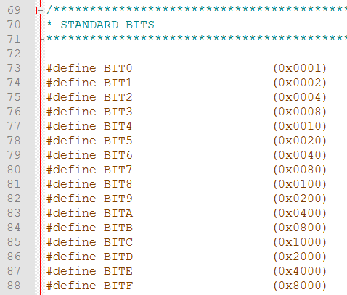
Constants we have been using…
From assembly template:
c:\ti\ccsv6\ccs_base\msp430\include\msp430.h
c:\ti\ccsv6\ccs_base\msp430\include\msp430g2553.h

Slide 18
Constants vs Macros (#define)
const
Tells the compiler the variable (or pointer) can not be modified
Properly scoped / identifier clash issues handled nicely
Depending on how it is used may not consume RAM
The compiler can check you are using it correctly (i.e. data type) and throw a warning or error if you are not
#define
It acts like a global copy/paste and can produce very difficult bugs to find
"global" scope / more prone to conflicting usages, which can produce hard-to-resolve compilation issues and unexpected run-time results rather than sane error messages
Compiler assumes it is untyped and some compilers will allow comparisons between defines and unsigned ints (which you may not want)

Slide 19
C Language: Operators
Assignment, Arithmetic Operators
char myVar, a, b; // variable declaration
myVar = a; // assignment - note, all vars have undefined values at this point
myVar = a + b; // addition
myVar = a - b; // subtraction
myVar = a * b; // multiplication
myVar = a / b; // division
myVar = a % b; // modulus (remainder)
myVar++; // increment
myVar--; // decrement
myVar += a; // myVar = myVar + a
myVar -= a; // myVar = myVar - a

Slide 20
C Language: Operators
Relational Operators
if ((a < 10) && (a > 5))
{
// literally: if a is greater than 5 and less than 10, do whatever is in here
// practically: if a is between 5 and 10, do whatever is in here
}
•Note: In C, "false" is 0, while any non-zero value is considered true.
Operator | Description | Example
< | less than
<= | less than or equal to
> | greater than
>= | greater than or equal to
== | equal to
!= | not equal to
&& | logical AND
| | | logical OR

Slide 21
C Language: Operators
Bit-wise Operators
// Example with SPI
UCA0CTL1 &= ~UCSWRST; // enable the subsystem (AND UCA0CTL1 with NOT UCSWRST)
UCA0CTL1 |= UCSWRST; // disable the subsystem (OR UCA0CTL1 with UCSWRST)
Operator | Description | Example
& | AND
| | OR
^ | XOR
~ | One's Complement
>> | Bit-shift right
<< | Bit-shift left

Slide 22
If Statement
if (logical expression)
{
statements;
} else if (logical expression)
{
statements;
}
...
else
{
statements;
}
Example:
if (temp < MIN_TEMP)
{
flag = TOO_LOW;
} else if (temp > MAX_TEMP)
{
flag = TOO_HIGH;
}
else
{
flag = JUST_RIGHT;
}

Slide 23
Switch Statement
switch (value)
{
case constant-expression1:
statements;
break;
case constant-expression2:
statements;
break;
default:
// gets executed if no other case hits
statements;
break;
}
Example:
switch (GAME_STATE)
{
case MENU:
displayMenu();
break;
case PLAYING:
updateState();
break;
case LOST:
displayLost();
break;
}

Slide 24
For Loop
for (initial; continue; increment)
{
statements;
}
initial - evaluated once, immediately before the first iteration of the loop. Usually used to initialize variable.
continue - condition checked to execute the next iteration. If false, then the loop terminates.
increment - single statement executed at the end of each loop. Usually used to increment / decrement a variable.
Example:
// i and sum must already be declared
for (i = 1; i <= 20; i++)
{
sum += i;
}

Slide 25
While / Do While Loop
while (condition) {
statements;
}
do while is guaranteed to be executed once, while isn't.
do
{
statements;
} while (condition);
Example:
int i = 5;
while (i < 10)
{
i++;
}
do {
i++
} while (i < 10);
// final value of i is 11
Will execute at least once!

Slide 26
Basic C Program Structure
// #include statements
// #define statements
// global variables
void main(void)
{
// Variable declarations
// Useful code
while (1) {} // trap the CPU
}
Example:
#include <stdio.h>
#include “math.h"
#define NUM_LOOPS 23
void main(void)
{
unsigned char i;
unsigned int summation = 0;
for (i = 1; i <= NUM_LOOPS; i++)
{
summation += i;
}
while (1) {} // trap the CPU
}

Slide 27
Headers !!!!
/*--------------------------------------------------------------------
Name:<Your Name>
Date:<The date you stated working on the file>
Course: <The course's name>
File:<This file's name>
HW: <HW# and name>
Purp:A brief description of what this program does and
the general solution strategy.
Doc: <list the names of the people who you helped>
<list the names of the people who assisted you>
Academic Integrity Statement: I certify that, while others may have
assisted me in brain storming, debugging and validating this program,
the program itself is my own work. I understand that submitting code
which is the work of other individuals is a violation of the honor
code. I also understand that if I knowingly give my original work to
another individual is also a violation of the honor code.
-------------------------------------------------------------------------*/
Template on ECE.Ninja - http://ece.ninja/382/admin/main_template.c
Want to edit your default empty C template??? Then modify:
C:\ti\ccsv6\eclipse\plugins\com.ti.ccstudio.project.templates_VERSION_NUMBERS\resources\msp430\empty\main.c
Try Assignment 6:
http://ece.ninja/382/notes/L19/L19_C_basics.html

Slide 28
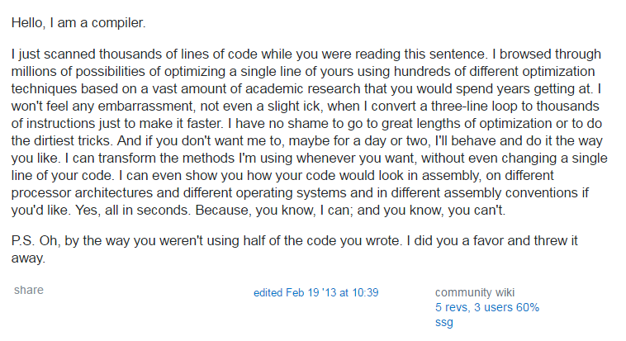
High Level Language versus Assembly
I'm a Compiler
List of Programming Languages
Benefits of using these over programming in assembly?

