Slide 1

ECE382
Lesson 3,4,5
1

Slide 2
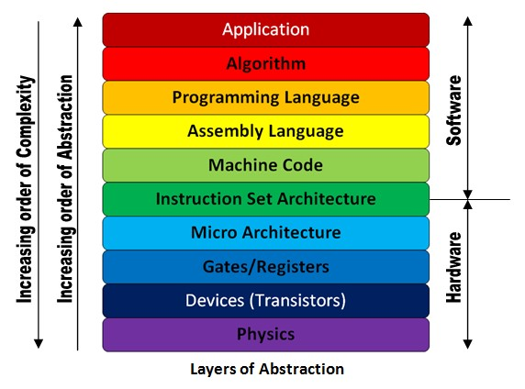
Outline
Objectives
MSP430 Instructions
Types of assembly instructions
How they work
Go from ASM -> machine code (remember ECE281??)
Assembly clock cycles
ISA

Slide 3
MSP430’s ISA
Types of Instructions (16b)
Single-operand: Instr <reg>
SWPB r12
Two-operand: Instr <reg>, <reg>
add r5, r6
add src, dst
Jump: JMP <Addr>
JMP loop
Emulated Instructions
These are instructions that live within the IDE and are designed to make your life (the programmer) easier.
However, if you change IDE’s these might not be available!
These instructions are (invisible to you) made up of actual instructions listed above

Slide 4
MSP430’s ISA
Immediate Values
#10
What's the # mean?
What base is this number in?
#0x10
What base is this number in?
#0b10
What base is this number in?
Assembler does the work of base conversion for you.
The default is always assumed to be decimal
Memory Address
$0xC000

Slide 5
MSP430 Instruction Set
MSP430 Instruction Set
All instructions are 16 bits long. Their binary format looks like this:
15 | 14 | 13 | 12 | 11 | 10 | 9 | 8 | 7 | 6 | 5 | 4 | 3 | 2 | 1 | 0
0 | 0 | 0 | 1 | 0 | 0 | Opcode |  |  | W=0/ B=1 | Ad |  | Dest reg
0 | 0 | 1 | Condition |  |  | PC offset (10 bit)
Opcode |  |  |  | Source reg |  |  |  | Ad | W=0/B=1 | As |  | Dest reg
Which row corresponds to each format?
:
Double-Operand (Format I)
Single-Operand (Format II)
Jumps (Format III)

Slide 6
One Operand Instructions
Opcode | Assembly Instruction | Description
000 | RRC(.B) | 9-bit rotate right through carry. C->msbit->...->lsbit->C. Clear the carry bit beforehand to do a logical right shift.
001 | SWPB | Swap 8-bit register halves. No byte form.
010 | RRA(.B) | Badly named, this is an arithmetic right shift - meaning the most significant bit is preserved.
011 | SXT | Sign extend 8 bits to 16. No byte form.
100 | PUSH(.B) | Push operand on stack. Push byte decrements SP by 2. Most significant byte not overwritten. CPU BUG: PUSH #4 and PUSH #8 do not work when the short encoding using @r2 and @r2+ is used. The workaround, to use a 16-bit immediate, is trivial, so TI do not plan to fix this bug.
101 | CALL | Fetch operand, push PC, then assign operand value to PC. Note the immediate form is the most commonly used. There is no easy way to perform a PC-relative call; the PC-relative addressing mode fetches a word and uses it as an absolute address. This has no byte form.
110 | RETI | Pop SR, then pop PC. Note that because flags like CPUOFF are in the stored status register, the CPU will normally return to the low-power mode it was previously in. This can be changed by adjusting the SR value stored on the stack before invoking RETI (see below). The operand field is unused.
111 | Unused
:

Slide 7
Two Operand Instructions
Opcode | Assembly Instruction | Description | Notes
0100 | MOV src, dest | dest = src | The status flags are NOT set.
0101 | ADD src, dest | dest += src
0110 | ADDC src, dest | dest += src + C
0111 | SUBC src, dest | dest += ~src + C
1000 | SUB src, dest | dest -= src | Implemented as dest += ~src + 1
1001 | CMP src, dest | dest - src | Sets status only; the destination is not written.
1010 | DADD src, dest | dest += src + C, BCD (Binary Coded Decimal)
1011 | BIT src, dest | dest & src | Sets status only; the destination is not written.
1100 | BIC src, dest | dest &= ~src | The status flags are NOT set.
1101 | BIS src, dest | dest |=src | The status flags are NOT set.
1110 | XOR src, dest | dest ^= src
1111 | AND src, dest | dest &= src
:
These uniary commands (dest += src) actually means dest = src OP dest.

Slide 8
Relative Jumps
Condition Code | Assembly Instruction | Description
000 | JNE/JNZ | Jump if Z==0 (if !=)
001 | JEQ/Z | Jump if Z==1 (if ==)
010 | JNC/JLO | Jump if C==0 (if unsigned <)
011 | JC/JHS | Jump if C==1 (if unsigned >)
100 | JN | Jump if N==1 - Note there is no jump if N==0
101 | JGE | Jump if N==V (if signed >=)
110 | JL | Jump if N!=V (if signed <)
111 | JMP | Jump unconditionally
:

Slide 9
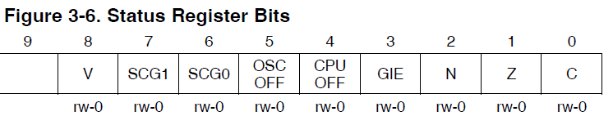
Emulated Instructions
Emulated Instruction | Assembly Instruction | Notes
NOP | MOV r3, r3
POP dst | MOV @SP+, dst
BR dst | MOV dst, PC | BR dst
RET | MOV @SP+, PC | RET
CLRC | BIC #1, SR
SETC | BIS #1, SR
CLRZ | BIC #2, SR
SETZ | BIS #2, SR
CLRN | BIC #4, SR
SETN | BIS #4, SR
DINT | BIC #8, SR
EINT | BIS #8, SR
:

Slide 10
More Emulated Instructions
Emulated Instruction | Assembly Instruction
RLA(.B) | ADD(.B) dst, dst
RLC(.B) | ADDC(.B) dst, dst
INV(.B) dst | XOR(.B) #-1, dst
CLR(.B) dst | MOV(.B) #0, dst
TST(.B) dst | CMP(.B) #0, dst
DEC(.B) dst | SUB(.B) #1, dst
DECD(.B) dst | SUB(.B) #2, dst
INC(.B) dst | ADD(.B) #1, dst
INCD(.B) dst | ADD(.B) #2, dst
ADC(.B) dst | ADDC(.B) #0, dst
DADC(.B) dst | DADD(.B) #0, dst
SBC(.B) dst | SUBC(.B) #0, dst
:

Slide 11
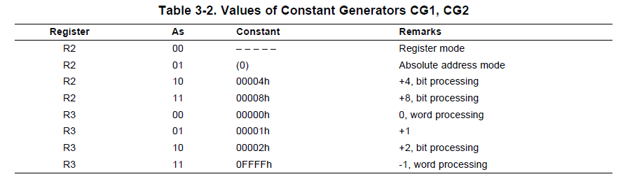
Values of Constant Generators CG1, CG2
Notice how SR Emulated Instructions use Constant Generators for Bit Masking
Family User Guide 3.2.4 pp46

Slide 12
Let's write a MSP430 program
Our chip version: Msp430g2553
; This program sets all pins on Port 1 to output and high. Since LEDs 1 and 2 are connected to P1.0 and P1.6 respectively, they will light up. This program turns the LEDs on and off
.text
; turning off watchdog timer NOT shown
main:
bis.b #0xFF, &P1DIR ; set port1 direction to output
Turn_on:
bis.b #0xFF, &P1OUT ; turn on leds at port1, bis?
Turn_off:
bic.b #0xFF, &P1OUT ; turn on leds at port1, bic?
jmp Turn_on ; loop forever
← what?

Slide 13
Sample Program
c010: 7a 40 75 00 mov.b #117, r10 ;#0x0075
c014: 7a 50 c7 00 add.b #199, r10 ;#0x00c7
c018: 0a 63 adc r10
c01a: 7a e3 xor.b #-1, r10 ;r3 As==11
c01c: 3a 40 aa 00 mov #170, r10 ;#0x00aa
c020: 8a 11 sxt r10
c022: 3a e3 inv r10
c024: 8a 10 swpb r10
c026: 09 4a mov r10, r9
c028: f3 3f jmp $-24 ;abs 0xc010
1: Emulated Instruction
2: Jump Instruction
3: Double Operand Instruction
4: Single Operand Instruction
4
1
3
2

Slide 14
MSP430 Instruction Set
MSP430 Instruction Set
All instructions are 16 bits long. Their binary format looks like this:
15 | 14 | 13 | 12 | 11 | 10 | 9 | 8 | 7 | 6 | 5 | 4 | 3 | 2 | 1 | 0
0 | 0 | 0 | 1 | 0 | 0 | Opcode |  |  | W=0/ B=1 | Ad |  | Dest reg
0 | 0 | 1 | Condition |  |  | PC offset (10 bit)
Opcode |  |  |  | Source reg |  |  |  | Ad | W=0/B=1 | As |  | Dest reg
Double-Operand (Format I)
Single-Operand (Format II)
Jumps (Format III)
Opcode: instruction
Ad: addressing mode
PC: program counter
:

Slide 15
Basic addressing modes
As/Ad | Addressing Mode | Description | Example
00/0 | Rn | Register direct | mov r8, r9
01/1 | offset(Rn) | Register Indexed | mov 2(r8), r9
10/- | @Rn | Register indirect | mov @r8, r9
11/- | @Rn+ | Register indirect with post-increment | mov @r8+, r9
memory
registers
203 | 56
202 | 78
201 | 12
200 | 34
r8 | 0200
r9 | 0000

Slide 16
Basic addressing modes
As/Ad | Addressing Mode | Description | Example
00/0 | Rn | Register direct | mov r8, r9
01/1 | offset(Rn) | Register Indexed | mov 2(r8), r9
10/- | @Rn | Register indirect | mov @r8, r9
11/- | @Rn+ | Register indirect with post-increment | mov @r8+, r9
memory
registers
203 | 56
202 | 78
201 | 12
200 | 34
r8 | 0200
r9 | 0200

Slide 17
Basic addressing modes
As/Ad | Addressing Mode | Description | Example
00/0 | Rn | Register direct | mov r8, r9
01/1 | offset(Rn) | Register Indexed | mov 2(r8), r9
10/- | @Rn | Register indirect | mov @r8, r9
11/- | @Rn+ | Register indirect with post-increment | mov @r8+, r9
memory
registers
203 | 56
202 | 78
201 | 12
200 | 34
r8 | 0200
r9 | 0000

Slide 18
Basic addressing modes
As/Ad | Addressing Mode | Description | Example
00/0 | Rn | Register direct | mov r8, r9
01/1 | offset(Rn) | Register Indexed | mov 2(r8), r9
10/- | @Rn | Register indirect | mov @r8, r9
11/- | @Rn+ | Register indirect with post-increment | mov @r8+, r9
memory
registers
0200
+ 2
0202
203 | 56
202 | 78
201 | 12
200 | 34
r8 | 0200
r9 | 5678
How about: mov.w 2(r6), 6(r5) ???

Slide 19
Basic addressing modes
As/Ad | Addressing Mode | Description | Example
00/0 | Rn | Register direct | mov r8, r9
01/1 | offset(Rn) | Register indexed | mov 2(r8), r9
10/- | @Rn | Register indirect | mov @r8, r9
11/- | @Rn+ | Register indirect with post-increment | mov @r8+, r9
memory
registers
203 | 56
202 | 78
201 | 12
200 | 34
r8 | 0200
r9 | 0000

Slide 20
Basic addressing modes
As/Ad | Addressing Mode | Description | Example
00/0 | Rn | Register direct | mov r8, r9
01/1 | offset(Rn) | Register Indexed | mov 2(r8), r9
10/- | @Rn | Register indirect | mov @r8, r9
11/- | @Rn+ | Register indirect with post-increment | mov @r8+, r9
memory
registers
203 | 56
202 | 78
201 | 12
200 | 34
r8 | 0200
r9 | 1234
Like a pointer
Is this the same as: move 0(r8), r9 ???

Slide 21
Basic addressing modes
As/Ad | Addressing Mode | Description | Example
00/0 | Rn | Register direct | mov r8, r9
01/1 | offset(Rn) | Register Indexed | mov 2(r8), r9
10/- | @Rn | Register indirect | mov @r8, r9
11/- | @Rn+ | Register indirect with post-increment | mov @r8+, r9
memory
registers
203 | 56
202 | 78
201 | 12
200 | 34
r8 | 0200
r9 | 0000

Slide 22
Basic addressing modes
As/Ad | Addressing Mode | Description | Example
00/0 | Rn | Register direct | mov r8, r9
01/1 | offset(Rn) | Register Indexed | mov 2(r8), r9
10/- | @Rn | Register indirect | mov @r8, r9
11/- | @Rn+ | Register indirect with post-increment | mov @r8+, r9
memory
registers
203 | 56
202 | 78
201 | 12
200 | 34
r8 | 0202
r9 | 1234

Slide 23
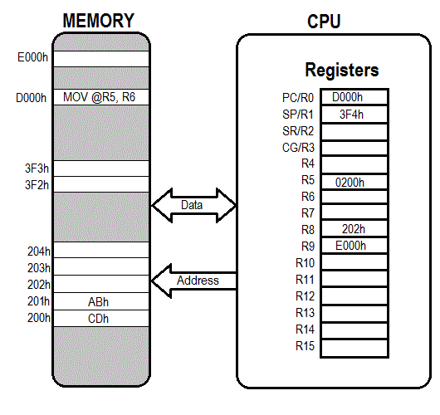
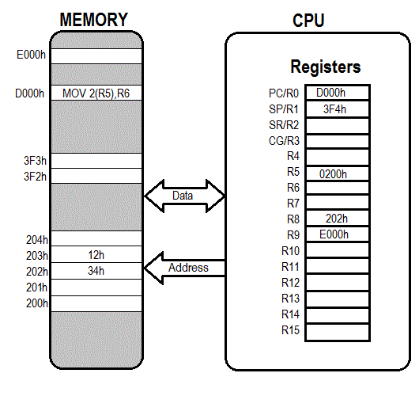

Addressing Modes
Given this instruction, how does the memory and CPU change?
Now, go ahead and take a couple minutes and fill out the tables on your sheet of paper. I will call some people to answer them

Slide 24
MSP430 Instruction Set
MSP430 Instruction Set
All instructions are 16 bits long. Their binary format looks like this:
15 | 14 | 13 | 12 | 11 | 10 | 9 | 8 | 7 | 6 | 5 | 4 | 3 | 2 | 1 | 0
0 | 0 | 0 | 1 | 0 | 0 | Opcode |  |  | W=0/ B=1 | Ad |  | Dest reg
0 | 0 | 1 | Condition |  |  | PC offset (10 bit)
Opcode |  |  |  | Source reg |  |  |  | Ad | W=0/B=1 | As |  | Dest reg
Double-Operand (Format I)
Single-Operand (Format II)
Jumps (Format III)
:
Let’s talk about how to assemble this instructions
ASM -> machine code

Slide 25
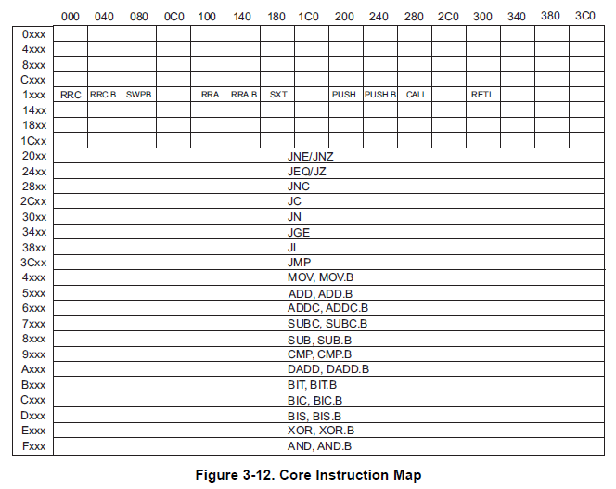
Core Instruction Map
The beginning of every 16b instruction tells us what it is
Figure 3-12
Family User Guide 3.4.5 pp62

Slide 26
Single-Operand Instruction
SXT r10
All instructions are 16 bits long. Their binary format looks like this:
Let’s assemble this instruction (SXT r10) into binary machine code
Remember doing this in ECE281 … it’s back!!!!
15 | 14 | 13 | 12 | 11 | 10 | 9 | 8 | 7 | 6 | 5 | 4 | 3 | 2 | 1 | 0
0 | 0 | 0 | 1 | 0 | 0 | Opcode |  |  | W=0/ B=1 | Ad |  | Dest reg
:

Slide 27
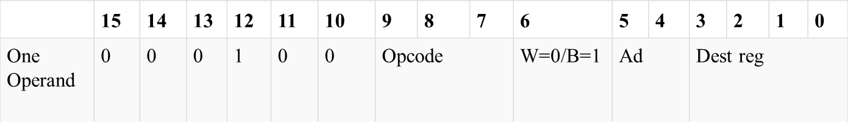
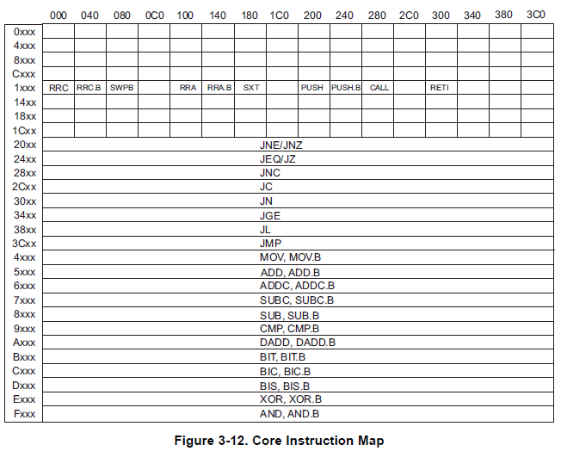
Single-Operand Instruction: Register
no .b
register mode
Table 3-3 Blue Book Pg 12
SXT r10
All instructions are 16 bits long. Their binary format looks like this:
0 0 0 1 0 0 0 1 8 0 0 0 1 0 1 0
_ _ _ _ _ _ _ _ _ _ _ _ _ _ _ _
:
1 0/ 1 8/0/0 A
Figure 3-12
Family User Guide 3.4.5 pp62

Slide 28
Relative Jumps
Not directly found in datasheets!
Condition Code | Assembly Instruction | Description
000 | JNE/JNZ | Jump if Z==0 (if !=)
001 | JEQ/Z | Jump if Z==1 (if ==)
010 | JNC/JLO | Jump if C==0 (if unsigned <)
011 | JC/JHS | Jump if C==1 (if unsigned >)
100 | JN | Jump if N==1 - Note there is no jump if N==0
101 | JGE | Jump if N==V (if signed >=)
110 | JL | Jump if N!=V (if signed <)
111 | JMP | Jump unconditionally
:
How many bits do we have for offset in a jump?
What is the range of signed numbers?

Slide 29
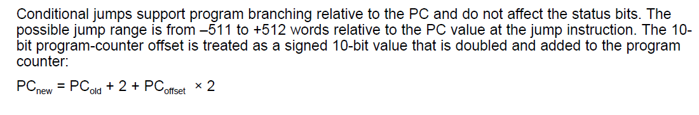
Relative Jump Instruction
JMP $-024
All instructions are 16 bits long. Their binary format looks like this:
15 | 14 | 13 | 12 | 11 | 10 | 9 | 8 | 7 | 6 | 5 | 4 | 3 | 2 | 1 | 0
0 | 0 | 1 | Condition |  |  | PC offset (10 bit)
Figure 3-12
Family User Guide 3.4.5 pp62
:
_ _ _ _ _ _ _ _ _ _ _ _ _ _ _ _
0011 11/11 1 1 1 1 0 0 1 1
C/3 =F F 3
-24 = 2+PC*2
PC = (-24-2)/2 = -13
Family User Guide 3.4.5 pp59

Slide 30
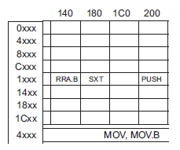
Two Operand Instruction: Register
no .b
register mode
MOV r10, r9
All instructions are 16 bits long. Their binary format looks like this:
 | 15 | 14 | 13 | 12 | 11 | 10 | 9 | 8 | 7 | 6 | 5 | 4 | 3 | 2 | 1 | 0
Two Operand | Opcode |  |  |  | Source reg |  |  |  | Ad | W=0/B=1 | As |  | Dest reg
register mode
:
0 1 0 0 1 0 1 0 0 0 0 0 1 0 0 1
_ _ _ _ _ _ _ _ _ _ _ _ _ _ _ _
4 A 0 9

Slide 31
Two-Operand Instruction: Immediate
yes .b
Register mode = Immediate
As/Ad →11/-
add.b #0xC7, r10
15 | 14 | 13 | 12 |  | 11 | 10 | 9 | 8 | 7 | 6 | 5 | 4 | 3 | 2 | 1 | 0
Opcode |  |  |  |  | Source reg |  |  |  | Ad | W=0/B=1 | As |  | Dest reg
Source or Destination 15:0
Destination 15:0
????
***Immediate mode so Source is the PC (i.e. 0000)
:
Figure 3-12
Family User Guide 3.4.5 pp62
_ _ _ _ _ _ _ _ _ _ _ _ _ _ _ _
Notes:
The source and destination of an instruction are defined by the following fields:
src The source operand defined by As and S-reg
dst The destination operand defined by Ad and D-reg
As The addressing bits responsible for the addressing mode used for the source (src)
S-reg The working register used for the source (src)
Ad The addressing bits responsible for the addressing mode used for the destination (dst)
D-reg The working register used for the destination (dst)
B/W Byte or word operation:
0: word operation
1: byte operation

Slide 32
What is going on here???
mov.w #0x200, r6
mov.w #0xbeef, 2(r6) ;places 0xbeef at address 0x0202
mov.w r6, r5
mov.w 2(r6), 6(r5)
Instructions
Disassembled:
c01c: 36 40 00 02 mov #512, r6 ;#0x0200, immediate number after instr
c020: b6 40 ef be mov #-16657,2(r6) ;#0xbeef, 0x0002(r6)
c024: 02 00
c026: 05 46 mov r6, r5
c028: 95 46 02 00 mov 2(r6), 6(r5) ;0x0002(r6), 0x0006(r5)
c02c: 06 00
Extension Words: tell the relative offset of Indexed Addr Mode, always 16b numbers

Slide 33
Two Operand Instruction: Indexed
no .b
indexed register mode
mov.w 2(r6), 6(r5)
 | 15 | 14 | 13 | 12 | 11 | 10 | 9 | 8 | 7 | 6 | 5 | 4 | 3 | 2 | 1 | 0
Two Operand | Opcode |  |  |  | Source reg |  |  |  | Ad | W=0/B=1 | As |  | Dest reg
Source or Destination 15:0
Destination 15:0
indexed register mode
Figure 3-12
Family User Guide 3.4.5 pp62
_ _ _ _ _ _ _ _ _ _ _ _ _ _ _ _

Slide 34
Operands
So as we have just seen, addressing modes and numbers effect memory size
Register direct: none
Register indexed: add 1 16b number per use
Register indirect: none
Register indirect w/post incr: what do you think, why?
Immediate Numbers: add 1 16b number per use
As/Ad | Addressing Mode | Description | Example
00/0 | Rn | Register direct | mov r8, r9
01/1 | offset(Rn) | Register Indexed | mov 2(r8), r9
10/- | @Rn | Register indirect | mov @r8, r9
11/- | @Rn+ | Register indirect with post-increment | mov @r8+, r9

Slide 35
Try These
Turn the following into machines code
For each of these, break the instruction up into the 4B/16b like we did with the previous instructions
RRC r6
MOV r11, r10
SWPB r10
MOV @r7, r8
You must understand the process to get the right answer on a quiz or test. Practice is the best answer and you can always double check your answer with Code Composer Studio (CCS)

Slide 36

Assembly Clock Cycles
How long do instructions take to execute?
Tables 3-14, 3-15, 3-16 and para 3.4.4.3
Table 4-7 for emulated instructions
What is an emulated instruction?

Slide 37
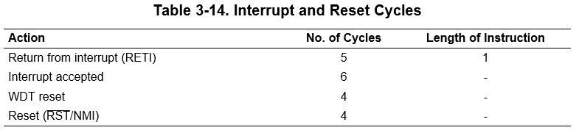
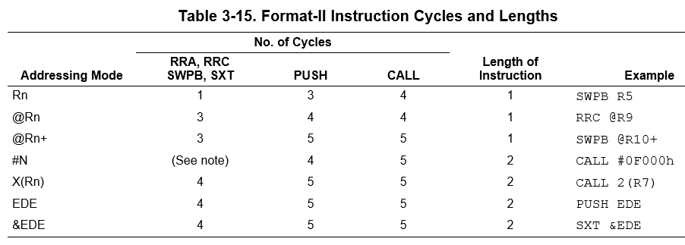
Assembly Clock Cycles

Slide 38
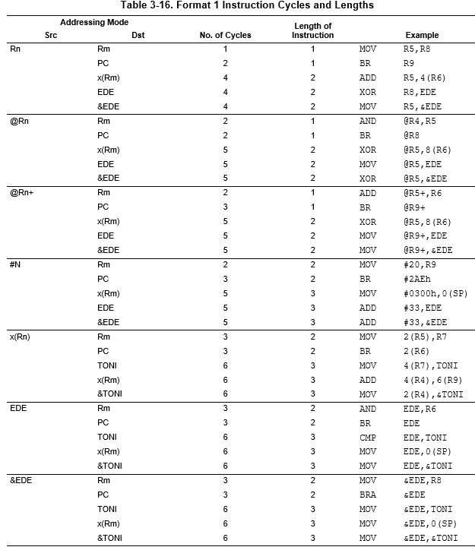
Assembly Clock Cycles
Based on addressing modes, different instructions take different times

Slide 39
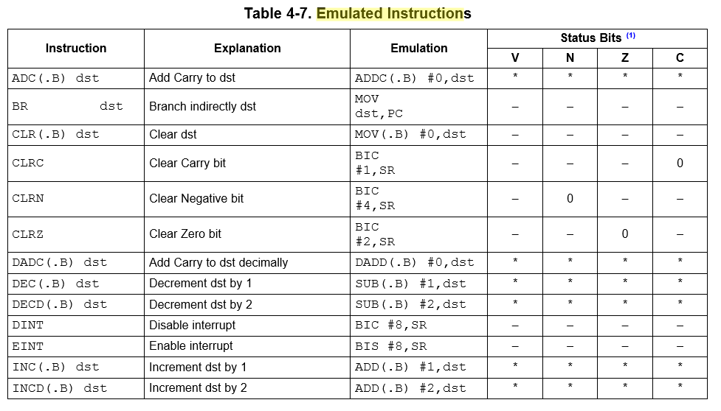
Assembly Clock Cycles
This is the real command, so use the previous tables to figure out how long they take

Slide 40
Assembly Clock Cycles
How long is this software delay?
call #software_delay ; 5 cycles
software_delay:
push r5 ; 3 cycles
mov.w #0xaaaa, r5 ; 2 cycles
delay: dec r5 ; 2 cycles?
; no 1 cycle !!!
jnz delay ; 2 cycles
pop r5 ; 2 cycles
ret ; 2 cycles?
; no 3 cycles !!!
5 + 3 + 2 + (0xaaaa * (1 + 2)) + 2 + 3 = 131085 total clock cycles
Only variable is r5… if I change r5 by “one”, how many cycles is this?
(ie., precision of delay?)
So, How long in time is this?

Slide 41
Backups

Slide 42
What does this program do? Where’s the BEEF?
; first thing's first - how do we create a comment?
mov.w #0x0200, r5
mov.w #0xbeef, r6
fill mov.w r6, 0(r5) ; anyone know what this syntax means?
incd r5
cmp.w #0x0400, r5 ; what does this instruction do?
jne fill
forever jmp forever
BEEF is a magic number used in programming. Specific values are written to memory, so it is possible to tell whether they have become corrupted, and to make it obvious when values are taken from uninitialized memory.

Slide 43
Relative Jump Instruction
Doesn’t use addressing mode.
forever JMP forever ; what does this do?
All instructions are 16 bits long. Their binary format looks like this:
15 | 14 | 13 | 12 | 11 | 10 | 9 | 8 | 7 | 6 | 5 | 4 | 3 | 2 | 1 | 0
0 | 0 | 1 | Condition |  |  | PC offset (10 bit)
Figure 3-12
Family User Guide 3.4.5 pp62
Blue Book pp19
:
:
_ _ _ _ _ _ _ _ _ _ _ _ _ _ _ _
Family User Guide 3.4.5 pp59
Blue Book pp18

Slide 44
Debugging Example Using breakpoints
; example program to add the numbers 10+9+8+...+1 and put result into 0x0200
mov.w #10, r6
mov.w #0, r5
summation: add.w r6, r5
dec r6
jnz summation
mov.w r5, &0x0200
forever: jmp forever

Slide 45
Sample Program
repeat:
mov.b #0x75, r10
add.b #0xC7, r10
;result should be 0x13c, so we should see 3c in r10 and carry bit set
adc r10 ;since carry bit was set, this should increment r10 to 3d
inv.b r10 ;invert, so r10 should be c2
mov.w #0x00aa, r10
sxt r10 ;sign extend should clear upper 8 bits
inv r10
swpb r10
mov.w r10, r9
jmp repeat
c010: 7a 40 75 00 mov.b #117, r10 ;#0x0075
c014: 7a 50 c7 00 add.b #199, r10 ;#0x00c7
c018: 0a 63 adc r10
c01a: 7a e3 xor.b #-1, r10 ;r3 As==11
c01c: 3a 40 aa 00 mov #170, r10 ;#0x00aa
c020: 8a 11 sxt r10
c022: 3a e3 inv r10
c024: 8a 10 swpb r10
c026: 09 4a mov r10, r9
c028: f3 3f jmp $-24 ;abs 0xc010
Hex
Decimal

Slide 46
Sample Program
repeat:
mov.b #0x75, r10
add.b #0xC7, r10
;result should be 0x13c, so we should see 3c in r10 and carry bit set
adc r10
;since carry bit was set, this should increment r10 to 3d
inv.b r10
;invert, so r10 should be c2
mov.w #0x00aa, r10
sxt r10
;sign extend should clear upper 8 bits
inv r10
swpb r10
mov.w r10, r9
jmp repeat
PC_{NEW}
c010: 7a 40 75 00 mov.b #117, r10 ;#0x0075
c014: 7a 50 c7 00 add.b #199, r10 ;#0x00c7
c018: 0a 63 adc r10
c01a: 7a e3 xor.b #-1, r10 ;r3 As==11
c01c: 3a 40 aa 00 mov #170, r10 ;#0x00aa
c020: 8a 11 sxt r10
c022: 3a e3 inv r10
c024: 8a 10 swpb r10
c026: 09 4a mov r10, r9
c028: f3 3f jmp $-24 ;abs 0xc010
PC_{NEW} - PC_{OLD}
PC_{OLD}

Slide 47
Sample Program
repeat:
mov.b #0x75, r10
add.b #0xC7, r10
;result should be 0x13c, so we should see 3c in r10 and carry bit set
adc r10
;since carry bit was set, this should increment r10 to 3d
inv.b r10
;invert, so r10 should be c2
mov.w #0x00aa, r10
sxt r10
;sign extend should clear upper 8 bits
inv r10
swpb r10
mov.w r10, r9
jmp repeat
c010: 7a 40 75 00 mov.b #117, r10 ;#0x0075
c014: 7a 50 c7 00 add.b #199, r10 ;#0x00c7
c018: 0a 63 adc r10
c01a: 7a e3 xor.b #-1, r10 ;r3 As==11
c01c: 3a 40 aa 00 mov #170, r10 ;#0x00aa
c020: 8a 11 sxt r10
c022: 3a e3 inv r10
c024: 8a 10 swpb r10
c026: 09 4a mov r10, r9
c028: f3 3f jmp $-24 ;abs 0xc010

Slide 48
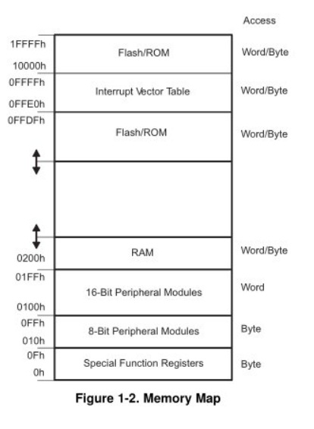
MSP430’s ISA
How many addr bits?
Msp430g2553 Memory Map
512b of RAM - 0x200-0x400 16kb of ROM - 0xc000-0xffdf
0x1100-0xc000 is empty!
- There is no memory backing it up!
- If you attempt to write to this area of memory, you'll trigger what's essentially a segmentation fault because that memory doesn't exist. It will cause the chip to do a Power-up Clear (PUC), resetting the state of your processor. This is a tough error to debug.

Slide 49
MSP430 addressing modes
The different types of instructions we are about to go through can use different types of addressing modes … see below:
We will cover these in more detail later.
As/Ad | Addressing Mode | Description | Example
00/0 | Rn | Register direct | mov r8, r9
01/1 | offset(Rn) | Indexed | mov 2(r8), r9
10/- | @Rn | Register indirect | mov @r8, r9
11/- | @Rn+ | Register indirect with post-increment | mov @r8+, r9
01/1 | ADDR | Symbolic (PC relative) | mov LoopCtr, r6
01/1 | &ADDR | Absolute | mov r5, &0x0200
11/- | #N | Immediate | mov #0x2006, r6

Slide 50
Hand assembly
no .b
register mode
mov @r7, r8
 | 15 | 14 | 13 | 12 | 11 | 10 | 9 | 8 | 7 | 6 | 5 | 4 | 3 | 2 | 1 | 0
Two Operand | Opcode |  |  |  | Source reg |  |  |  | Ad | W=0/B=1 | As |  | Dest reg
indirect register mode
Figure 3-12
Family User Guide 3.4.5 pp62
Blue Book pp19
_ _ _ _ _ _ _ _ _ _ _ _ _ _ _ _

Slide 51
Hand assembly
no .b
register mode
rrc r6
_ _ _ _ _ _ _ _ _ _ _ _ _ _ _ _
Figure 3-12
Family User Guide 3.4.5 pp62
Blue Book pp19

Slide 52
Hand assembly
no .b
register mode
mov r11, r10
 | 15 | 14 | 13 | 12 | 11 | 10 | 9 | 8 | 7 | 6 | 5 | 4 | 3 | 2 | 1 | 0
Two Operand | Opcode |  |  |  | Source reg |  |  |  | Ad | W=0/B=1 | As |  | Dest reg
register mode
_ _ _ _ _ _ _ _ _ _ _ _ _ _ _ _
Fig. 3-12

Slide 53
Hand assembly
no .b
register mode
swpb r10
_ _ _ _ _ _ _ _ _ _ _ _ _ _ _ _
Figure 3-12
Family User Guide 3.4.5 pp62
Blue Book pp19

Slide 54
Register Direct

Slide 55
Indexed

Slide 56
Register Indirect

