Slide 1

ECE382
Lesson 31
1

Slide 2

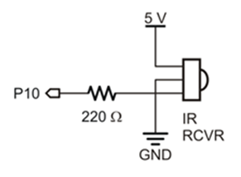
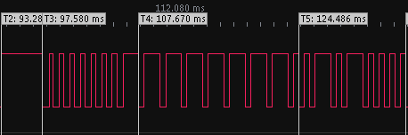
Overview
Lesson Outline
Capture and Compare
MSP430
By timing how wide these pulses are, we can translate the pulses into 0’s or 1’s (binary) and understand what the remote is telling us

Slide 3
PWM Setup Tasks
Set I/O direction for output
MUX PWM
Set period
Set on time
Enable PWM mode on timer
Config / Start timer

Slide 4
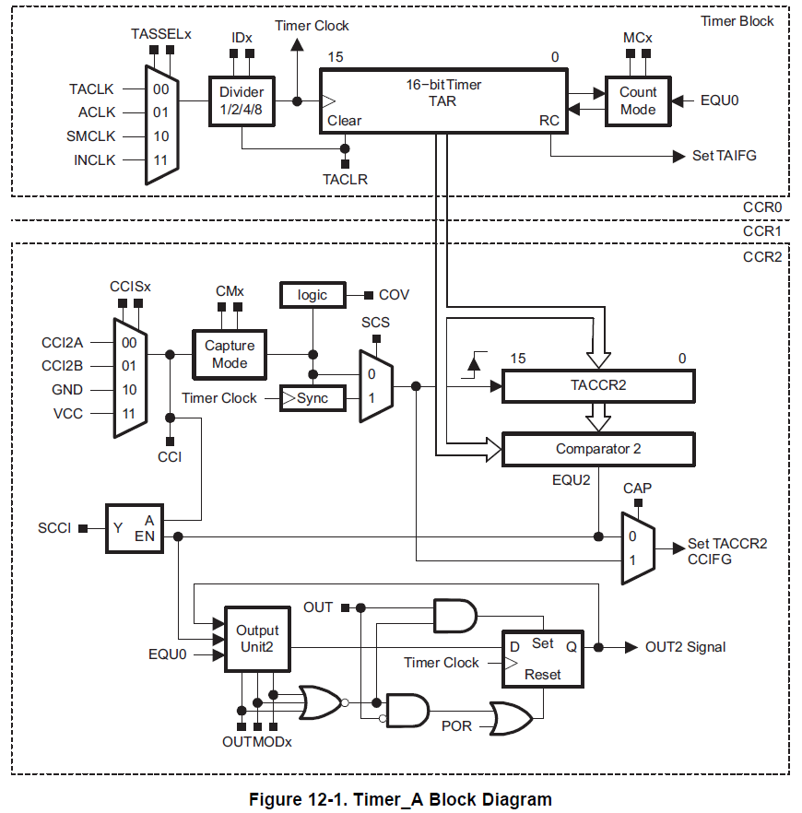
Timer Block Diagram
1
2
3
0
clks
cnts
Capture / Compare
4
5
Family User Guide pp 357

Slide 5
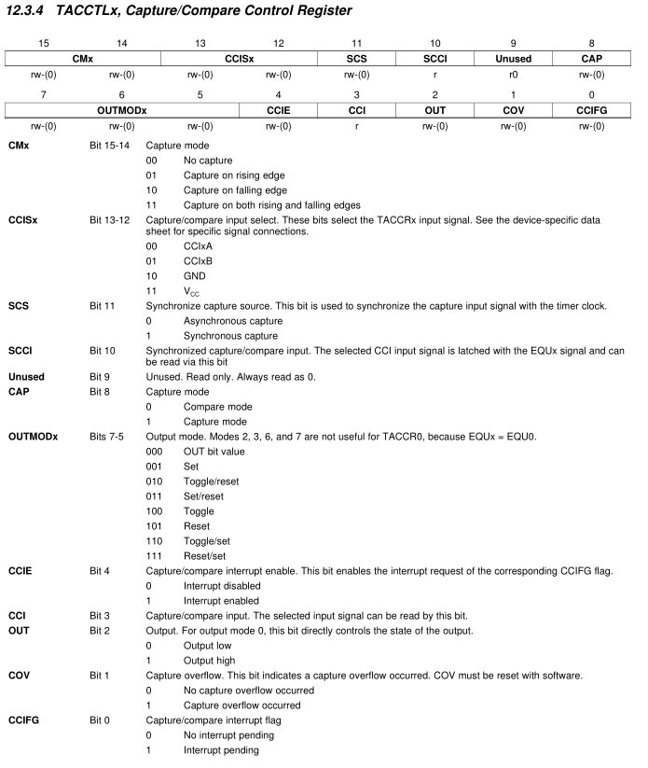
Backup Slides
Family User Guide pp 372

Slide 6
Timer Block Diagram
CAP
Family User Guide pp 357

Slide 7
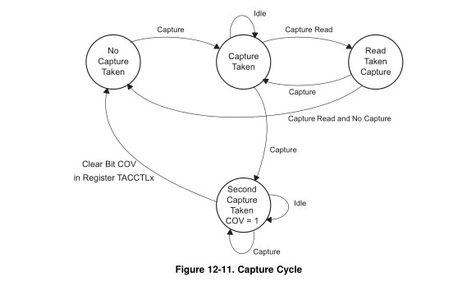
Input Capture
Capture mode is selected when the CAP bit in TACCTL is set to 1. It's used to record time events. It can be used for:
Event detection
Event counting
Pulse-width measurement ***
Frequency measurement
Each TACCRx has two possible capture pins - CCIxA and CCIxB. The one being monitored is selectable by software.
If a capture occurs: - The TAR value is copied into the TACCRx register - The interrupt flag CCIFG is set
Family User Guide pp 363

Slide 8
Backup Slides
Family User Guide pp 372

Slide 9
Timer Block Diagram
CCISx
CMx
SCS
CCIFG
Family User Guide pp 357

Slide 10
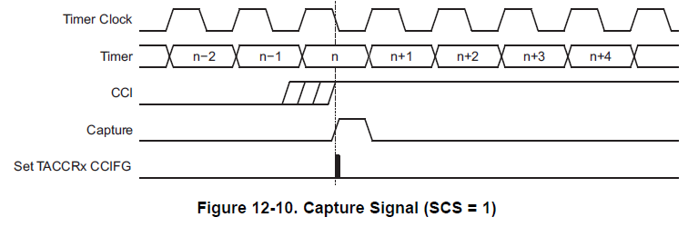
Input Capture
The input signal level can be read at any time via the CCI bit. MSP430x2xx family devices may have different signals connected to CCIxA and CCIxB. See the device-specific data sheet for the connections of these signals.
Family User Guide pp 362

Slide 11
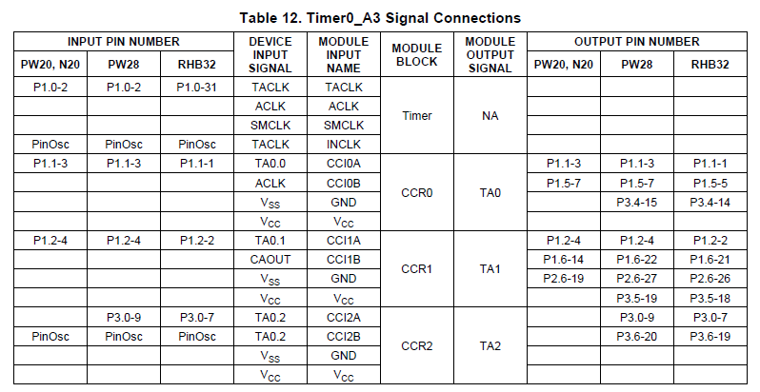
Input Capture
The input signal level can be read at any time via the CCI bit. MSP430x2xx family devices may have different signals connected to CCIxA and CCIxB. See the device-specific data sheet for the connections of these signals.
Device Specific pp 16

Slide 12
Backup Slides
Family User Guide pp 372

Slide 13
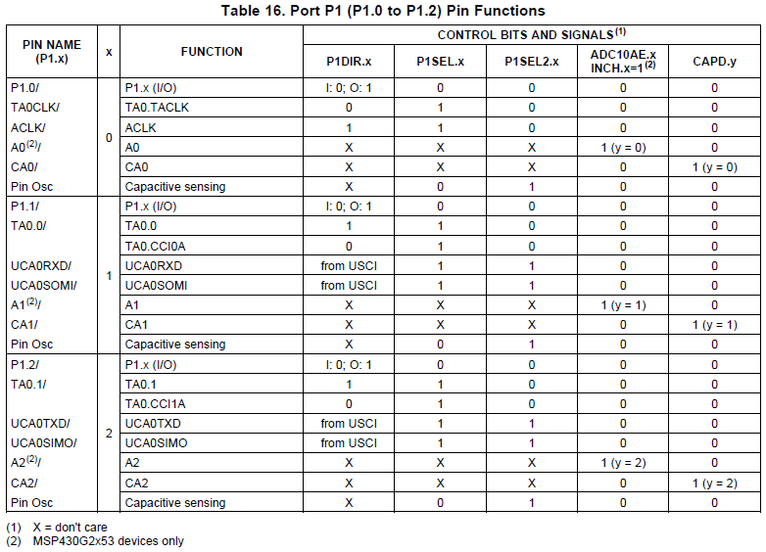
Input Capture
Device Specific pp 43

Slide 14
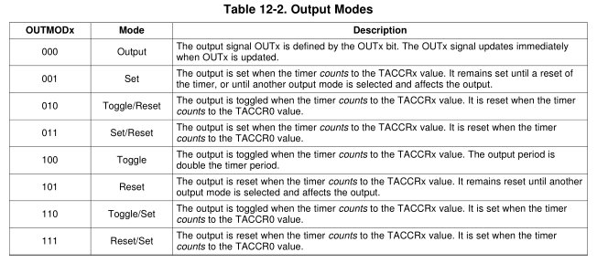
Output Compare
Compare mode is selected when the CAP bit in TACCTL is set to 0
Same Timer Modes: MCx
Count up to TACCRO. Now adding two new registers: TA0CCR1 and TA0CCR2
Mcx | Mode | Description
00 | Stop | The timer is halted. MC_0
01 | Up | The timer repeatedly counts from zero to the value of TACCR0. MC_1
10 | Continuous | The timer repeatedly counts from zero to 0FFFFh. MC_2
11 | Up/down | The timer repeatedly counts from zero up to the value of TACCR0 and back down to zero. MC_3

Slide 15
Timer Block Diagram
CCR0-2
Family User Guide pp 357

Slide 16
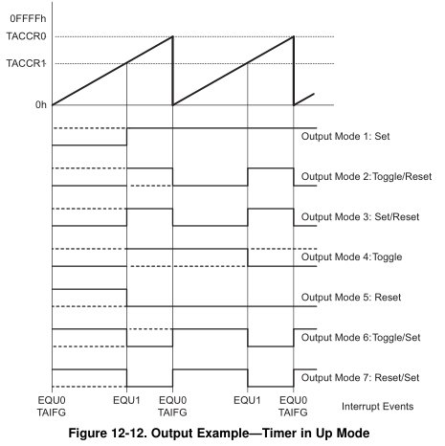
Output Compare
You will likely use mode 3 & 7 for PWM

Slide 17
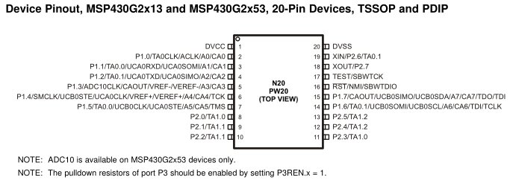
Ports?
Pin 3 TA0.0 P1.1
Pin 4 TA0.1 P1.2
Pin 8 TA1.0 P2.0
Pin 9 TA1.1 P2.1

Slide 18
PWM Setup Tasks
PxDIR
Set I/O direction for output
MUX PWM
Set period
Set on time
Enable PWM mode on timer
Config / Start timer
PxSEL, PxSEL2
TAxCCRx
TAxCCTLx
TAxCTL

Slide 19
Example
#include <msp430.h>
int main(void)
{
WDTCTL = WDTPW|WDTHOLD; // stop the watchdog timer
P1DIR |= BIT2; // TA0CCR1 on P1.2
P1SEL |= BIT2; // TA0CCR1 on P1.2
TA0CTL &= ~MC1|MC0; // stop timer A0
TA0CTL |= TACLR; // clear timer A0
TA0CTL |= TASSEL1; // configure for SMCLK
TA0CCR0 = 100; // set signal period to 100 clock cycles (~100 microseconds)
TA0CCR1 = 25; // set duty cycle to 25/100 (25%)
TA0CCTL1 |= OUTMOD_7; // set TACCTL1 to Reset / Set mode
TA0CTL |= MC0; // count up
while (1) {
__delay_cycles(1000000);
TA0CCR1 = 50; // set duty cycle to 50/100 (50%)
__delay_cycles(1000000);
TA0CCR1 = 75; // set duty cycle to 75/100 (75%)
__delay_cycles(1000000);
TA0CCR1 = 100; // set duty cycle to 100/100 (100%)
__delay_cycles(1000000);
TA0CCR1 = 25; // set duty cycle to 25/100 (25%)
}
return 0;
}

Slide 20
Example with Interrupt
#include <msp430.h>
void main(void)
{
WDTCTL = WDTPW|WDTHOLD;// stop the watchdog timer
P2DIR |= BIT1; // TA1CCR1 on P2.1
P2SEL |= BIT1; // TA1CCR1 on P2.1
P2OUT &= ~BIT1;
TA1CTL |= TASSEL_2|MC_1|ID_0; // configure for SMCLK
P1DIR |= BIT0; //use LED to indicate duty cycle has toggled
P1REN |= BIT3;
P1OUT |= BIT3;
TA1CCR0 = 1000; // set signal period to 1000 clock cycles (~1 millisecond)
TA1CCR1 = 250; // set duty cycle to 250/1000 (25%)
TA1CCTL0 |= CCIE; // enable CC interrupts
TA1CCTL1 |= OUTMOD_7|CCIE; // set TACCTL1 to Set / Reset mode//enable CC interrupts
TA1CCTL1 &= ~CCIFG; //clear capture compare interrupt flag
_enable_interrupt();
while (1) {
while (P1IN & BIT3); //every time the button is pushed, toggle the duty cycle
__delay_cycles(1000000);
TA1CCR1 = 1000; // set duty cycle to 1000/1000 (100%)
while (P1IN & BIT3);
__delay_cycles(1000000);
TA1CCR1 = 750; // set duty cycle to 750/1000 (75%)
while (P1IN & BIT3);
__delay_cycles(1000000);
TA1CCR1 = 500; // set duty cycle to 500/1000 (50%)
while (P1IN & BIT3);
__delay_cycles(1000000);
TA1CCR1 = 250; // set duty cycle to 250/1000 (25%)
while (P1IN & BIT3);
__delay_cycles(1000000);
TA1CCR1 = 100; // set duty cycle to 100/1000 (10%)
while (P1IN & BIT3);
__delay_cycles(1000000);
TA1CCR1 = 20; // set duty cycle to 20/1000 (2%)
}
}

Slide 21
Example with Interrupt
#pragma vector = TIMER1_A0_VECTOR // This is from the MSP430G2553.h file
__interrupt void captureCompareInt (void) {
P1OUT |= BIT0; //Turn on LED
// Disable Timer A Interrupt
TA1CCTL1 &= ~CCIFG; //clear capture compare interrupt flag
// TACTL &= ~TAIFG;
}
#pragma vector = TIMER1_A1_VECTOR // This is from the MSP430G2553.h file
__interrupt void captureCompareInt2 (void) {
P1OUT &= ~BIT0; //Turn off LED
// Disable Timer A Interrupt
TA1CCTL1 &= ~CCIFG; //clear capture compare interrupt flag
// TACTL &= ~TAIFG;
}

Slide 22
BACKUPS

Slide 23
Using DC Motors
How do DC motors work? How do you make them go faster?

Slide 24
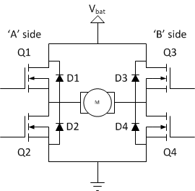
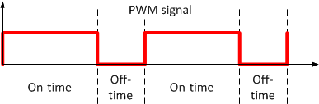
Basic H Bridge

Slide 25
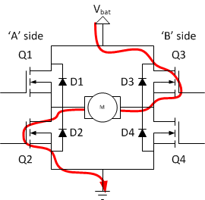
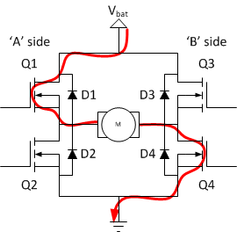
Direction Control
H-bridge is design to turn on/off the FETs in a particular order such that current can flow through the motor in one or 2 ways. This has the effect of turning the motor shaft either CW or CCW

Slide 26
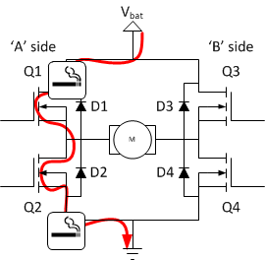
Danger!
Since this is already setup on your system, this shouldn’t be a problem. However, if you build your own h-bridge, be careful!

Slide 27
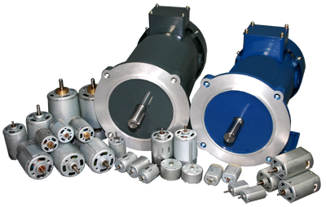
DC Motors & Generators

Slide 28
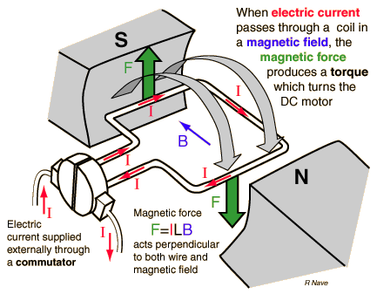
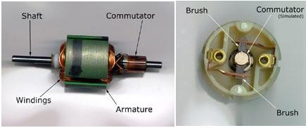
How Does a DC Motor Work
Typical DC motor characteristics:
Stall torque – max torque produced when it stops moving
Voltage – operating voltage (higher V, lower current)
No load current – min free running current
Stall current – max current at stall
Horsepower: 2 hp = ~1492 W
1 hp = 745.7 W

Slide 29
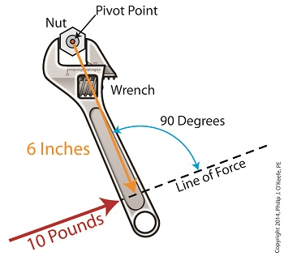
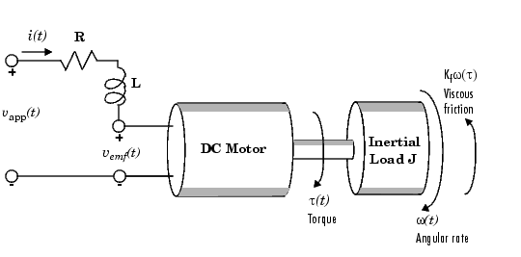
Motor Torque
Torque is a measure of how much a force acting on an object causes that object to rotate.

Slide 30
Using DC Motors
How do DC motors work? How do you make them go faster?
Provide analog DC voltage… The higher the voltage, the faster it spins
Two issues interfacing MSP430 with a DC motor?
MSP430 only produces two voltages (Vcc and Gnd)
Solution? PWM- pulse width modulation (remember this?)
MSP430 does not source enough current to power the motors (blow the chip)
Solution? Motor driver chip (SN754410)
MSP430 Timer system helps
Input Capture: Monitor a pin for a specified signal (rising edge, falling edge, either edge) and record when it occurs. → Ultrasonic sensor
Output Compare: Generate a specified signal with precise timing. (can make a PWM signal) → drive motors, servos
Do Not Exceed the 1A current rating (i.e. ~60% Duty Cycle)

