Slide 1

ECE382
Lesson 26+27
1

Slide 2
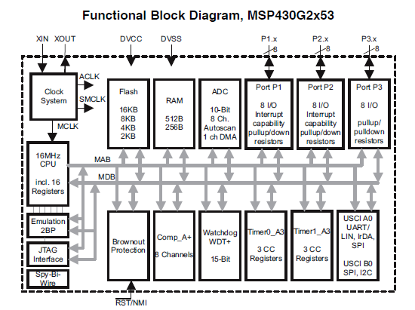
MSP430G2553 Block Diagram

Slide 3
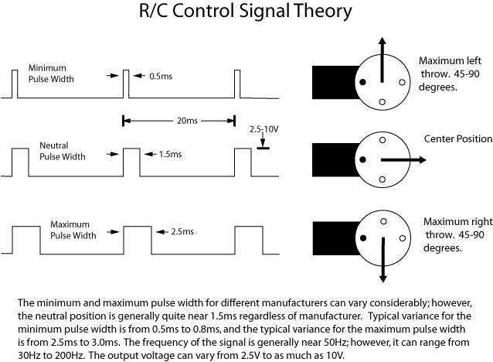
Overview
Lesson Outline
Timers
Timer_A and Timer_B are input/output ports that can be used to capture external signal events and generate signals for external devices
RC Servos
Using the timer, we can generate this signal easily

Slide 4
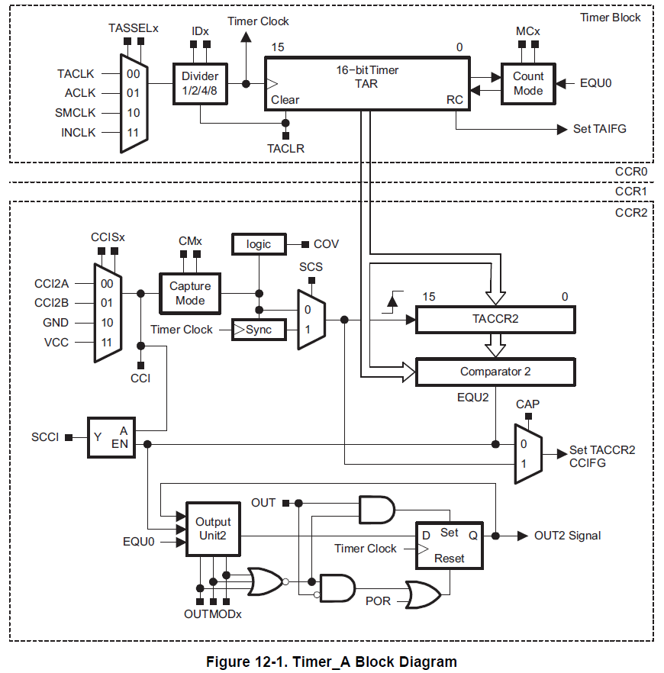
Timer Block Diagram
1
2
3
0
ACLK: internal “slow” clock
SMCLK: internal “fast” clock
INCLK: external clock signal
clks
cnts
4
5
Family User Guide pp 357

Slide 5
Timer (p 355 User’s Guide)
0. Heart of the Timer: TAR
16-bit Timer. How many clock ticks (cnts) till it rolls over?
How do you read the Time in the TAR timer?
Rising or Falling Edge?
Clear? TACLR?
RC? TAIFG?
Where can you find these bits?

Slide 6
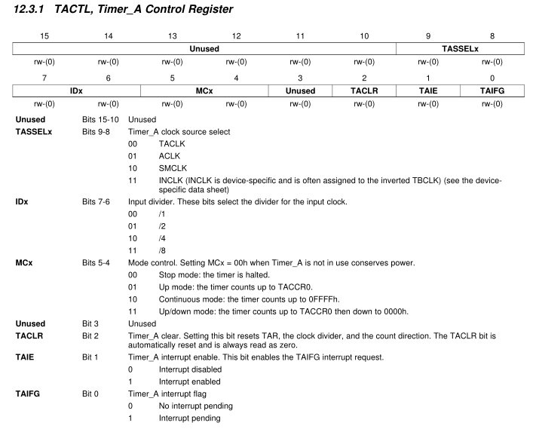
Timer (p 370 User’s Guide, BB p 52)

Slide 7
Timer Block Diagram
1
Family User Guide pp 357

Slide 8
Timer
1. TASSELx
Selects one of 4 possible clocks to drive the timer
TASSEL_2 // 2 means “10” mux select, or select SMCLK,
// actually the binary number 0000 0010 0000 0000

Slide 9
Timer Block Diagram
2
clks
cnts
Family User Guide pp 357

Slide 10
Timer (p 370 User’s Guide)
2. IDx: Timer Prescalar
Selects one of 4 possible clocks to drive the timer
IDx | Prescalar
00 | 1:1 or Divide by 1 ID_0
01 | 1:2 or Divide by 2 ID_1
10 | 1:4 or Divide by 4 ID_2
11 | 1:8 or Divide by 8 ID_3

Slide 11
Timer Block Diagram
3
Family User Guide pp 357

Slide 12
Timer
3. MCx - Count Mode
MC_0
MC_1
MC_2
MC_3

Slide 13
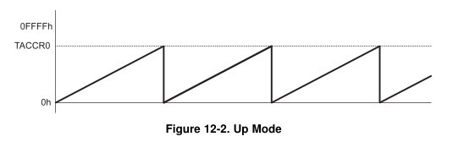
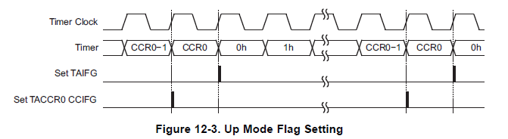
Timer
Up Mode MC_1
Counts from 0 to the value in register TACCR0. When it hits TACCR0, the CCIFG interrupt flag is set. When it hits 0 (the next tick), the TAIFG interrupt flag is set

Slide 14
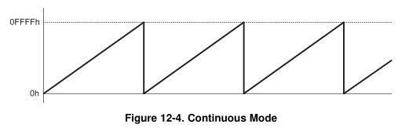
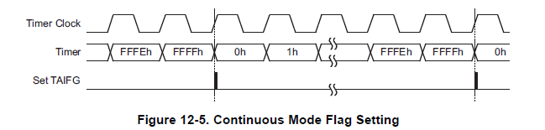
Timer
Continuous Mode MC_2
Continuous mode counts from 0 to 0xffff. When it hits 0, the TAIFG interrupt flag is set

Slide 15
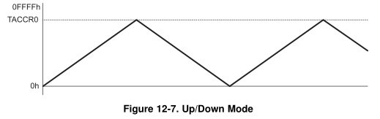
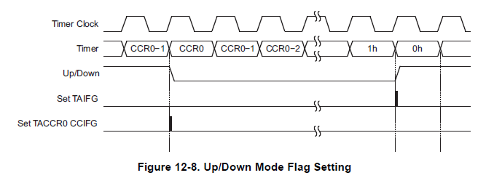
Timer
Up / Down Mode MC_3
Counts from 0 to the value in register TACCR0, then back down to 0. When it hits TACCR0, the CCIFG interrupt flag is set. When it hits 0, the TAIFG interrupt flag is set.

Slide 16
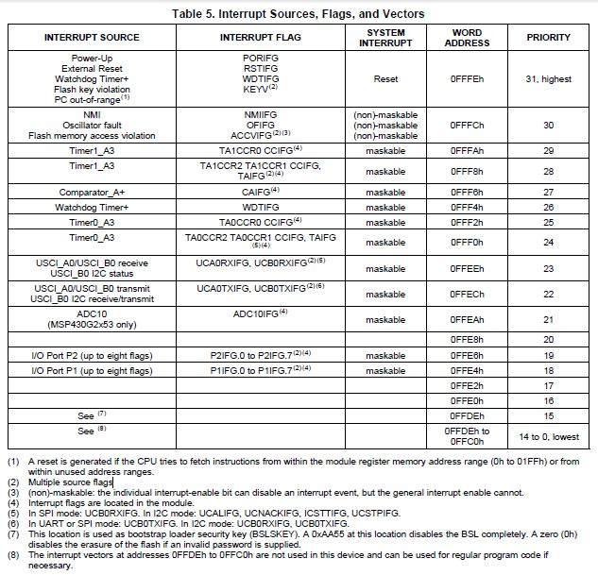
MSP430G2553 Interrupt Vector Table

Slide 17
Example Polling
void main(void) {
WDTCTL = WDTPW | WDTHOLD; // Stop watchdog timer
BCSCTL1 = CALBC1_8MHZ; // Set SMCLK 8 MHz
DCOCTL = CALDCO_8MHZ;
P1DIR = BIT6; // Set the green LED as an output
// ID_0 Divide by 1
// 1 sec 1 clks 65535 cnts
// ------------ * ------ * --------------- = 8.19 ms
// 8 *10^6 clks 1 cnt 1 TAR roll over
// ID_3 Divide by 8
// 1 sec 8 clks 65535 cnts
// ------------ * ------ * --------------- = 65.535 ms
// 8 *10^6 clks 1 cnt 1 TAR roll over
TA0CCR0 = 0xFFFF; // Set the interval
TA0CTL &= ~TAIFG; // Clear any rollover flag
TA0CTL |= ID_3 | TASSEL_2 | MC_1; // Important Timer stuff!
while(1) {
while ((TA0CTL & TAIFG) == 0); // Polling timer flag?
TA0CTL &= ~TAIFG; // Clear rollover flag
P1OUT ^= BIT6; // toggle LED
} // end infinite loop
}
We don’t have a good crystal oscillator so we can change the speed of our board, but it is only ballpark 8MHz
Notes:
Let's examine what's going on here.
The first line of code moves r1 (the stack pointer) into r4. The compiler is using r4 as the frame pointer. When you call a function (main() in this case), all of its local variables are allocated on the stack. We call the space on the stack used by a function a stack frame. However, the stack pointer changes as you allocate more variables on the stack. So a variable that was at 4(r1) at one point in your function could later be at 8(r1) if the stack pointer changes. The frame pointer ensures a consistent address for the same variable throughout the function. If we store the address of the base of the stack frame in the frame pointer, each variable will always be stored at the same place relative to the frame pointer - so a variable at 4(r4) will always be accessible at 4(r4).
So the first line of code is setting the frame pointer. Next, the compiler adds 2 to the frame pointer. In most functions, the first thing you do is push the frame pointer onto the stack via push r4 - main is the exception. Adding two puts the base of the stack frame below this value, which is what we want.
Next, the compiler subtracts two from the stack pointer. This is because we're allocating our int variable on the stack, so we're giving it two bytes. If we allocated two ints, the compiler would subtract 4 from the stack pointer.
Our first four instructions are identical to our first sample program. We're setting up the frame pointer and allocating our variable on the stack.
Next, we're moving our variable into r15. Remember, our ABI says that the first parameter to a function should be passed in through r15 - so we move our there.
Next, we call the recursiveSummation subroutine the compiler has created.
Once inside the recursiveSummation subroutine, we push the framePointer onto the stack so we don't destroy it. Then, we establish a new frame pointer and allocate a variable on the stack - just like we did in main.
Next, the compiler moves the parameter we passed in r15 into the variable we established. It compares the variable to 1.
If it's greater than or equal to 1, we jump to .L3 - the label that holds the code in our else case. We move our parameter into r15 (the register that holds the first parameter we pass to functions), subtract one, and call our recursiveSummation subroutine again. This code is the recursiveSummation(numberToSum - 1) piece of our code. The final instruction adds the current parameter to the result passed back in r15. This code is the return numberToSum + piece of our code.
If it's less than 1, we're finished. We move 0 into r15, deallocate our variable from the stack, retrieve the frame pointer we pushed initially, and return.
If you're interested in learning more, check out this Wikipedia reading on the Call Stack.
After we're done, we'll add 2 to the stack pointer to deallocate int variable since we're done using it.

Slide 18
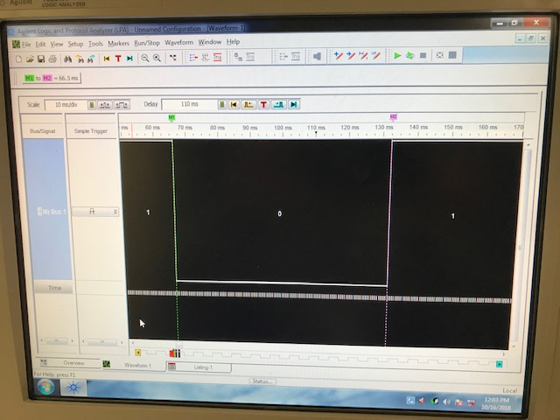
Example Polling
Here is our waveform with a dwell time of ~65.5 ms … remember, we don’t have a good crystal oscillator so we are ballpark 8MHz

Slide 19
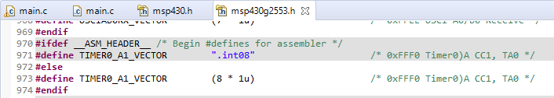
Example Interrupts
void main(void) {
WDTCTL = WDTPW | WDTHOLD; // Stop watchdog timer
BCSCTL1 = CALBC1_8MHZ; // Set SMCLK 8 MHz
DCOCTL = CALDCO_8MHZ;
P1DIR |= BIT6; // Set P1.6 (Green LED) as an output
TA0CTL &= ~TAIFG; // Turn off Timer A interrupt flag
TA0CTL |= ID_3 | TASSEL_2 | MC_1 | TAIE;
// Setting all our bits count up to TA0CCR0
TA0CCR0 = 0xFFFF; // Set Timer A 0 TA0CCR0 value
__enable_interrupt(); // Enable Interrupts and then write function
while (1); // cpu trap
}
#pragma vector = TIMER0_A1_VECTOR
__interrupt void timerOverFlow (void){
P1OUT ^= BIT6; // XOR Toggles our green LED on/off after timer
TA0CTL &= ~TAIFG; // Clears the interrupt flag to return
}
Interrupt vector names can be found in the msp430g2553.h header towards the bottom
Notes:
Let's examine what's going on here.
The first line of code moves r1 (the stack pointer) into r4. The compiler is using r4 as the frame pointer. When you call a function (main() in this case), all of its local variables are allocated on the stack. We call the space on the stack used by a function a stack frame. However, the stack pointer changes as you allocate more variables on the stack. So a variable that was at 4(r1) at one point in your function could later be at 8(r1) if the stack pointer changes. The frame pointer ensures a consistent address for the same variable throughout the function. If we store the address of the base of the stack frame in the frame pointer, each variable will always be stored at the same place relative to the frame pointer - so a variable at 4(r4) will always be accessible at 4(r4).
So the first line of code is setting the frame pointer. Next, the compiler adds 2 to the frame pointer. In most functions, the first thing you do is push the frame pointer onto the stack via push r4 - main is the exception. Adding two puts the base of the stack frame below this value, which is what we want.
Next, the compiler subtracts two from the stack pointer. This is because we're allocating our int variable on the stack, so we're giving it two bytes. If we allocated two ints, the compiler would subtract 4 from the stack pointer.
Our first four instructions are identical to our first sample program. We're setting up the frame pointer and allocating our variable on the stack.
Next, we're moving our variable into r15. Remember, our ABI says that the first parameter to a function should be passed in through r15 - so we move our there.
Next, we call the recursiveSummation subroutine the compiler has created.
Once inside the recursiveSummation subroutine, we push the framePointer onto the stack so we don't destroy it. Then, we establish a new frame pointer and allocate a variable on the stack - just like we did in main.
Next, the compiler moves the parameter we passed in r15 into the variable we established. It compares the variable to 1.
If it's greater than or equal to 1, we jump to .L3 - the label that holds the code in our else case. We move our parameter into r15 (the register that holds the first parameter we pass to functions), subtract one, and call our recursiveSummation subroutine again. This code is the recursiveSummation(numberToSum - 1) piece of our code. The final instruction adds the current parameter to the result passed back in r15. This code is the return numberToSum + piece of our code.
If it's less than 1, we're finished. We move 0 into r15, deallocate our variable from the stack, retrieve the frame pointer we pushed initially, and return.
If you're interested in learning more, check out this Wikipedia reading on the Call Stack.
After we're done, we'll add 2 to the stack pointer to deallocate int variable since we're done using it.

Slide 20
When Does the Timer Expire?
Ok, let’s figure out how to determine when the timer goes off (interrupt is set)
It really isn’t hard, but it is best if you follow the method described here

Slide 21
Timer Block Diagram
1
2
3
0
clks
cnts
4
5
Family User Guide pp 357

Slide 22
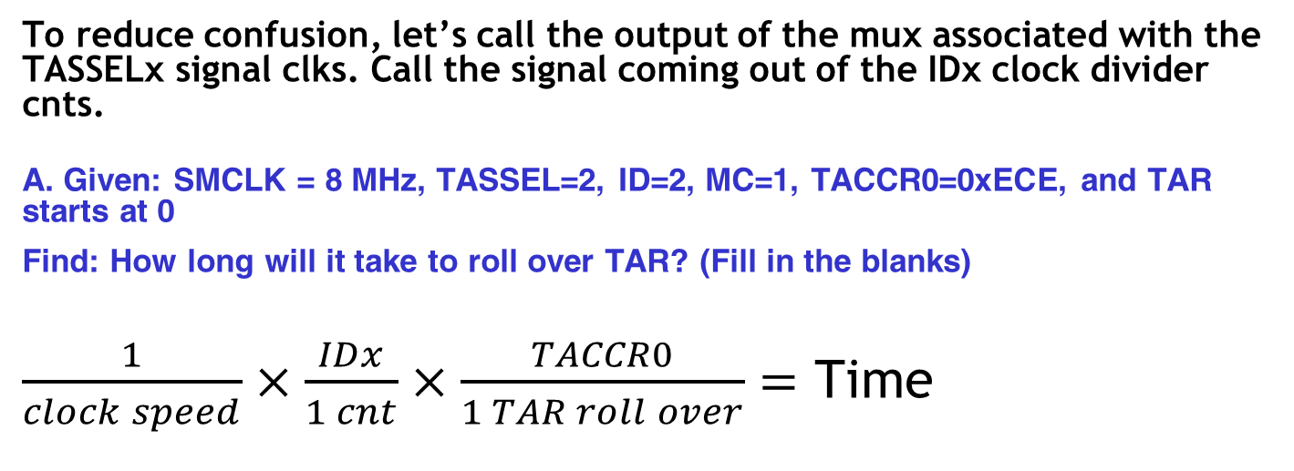
In-Class Worksheet
To reduce confusion, let’s call the output of the mux associated with the TASSELx signal clks. Call the signal coming out of the IDx clock divider cnts.
A. Given: SMCLK = 8 MHz, TASSEL=2, ID=2, MC=1, TACCR0=0xECE, and TAR starts at 0
Find: How long will it take to roll over TAR? (Fill in the blanks)
$\frac{1}{clock speed}×\frac{IDx}{1 cnt}×\frac{TACCR0}{1 TAR roll over}=$ Time
clks
cnts

Slide 23
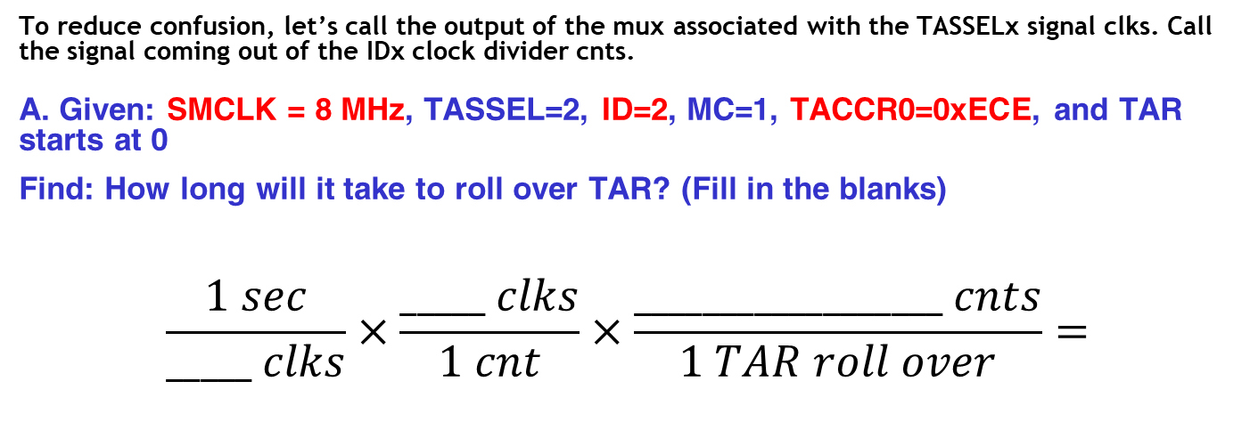
In-Class Worksheet
To reduce confusion, let’s call the output of the mux associated with the TASSELx signal clks. Call the signal coming out of the IDx clock divider cnts.
A. Given: SMCLK = 8 MHz, TASSEL=2, ID=2, MC=1, TACCR0=0xECE, and TAR starts at 0
Find: How long will it take to roll over TAR? (Fill in the blanks)
$$\frac{1 sec}{_____ clks}×\frac{_____ clks}{1 cnt}×\frac{__________________ cnts}{1 TAR roll over}=$$
4
0xECE (3,790)
1.895 msec
8E6
Also do:
1usec/8clks
clks
cnts

Slide 24
In-Class Worksheet
To reduce confusion, let’s call the output of the mux associated with the TASSELx signal clks. Call the signal coming out of the IDx clock divider cnts.
B. Given : SMCLK = 8 MHz, TASSEL= 2, ID= 2, MC= 1, and TAR starts at 0
Find: The TACCR0 values that will roll over TAR in 84 μs?
clks
cnts

Slide 25
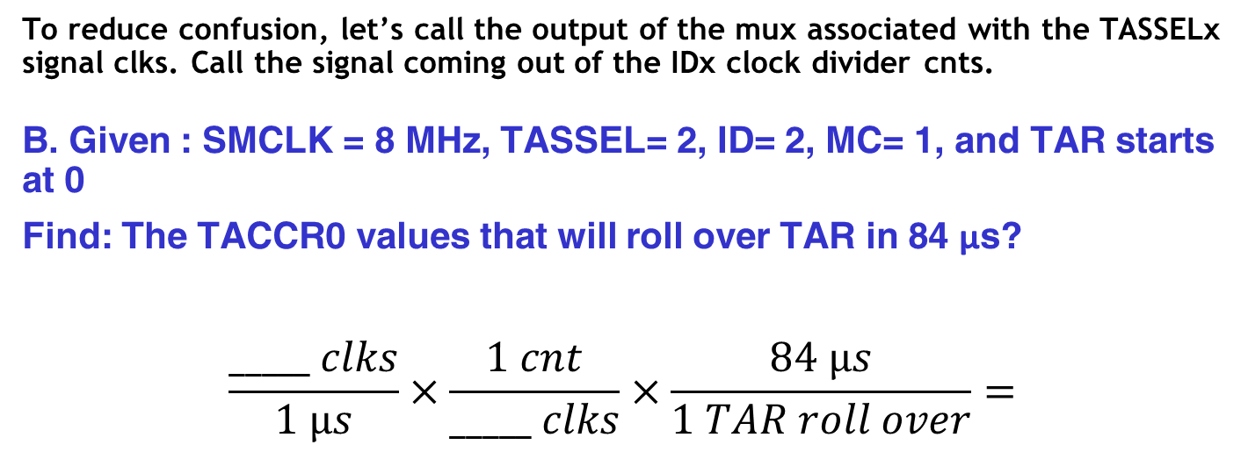
In-Class Worksheet
To reduce confusion, let’s call the output of the mux associated with the TASSELx signal clks. Call the signal coming out of the IDx clock divider cnts.
B. Given : SMCLK = 8 MHz, TASSEL= 2, ID= 2, MC= 1, and TAR starts at 0
Find: The TACCR0 values that will roll over TAR in 84 μs?
$$\frac{_____ clks}{1 µs}×\frac{1 cnt}{_____ clks}×\frac{84 µs}{1 TAR roll over}=$$
clks
cnts

Slide 26
In-Class Worksheet
To reduce confusion, let’s call the output of the mux associated with the TASSELx signal clks. Call the signal coming out of the IDx clock divider cnts.
Given an TAR=0, a 8Mhz clock, TASSEL_2, ID_2, MC_1,
and TACCR0=255, how long will it take to roll over TAR?
clks
cnts

Slide 27
In-Class Worksheet
To reduce confusion, let’s call the output of the mux associated with the TASSELx signal clks. Call the signal coming out of the IDx clock divider cnts.
Given an TAR=0, a 8Mhz clock, TASSEL_2, ID_2, MC_1,
and TACCR0=255, how long will it take to roll over TAR?
1 usec 4 clks 254 cnts
------------ * ------ * --------------- = 127.5 usec
8 clks 1 cnt 1 TAR roll over
clks
cnts

Slide 28
In-Class Worksheet
To reduce confusion, let’s call the output of the mux associated with the TASSELx signal clks. Call the signal coming out of the IDx clock divider cnts.
Given an TAR=0, a 8Mhz clock, TASSEL_2, ID_0, MC_1
and TACCR0=2^16-1, how long will it take to roll over TAR?
clks
cnts

Slide 29
In-Class Worksheet
To reduce confusion, let’s call the output of the mux associated with the TASSELx signal clks. Call the signal coming out of the IDx clock divider cnts.
Given an TAR=0, a 8Mhz clock, TASSEL_2, ID_0, MC_1
and TACCR0=2^16-1, how long will it take to roll over TAR?
1 usec 1 clks 2^¹⁶ cnts
------------ * ------ * --------------- = 8.19 msec
8 clks 1 cnt 1 TAR roll over
clks
cnts

Slide 30
In-Class Worksheet
To reduce confusion, let’s call the output of the mux associated with the TASSELx signal clks. Call the signal coming out of the IDx clock divider cnts.
Given an TAR=0, a 8Mhz clock, TASSEL_2, ID_0, MC_1 and TACCR0=2^16-1, how long will it take to roll over TAR?
Do the previous problem, except with ID_1.
clks
cnts

Slide 31
In-Class Worksheet
To reduce confusion, let’s call the output of the mux associated with the TASSELx signal clks. Call the signal coming out of the IDx clock divider cnts.
Given an TAR=0, a 8Mhz clock, TASSEL_2, ID_0, MC_1 and TACCR0=2^16-1, how long will it take to roll over TAR?
Do the previous problem, except with ID_1.
1 usec 2 clks 2^¹⁶ cnts
------------ * ------ * --------------- = 16.384 msec
8 clks 1 cnt 1 TAR roll over
clks
cnts

Slide 32
In-Class Worksheet
To reduce confusion, let’s call the output of the mux associated with the TASSELx signal clks. Call the signal coming out of the IDx clock divider cnts.
Given an TAR=0, a 8Mhz clock, TASSEL_2, ID_0, MC_1 and TACCR0=2^16-1, how long will it take to roll over TAR?
Do the previous problem, except with ID_2.
clks
cnts

Slide 33
In-Class Worksheet
To reduce confusion, let’s call the output of the mux associated with the TASSELx signal clks. Call the signal coming out of the IDx clock divider cnts.
Given an TAR=0, a 8Mhz clock, TASSEL_2, ID_0, MC_1 and TACCR0=2^16-1, how long will it take to roll over TAR?
Do the previous problem, except with ID_2.
1 usec 4 clks 2^¹⁶ cnts
------------ * ------ * --------------- = 32.77 msec
8 clks 1 cnt 1 TAR roll over
clks
cnts

Slide 34
In-Class Worksheet
To reduce confusion, let’s call the output of the mux associated with the TASSELx signal clks. Call the signal coming out of the IDx clock divider cnts.
Given an TAR=0, a 8Mhz clock, TASSEL_2, ID_0, MC_1 and TACCR0=2^16-1, how long will it take to roll over TAR?
Do the previous problem, except with ID_3.
clks
cnts

Slide 35
In-Class Worksheet
To reduce confusion, let’s call the output of the mux associated with the TASSELx signal clks. Call the signal coming out of the IDx clock divider cnts.
Given an TAR=0, a 8Mhz clock, TASSEL_2, ID_0, MC_1 and TACCR0=2^16-1, how long will it take to roll over TAR?
Do the previous problem, except with ID_3.
1 usec 8 clks 2^¹⁶ cnts
------------ * ------ * --------------- = 65.535 msec
8 clks 1 cnt 1 TAR roll over
clks
cnts

Slide 36
In-Class Worksheet
To reduce confusion, let’s call the output of the mux associated with the TASSELx signal clks. Call the signal coming out of the IDx clock divider cnts.
Given an TAR=0, a 8Mhz clock, TASSEL_2, ID_1, and
MC_1, how many counts would it take to roll over TAR in
84us?
clks
cnts

Slide 37
In-Class Worksheet
To reduce confusion, let’s call the output of the mux associated with the TASSELx signal clks. Call the signal coming out of the IDx clock divider cnts.
Given an TAR=0, a 8Mhz clock, TASSEL_2, ID_1, and
MC_1, how many counts would it take to roll over TAR in
84us?
8 clks 1 cnt 84uS
---------- * ------ * ------ = 336 counts
1 usec 2 clk
clks
cnts

Slide 38
In-Class Worksheet
To reduce confusion, let’s call the output of the mux associated with the TASSELx signal clks. Call the signal coming out of the IDx clock divider cnts.
7. Complete the following table assuming SMCLK = 8 MHz, TASSEL= 2, MC= 1, TACCR0=0x2006, and TAR starts at 0. How long will it take to roll over TAR?
ID | Prescalar | MaxDelay (milliseconds)
0 | 1:1
1 | 1:2
2 | 1:4
3 | 1:8

Slide 39
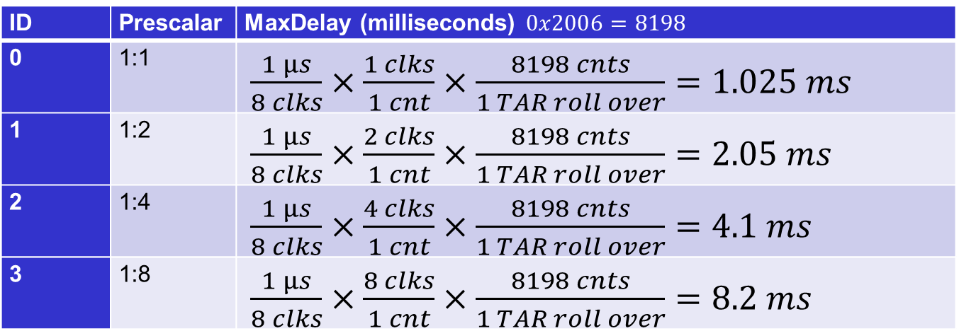
In-Class Worksheet
To reduce confusion, let’s call the output of the mux associated with the TASSELx signal clks. Call the signal coming out of the IDx clock divider cnts.
7. Complete the following table assuming SMCLK = 8 MHz, TASSEL= 2, MC= 1, TACCR0=0x2006, and TAR starts at 0. How long will it take to roll over TAR?
ID | Prescalar | MaxDelay (milliseconds) $0x2006=8198$
0 | 1:1 | $\frac{1 µs}{8 clks}×\frac{1 clks}{1 cnt}×\frac{8198 cnts}{1 TAR roll over}=1.025 ms$
1 | 1:2 | $\frac{1 µs}{8 clks}×\frac{2 clks}{1 cnt}×\frac{8198 cnts}{1 TAR roll over}=2.05 ms$
2 | 1:4 | $\frac{1 µs}{8 clks}×\frac{4 clks}{1 cnt}×\frac{8198 cnts}{1 TAR roll over}=4.1 ms$
3 | 1:8 | $\frac{1 µs}{8 clks}×\frac{8 clks}{1 cnt}×\frac{8198 cnts}{1 TAR roll over}=8.2 ms$

Slide 40
In-Class Worksheet
To reduce confusion, let’s call the output of the mux associated with the TASSELx signal clks. Call the signal coming out of the IDx clock divider cnts.
8. Given SMCLK = 8 MHz, TASSEL= 2, MC_1, ID_2, provide a nice round number for TACCR0 that will cause TAR to roll over in 40 ms.
clks
cnts

Slide 41
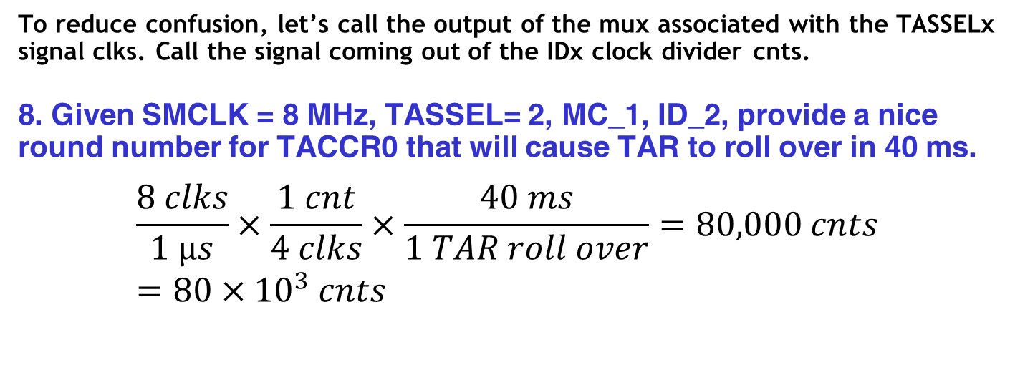
In-Class Worksheet
To reduce confusion, let’s call the output of the mux associated with the TASSELx signal clks. Call the signal coming out of the IDx clock divider cnts.
8. Given SMCLK = 8 MHz, TASSEL= 2, MC_1, ID_2, provide a nice round number for TACCR0 that will cause TAR to roll over in 40 ms.
$$\frac{8 clks}{1 µs}×\frac{1 cnt}{4 clks}×\frac{40 ms}{1 TAR roll over}=80,000 cnts=80×{10}^{3} cnts$$
clks
cnts

Slide 42
In-Class Worksheet
To reduce confusion, let’s call the output of the mux associated with the TASSELx signal clks. Call the signal coming out of the IDx clock divider cnts.
9. Given these settings, how many counts will it take to create a delay of 550 μs? 1.65 ms? 4.5 ms? 90 ms?
clks
cnts

Slide 43
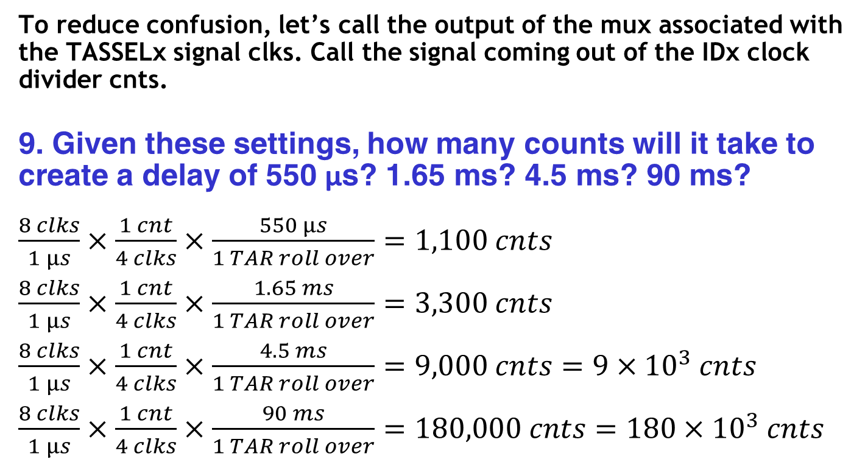
In-Class Worksheet
To reduce confusion, let’s call the output of the mux associated with the TASSELx signal clks. Call the signal coming out of the IDx clock divider cnts.
9. Given these settings, how many counts will it take to create a delay of 550 μs? 1.65 ms? 4.5 ms? 90 ms?
$\frac{8 clks}{1 µs}×\frac{1 cnt}{4 clks}×\frac{550 µs}{1 TAR roll over}=1,100 cnts$
$\frac{8 clks}{1 µs}×\frac{1 cnt}{4 clks}×\frac{1.65 ms}{1 TAR roll over}=3,300 cnts$
$\frac{8 clks}{1 µs}×\frac{1 cnt}{4 clks}×\frac{4.5 ms}{1 TAR roll over}=9,000 cnts=9×{10}^{3} cnts$
$\frac{8 clks}{1 µs}×\frac{1 cnt}{4 clks}×\frac{90 ms}{1 TAR roll over}=180,000 cnts=180×{10}^{3} cnts$

Slide 44
BACKUPS

Slide 45
In-Class Programming Exercise
(see interruptTones.c)
Create a project around interruptTones.c. This C program utilizes interrupts to Blink the Green LED (P1.0 using Timer A at 440Hz Modify the program to do the following:
Put a speaker or headphones on P1.6 to listen to the 440Hz 'A' Tone using the following schematic.
Implement another interrupt from a button press (P1.3) to toggle the Red LED (P1.0) and then increment through each tone in the counts array.
Use the button interrupt to increment through the counts array to be output the different tones on a speaker.

Slide 46
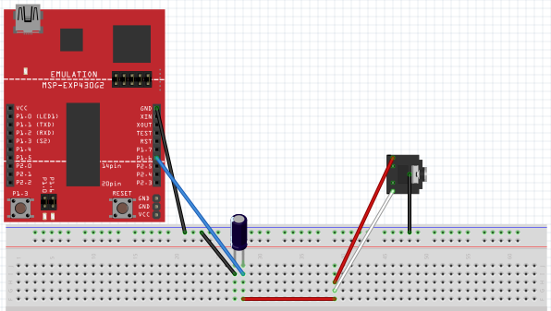
In-Class Programming Exercise
(see interruptTones.c)
Setup for the hooking up 3.5mm Audio Jack to the MSP430 Launchpad Board
without Volume Control

Slide 47
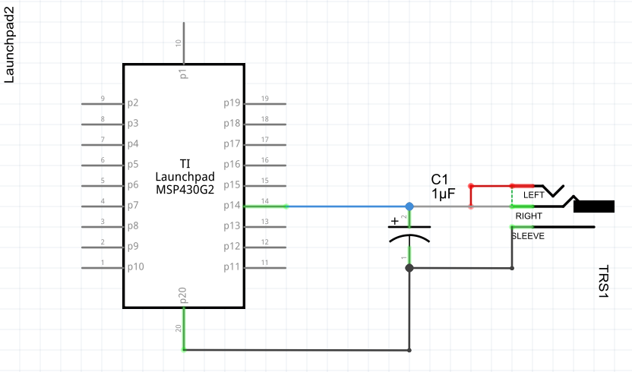
In-Class Programming Exercise
(see interruptTones.c)
Setup for the hooking up 3.5mm Audio Jack to the MSP430 Launchpad Board
without Volume Control

Slide 48
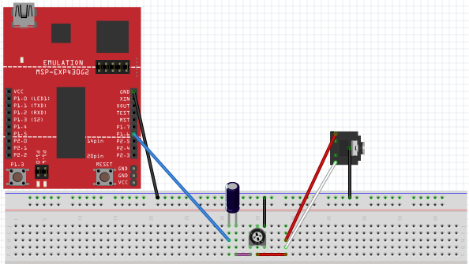
In-Class Programming Exercise
(see interruptTones.c)
Setup for the hooking up 3.5mm Audio Jack to the MSP430 Launchpad Board
with Volume Control

Slide 49
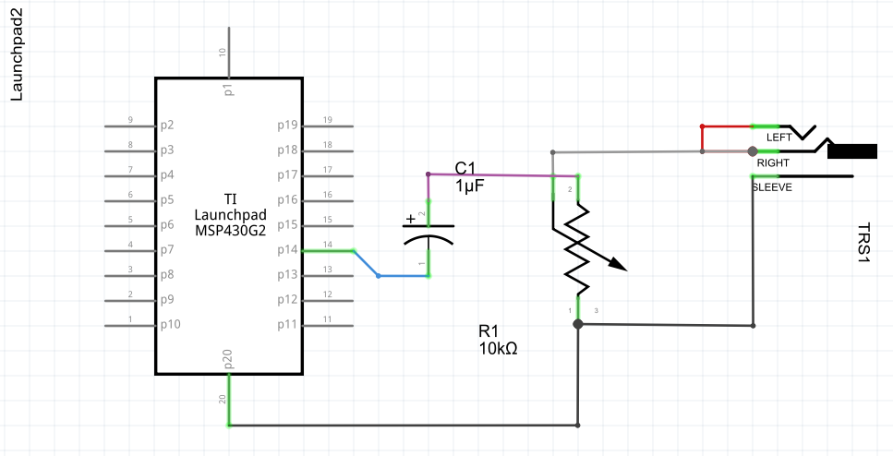
In-Class Programming Exercise
(see interruptTones.c)
Setup for the hooking up 3.5mm Audio Jack to the MSP430 Launchpad Board
with Volume Control

Slide 50
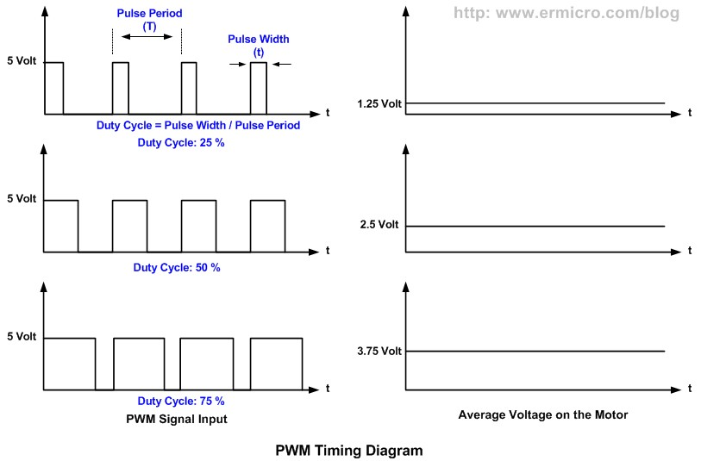
Mimic DC Values

Slide 51
Servos

