Slide 1
ECE231
Op Amps III
Maj Kevin Walchko

Slide 2
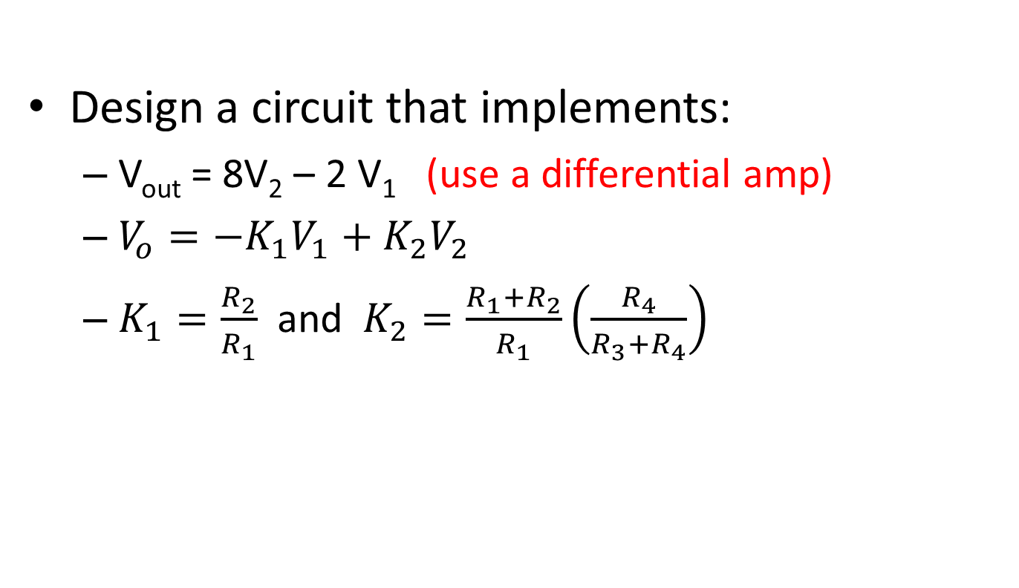
Example from last time
Design a circuit that implements:
  V_{out} = 8V₂ – 2 V₁ (use a differential amp)
  $V_{o}=−K_{1}V_{1}+K_{2}V_{2}$
  $K_{1}=\frac{R_{2}}{R_{1}}$ and $K_{2}=\frac{R_{1}+R_{2}}{R_{1}}\left(\frac{R_{4}}{R_{3}+R_{4}}\right)$

Slide 3
Summary
V_{in}
K
V_{out}=KV_{in}
Non-inverting Op Amp
V_{in}
-K
V_{out}=-KV_{in}
Inverting Op Amp
V_{in1}
-K1
V_{in2}
-K2
+
V_{out}=-K1*V_{in1}-K2*V_{in2}-…-K_{n}*V_{inn}
Summing Op Amp
…
V_{inn}
-Kn
V_{in}
1
V_{out}=V_{in}
Buffer
V_{in1}
K1
+
V_{out}=K1*V_{in1}-K2*V_{in2}
Differential Op Amp
V_{in2}
-K2
More than one way to draw these, Fig 4-48, pg 188 is different

Slide 4
Implement the following
V_{out} = 6V₁-18V₂+3
Use 2, 2 input summers:
-6
V_{stage1}=-6*V_{in1}-1*3
V_{in1}
3V
-1
+
-1
V_{out}=6*V_{in1}+3-18*V_{in2}
V_{in2}
-18
+
Use an inverter and a summer w/ 3 inputs:
V_{in1}
-6
-1
V_{in2}
-18
+
V_{out}=6*V_{in1}+3-18*V_{in2}
V_{stage1}=-6*V_{in1}
-3V
-1

Slide 5
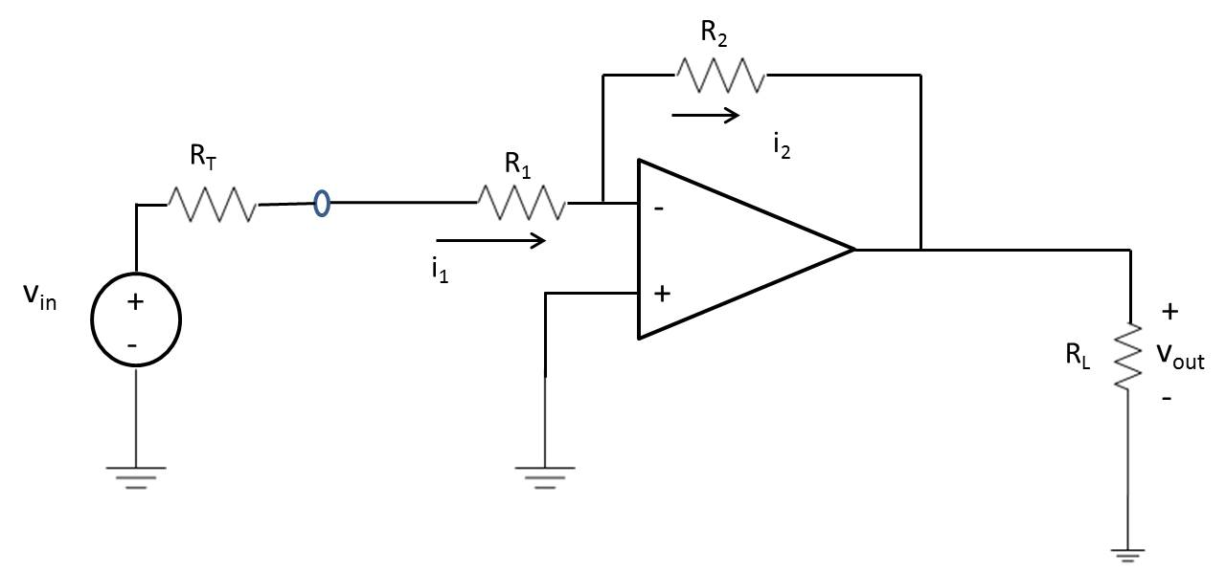
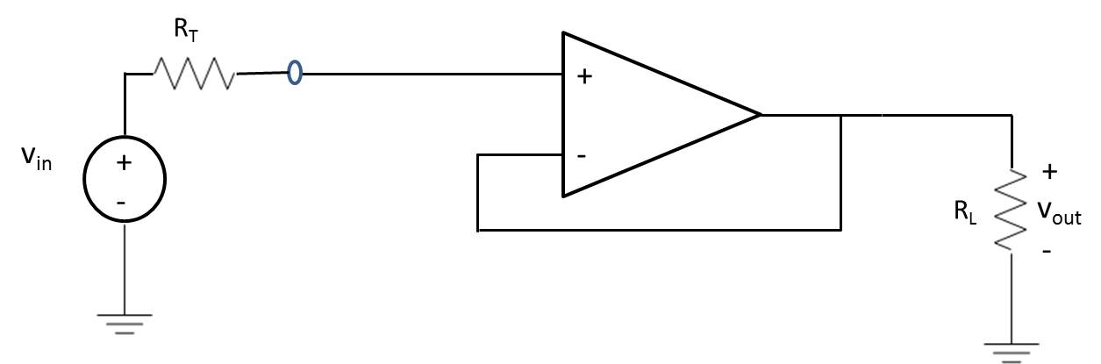
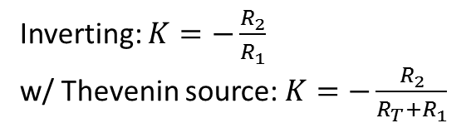
Loading with Thevenin Sources
Vin is not the voltage across R1
Inverting: $K=−\frac{R_{2}}{R_{1}}$
w/ Thevenin source: $K=−\frac{R_{2}}{R_{T}+R_{1}}$
Op Amp | Loading Issues
Non-inverting | No
Inverting | Yes
Summer | Yes
Differential | Yes
Buffer | No
This is where buffering comes in, no current flow across R_{T}, thus V_{T} is what the op amp sees

Slide 6
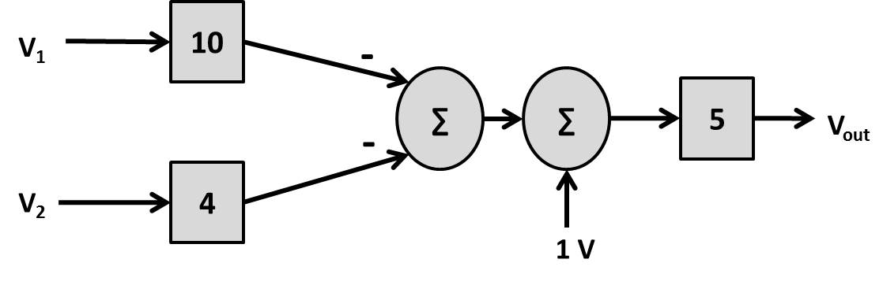
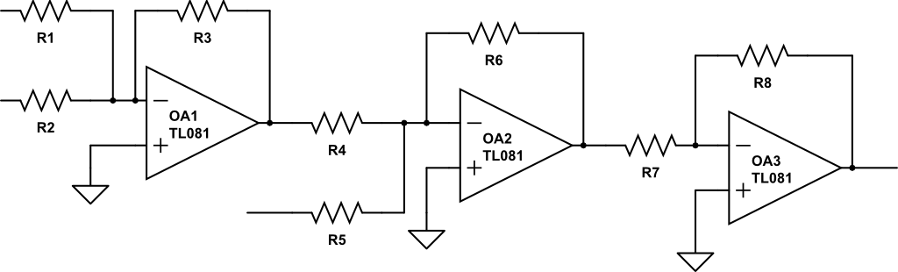
Implement this equation
What is the equation?
V_{out}=-50*V_{in1}-20*V_{in2}+5
V1
V2
Vout
1

Slide 7
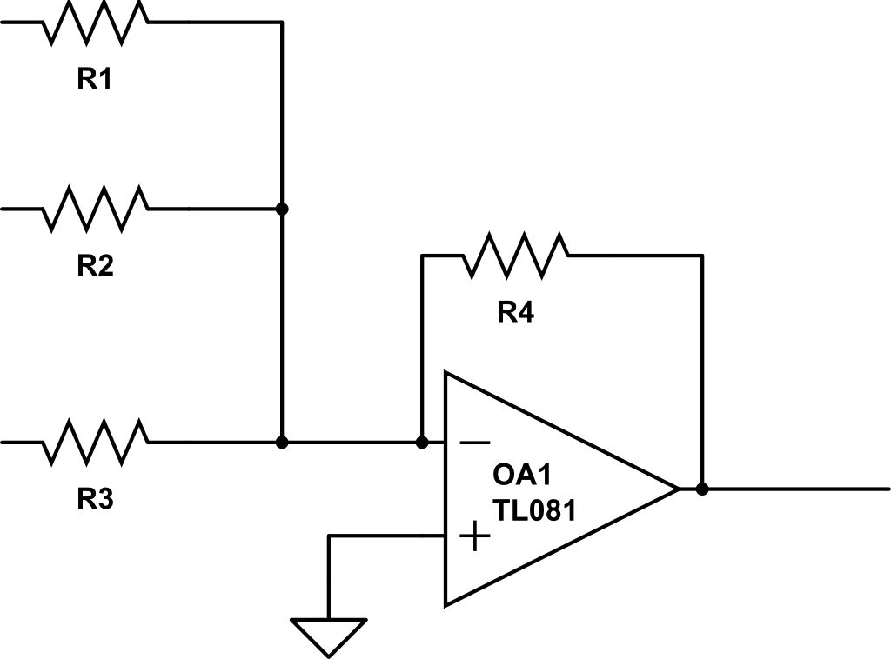
Can We Do Better?
V1
V2
V3
Vout

Slide 8
Backups

Slide 9
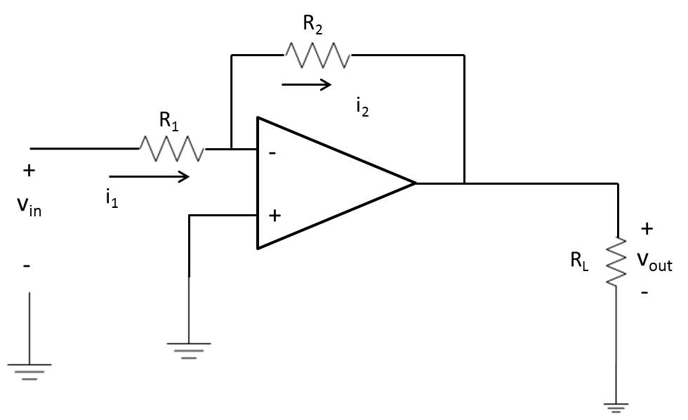
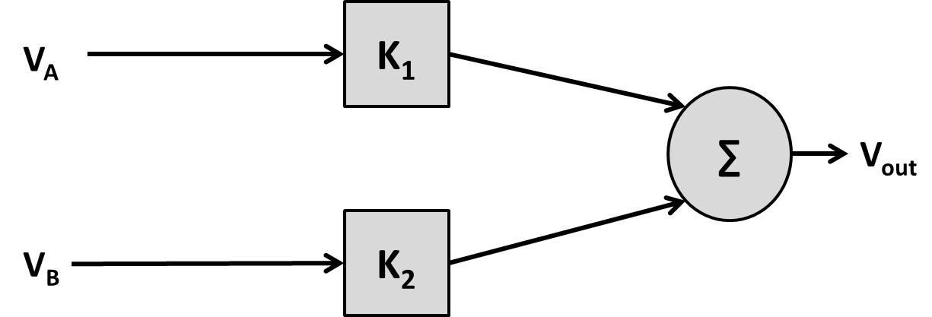
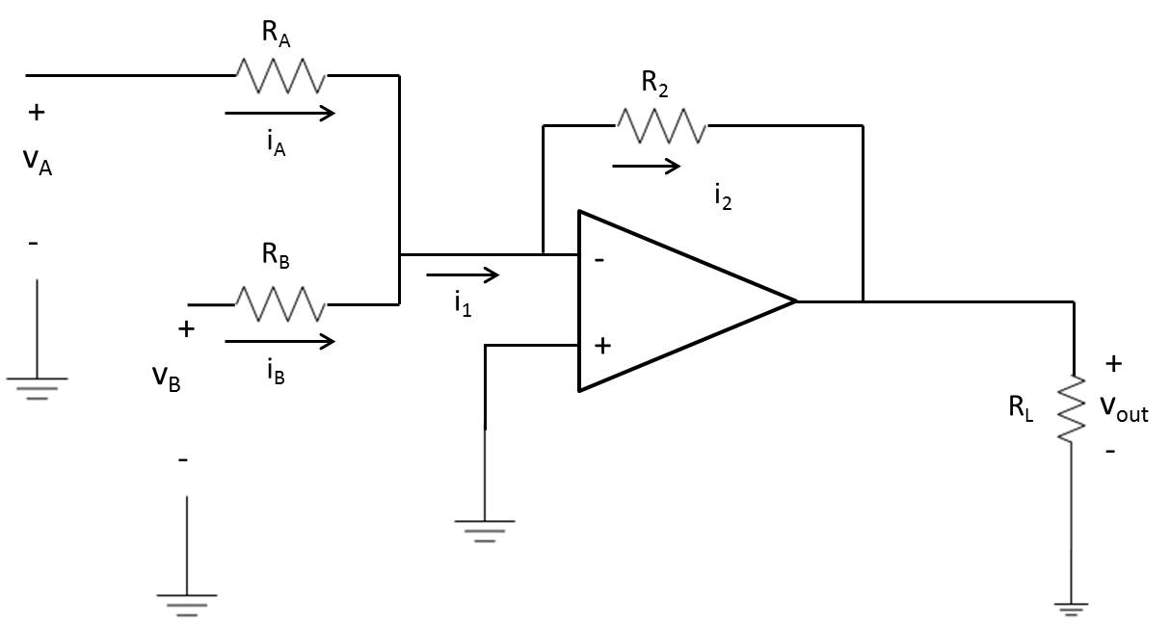
Summer

Slide 10
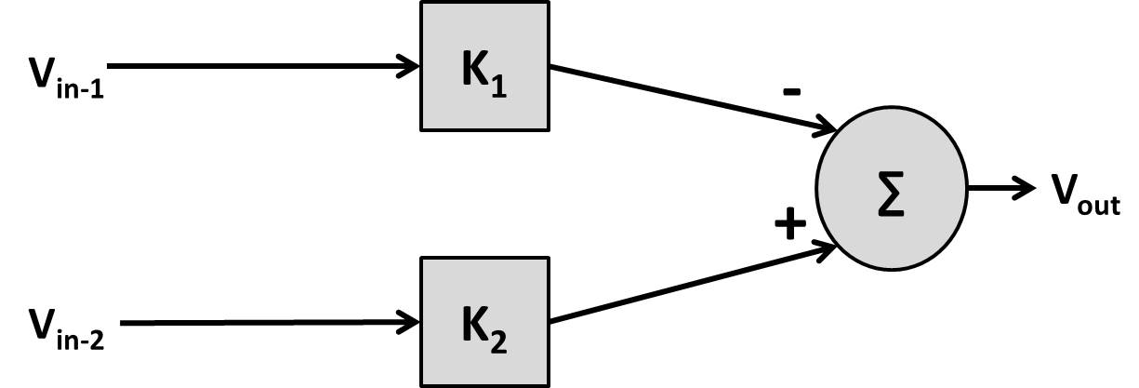
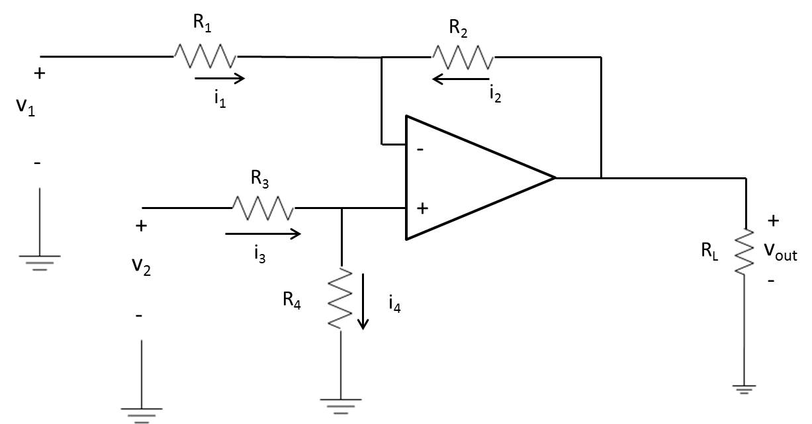
Differential Amp (Subtractor)

Slide 11
Examples
Design an inverting summer that implements:
  V_{out} = -(5V_{A} + 13V_{B})
Using the above gains, find V_{out} if V_{A} = 2V and V_{B} = -.5V
Using the above and V_{A} = 500 mV, V_{cc} = 15V, what is the maximum value of V_{B} and still have it be linear?
Design a circuit that implements:
  V_{out} = 8V₂ – 4 V₁ (use a differential amp)

Slide 12
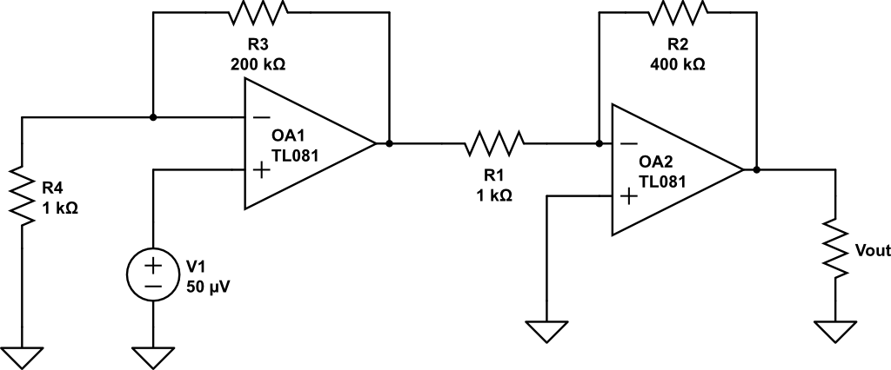
Find V_{out}
+
V_{B}
-
Non-inverting
Inverting

Slide 13
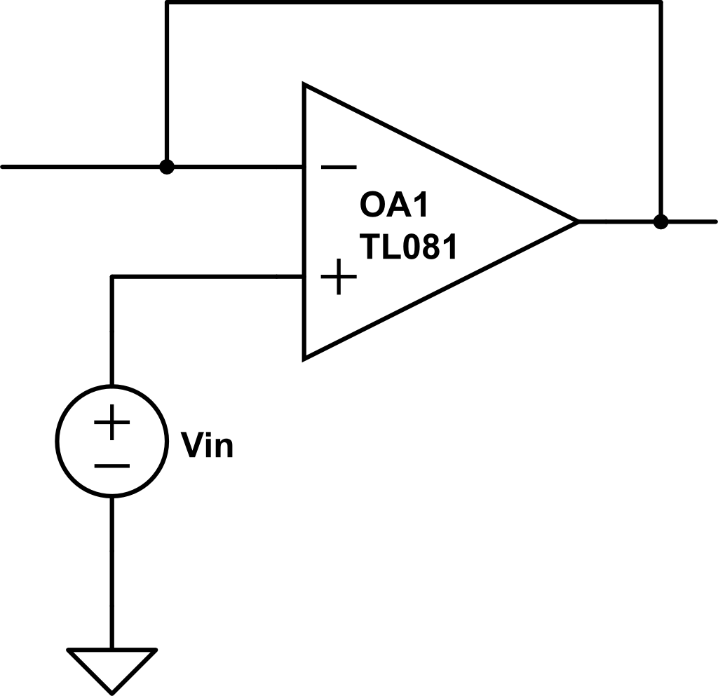

Buffer
Short
Open
circuit
+
V_{out}
+
-
V_{out}
-
Looking at the non-inverting op amp
Buffers help circuits with different impedances work correctly without overloading one another or effecting operation

Slide 14
Example
(a) Find the transfer characteristics of a differential amplifier if:
R1 = 10k Ω
R2 = 40k Ω
R3 = 10k Ω
R4 = 15k Ω
(b) If Vcc is ± 15 V and V1 = 3V, what is the allowable range of V2 for linear ops?
Vo = -4V1 + 3V2
-1 V ≤ V2 ≤ 9 V

