Slide 1
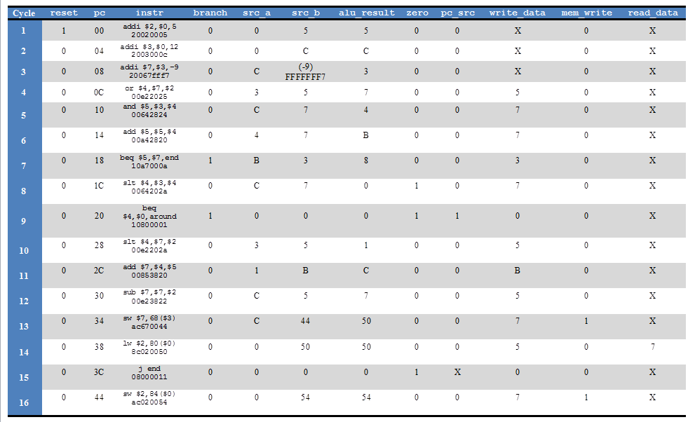

Slide 2
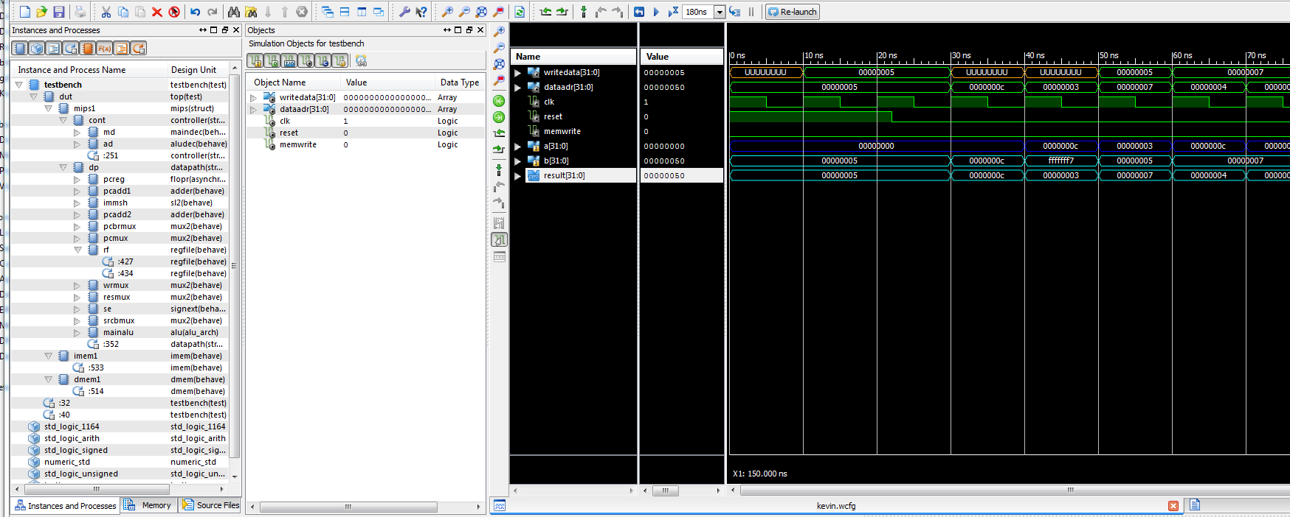
Just a small snippet, you need to pullout all of the appropriate signals to double check the table … I am only showing a, b, and alu_result

