Slide 1
Introduction to CCDs
Claudio Cumani
Optical Detector Team - European Southern Observatory
for ITMNR-5
Fifth International Topical Meeting on Neutron Radiography
Technische Universität München, Garching, July 26, 2004

Slide 2
CCDs - Introduction
Charge Coupled Devices (CCDs) were invented in October 19, 1969, by William S. Boyle and George E. Smith at Bell Telephone Laboratories
(“A new semiconductor device concept has been devised which shows promise of having wide application”, article on Bell System Technical Journal, 49, 587-593 (April 1970).
CCDs are electronic devices, which work by converting light into electronic charge in a silicon chip (integrated circuit). This charge is digitised and stored as an image file on a computer.

Slide 3
“Bucket brigade” analogy
VERTICAL
CONVEYOR
BELTS
(CCD COLUMNS)
RAIN (PHOTONS)
BUCKETS (PIXELS)
METERING
STATION
(OUTPUT
AMPLIFIER)
HORIZONTAL
CONVEYOR BELT
(SERIAL REGISTER)

Slide 4
Exposure finished, buckets now contain samples of rain.

Slide 5
Conveyor belt starts turning and transfers buckets.
Rain collected on the vertical conveyor is tipped into buckets on the horizontal conveyor.

Slide 6
Vertical conveyor stops.
Horizontal conveyor starts up and tips each bucket in turn into the metering station.

Slide 7
After each bucket has been measured, the metering station is emptied, ready for the next bucket load.
`

Slide 13
A new set of empty buckets is set up on the horizontal conveyor and the process is repeated.

Slide 27
CCD structure
A CCD is a two-dimensional array of metal-oxide-semiconductor (MOS) capacitors
The charges are stored in the depletion region of the MOS capacitors
Charges are moved in the CCD circuit by manipulating the voltages on the gates of the capacitors so as to allow the charge to spill from one capacitor to the next (thus the name “charge-coupled” device)
A charge detection amplifier detects the presence of the charge packet, providing an output voltage that can be processed
The CCD is a serial device where charge packets are read one at a time.

Slide 28
CCD structure - 1
Image area
(exposed to light)
Parallel (vertical) registers
Charge motion
Pixel
Serial (horizontal) register
Output amplifier
masked area
(not exposed to light)
Charge motion

Slide 29
CCD structure - 2
Channel stops to define the columns of the image
Plan View
Transparent
horizontal electrodes
to define the pixels
vertically. Also
used to transfer the
charge during readout
One pixel
Electrode
Insulating oxide
n-type silicon
p-type silicon
Cross section

Slide 30
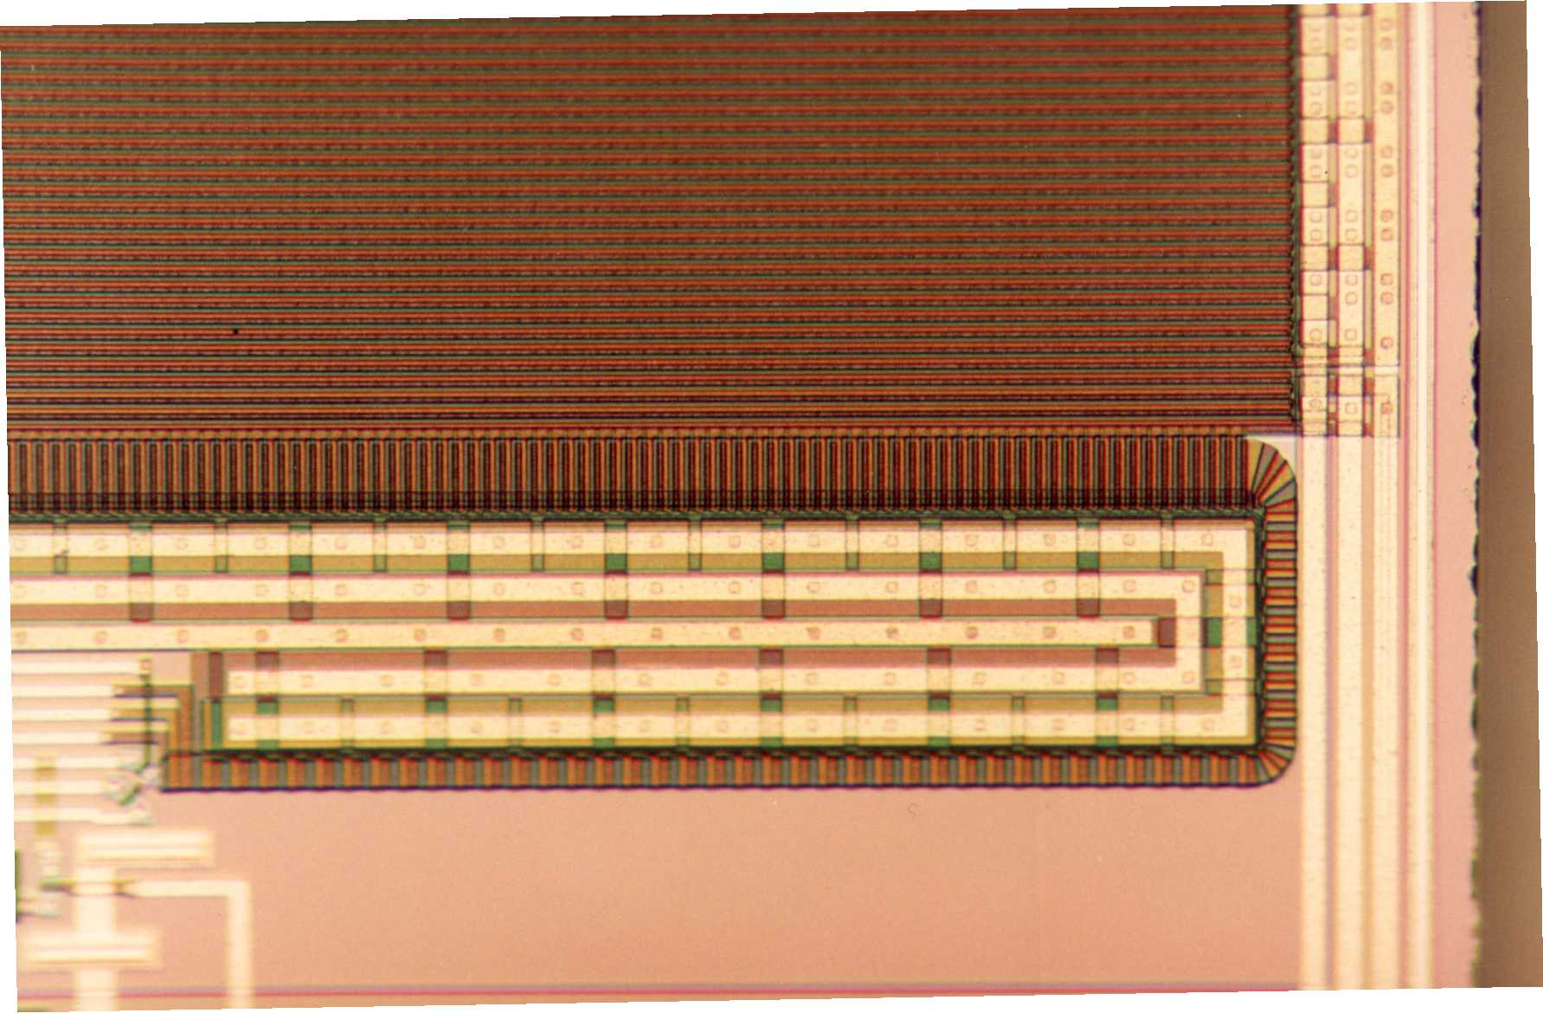
Photomicrograph of a corner of an EEV CCD
160mm
Image Area
Serial Register
Bus wires
Edge of
Silicon
Read Out Amplifier

Slide 31
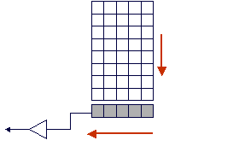
Full-Frame CCD
Image area = parallel registers
Charge motion
Charge motion
Masked area = serial register

Slide 32
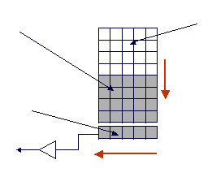
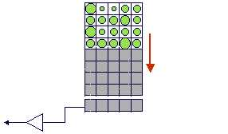
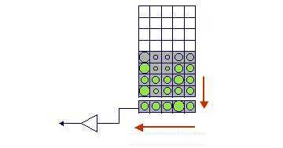
Frame-Transfer CCD
Storage (masked) area
Image area
Charge motion
Serial register

Slide 33
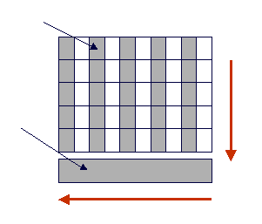
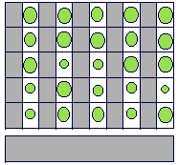
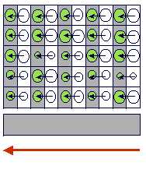
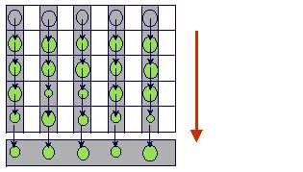
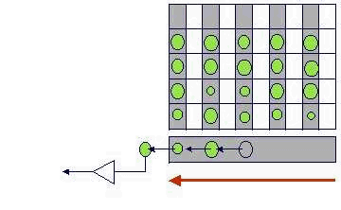
Interline-Transfer CCD
Storage (masked) area
Image area
Serial register

Slide 34
Basic CCD functions
Charge generation
photoelectric effect
Charge collection
potential well
Charge transfer
potential well
Charge detection
sense node capacitance

Slide 35
Photoelectric Effect - 1
Atoms in a silicon crystal have electrons
arranged in discrete energy bands:
Valence Band
Conduction Band
Conduction Band
Increasing energy
1.12 eV
Valence Band

Slide 36
Photoelectric Effect - 2
The electrons in the valence band can be excited into the conduction band by heating or by the absorption of a photon
photon
photon
Hole Electron

Slide 37
Potential Well - 1
Diode junction: the n-type layer contains an excess of electrons that diffuse into the p-layer. The p-layer contains an excess of holes that diffuse into the n-layer (depletion region, region where majority charges are ‘depleted’ relative to their concentrations well away from the junction’).
The diffusion creates a charge imbalance and induces an internal electric field (Buried Channel).
Electric potential
Potential along this line shown
in graph above.
n
p
Cross section through the thickness of the CCD

Slide 38
Potential Well - 2
During integration of the image, one of the electrodes in each pixel is held at a positive potential. This
further increases the potential in the silicon below that electrode and it is here that the photoelectrons are accumulated. The neighboring electrodes, with their lower potentials, act as potential barriers that define the vertical boundaries of the pixel. The horizontal boundaries are defined by the channel stops.
Electric potential
Region of maximum
potential
n
p

Slide 39
Charge collection in a CCD - 1
Photons entering the CCD create electron-hole pairs. The electrons are then attracted towards the most positive potential in the device where they create ‘charge packets’. Each packet corresponds to one pixel
incoming
photons
pixel
boundary
pixel
boundary
n-type silicon
Electrode Structure
Charge packet
p-type silicon
SiO2 Insulating layer

Slide 40
Charge transfer in a CCD
+5V
0V
-5V
2
+5V
0V
-5V
1
+5V
0V
-5V
3
1
2
3
Time-slice shown in diagram

Slide 41
+5V
0V
-5V
2
+5V
0V
-5V
1
+5V
0V
-5V
3
1
2
3

Slide 42
+5V
0V
-5V
2
+5V
0V
-5V
1
+5V
0V
-5V
3
1
2
3

Slide 43
+5V
0V
-5V
2
+5V
0V
-5V
1
+5V
0V
-5V
3
1
2
3

Slide 44
+5V
0V
-5V
2
+5V
0V
-5V
1
+5V
0V
-5V
3
1
2
3

Slide 45
+5V
0V
-5V
2
+5V
0V
-5V
1
+5V
0V
-5V
3
1
2
3

Slide 46
Performance functions
Charge generation
Quantum Efficiency (QE), Dark Current
Charge collection
full well capacity, pixels size, pixel uniformity,
defects, diffusion (Modulation Transfer
Function, MTF)
Charge transfer
Charge transfer efficiency (CTE),
defects
Charge detection
Readout Noise (RON), linearity

Slide 47
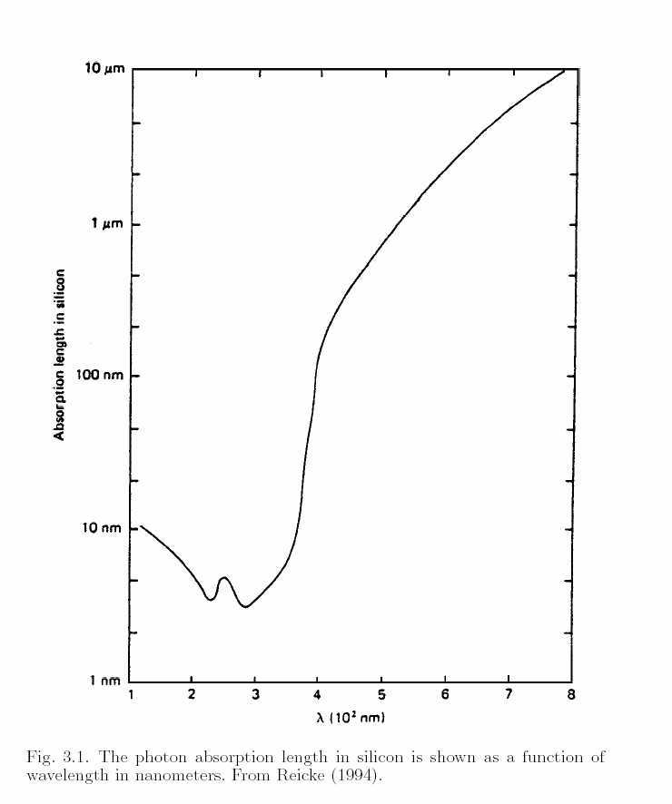
Photon absorption length
Semiconductor | T (K) | Δ (E_{Cond} – E_{Val}) (eV) | λ_{c} (nm)
CdS | 295 | 2.4 | 500
CdSe | 295 | 1.8 | 700
GaAs | 295 | 1.35 | 920
Si | 295 | 1.12 | 1110
Ge | 295 | 0.67 | 1850
PbS | 295 | 0.42 | 2950
InSb | 295 | 0.18 | 6900
λ_{c}: beyond this wavelength
CCDs become insensitive.

Slide 48
(Thick) front-side illuminated CCDs
Incoming photons
p-type silicon
n-type silicon
625 μ m
Polysilicon electrodes
low QE (reflection and absorption of light in the surface electrodes)
No anti-reflective coating possible (for electrode structure)
Poor blue response

Slide 49
(Thin) back-side illuminated CCDs
Anti-reflective (AR) coating
Incoming photons
p-type silicon
n-type silicon
Silicon dioxide insulating layer
15μm
Polysilicon electrodes
Silicon chemically etched and polished down to a thickness of about 15microns.
Light enters from the rear and so the electrodes do not obstruct the photons. The QE can approach 100% .
Become transparent to near infra-red light and poor red response
Response can be boosted by the application of anti-reflective coating on the thinned rear-side
Expensive to produce

Slide 50
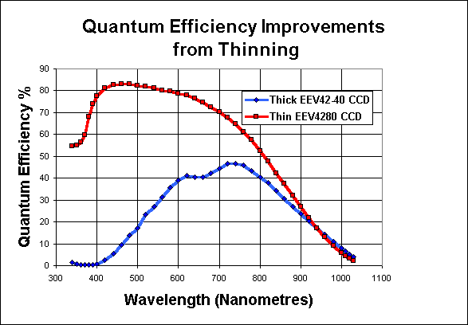
Front vs. Back side CCD QE

Slide 51
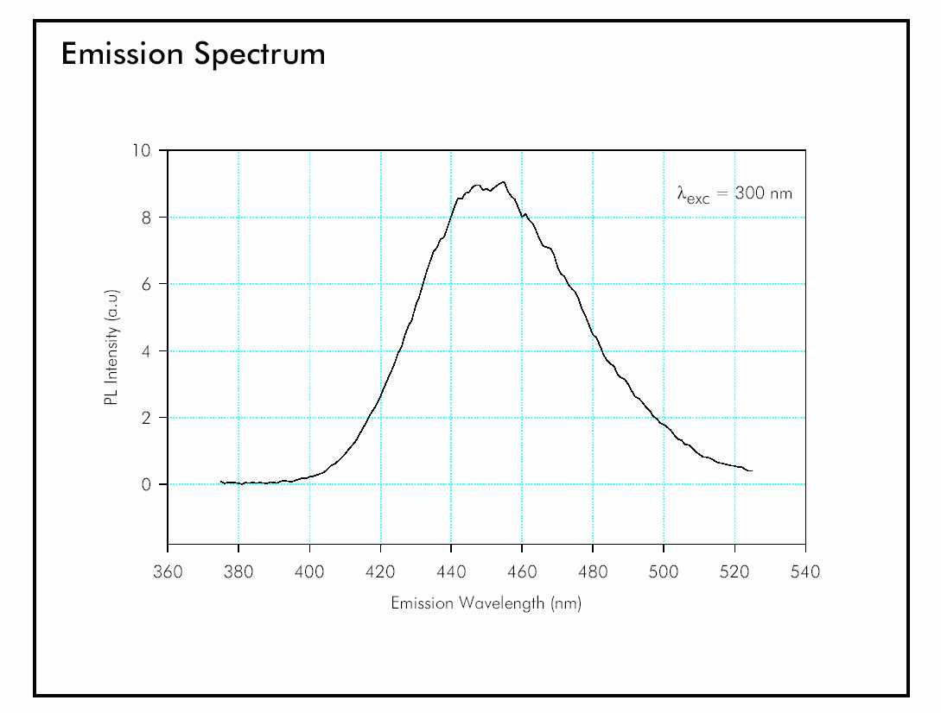
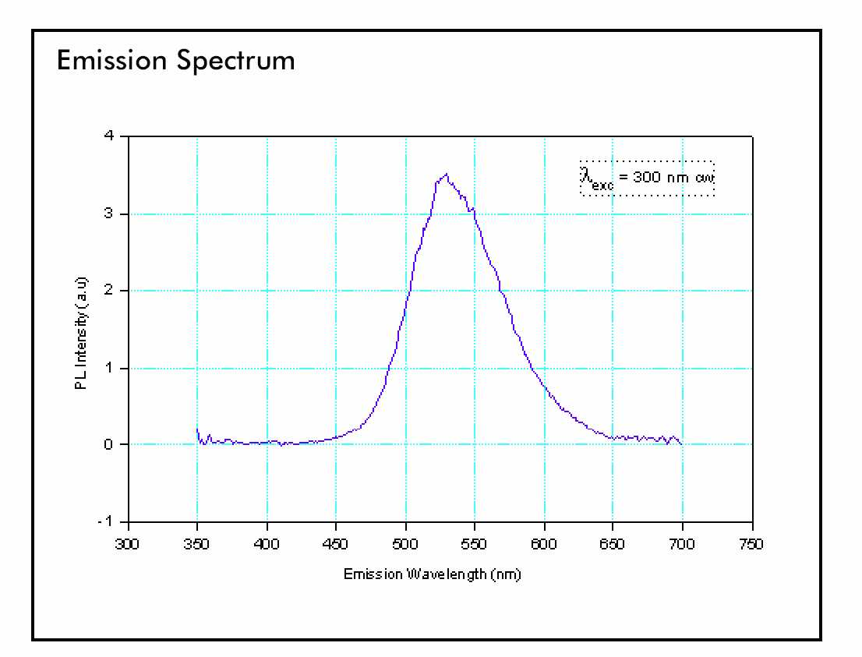
CCD QE and neutron detectors - 1
Phosphor/Scintillators from “Applied Scintillation Technologies” data sheets (www.appscintech.com)

Slide 52
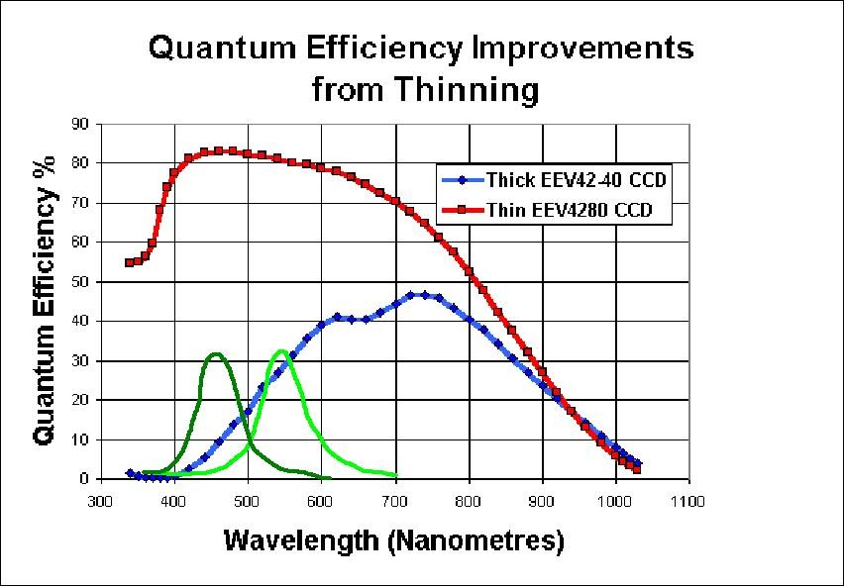
CCD QE and neutron detectors - 2

Slide 53
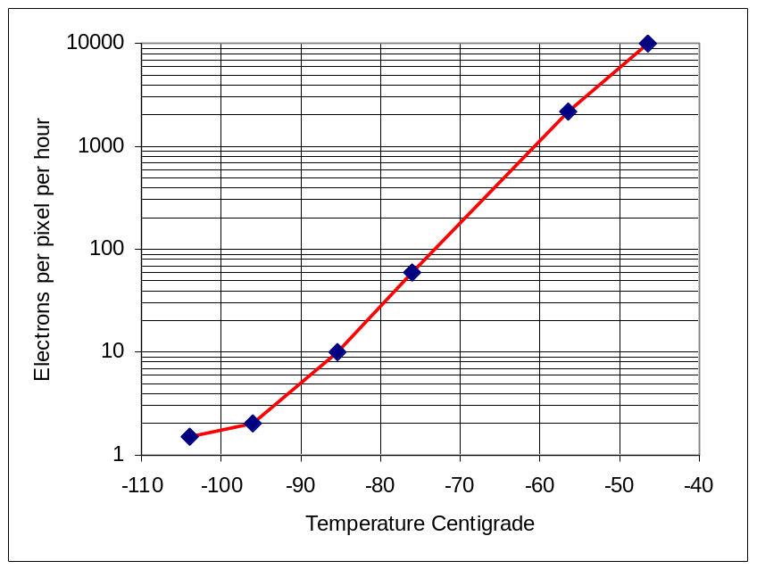
Dark current
Thermally generated electrons are indistinguishable from photo-generated electrons : “Dark Current” (noise)
Cool the CCD down!!!

Slide 54
Full well - 1
Spillage
Spillage
pixel
boundary
pixel
boundary
Overflowing
charge packet
Photons
Photons
Blooming

Slide 55
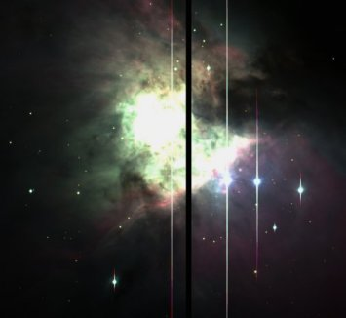
Full well - 2
Bloomed star images
Blooming

Slide 56
CTE - 1
Percentage of charge which is really transferred.
“n” 9s: five 9s = 99,99999%

Slide 57
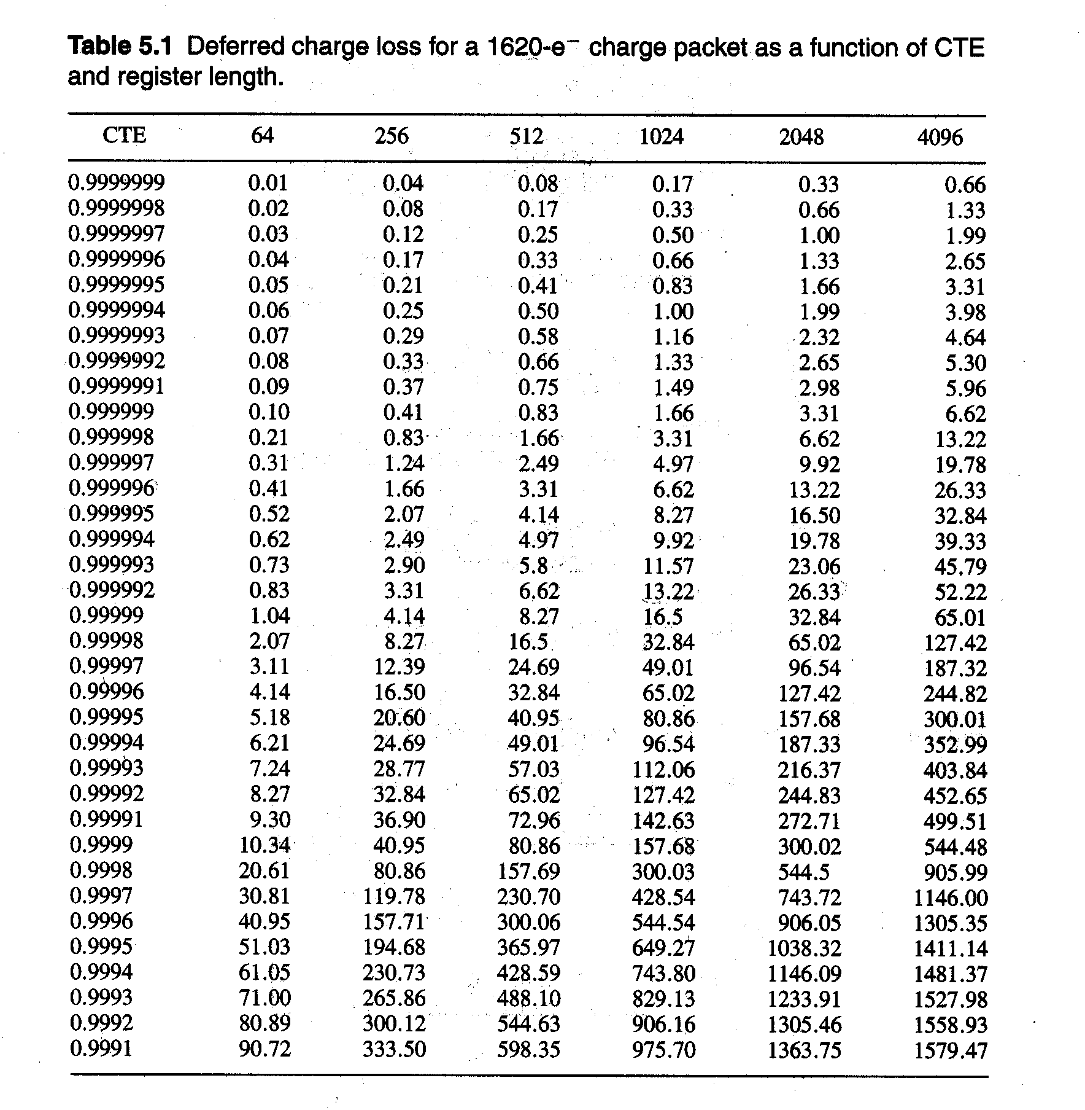
CTE - 2

Slide 58
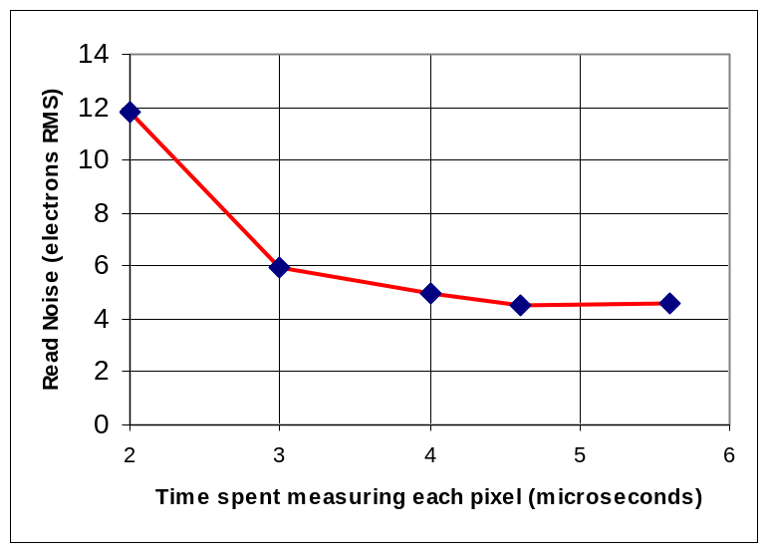
Read-Out Noise
Mainly caused by thermally induced motions of electrons in the output amplifier. These cause
small noise voltages to appear on the output. This noise source, known as Johnson Noise, can be
reduced by cooling the output amplifier or by decreasing its electronic bandwidth. Decreasing the
bandwidth means that we must take longer to measure the charge in each pixel, so there is always a trade-off between low noise performance and speed of readout.
The graph below shows the trade-off between noise and readout speed for an EEV4280 CCD.

Slide 59
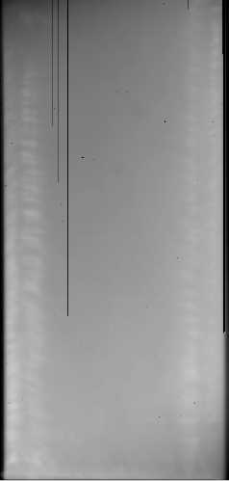
CCD defects - 2
Dark columns: caused by ‘traps’ that block the vertical transfer of charge during image readout.
Traps can be caused by crystal boundaries in the silicon of the CCD or by manufacturing defects.
Although they spoil the chip cosmetically, dark columns are not a big problem (removed by calibration).

Slide 60
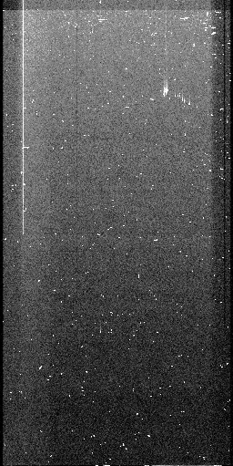
CCD defects - 2
Bright columns are also caused by traps . Electrons contained in such traps can leak out during readout causing a vertical streak.
Hot Spots are pixels with higher than normal dark current. Their brightness increases linearly with exposure times
Somewhat rarer are light-emitting defects which are hot spots that act as tiny LEDS and cause a halo of light on the chip.
Bright
Column
Cluster of
Hot Spots
Cosmic rays

Slide 61
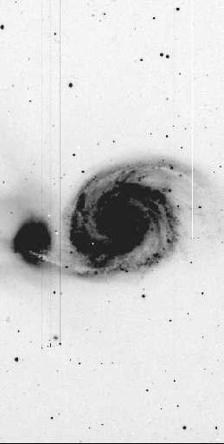
CCD defects - 3
Dark column
Hot spots and bright columns
Bright first image row caused by
incorrect operation of signal
processing electronics.

Slide 62
CCDs:
- small, compact, rugged, stable, low-power devices
- excellent, near-perfect sensitivity over a wide range in wavelengths
- wide dynamic range (from low to high light levels)
- no image distortion (pixel fixed by construction)
- easily connected to computer
“The CCD is an almost perfect detector”
Ian S. McLean - Craig Mackay

Slide 63
“The only uniform CCD is a dead CCD”
Craig Mackay

Slide 64
CCD Calibration - 1
Bias: exposure time = 0, no light
shows variations in electronic response across the CCD
Flat Field: exposure time ≠ 0, uniform light
shows variations in the sensitivity of the pixels across the CCD
Dark Frame: exposure time ≠ 0, no light
shows variations in dark current generation across the CCD

Slide 65
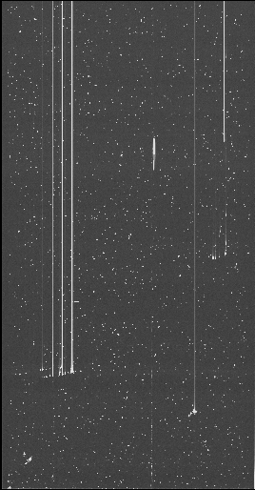
CCD calibration - 2
Dark frame shows a number of bright defects on the chip
Flat field shows a pattern on the chip created during manufacture and a slight loss of sensitivity in two corners of the image
Some dust spots are also visible
Dark Frame
Flat Field

Slide 66
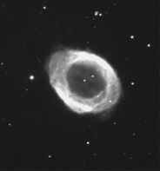
CCD calibration - 3
If there is significant dark current present:
Science Frame
Dark Frame
Science
-Dark
-Bias
Output Image
Bias Image
Sc-Dark-Bias
Flat-Dark-Bias
Flat
-Dark
-Bias
Flat Field Image

Slide 67
CCD Calibration - 4
If negligible dark current
Science Frame
Science
-Bias
Bias Image
Output Image
Science -Bias
Flat-Bias
Flat Field Image
Flat
-Bias

Slide 68
A CCD Camera
Thermally Electrical feed-through Vacuum Space Pressure vessel Pump Port
Insulating
Pillars
Face-plate
Telescope beam
.
.
Boil-off
.
Optical window CCD CCD Mounting Block Thermal coupling Nitrogen can Activated charcoal ‘Getter’
Focal Plane
of Telescope

Slide 69
Acknowledgments
pictures at pages 4-27, 30, 36-37, 39-47, have been taken or adapted from: Simon Tulloch, "Activity 1 : Introduction to CCDs“,
pictures at pages 50-52, 56-57, 61-63, 67-69 have been taken or adapted from: Simon Tulloch, "Activity 2 : Use of CCD Cameras“
pictures at pages 55, 60, 70 have been taken or adapted from: Simon Tulloch, "Activity 3 : Advanced CCD Techniques"
Simon Tulloch’s documents are available at
http://www.iai.heig-vd.ch/~fwi/temp/
http://www.ifa.hawaii.edu/~hodapp/UHH-ASTR-450/
picture at page 31 has been taken from: Howell, S.B, "Handbook of CCD Astronomy", Cambridge University Press
pictures at pages 32-34 have been adapted from http://www.ccd-sensor.de/index.html
picture at page 49 has been taken from: Rieke, G.H. 1994, "Detection of Light: From the Ultraviolet to the Submillimeter", Cambridge University Press
pictures at pages 53 have been taken from: "Applied Scintillation Technologies” data sheets available at http://www.appscintech.com

