Slide 2
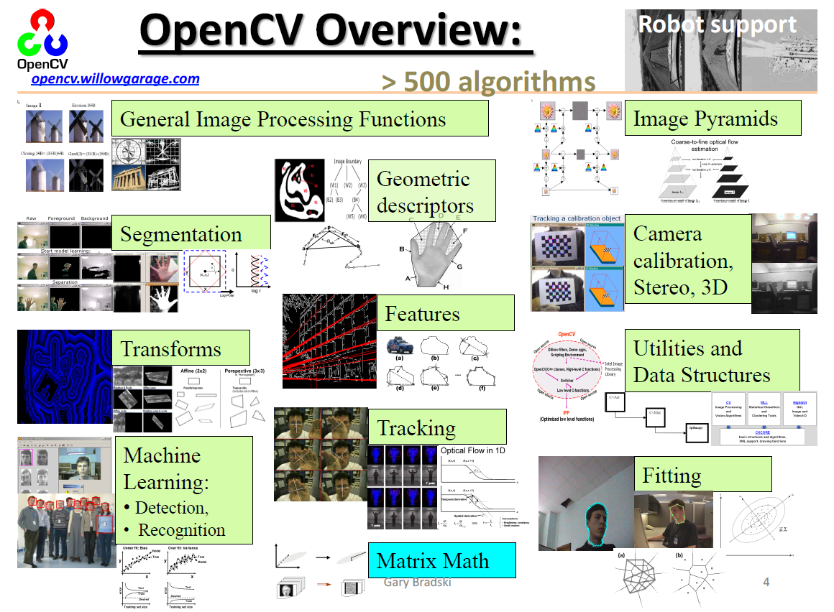

Slide 3
Python Interface
Cross platform: Windows, Linux, macOS, iOS, Andriod, etc
Python API is similar to C++ interface
Uses numpy for images
Huge library of algorithms
Lots of online tutorials
Source code: https://github.com/opencv/opencv
All of the tutorials are also on github: samples/python

