Slide 1
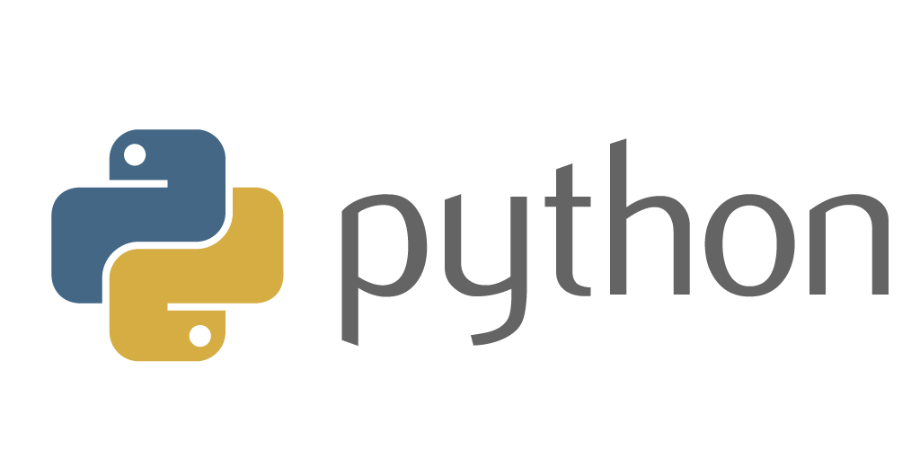

Slide 2
Overview
What is python and why are we using it?
Basics:
general syntax
for and while loops
flow control with
functions
Data types: tuples, lists, strings, int, float, dict

Slide 3
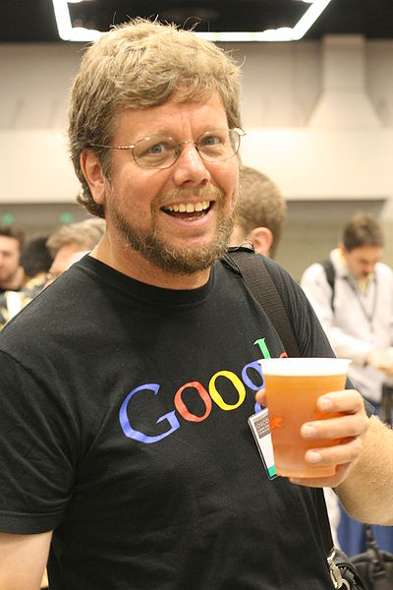
Python’s Benevolent Dictator For Life
“Python is an experiment in how much freedom program-mers need. Too much freedom and nobody can read another's code; too little and expressive-ness is endangered.”
- Guido van Rossum
Works for dropbox now
Python is a widely used high-level programming language for general-purpose programming, created by Guido van Rossum and first released in 1991. An interpreted language, Python has a design philosophy which emphasizes code readability (notably using whitespace indentation to delimit code blocks rather than curly brackets or keywords), and a syntax which allows programmers to express concepts in fewer lines of code than might be used in languages such as C++ or Java. The language provides constructs intended to enable writing clear programs on both a small and large scale.

Slide 4
Why are we using python?
Simple and easy to use and very efficient
What you can do in a 100 lines of python could take you a 1000 in C++ … this is the reason many startups (e.g., Instagram) use python and keep using it
90% of robotics uses either C++ or python
Although C++ is faster in run-time, development (write, compile, link, etc) is much slower due to complex syntax, memory management, pointers (they can be fun!) and difficulty in debugging any sort of real program
Java is dying (or dead)

Slide 5
Who uses python?
Industrial Light & Magic (Stars Wars people): used in post production scripting to tie together outputs from other C++ programs
Eve-Online (big MMORGP game): used for both client and server aspects of the game
Instagram, Spotify, SurveyMonkey, The Onion, Bitbucket, Pinterest, and more use Django (python website template framework) to create/serve millions of users
Dropbox, Paypal, Walmart and Google (YouTube)
Note: Guido van Rossum worked for Google and now works for Dropbox

Slide 6
Running Programs on UNIX (or on your robot)
Call python program via the python interpreter
% python my_program.py
Make a python file directly executable by
Adding the shebang (it’s a Unix thing) to the top of your program
#!/usr/bin/env python
Making the file executable
% chmod a+x my_program.py
Invoking file from Unix command line
% ./my_program.py

Slide 7
Enough to Understand the Code
Indentation matters for functions, loops, classes, etc
First assignment to a variable creates it
Variable types (int, float, etc) don’t need to be declared.
Assignment is = and comparison is ==
For numbers + - * % are as expected
Logical operators are words (and, or, not) not symbols
We are using __future__ for python 2 / 3 compatibility
The basic printing command is print(‘hello’)
Division works like expected:
Float division: 5/2 = 2.5
Integer division: 5//2 = 2

Slide 8
Comments
Start comments with #, rest of line is ignored
Can include a “documentation string” as the first line of a new function or class you define
Development environments, debugger, and other tools use it: it’s good style to include one
def fact(n):
“““fact(n) assumes n is a positive integer and returns facorial of n.””” assert(n>0)
return 1 if n==1 else n*fact(n-1)

Slide 9
Example
#! /usr/bin/env python
from __future__ import division, print_function
print(‘hello world’)
print(“hello world”)
print(‘3/4 is’, 3/4) # this prints 0.75
print(‘I am {} and I am {} yrs old’.format(‘kevin’, 45))
print(‘float: {:5.1f}’.format(3.1424567)) # prints float: 3.1

Slide 10
Basic Datatypes
Using: from __future__ import division
Integers (default for numbers)
z = 5 // 2 # 2, int div
Floats
z = 5/2 or x = 3.456
Strings
Can use “ or ‘:“ab” == ‘ab’
Bools
True or False
Dictionary or Hash
bob = {‘a’: 5, ‘b’: 6}
bob[‘a’] → 5
len(bob) → 2
Array or list (mutable)
bob = [1,2,3,4,5]
bob[3] → 4
Tuple (immutable)
bob = (1,2,3,4)
bob[0] → 1

Slide 11
Assignment
You can assign to multiple names at the same time
x, y = 2, 3 now x = 2 and y = 3
bob = {‘a’: [1,2,3]}
x, y, z = bob[‘a’]
This makes it easy to swap values
>>> x, y = y, x
Assignments can be chained
>>> a = b = x = 2

Slide 12
Changing a Shared List
a
1
2
3
a = [1, 2, 3]
a
1
2
3
b = a
b
a
1
2
3
a.append(4)
4
b

Slide 13
Catching Exceptions (Errors)
def foo(x):
return 1/x
def bar(x):
try:
print( foo(x) )
except ZeroDivisionError, message:
print "Can’t divide by zero:", message
bar(0)

Slide 14
Raising Exceptions (Errors)
raise Exception
raise Exception("k out of range")
raise Exception, "k out of range"
try: something except: # catch everything print("Oops“) raise # raise the exception that called this exception

Slide 15
range
The range function specifies a range of integers:
range(start, stop) - the integers between start (inclusive)
and stop (exclusive)
It can also accept a third value specifying the change between values.
range(start, stop, step) - the integers between start (inclusive)
and stop (exclusive) by step
Example:
for x in range(5, 0, -1):
print x
print("Blastoff!“)
Output:
5
4
3
2
1
Blastoff!
Exercise: How would we print the "99 Bottles of Beer" song?

Slide 16
The for loop
for loop: Repeats a set of statements over a group of values.
Syntax:
for variableName in groupOfValues:
statements
We indent the statements to be repeated with tabs or spaces.
variableName gives a name to each value, so you can refer to it in the statements.
groupOfValues can be a range of integers, specified with the range function.
Example:
for x in range(1, 6):
print(x, "squared is", x * x)
Output:
1 squared is 1
2 squared is 4
3 squared is 9
4 squared is 16
5 squared is 25

Slide 17
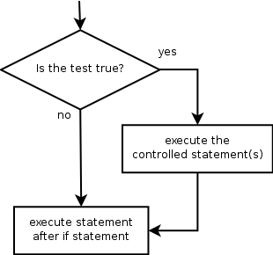
if
if statement: Executes a group of statements only if a certain condition is true. Otherwise, the statements are skipped.
Syntax:
if condition:
statements
Example:
gpa = 3.4
if gpa > 2.0:
print("Your application is accepted.“)

Slide 18
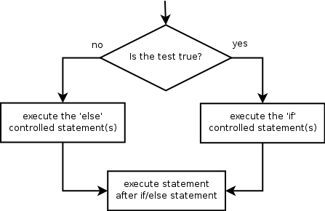
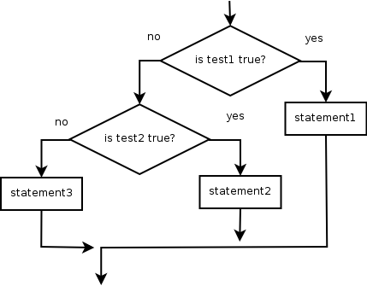
if/else
if/else statement: Executes one block of statements if a certain condition is True, and a second block of statements if it is False.
Syntax:
if condition:
statements
else:
statements
Example:
gpa = 1.4
if gpa > 2.0:
print("Welcome to Mars University!“)
else:
print("Your application is denied.“)
Multiple conditions can be chained with elif ("else if"):
if condition:
statements
elif condition:
statements
else:
statements

Slide 19
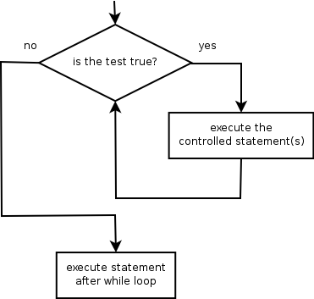
while
while loop: Executes a group of statements as long as a condition is True.
good for indefinite loops (repeat an unknown number of times)
Syntax:
while condition:
statements
Example:
number = 1
while number < 200:
print(number)
number = number * 2
Output:
1 2 4 8 16 32 64 128

Slide 20
Logic
Many logical expressions use relational operators:
Logical expressions can be combined with logical operators:
Operator | Meaning | Example | Result
== | equals | 1 + 1 == 2 | True
!= | does not equal | 3.2 != 2.5 | True
< | less than | 10 < 5 | False
> | greater than | 10 > 5 | True
<= | less than or equal to | 126 <= 100 | False
>= | greater than or equal to | 5.0 >= 5.0 | True
Operator | Example | Result
and | 9 != 6 and 2 < 3 | True
or | 2 == 3 or -1 < 5 | True
not | not 7 > 0 | False

Slide 21
Backups
These are slides of minimal value, but if you want to see more … go ahead!

Slide 22
Assignment
Binding a variable in Python means setting a name to hold a reference to some object
Assignment creates references, not copies
Names in Python do not have an intrinsic type, objects have types
Python determines the type of the reference automatically based on what data is assigned to it
You create a name the first time it appears on the left side of an assignment expression: x = 3
A reference is deleted via garbage collection after any names bound to it have passed out of scope
Python uses reference semantics (more later)

Slide 23
Naming Rules
Names are case sensitive and cannot start with a number. They can contain letters, numbers, and underscores.
bob Bob _bob _2_bob_ bob_2 BoB
There are some reserved words:
and, assert, break, class, continue, def, del, elif, else, except, exec, finally, for, from, global, if, import, in, is, lambda, not, or, pass, print, raise, return, try, while

Slide 24
Naming conventions
The Python community has these recommend-ed naming conventions
joined_lower for functions, methods and, attributes
joined_lower or ALL_CAPS for constants
StudlyCaps for classes
camelCase only to conform to pre-existing conventions
Attributes: interface, _internal, __private

Slide 25
Slicing: return copy of a =subset
>>> t = (23, ‘abc’, 4.56, (2,3), ‘def’)
Omit first index to make copy starting from beginning of the container
>>> t[:2]
(23, ‘abc’)
Omit second index to make copy starting at first index and going to end
>>> t[2:]
(4.56, (2,3), ‘def’)

Slide 26
Copying the Whole Sequence
[ : ] makes a copy of an entire sequence
>>> t[:]
(23, ‘abc’, 4.56, (2,3), ‘def’)
Note the difference between these two lines for mutable sequences
>>> l2 = l1 # Both refer to 1 ref,
# changing one affects both
>>> l2 = l1[:] # Independent copies, two refs

Slide 27
The ‘in’ Operator
Boolean test whether a value is inside a container:
>>> t = [1, 2, 4, 5]
>>> 3 in t
False
>>> 4 in t
True
>>> 4 not in t
False
For strings, tests for substrings
>>> a = 'abcde'
>>> 'c' in a
True
>>> 'cd' in a
True
>>> 'ac' in a
False
Be careful: the in keyword is also used in the syntax of for loops and list comprehensions

Slide 28
The + Operator
The + operator produces a new tuple, list, or string whose value is the concatenation of its arguments.
>>> (1, 2, 3) + (4, 5, 6)
(1, 2, 3, 4, 5, 6)
>>> [1, 2, 3] + [4, 5, 6]
[1, 2, 3, 4, 5, 6]
>>> “Hello” + “ ” + “World”
‘Hello World’

Slide 29
The * Operator
The * operator produces a new tuple, list, or string that “repeats” the original content.
>>> (1, 2, 3) * 3
(1, 2, 3, 1, 2, 3, 1, 2, 3)
>>> [1, 2, 3] * 3
[1, 2, 3, 1, 2, 3, 1, 2, 3]
>>> “Hello” * 3
‘HelloHelloHello’

Slide 30
Strings
"hello"+"world" "helloworld" # concatenation
"hello"*3 "hellohellohello" # repetition
"hello"[0] "h" # indexing
"hello"[-1] "o" # (from end)
"hello"[1:4] "ell" # slicing
len("hello") 5 # size
"hello" < "jello" 1 # comparison
"e" in "hello" 1 # search
"escapes: \n etc, \033 etc, \if etc"
'single quotes' """triple quotes""" r"raw strings"

Slide 31
Dictionaries
Hash tables, "associative arrays"
d = {"duck": "eend", "water": "water"}
Lookup:
d["duck"] -> "eend"
d["back"] # raises KeyError exception
Delete, insert, overwrite:
del d["water"] # {"duck": "eend", "back": "rug"}
d["back"] = "rug" # {"duck": "eend", "back": "rug"}
d["duck"] = "duik" # {"duck": "duik", "back": "rug"}

Slide 32
More Dictionary Ops
Keys, values, items:
d.keys() -> ["duck", "back"]
d.values() -> ["duik", "rug"]
d.items() -> [("duck","duik"), ("back","rug")]
Presence check:
d.has_key("duck") -> 1; d.has_key("spam") -> 0
Values of any type; keys almost any
{"name":"Guido", "age":43, ("hello","world"):1, 42:"yes", "flag": ["red","white","blue"]}

Slide 33
Dictionary Details
Keys must be immutable:
numbers, strings, tuples of immutables
these cannot be changed after creation
reason is hashing (fast lookup technique)
not lists or other dictionaries
these types of objects can be changed "in place"
no restrictions on values
Keys will be listed in arbitrary order
again, because of hashing

Slide 34
Tuples
key = (lastname, firstname)
point = x, y, z # parentheses optional
x, y, z = point # unpack
lastname = key[0]
singleton = (1,) # trailing comma!!!
empty = () # parentheses!
tuples vs. lists; tuples immutable

