Slide 1
Sensors

Slide 2
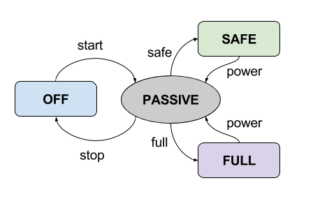
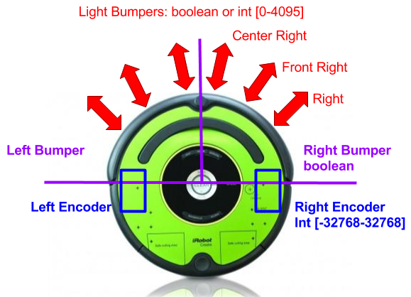
Roomba Sensors and Ops
Main sensors we will use
Some others:
Cliff sensors: boolean
Wheel drop: boolean
Motor Current: int [-32768-32767] mA
Battery Charge: uint [0-65535] mAhr
Voltage: uint [0-65535] V
Temperature: int [-128-127] deg C

Slide 3
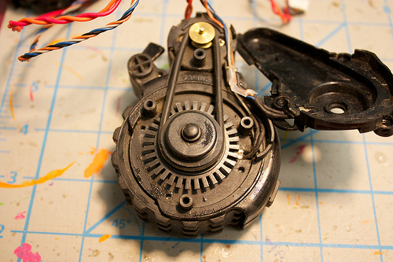
Encoder

Slide 4
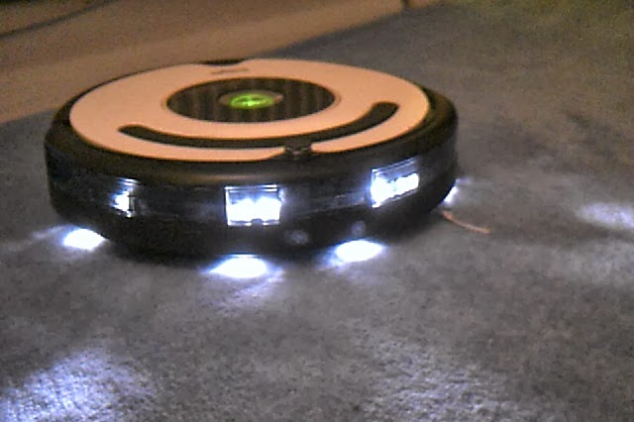
Infra Red

Slide 5
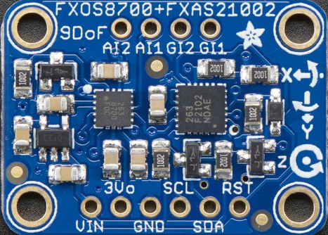
IMU

