Slide 1
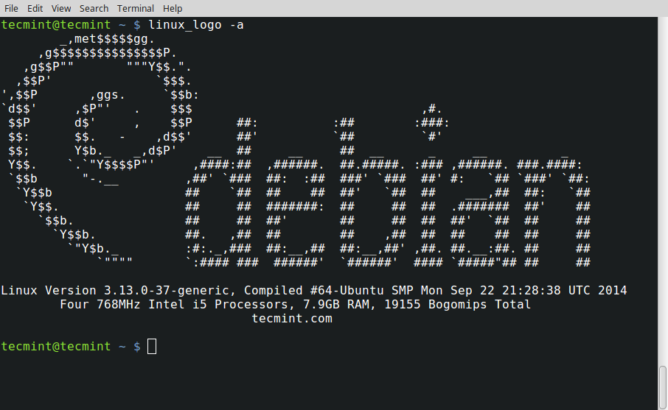



Slide 2
Overview
The expectation is you did the codeacademy.com “learn the command line” training and have a familiarity with the Linux/Unix tools
Today we will brush over them and expand a little upon them
sudo

Slide 3

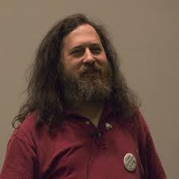
What is Linux? Linux + GNU Utilities = Free Unix
a set of small programs written by Richard Stallman and others. They are the GNU utilities.
http://www.gnu.org/
Linux is an O/S kernel written by Linus Torvalds and others AND
Notes:
Richard Stallman source: http://www.stuffyouwillhate.com/wp-content/uploads/richard-stallman.jpg
Linux Torvalds source: https://netfiles.uiuc.edu/rhasan/linux/Linus_Torvalds.jpg

Slide 4
What is Linux?
Linux is a Unix clone written from scratch by Linus Torvalds with assistance from a loosely-knit team of hackers across the Net.
Unix is a multitasking, multi-user computer operating system originally developed in 1969 by a group of AT&T employees at Bell Labs.
Linux and Unix strive to be POSIX compliant.
64% of the world’s servers run some variant of Unix or Linux.
The Android phone, the Kindle, and a bunch of IoT’s run Linux.
Apple’s macOS is a UNIX and POSIX compliant
Notes:
What is Linux? source: http://www.kernel.org/pub/linux/kernel/README and http://en.wikipedia.org/wiki/Linux and http://en.wikipedia.org/wiki/Unix
POSIX an acronym for "Portable Operating System Interface", is a family of standards specified by the IEEE for maintaining compatibility between operating systems. POSIX defines the application programming interface (API), along with command line shells and utility interfaces, for software compatibility with variants of Unix and other operating systems (source: http://en.wikipedia.org/wiki/POSIX).

Slide 5

Linux Has Many Distributions
We will use Raspbian on a Raspberry Pi 3 … it is based off debian
Notes:
Logos source: http://www.muylinux.com/wp-content/uploads/2009/04/logos-distros.jpg

Slide 6


Let the Linux Intro Begin!
Your Instructor Today
The Ideal Lab Facility
Notes:
Lab image source: http://www.sidekickcomicsuk.com/blogs/media/blogs/sidekick//frankenstein_lab.jpg
Frankenstein image source: http://4.bp.blogspot.com/_OcNNOGpvVSI/RyZDUhUpE2I/AAAAAAAAAEU/e-i67sz7_8U/s1600/2007_7young-frankenstein.jpg

Slide 7
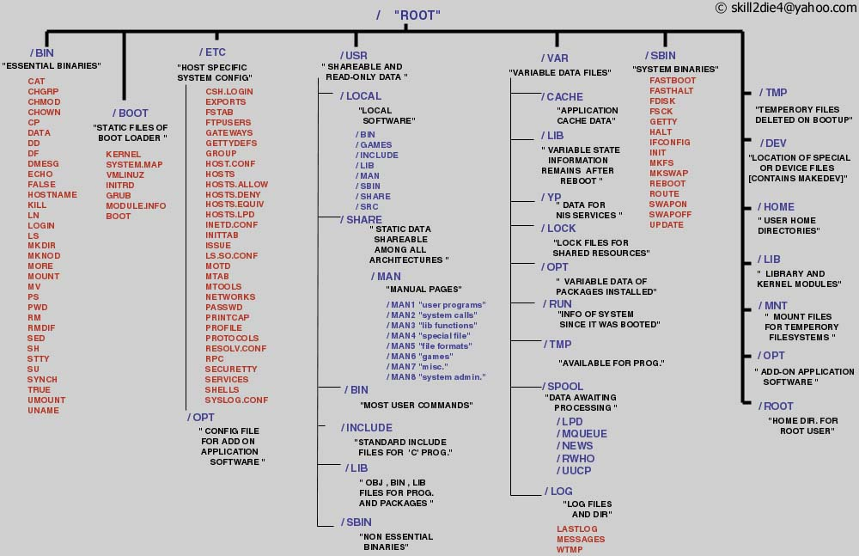
The Linux File System
A Typical Linux File System
Notes:
Source: http://www.tuxmachines.org/images/linux_file_structure.jpg

Slide 8
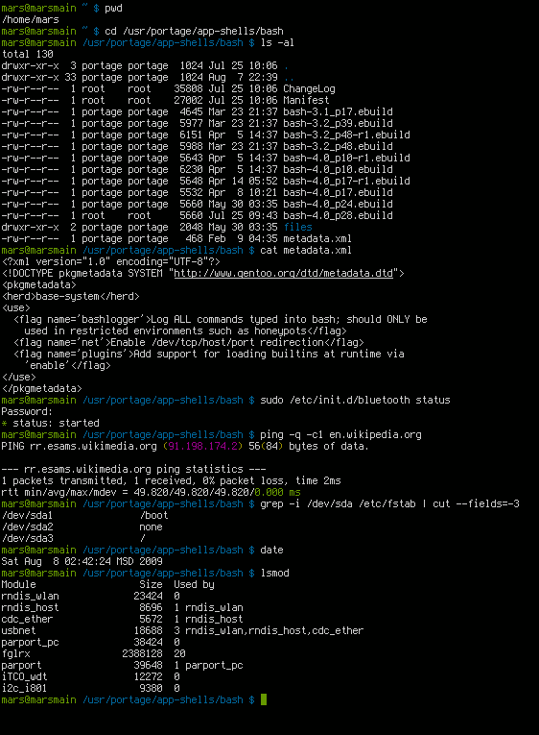


Bash is a Unix shell and command language written by Brian Fox for the GNU Project as a free software replacement for the Bourne shell. First released in 1989, it has been distributed widely as the default login shell for most Linux distributions and Apple's macOS (formerly OS X). A version is also available for Windows 10.
However, since we are on Windows, we will use git-bash to practice today. Later, we will use it to login to our Linux robots.
Also, later, we will cover the git part of git-bash.

Slide 9
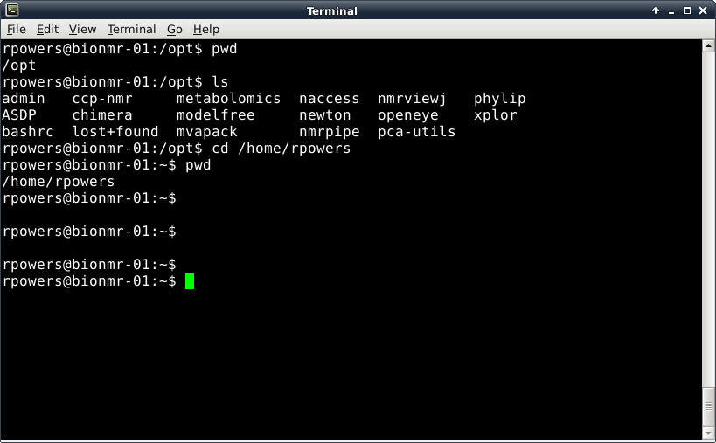
Introduction to Linux/Unix
Three Common Linux Commands: pwd, ls and cd
pwd – identifies the current path or directory
ls – list the files and folders in the current directory
cd path - move to the defined path (change directory)
cd .. (move up one directory),
cd ../.. ( move up two directories)

Slide 10
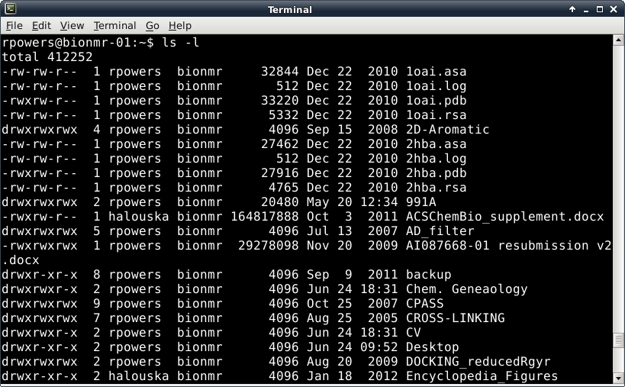
Permissions
You can’t read, write, edit or execute a file without permission!
Size of file in kilobytes
Directory
File Owner
Filename
Number of files in Directory
Group Owner belongs to
File Date or Time Stamp

Slide 11
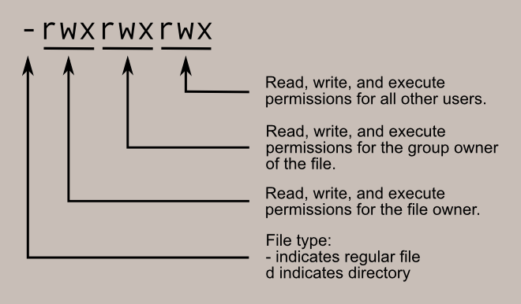
Permissions
Reading and understanding permissions
Permissions

Slide 12
Permissions
Where did the 755 come from in the chmod command?
Think of the permission settings as a series of bits :
rwx rwx rwx = 111 111 111
rw- rw- rw- = 110 110 110
rwx --- --- = 111 000 000
and so on...
rwx = 111 in binary = 7
rw- = 110 in binary = 6
r-x = 101 in binary = 5
r-- = 100 in binary = 4
-xx = 011 in binary = 3
-x- = 010 in binary = 2
--x = 001 in binary = 1
--- = 000 in binary = 0
Binary!

Slide 13
Introduction to Linux/Unix
For a Complete List of Linux Commands and Explanations see
http://linuxcommand.org/
Or the book “Linux in a Nutshell”
Some Other Common Commands
echo “text” – display or print text
exit – close a terminal
clear – clear all text in a terminal
mkdir - make a new directory
rm - remove/delete file
mv - moves files
cp - copies files
ps – lists all active user programs and display a PID (process identification number)
kill pid - will kill (stop) the process with the listed pid number
man command - will display the manual for the listed command
cat file – display the contents of a file (also used to combine or concatenate multiple files)
vi file – will open file with a primitive text editor
chmod file [flags] – will change or set permissions for file defined by flags
touch file – create an empty file or update the access of an existing file

Slide 14
Introduction to Linux/Unix
It Gets More Complicated!
A number of commands have a range of options that are implemented on the command line with a “flag”
ls –l - lists files and folders with associated permissions
rm –R - remove/delete folder
mv –i – prompt before overwriting an existing file with the same name
cp –n – do not overwrite an existing file with the same name
cp –u – only overwrite an older file with the same name
ps –axu – lists the detailed status of every process on the system with the name of the user
chmod 755 file – change file’s permission such that file's owner may read, write, and execute the file. All others may only read and execute the file.
Multiple flags can be used simultaneously
Again, man pages, Linux web site and reference books provide more details

Slide 15
Pipes and Redirection
| (pipe) - passes output of one Linux command to the input of a second command
Example: ls | wc (wc – counts the number of characters, words and lines)
Not limited to just one pipe, can string multiple pipes together
>, < - redirection of files
command > filename – output of command (or program) is sent to a file called filename instead of being displayed on the screen
Example: ls > file_list
command < filename – the file filename is the input to the command or program
Example: xplor < psf.inp

