Slide 1


Slide 2
What is Markdown?
Markdown is a lightweight markup language with plain text formatting syntax.
It is designed so that:
It can be converted to HTML and many other formats easily
You can read the raw text document and still understand it easily (try reading a raw word document without the program installed)
Markdown is often used to format readme files and documentation
There are only a couple attributes you need to know and almost all of them are on the next slide

Slide 3
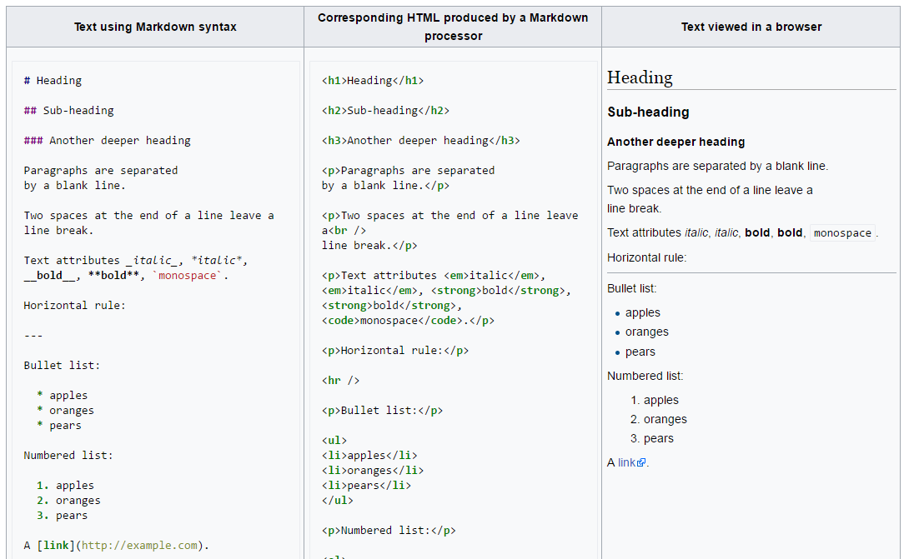

Slide 4
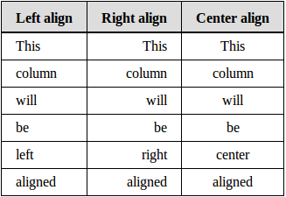
| Left align | Right align | Center align |
|:-----------|----------:|:--------------:|
| This | This | This |
| column | column | column |
| will | will | will |
| be | be | be |
| left | right | center |
| aligned | aligned | aligned |
To embed images: ![](path/to/image) or ![](http://path.to.image)

