Slide 1
Probabilistic Robotics
Probabilistic Motion Models

Slide 2
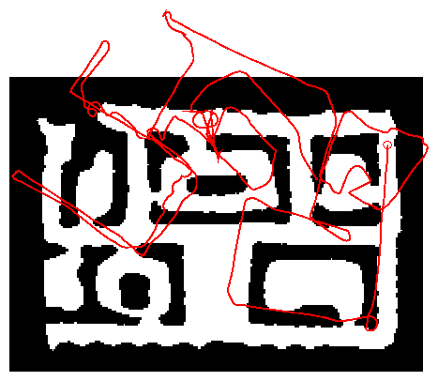
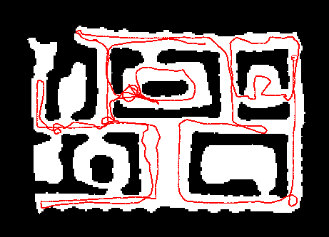
Robot Motion
Robot motion is inherently uncertain.
How can we model this uncertainty?

Slide 3
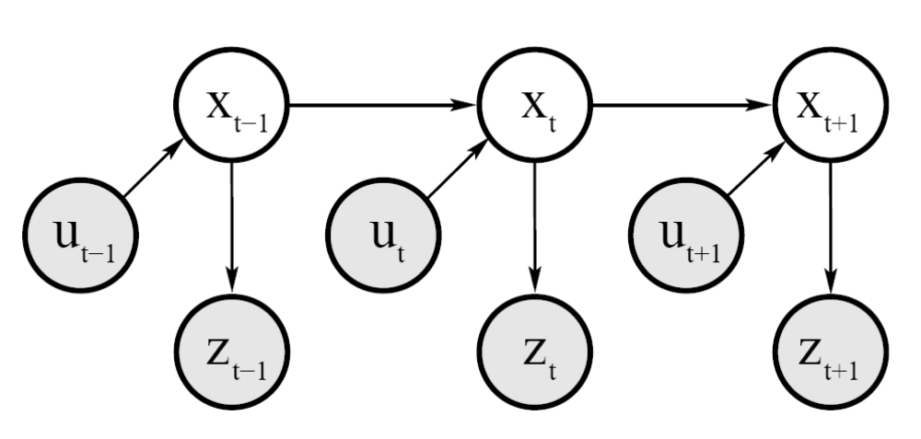
Dynamic Bayesian Network for Controls, States, and Sensations

Slide 4
Probabilistic Motion Models
To implement the Bayes Filter, we need the transition model p(x | x’, u).
The term p(x | x’, u) specifies a posterior probability, that action u carries the robot from x’ to x.
In this section we will specify, how
p(x | x’, u) can be modeled based on the motion equations.

Slide 5
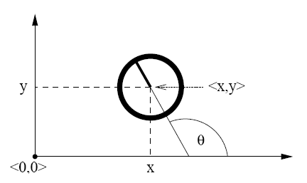
Coordinate Systems
In general the configuration of a robot can be described by six parameters.
Three-dimensional cartesian coordinates plus three Euler angles pitch, roll, and tilt.
Throughout this section, we consider robots operating on a planar surface.
The state space of such systems is three-dimensional (x,y,θ).

Slide 6
Typical Motion Models
In practice, one often finds two types of motion models:
  Odometry-based
  Velocity-based (dead reckoning)
Odometry-based models are used when systems are equipped with wheel encoders.
Velocity-based models have to be applied when no wheel encoders are given.
They calculate the new pose based on the velocities and the time elapsed.

Slide 7
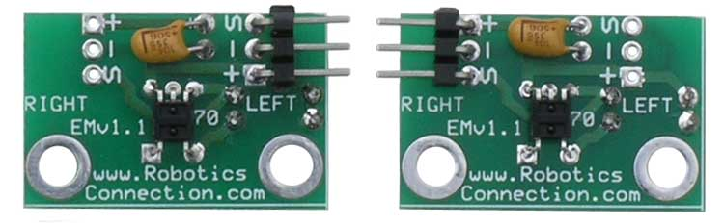
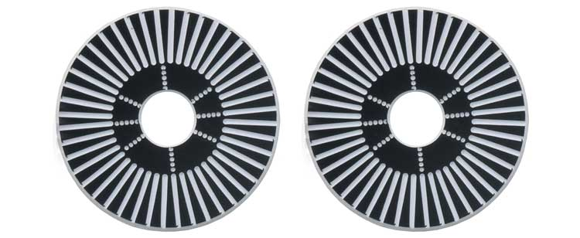
Example Wheel Encoders
These modules require +5V and GND to power them, and provide a 0 to 5V output. They provide +5V output when they "see" white, and a 0V output when they "see" black.
These disks are manufactured out of high quality laminated color plastic to offer a very crisp black to white transition. This enables a wheel encoder sensor to easily see the transitions.
Source: http://www.active-robots.com/

Slide 8
Dead Reckoning
Derived from “deduced reckoning.”
Mathematical procedure for determining the present location of a vehicle.
Achieved by calculating the current pose of the vehicle based on its velocities and the time elapsed.

Slide 9
Reasons for Motion Errors
different wheel
diameters
ideal case
bump
carpet
and many more …

Slide 10
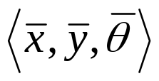
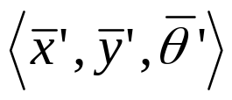
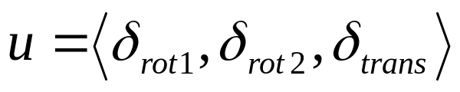
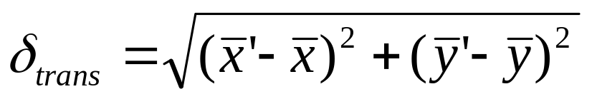
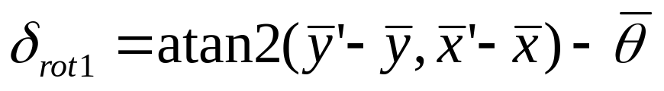
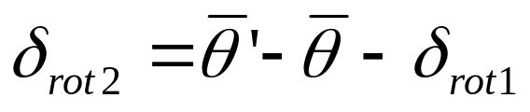
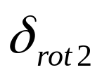
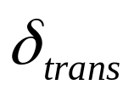

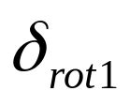
Odometry Model
Robot moves from to .
Odometry information .

Slide 11
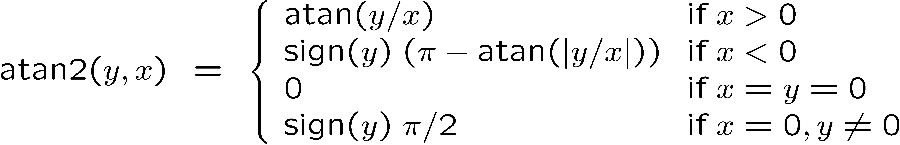
The atan2 Function
Extends the inverse tangent and correctly copes with the signs of x and y.

Slide 12
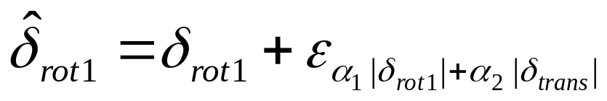
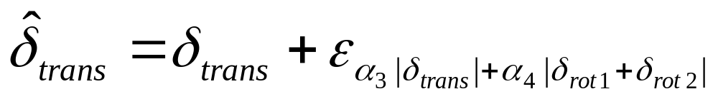
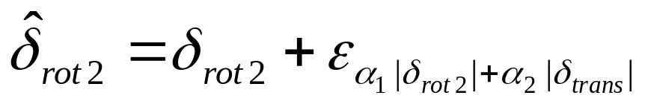
Noise Model for Odometry
The measured motion is given by the true motion corrupted with noise.

Slide 13
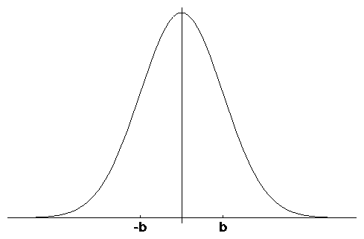
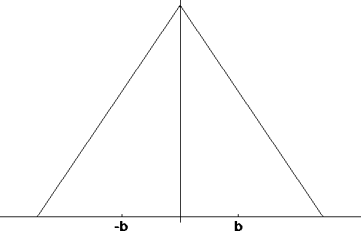
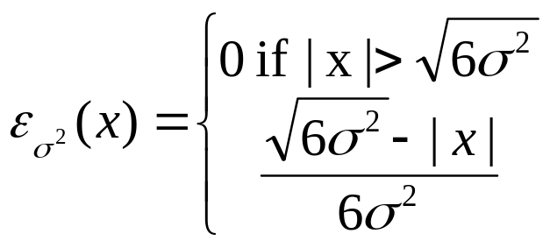
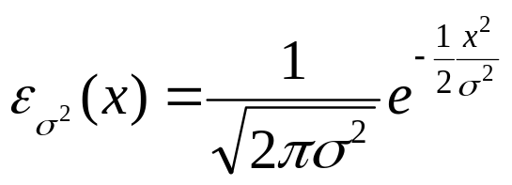
Typical Distributions for Probabilistic Motion Models
Normal distribution
Triangular distribution

Slide 14
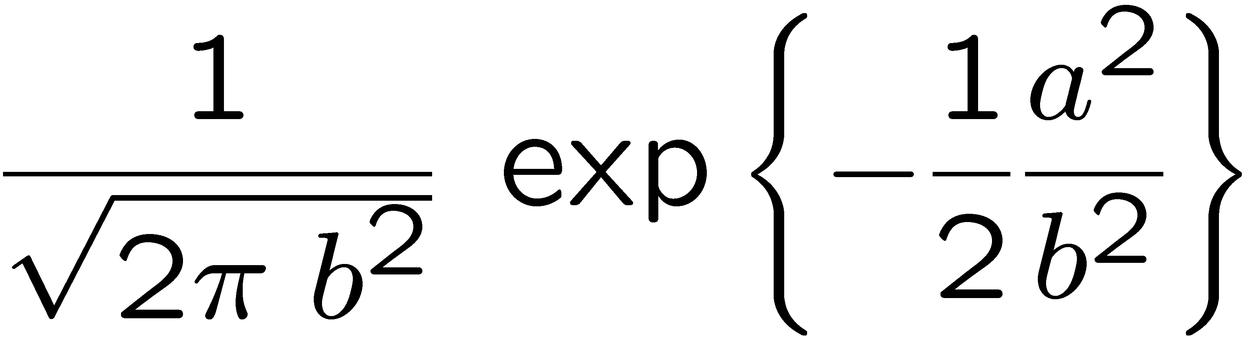
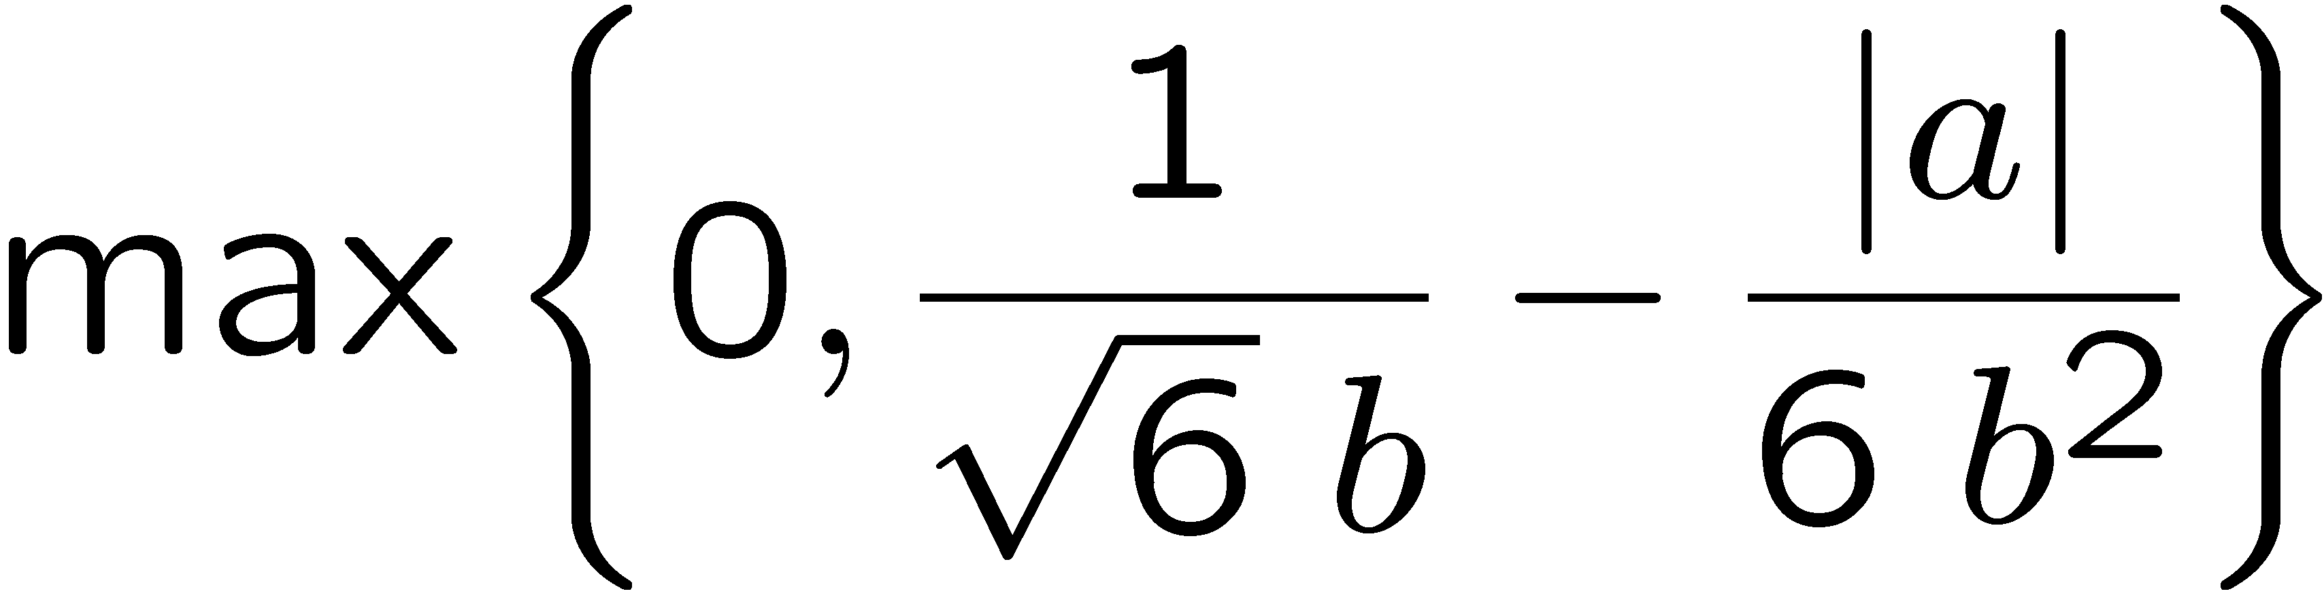
Calculating the Probability (zero-centered)
For a normal distribution
For a triangular distribution
Algorithm prob_normal_distribution(a,b):
return
Algorithm prob_triangular_distribution(a,b):
return

Slide 15
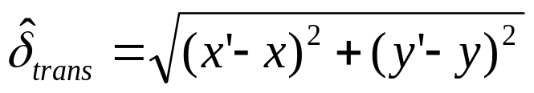
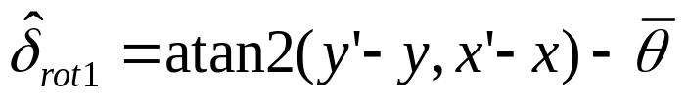
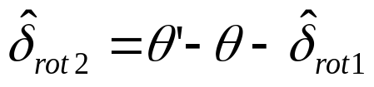
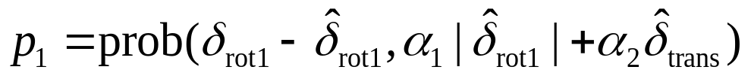
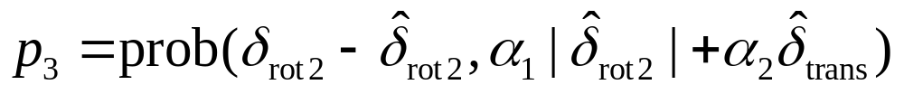
Calculating the Posterior
Given x, x’, and u
Algorithm motion_model_odometry(x,x’,u)
return p₁ · p₂ · p₃
odometry values (u)
values of interest (x,x’)

Slide 16
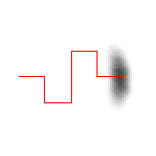

Application
Repeated application of the sensor model for short movements.
Typical banana-shaped distributions obtained for 2d-projection of 3d posterior.
p(x|u,x’)
x’
x’
u
u

Slide 17
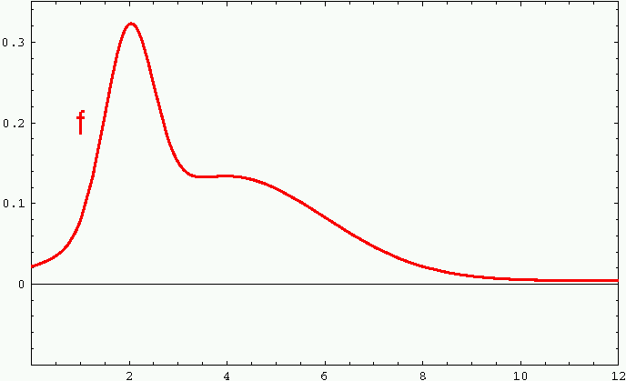
Sample-based Density Representation

Slide 18
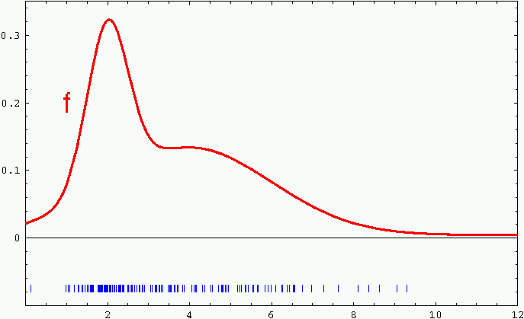
Sample-based Density Representation

Slide 19
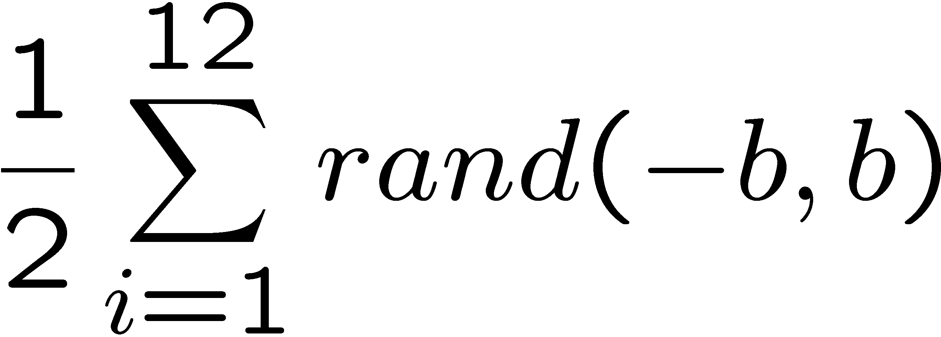
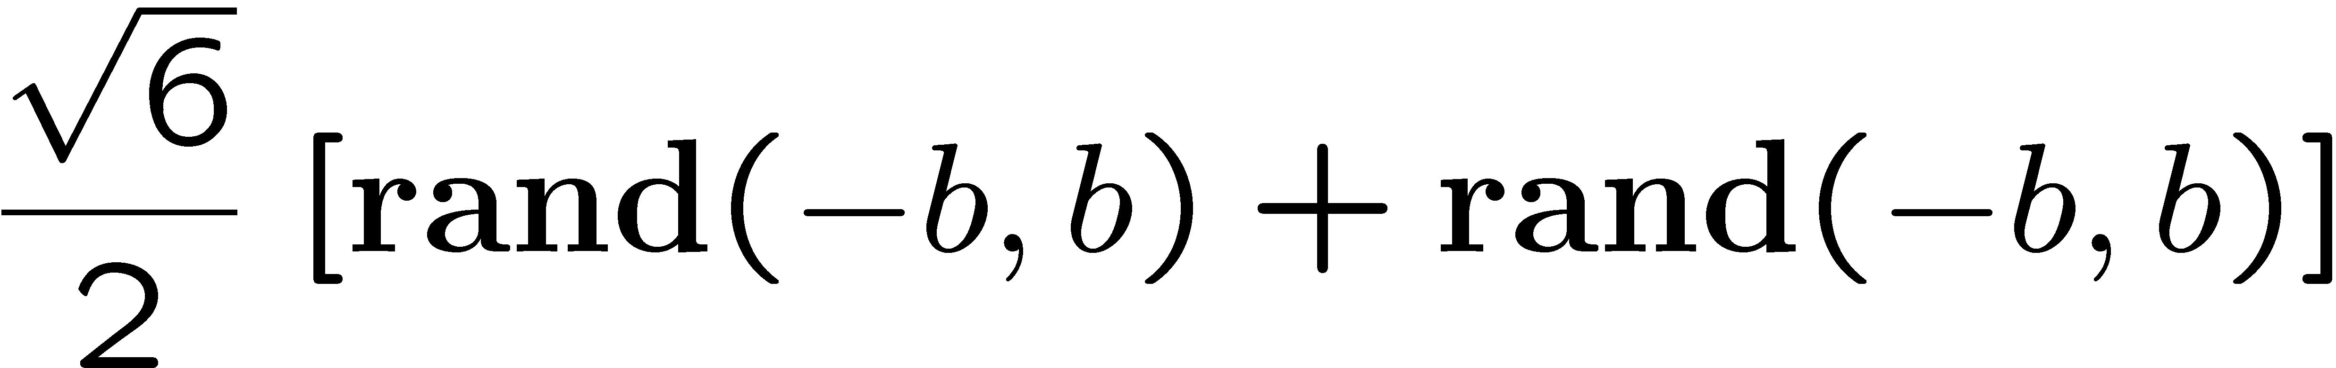
How to Sample from Normal or Triangular Distributions?
Sampling from a normal distribution
Sampling from a triangular distribution
Algorithm sample_normal_distribution(b):
return
Algorithm sample_triangular_distribution(b):
return

Slide 20
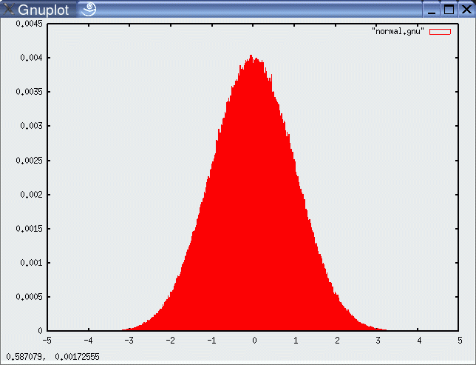
Normally Distributed Samples
10⁶ samples

Slide 21
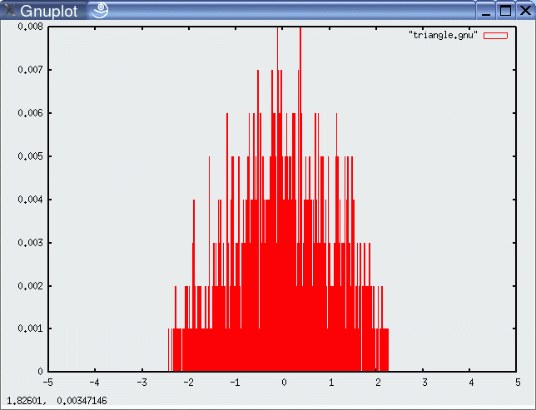
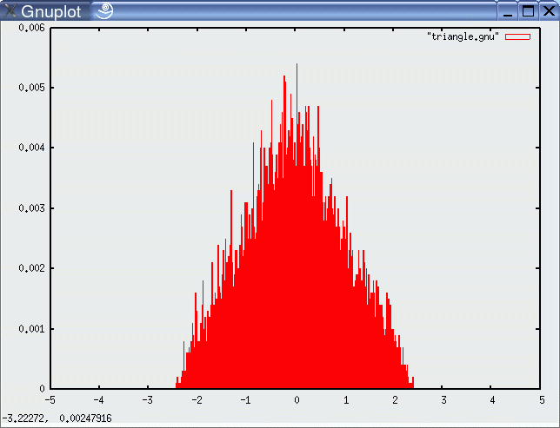
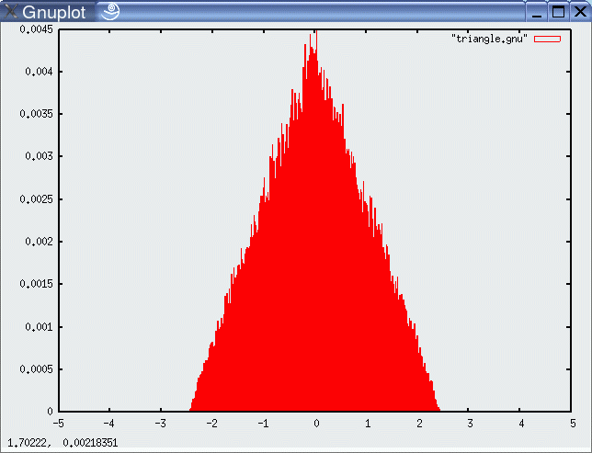
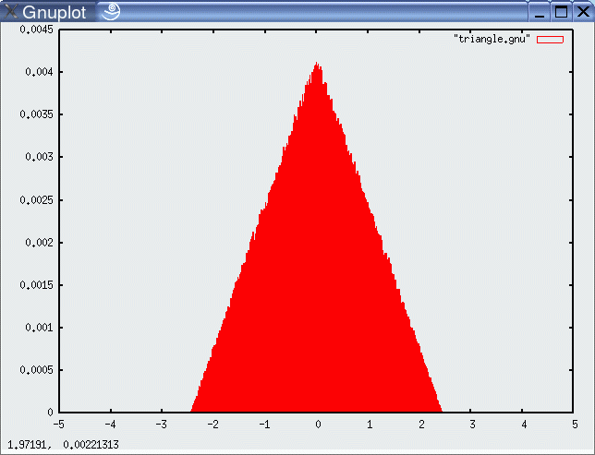
For Triangular Distribution
10³ samples
10⁴ samples
10⁵ samples
10⁶ samples

Slide 22
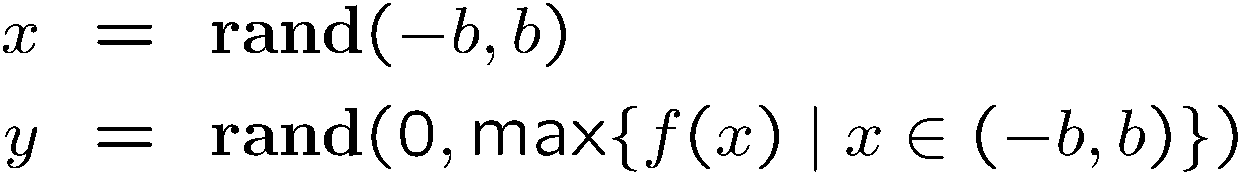
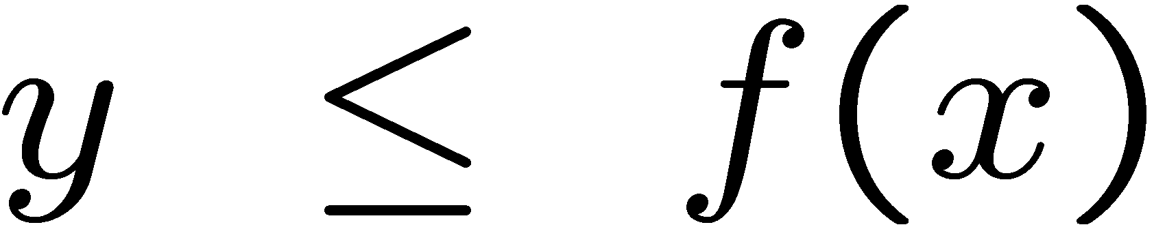

Rejection Sampling
Sampling from arbitrary distributions
Algorithm sample_distribution(f,b):
repeat
until ( )
return

Slide 23
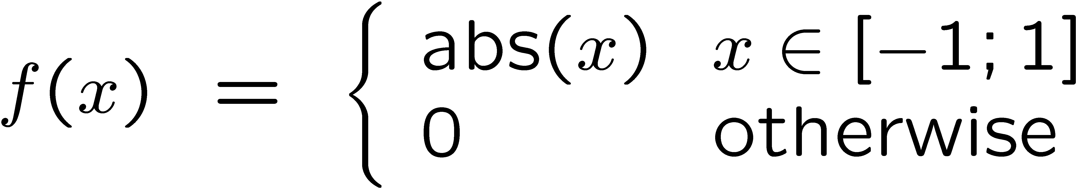
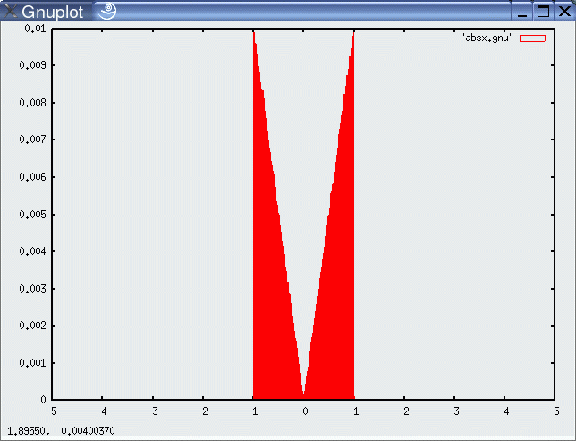
Example
Sampling from

Slide 24







Sample Odometry Motion Model
Algorithm sample_motion_model(u, x):
Return
sample_normal_distribution

Slide 25
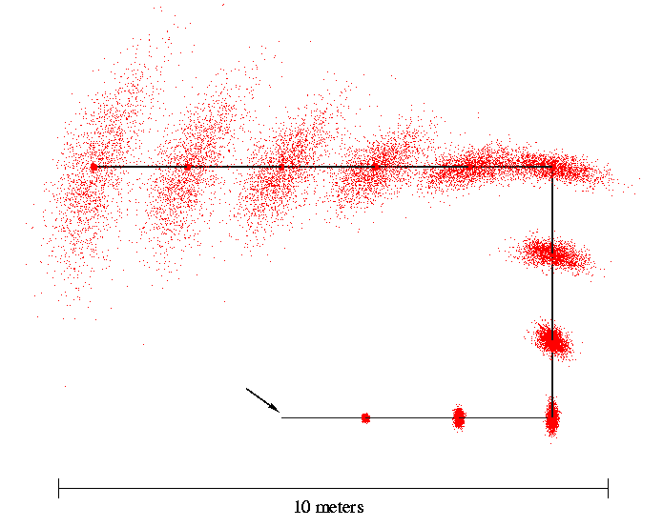
Sampling from Our Motion Model
Start

Slide 26
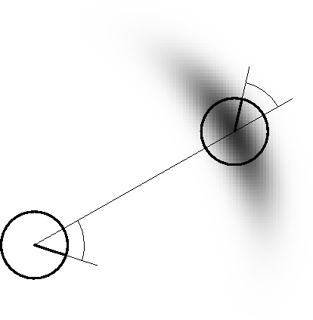
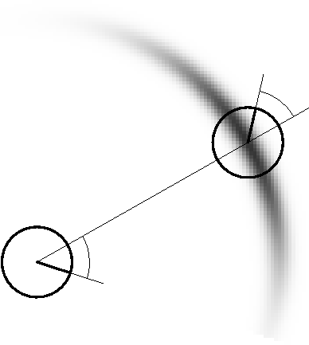
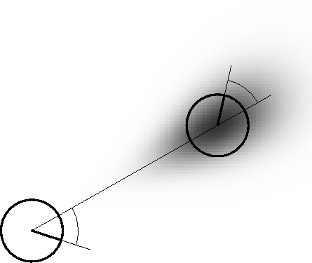
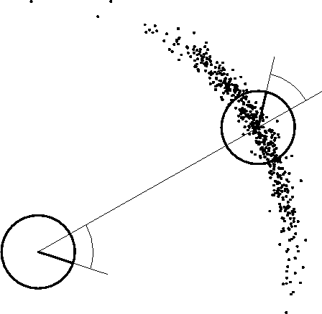
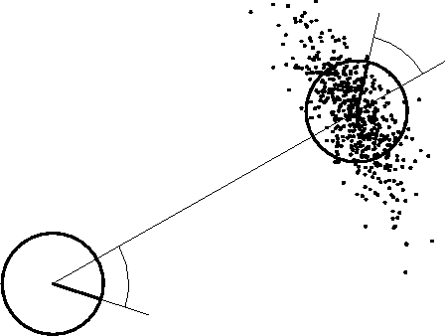

Examples (Odometry-Based)

Slide 27

Velocity-Based Model

Slide 28


Equation for the Velocity Model
Center of circle:
with

Slide 29

Posterior Probability for Velocity Model

Slide 30

Sampling from Velocity Model

Slide 31






Examples (velocity based)

Slide 32




Map-Consistent Motion Model
≠
Approximation:

Slide 33
Summary
We discussed motion models for odometry-based and velocity-based systems
We discussed ways to calculate the posterior probability p(x| x’, u).
We also described how to sample from p(x| x’, u).
Typically the calculations are done in fixed time intervals Δt.
In practice, the parameters of the models have to be learned.
We also discussed an extended motion model that takes the map into account.

