Slide 1
ECE387: INTRODUCTION TO ROBOTIC SYSTEMS
“What is a robot?”
Class webpage: https://marsuniversity.github.io/ece387/
Book mark it NOW!!!!

Slide 2
Definitions
Robot: a device that automatically performs complicated often repetitive tasks
Cyborg: a person whose body contains mechanical or electrical devices and whose abilities are greater than the abilities of normal humans (bionic human)
Android: a mobile robot usually with a human form

Slide 3
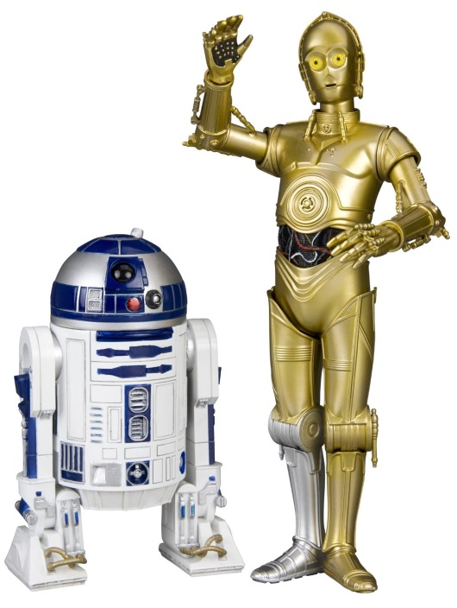
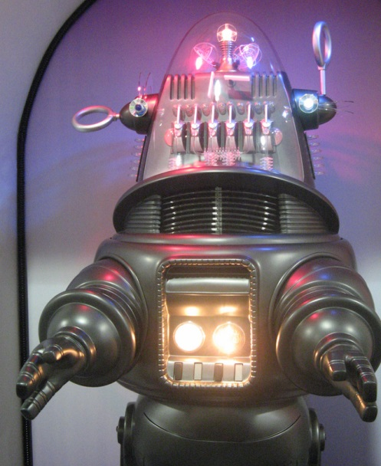
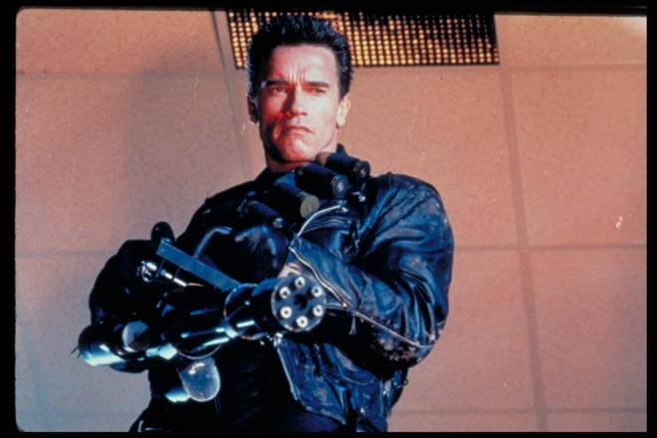
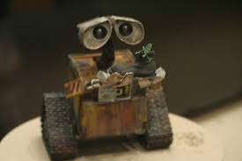
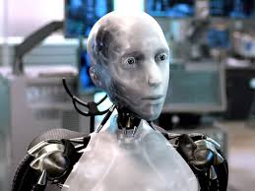
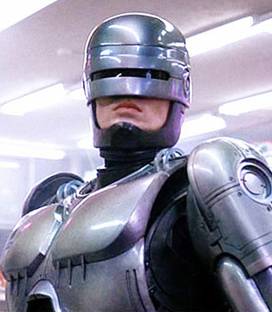
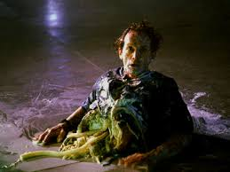
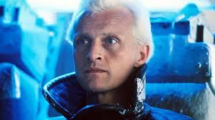
Hollywood’s View

Slide 4
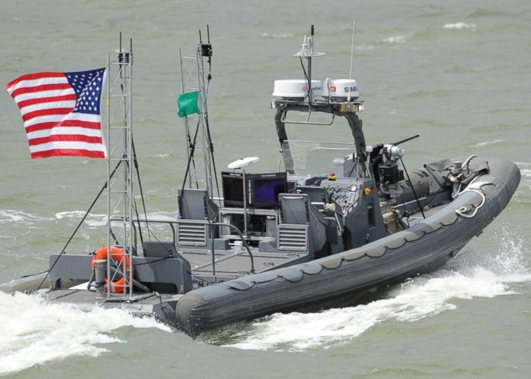
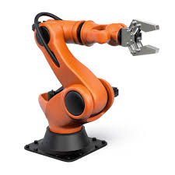
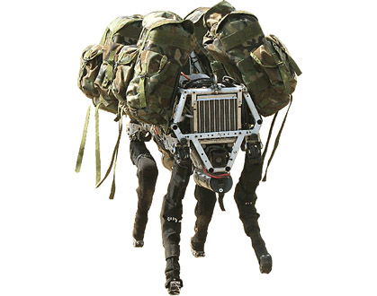
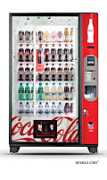
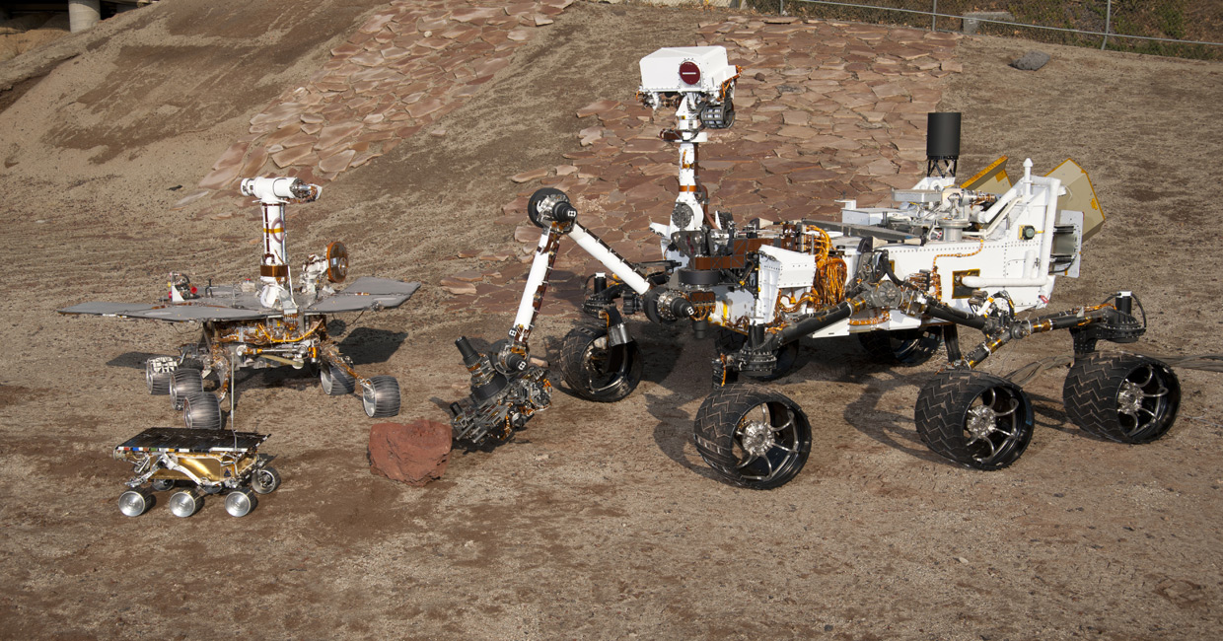
?
Navy ONR: swarm boats
Boston Dynamics: Mule
Spirit
Opportunity
Curiosity
Sojourner
JPL: Mars rovers

Slide 5
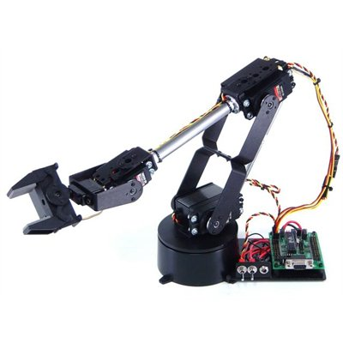
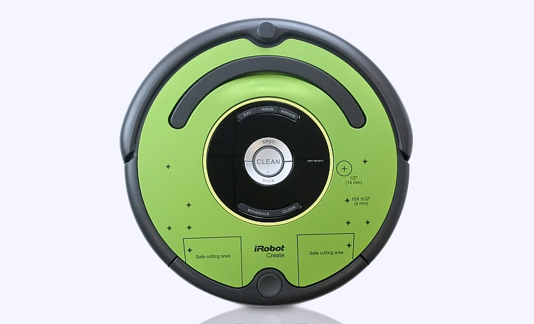
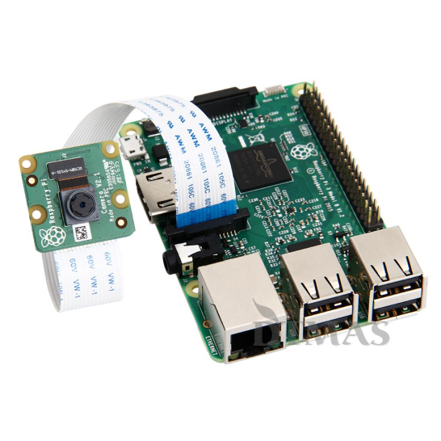
Course Content
Basics:
Linux
Python
Robot Arms:
Forward/inverse kinematics
Vision Systems:
Camera systems
Image processing
Computer vision
Mobile Robots:
Mobile robot systems
Sensors
Control and planning
I will NOT cover all of the material, you need to read the lessons and make sure you understand

Slide 6
What are you going to do?
2 GR’s and 4 Quizzes
5 Labs (Arm, Vision, and Roomba)
1 Final Project
Homework (HW) supports labs
Group work: labs
You need to be here for labs, no make-ups
Individual work: HW and GRs/Quizzes
No help, except for instructor’s help

Slide 7
Expectations
We will cover a lot of material and move fast
Keep up!
Since this is an undergrad class and an introduction class, we will not learn a lot of the details behind things.
I expect you to know how things go together and how to use the tools
I do not expect you to be able to derive algorithms from first principles
Kinematics will be the only place where you need to understand the lower level math to move the robot arm
Wait until grad school to learn how to derive these yourself
Lots of programming!!!
Every quiz/GR will have python/linux material on it
Answer the questions and do the exercises for every reading, those are good examples of test questions

Slide 8
Movies
Darpa Robot Challenge
Darpa Robot Fails
Walking Robot

