Slide 1
ECE387: INTRODUCTION TO ROBOTIC SYSTEMS
“What is a robot?”

Slide 2
Definitions
Robot: a device that automatically performs complicated often repetitive tasks
Cyborg: a person whose body contains mechanical or electrical devices and whose abilities are greater than the abilities of normal humans (bionic human)
Android: a mobile robot usually with a human form

Slide 3
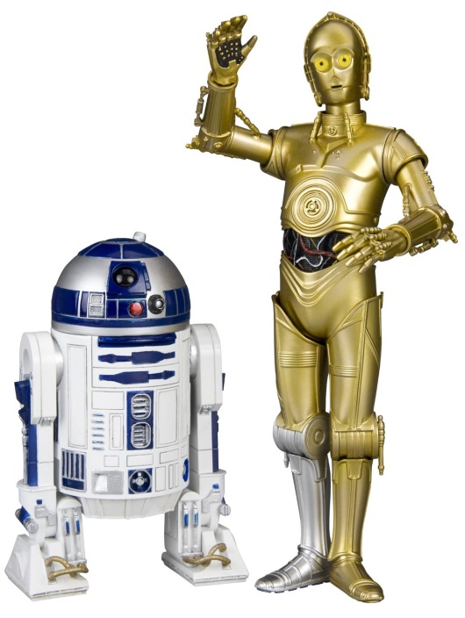
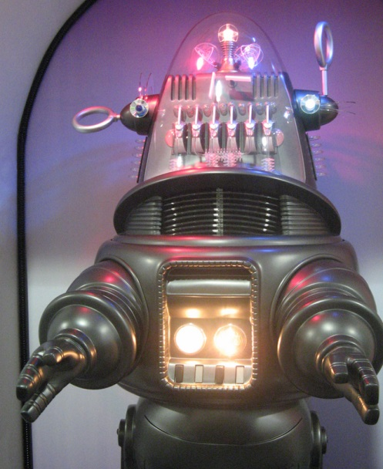
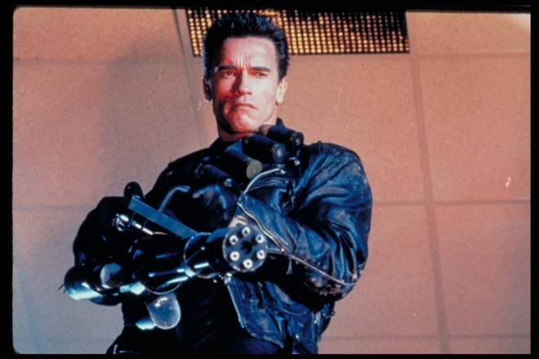
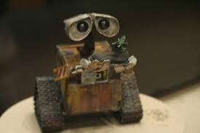
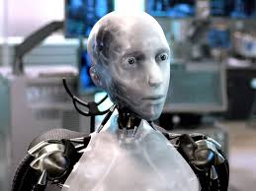
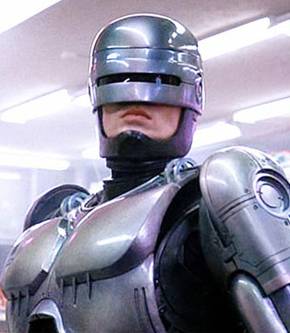
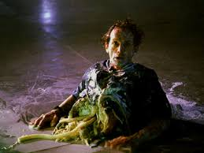
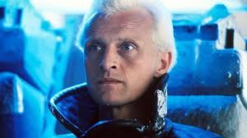
Hollywood’s View

Slide 4
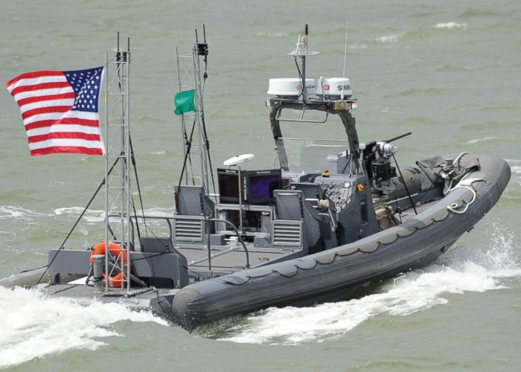
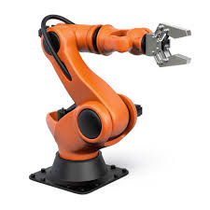
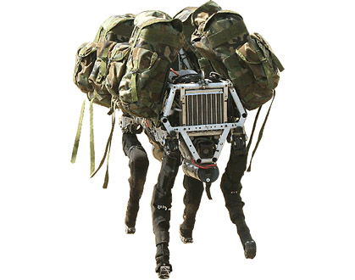
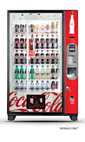
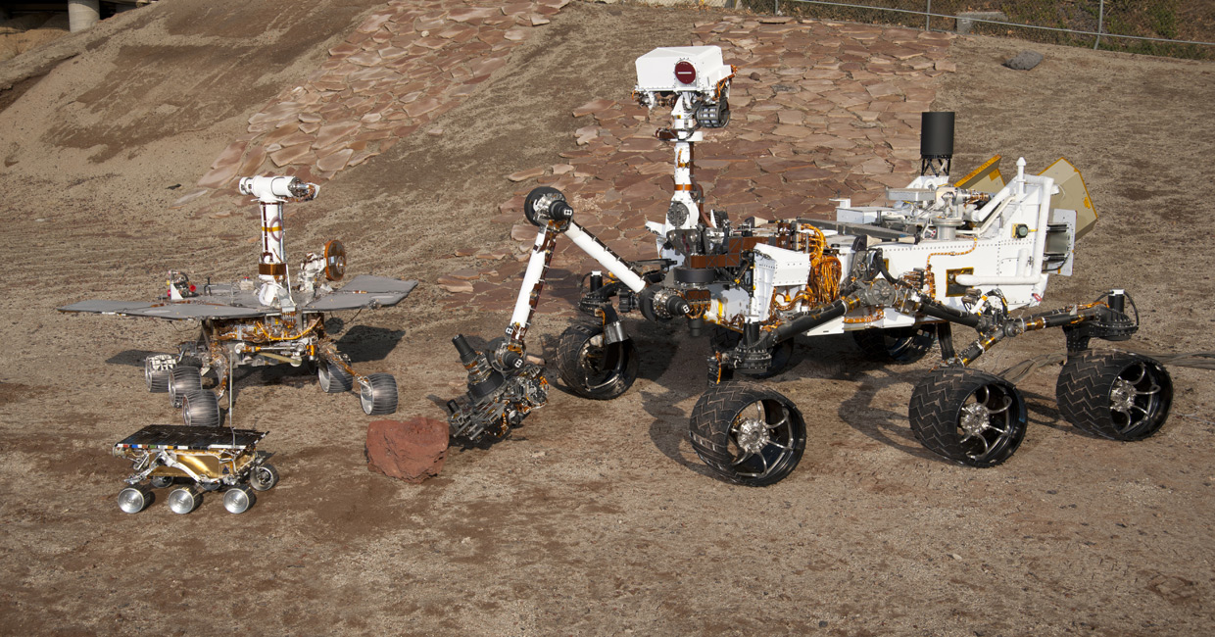
?
Navy ONR: swarm boats
Boston Dynamics: Mule
Spirit
Opportunity
Curiosity
Sojourner
JPL: Mars rovers

Slide 5
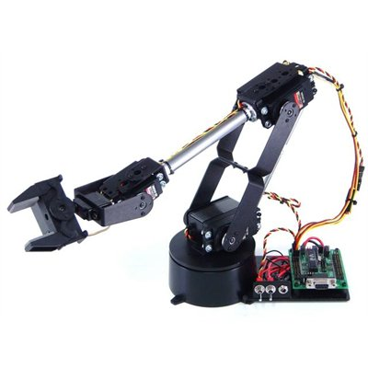
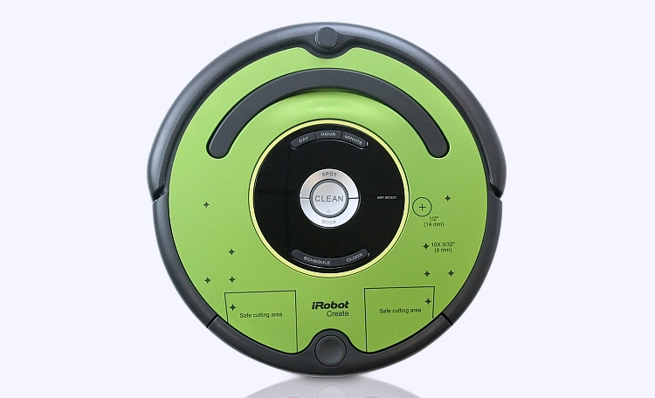
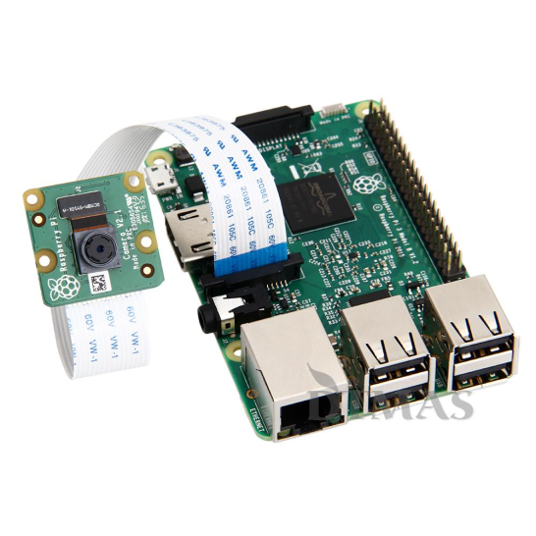
Course Content
Basics:
Linux
Python
Robot Arms:
Forward/inverse kinematics
Vision Systems:
Camera systems
Image processing
Computer vision
Mobile Robots:
Mobile robot systems
Sensors
Control and planning

Slide 6
What are you going to do?
2 GR’s
5 Labs (Arm, Vision, and Roomba)
1 Final Project
Homework (HW) supports labs
Group work: labs
You need to be here for labs, no make-ups
Individual work: HW and GRs
No help, except for instructor’s help

Slide 7
Movies
Darpa Robot Challenge
Darpa Robot Fails
Walking Robot

