Slide 1
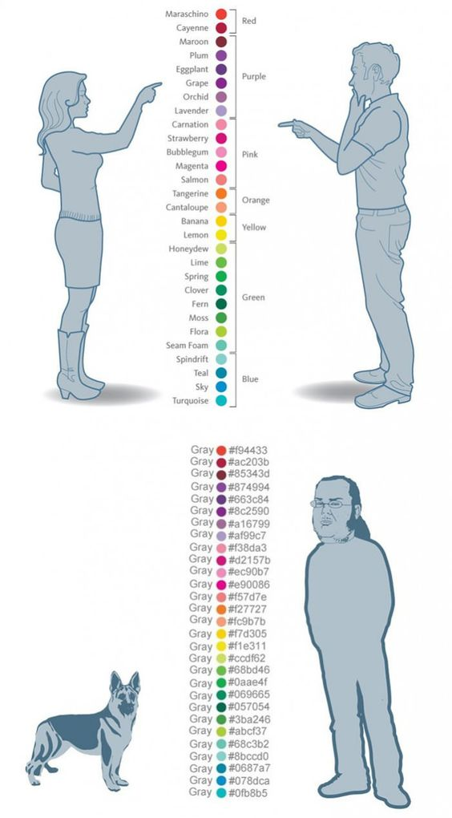
Men vs Women

Slide 2
Dogs vs Programmers

