Slide 1
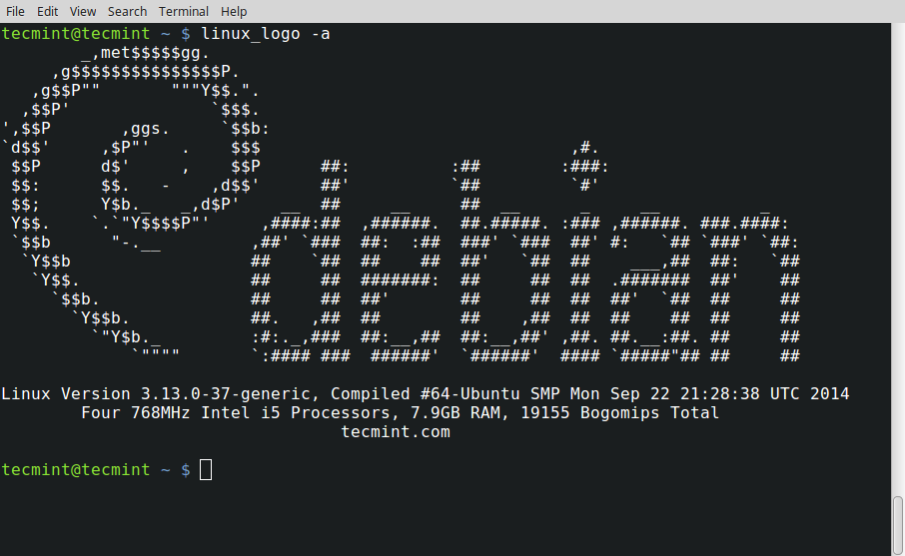



Slide 2
Overview
The expectation is you will do the codeacademy.com “learn the command line” training and get familiar with the Linux/Unix tools
Don’t forget to do the HW and turn in the screenshot next class
Today we will brush over them so your HW will go quicker!

Slide 3

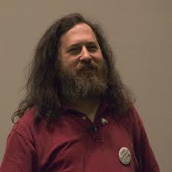
What is Linux? Linux + GNU Utilities = Free Unix
GNU utilities are a small set of programs written by Richard Stallman and others. They make the kernel work. http://www.gnu.org/
Linux is an O/S kernel written by Linus Torvalds and others
Notes:
Richard Stallman source: http://www.stuffyouwillhate.com/wp-content/uploads/richard-stallman.jpg
Linux Torvalds source: https://netfiles.uiuc.edu/rhasan/linux/Linus_Torvalds.jpg

Slide 4
What is Linux?
Linux is a Unix clone written from scratch by Linus Torvalds with assistance from a loosely-knit team of hackers across the Net.
Unix is a multitasking, multi-user computer operating system originally developed in 1969 by a group of AT&T employees at Bell Labs.
Linux and Unix strive to be POSIX compliant.
64% of the world’s servers run some variant of Unix or Linux.
The Android phone, the Kindle, and a bunch of IoT’s run Linux.
Apple’s macOS is a UNIX and POSIX compliant
Notes:
What is Linux? source: http://www.kernel.org/pub/linux/kernel/README and http://en.wikipedia.org/wiki/Linux and http://en.wikipedia.org/wiki/Unix
POSIX an acronym for "Portable Operating System Interface", is a family of standards specified by the IEEE for maintaining compatibility between operating systems. POSIX defines the application programming interface (API), along with command line shells and utility interfaces, for software compatibility with variants of Unix and other operating systems (source: http://en.wikipedia.org/wiki/POSIX).

Slide 5

Linux Has Many Distributions
We will use Raspbian on a Raspberry Pi 3 … it is based off Debian
Notes:
Logos source: http://www.muylinux.com/wp-content/uploads/2009/04/logos-distros.jpg

Slide 6
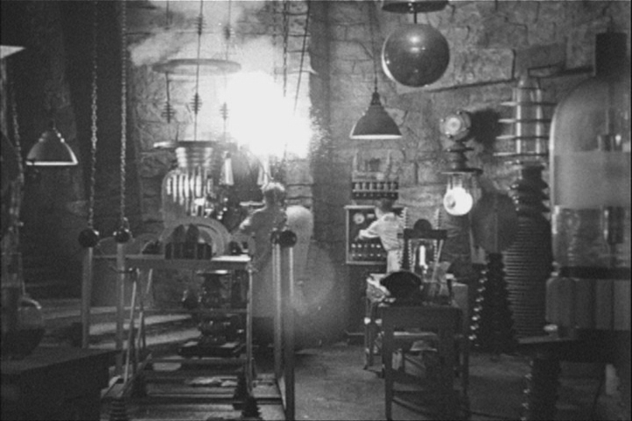

Let the Linux Intro Begin!
Your Instructor Today
The Ideal Lab Facility
Notes:
Lab image source: http://www.sidekickcomicsuk.com/blogs/media/blogs/sidekick//frankenstein_lab.jpg
Frankenstein image source: http://4.bp.blogspot.com/_OcNNOGpvVSI/RyZDUhUpE2I/AAAAAAAAAEU/e-i67sz7_8U/s1600/2007_7young-frankenstein.jpg

Slide 7
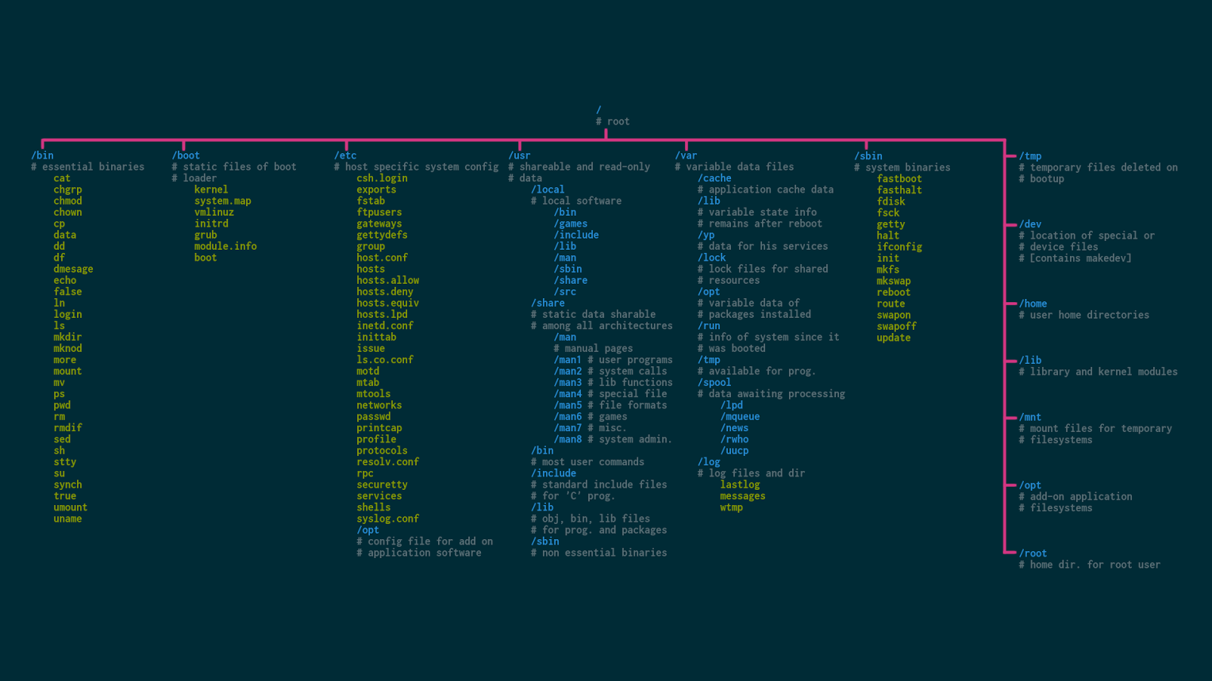
Linux File System
/bin – essential binaries
/boot – kernel
/etc – OS config files
/usr – user land binaries
/var – temporary
/home – user home folder
/dev – device drivers
/mnt – mount point
A Typical Linux File System

Slide 8
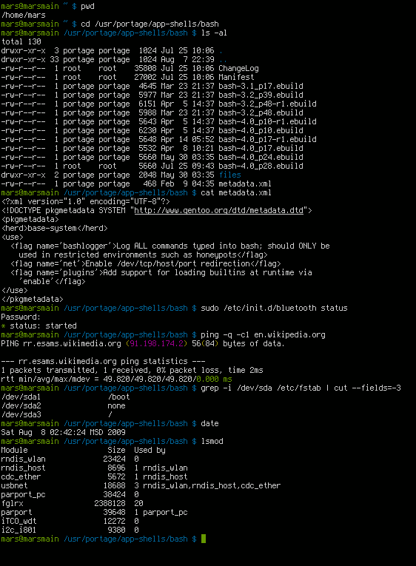

Bash is a Unix shell and command language written by Brian Fox for the GNU Project as a free software replacement for the Bourne shell. First released in 1989, it has been distributed widely as the default login shell for most Linux distributions and Apple's macOS (formerly OS X). A version is also available for Windows 10.
However, since we are on Windows, we will use git-bash to practice. Later, we will use it to login to our Linux robots.

Slide 9
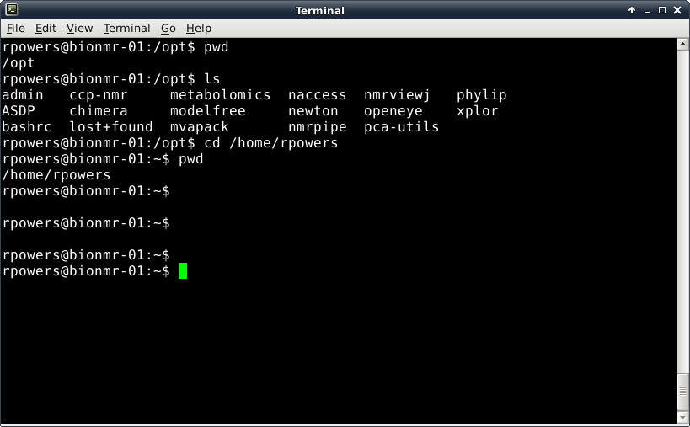
Introduction to Linux/Unix
Three Common Linux Commands: pwd, ls and cd
pwd – identifies the current path or directory
ls – list the files and folders in the current directory
cd path - move to the defined path (change directory)
cd .. (move up one directory),
cd ../.. ( move up two directories)
Go ahead and open up gitbash and follow along … after this lesson I will consider you an expert!

Slide 10
Introduction to Linux/Unix
For a Complete List of Linux Commands and Explanations see
http://linuxcommand.org/
Some Other Common Commands
pwd – display the current path (or where are you in the file system?)
exit – close a terminal
clear – clear all text in a terminal
nano [file] – open a simple text editor
mkdir file - make a new directory
rm file - remove/delete file
mv file - moves files or renames them: mv old_name.txt new_name.txt
cp file - copies files
ps – lists all active user programs and display a PID (process identification number)
kill pid - will kill (stop) the process with the listed pid number
man command - will display the manual for the listed command
cat file – display the contents of a file (also used to combine or concatenate multiple files)
chown usr:grp file – changes the owner of a file
chmod file flags – will change or set permissions for file defined by flags
touch file – create an empty file or update the access of an existing file

Slide 11
Introduction to Linux/Unix
It Gets More Complicated!
A number of commands have a range of options that are implemented on the command line with a “flag”
ls –l - lists files and folders with associated permissions
ls –alh – list all files (including hidden) with permissions and make file size human readable
cp –u – only overwrite an older file with the same name
chmod a+x file – allow anyone to execute file
chmod 755 file – change file’s permission such that file's owner may read, write, and execute the file. All others may only read and execute the file.
chown pi:pi -R /my_folder – change user/grp to pi and do it recursively for the following folder
Multiple flags can be used simultaneously
Again, man pages, Linux web site and reference books provide more details

Slide 12
DANGER
rm –Rf is very powerful … you can wipe out all of your work and the operating system if used incorrectly!
I suggest NEVER deleting anything and if you do, just use rm. The recursive and force can be vary dangerous … you have been warned.
DANGER

Slide 13
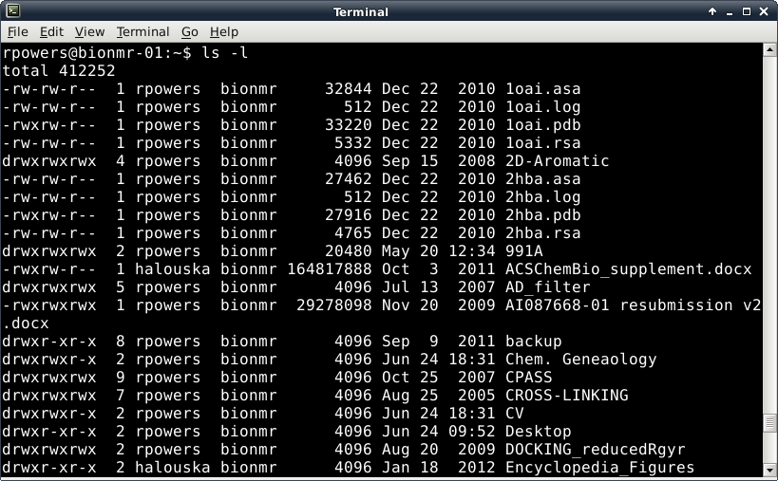
Permissions
You can’t read, write, edit or execute a file without permission!
Size of file in bytes
Directory
File Owner
Filename
Number of files in Directory
Group Owner belongs to
File Date or Time Stamp

Slide 14
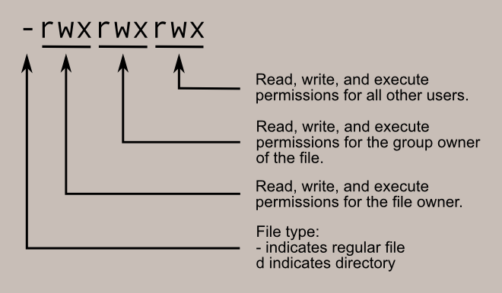
Permissions
Reading and understanding permissions
Usr Grp Other
Permissions

Slide 15
Permissions
chmod 755 bob.json
Where did the 755 come from in the chmod command?
Think of the permission settings as a series of bits :
rwx rwx rwx = 111 111 111 = 777
rw- rw- rw- = 110 110 110 = 666
rwx --- --- = 111 000 000 = 700
and so on...
rwx = 111 in binary = 7
rw- = 110 in binary = 6
r-x = 101 in binary = 5
r-- = 100 in binary = 4
-xx = 011 in binary = 3
-x- = 010 in binary = 2
--x = 001 in binary = 1
--- = 000 in binary = 0
Usr Grp Other
Binary!

Slide 16
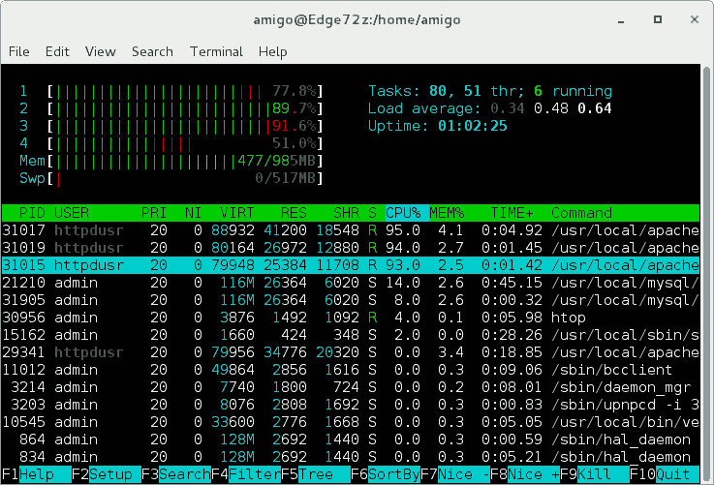
htop (only on linux)
ps and top are nice, but htop is better

Slide 17
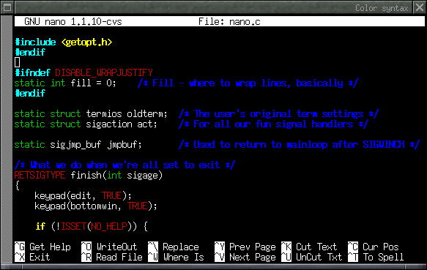
nano (or pico)
If you love vi, it is there too

Slide 18
Hands On/Demo
Refer to the cheat sheet on the webpage for help with these commands (or these slides)
Try:
Change into your home directory (if not already there) with cd ~
Make a directory called your_name and change into that directory
Create a file with touch called test.py
Edit it with pico and type:
#!/usr/bin/env python
print ‘hello world’
Make test.py executable with chmod a+x test.py
Now run test.py by doing: ./test.py

Slide 19

Extra Time?
Python package manager: pip
pip list shows everything installed
pip list --outdated shows libraries that aren’t current
Ignore the DEPRECATION warning, I am too lazy to get rid of it
Also, all of my libraries are up to date, so nothing is listed
pip search <package_name> helps you find things, but seriously, I just go to the web interface: https://pypi.python.org/pypi
pip install <package_name> installs new library
pip install -U <package_name> updates an old library

Slide 20
Backups

Slide 21
Pipes and Redirection
| (pipe) - passes output of one Linux command to the input of a second command
Example: ls | wc (wc – counts the number of characters, words and lines)
Not limited to just one pipe, can string multiple pipes together
>, < - redirection of files
command > filename – output of command (or program) is sent to a file called filename instead of being displayed on the screen
Example: ls > file_list
command < filename – the file filename is the input to the command or program
Example: xplor < psf.inp

Slide 22
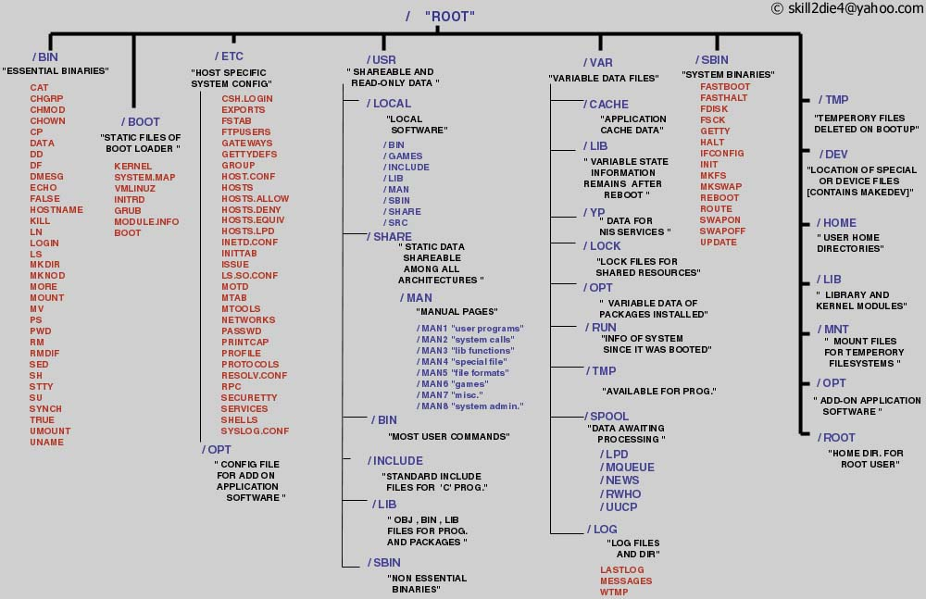
The Linux File System
/bin – binaries
/etc – config files
/boot – ramdisk
/usr – userland binaries
/var – temporary
/home – user home folder
/dev – device drivers
/mnt – mount point
A Typical Linux File System
Notes:
Source: http://www.tuxmachines.org/images/linux_file_structure.jpg

