Slide 1
Image Recognition: The Theory
Student: Milana Prodanov 12/12/2015
Advisor: Professor Veljko Milutinović

Slide 2
Discription of the Algorithm Used
Selection of images for training and test
Training of the model with a large enough training set (60000)
Testing the model with the test images (10000)
The above setting does correct recognition in about 91% of the cases chosen here

Slide 3

Training and Test Images Used
Each image contains a single digit
Each image is of the size 28*28 pixels
Each digit is described with only one parameter: The intensity
In the general case: Intensity related calculations are based on the standard RGB, using the conversion into the CIE XYZ model, with only the Y component extracted
In the specific case of this app: There was no need for the extraction of the Y component, since it was already extracted in the training and test sets used (the inherent characteristic of the MNIST base utilized)
Digit intensity is represented with eight bits, ranging from white (0), over the entire gray range, tillI black(255)
Each image has a label attached; labels in the example below are 5, 0, 4, 1

Slide 4


Algorithm phases
The used algorithm implies two basic phases:
Training
Validation

Slide 5
Training of the Model (1/4): The Cross Entropy
The first step: Defining the accuracy of the model
An alternative issue is the inaccuracy/cost of the model
The inaccuracy/cost of the model is measured by the Cross Entropy
Introduced for data compression (Huffman code); Used in machine learning (in a wide plethora of applications from quantum physics, all the way till popular gambling)
The generalized formula:
y is the predicted probably distribution of the model used; y‘ is the actual probability distribution, which is the training target
The goal is to create the minimal reasonable difference between y and y‘ in order to achieve the minimal cost of the Cross Entropy
The end result of the training process are parameters of the output y (they form a distribution)
Generation and tuning of the parameters to create the output y is the goal of the steps to follow

Slide 6
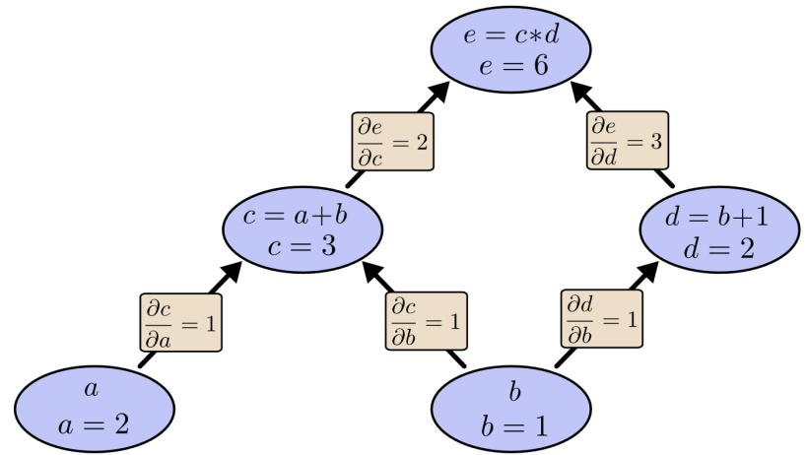
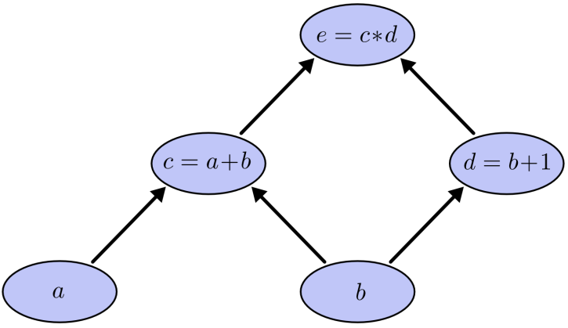
Training of the Model (2/4): The Backpropagation
Distribution y is the only output of the computation graph
Parameters are generated using the backpropagation algorithm (an alternative is the forward propagation algorithm, which is considered the less effective)
An example of a computation graph:
(a + b)*(b + 1) (picture 1)
contribution of each input given the values a = 2 and b = 1 (picture 2)

Slide 7
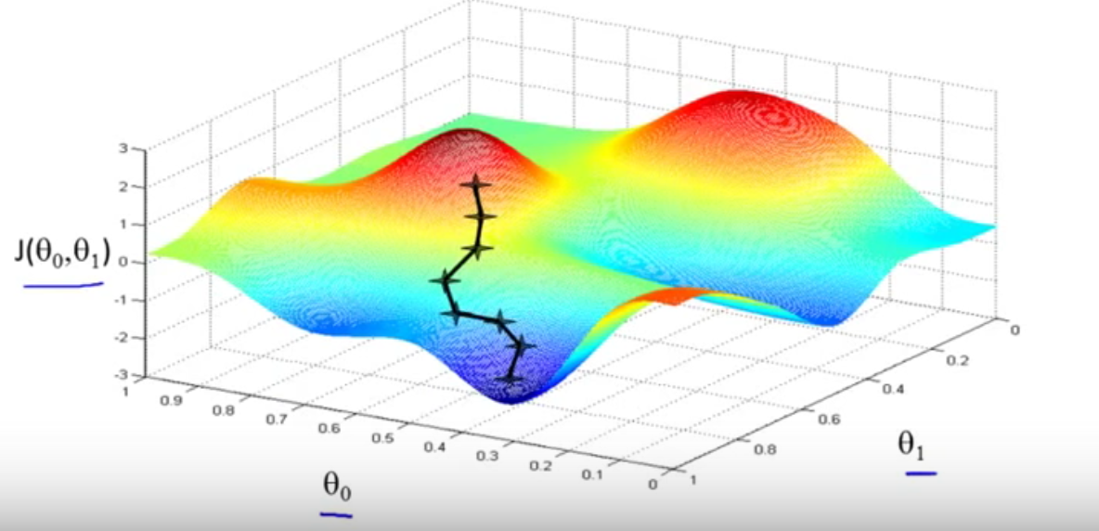
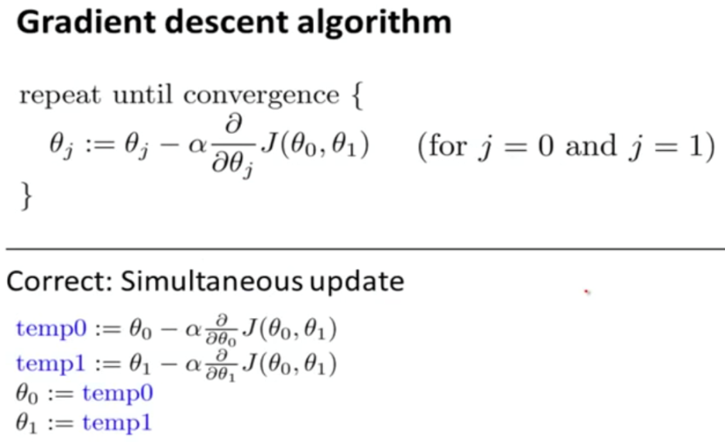
Training of the Model (3/4): The Gradient Descent
The third step is tuning of the parameters (this minimizes the cross entropy); this is done using the gradient descent algorithm
In other words, the gradient descent algorithm searches for the local minimum, step by step, using the steepest direction of multidimensional function

Slide 8
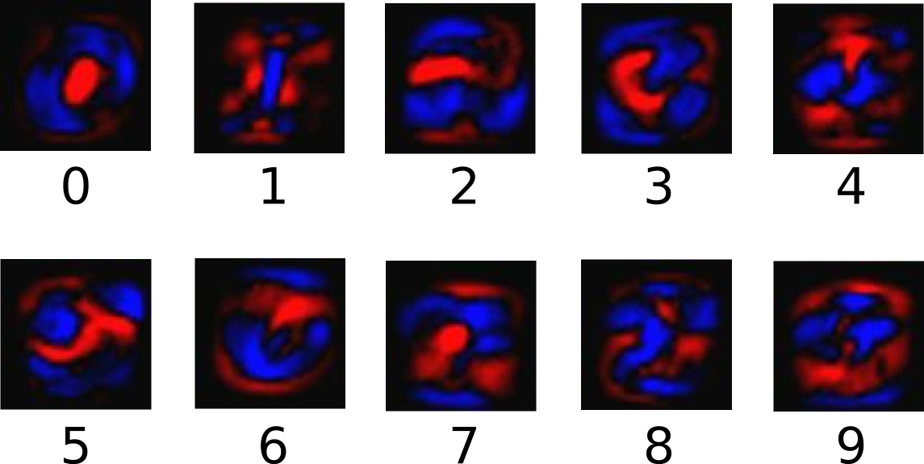
Training of the Model (4/4): The Training Outcome
Results of the training include:
Weights
Blue pixels represent positive weights: the more of those, the higher the likelihood that the image belongs to a given class
Red pixels represent negative weights: the more of those, the lower the likelihood that the image belongs to a given class
Biases

Slide 9
Validation on the Model (1/4): The Process Phases
Steps in determing the class of a test picture
Calculating the weighted sum of pixel intensities
Applying softmax regresion in order to convert weighted sums into probabilities
Classification by choosing the greatest probability

Slide 10
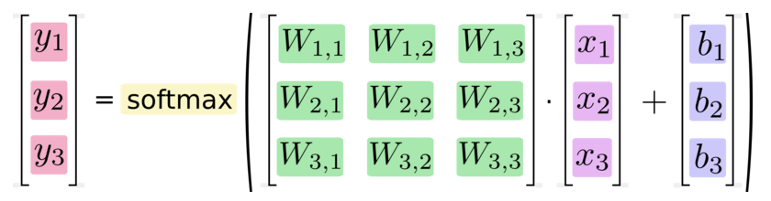
Validation on the Model (2/4): The Process Summary

Slide 11
Validation on the Model (3/4): The Weigthed Sum
Hypothesies that test picture x belongs to class i is equal to given equition
j is an index for summing over the pixels of test picture x
b is the bias, or classification tolerance on the given inputs

Slide 12
Validation on the Model (4/4): The Softmax Regression
Softmax regression is used when an object has more then 2 hypothesis, which is the case here
Softmax regression turns hypothesies into values ranging [0, 1]; in other words, hypothesies turn into probabilties

Slide 13
Results: Speed DFE vs CPU
The chart below describes validation speed differences between DFE and CPU, as the number of input data increases

Slide 14
About Possible Applications of the Algorithm
Examples of applications of the algorithm as part of computer vision include systems for:
Controlling processes, e.g., an industrial robot
Navigation, e.g., by an autonomous vehicle or mobile robot
Detecting events, e.g., for visual surveillance or people counting
Organizing information, e.g., for indexing databases of images and image sequences
Modeling objects or environments, e.g., medical image analysis
Interaction, e.g., as the input to a device for computer-human interaction
Automatic inspection, e.g., in manufacturing applications

Slide 15
References
The MNIST Data
http://yann.lecun.com/exdb/mnist/
The Cross Entropy
http://colah.github.io/posts/2015-09-Visual-Information/
The Backpropagation
http://colah.github.io/posts/2015-08-Backprop/
The Gradient Descent
https://www.youtube.com/watch?v=ZgXjKa0ChDw
Understanding the Color Models
https://en.wikipedia.org/wiki/Grayscale
Computer Vision
https://en.wikipedia.org/wiki/Computer_vision
The TensorFlow Theory
https://www.tensorflow.org/versions/master/tutorials/mnist/beginners/index.html
The Maxeler Tutorials
http://home.etf.rs/~vm/os/vlsi/razno/maxcompiler-tutorial%20(3).pdf
AccelerationTutorial Loops and Pipelining

