Slide 1
Image Recognition: A Hybrid CPU/DFE Implementation
Student: Milana Prodanov 12/12/2015
Advisor: Professor Veljko Milutinovic

Slide 2
TensorFlow Library
TensorFlow™ is an open source software library for numerical computation using data flow graphs
Nodes in the graph represent mathematical operations, while the graph edges represent the multidimensional data arrays (tensors) communicated between them
The flexible architecture allows one to deploy computation to one or more CPUs or GPUs in a desktop, server, or mobile device, with a single API

Slide 3
Tensors in Mathematics
Tensors are mathematical objects that can be used to describe physical properties, just like scalars and vectors
Tensors are a generalization of scalars and vectors; a scalar is the zero rank tensor, and a vector is the first rank tensor
The rank (or order) of a tensor is defined by the number of directions (and hence the dimensionality of the array) required to describe it
For example: Properties that require one direction (first rank) can be fully described by a 3×1 column vector, and properties that require two directions (second rank) can be described by 9 numbers, as a 3×3 matrix; as such, in general, an n^{th} rank tensor can be described by 3^{n} coefficients.

Slide 4

Hybrid: Computing Host + Accelerator

Slide 5


Intel Core
Intel Core is Intel's brand name for various mid-range to high-end home and business microprocessors
Identical or more capable versions of Core processors are also sold as Xeon processors for the server and workstation market
Intel Core processor used here:
i7-4850HQ
6MB Cache
2.3GHz Base Frequency
3.3GHz Max Turbo Frequency

Slide 6
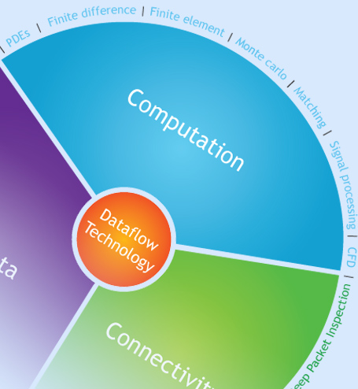
Maxeler DFE
Maxeler is a dataflow engine designed and manufactured by Maxeler Corporation targeted at solving intense computational problems at high speed
In order for Maxeler code to run, two units are needed
CPU for sending and receiving data
FPGA chip for computation

Slide 7

The hybrid approach: TensorFlow on CPU for training Weighted sums on DFE for validation
The details of the DFE implementation are described next.

Slide 8
Model Validation (1/7): Implementation steps
DFE performs calculation of weighted sums which is based on matrix multiplication
The first matrix contains pixels of all test pictures
Each row corresponds to one test picture
The second matrix contains weights of all classes
Each row corresponds to one class; classes are 0,1,…,9, respectively
CPU performs Softmax regression over DFE outputs

Slide 9
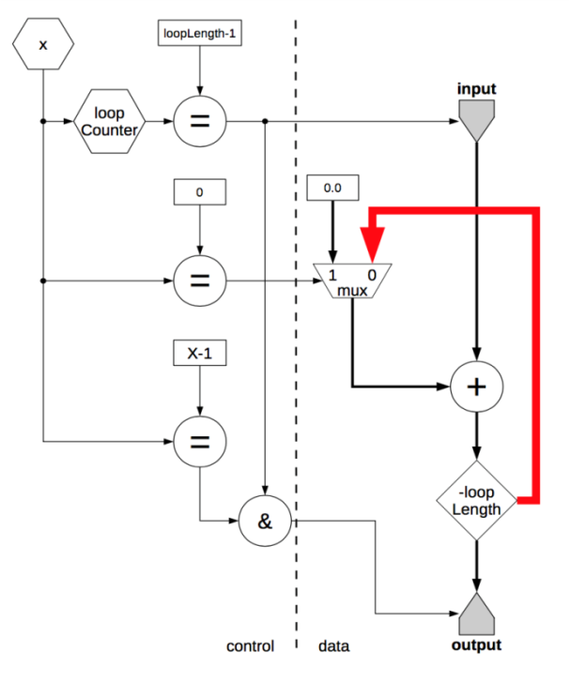
Model Validation(2/7): DFE Problem
Weighted sum performed in DFE encounters a performance issue since the current sum is dependant on results in the previous iteration
This produces a need to stall DFE Kernel for about 13 ticks, which is necessary for the last sum to pass through the computation pipeline
Solution is to modify the order of input data so that the next sum does not depend on results from the previous iteration (the loop tiling method)
Problem: Cycles in Kernel

Slide 10
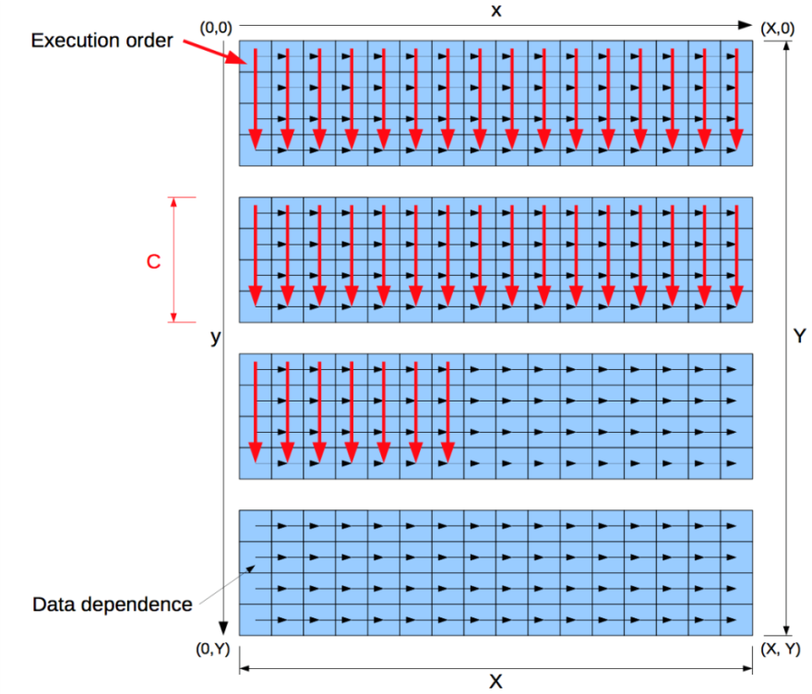
Model Validation (3/7): DFE Solution
Increasing dependency distance by changing the input order
Black arrows show data dependencies
Red arrows show input order
Each input will be sent to Kernel C ticks after its dependant input had been processed, since calculation lasts at least C ticks (C >= 13)
Solution: The Loop Tiling Method

Slide 11
Model Validation (4/7): Kernel Code
// Init parameters
int picSize = X;
int romSize = picSize * REF_NUM;
int addrBits = MathUtils.bitsToAddress(romSize);
DFEVectorType<DFEVar> vectorType = new DFEVectorType<DFEVar>(floatType, REF_NUM);
// Input
DFEVar input = io.input("input", floatType);
CounterChain chain = control.count.makeCounterChain();
DFEVar x = chain.addCounter(X, 1);
// Set up counter for innermost, y loop, except we count 0..C
// instead of yy..yy+C
chain.addCounter(C, 1) // yy
// Fill the rom
Memory<DFEVar> mappedRom = mem.alloc(floatType, romSize);
mappedRom.mapToCPU("mappedRom");
// Loop itself
DFEVector<DFEVar> carriedSum =
vectorType.newInstance(this);
DFEVector<DFEVar> sum =
vectorType.newInstance(this);
DFEVector<DFEVar> newSum =
vectorType.newInstance(this);
// Address for accessing rom
DFEVar addr = x.cast(dfeUInt(addrBits));
for(int i=0; i < REF_NUM; i++) {
DFEVar romOut = mappedRom.read(picSize * i + addr);
sum[i] <== ((x === 0) ? 0.0 : carriedSum[i]);
newSum[i] <== input * romOut + sum[i];
carriedSum[i] <== stream.offset(newSum[i], -C);
}
// We have a controlled output to deliver the sum at the end of each row
io.output("output", newSum, vectorType, x === (X - 1));

Slide 12
Model Validation (5/7): Kernel Code on CPU
void DigitRecognitionCPU(float *input, double *rom, float *output)
{
int count = 0;
for (int yy=0; count < X*Y; yy += C) {
for (int x=0; x<X; x += 1) {
for (int y=yy; y < yy+C; y += 1) {
if (x == 0) {
for(int k=0; k<REF_NUM; k++)
output[y * REF_NUM + k] = 0.0;
}
for(int k=0; k<REF_NUM; k++){
output[y * REF_NUM + k] += input[count] * rom[k * X + x];
}
count++;
}
}
}
printf("DigitRecognitonCPU\n");
}

Slide 13
Model Validation (6/7): Softmax Layer and Final Step
CPU invokes extractResults() on DFE outputs
extractResults() pulls data through Softmax Layer using convertToSoftmax() and classifies test pictures according to the maximum probability calculated
void convertToSoftmax(float* rawOutput);
void extractResult(float* rawInput, int* output)

Slide 14
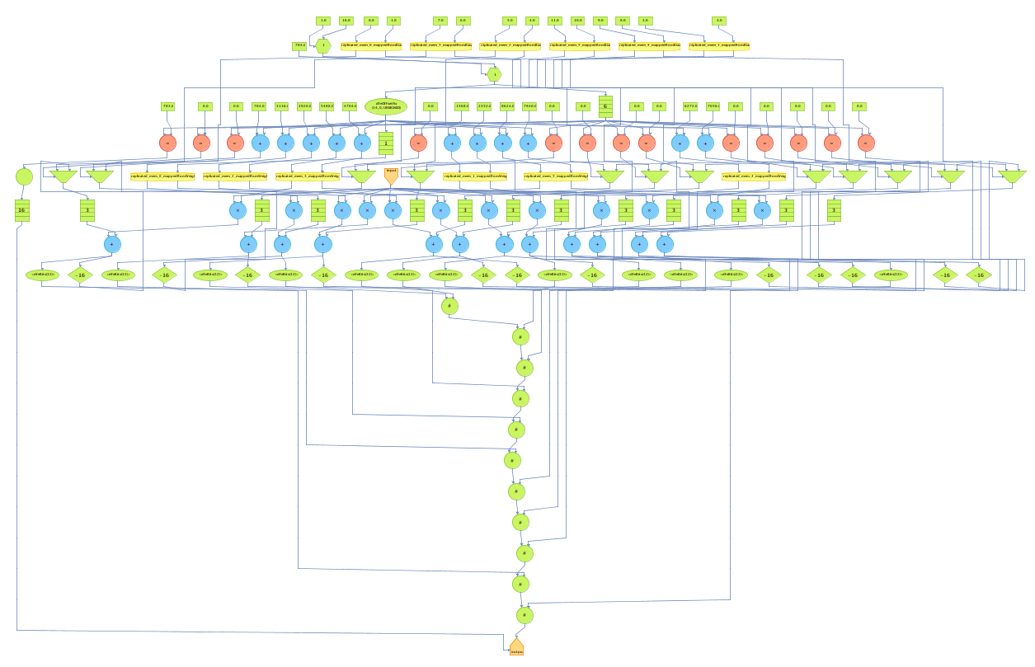
Model Validation (7/7): Final Kernel Graph

Slide 15
References
The TensorFlow Library
https://www.tensorflow.org/versions/master/tutorials/mnist/beginners/index.html
The Tensor Theory
http://www.doitpoms.ac.uk/tlplib/tensors/usage.php
The Maxeler Tutorials
http://home.etf.rs/~vm/os/vlsi/razno/maxcompiler-tutorial%20(3).pdf
AccelerationTutorial Loops and Pipelining

