Slide 1
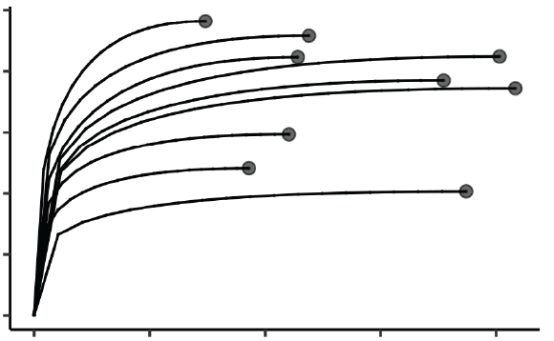
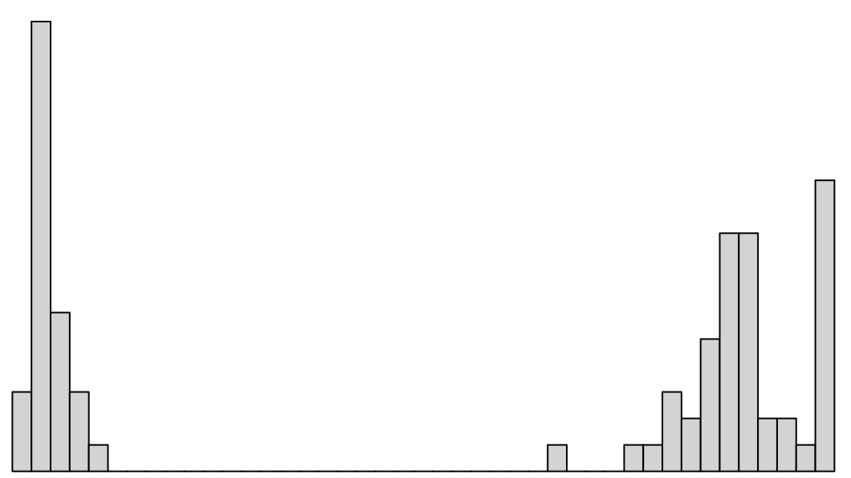
1. Assess sequencing depth |  | Examine distributions of sequencing depth Use rarefaction curves to estimate saturation Remove samples with too few reads (this will be dependent on richness)
2. Rarefy to lowest sample reads (many iterations) | x100 | Repeatedly subsample ASV abundance matrix to an even sequencing depth Use 100-1000 iterations
3. Convert to relative abundance | x100 | Divide the abundance of each ASV by the normalized sequencing depth
4. Convert to absolute abundance | x100 | Multiple the relative abundance of each ASV by the total cell count or 16S copy number of each sample
5. Calculate distance or dissimilarity | x100 | Repeatedly calculate distance or dissimilarity metric across all iterations of rarefied ASV abundance matrices
6. Average distances or dissimilarities |  | Average distance/dissimilarity matrices across all iterations of rarefaction
 | S1 | S2 | S3
ASV1 | 5 | 3 | 9
ASV2 | 2 | 3 | 0
ASV3 | 3 | 4 | 1
 | S1 | S2 | S3
ASV1 | 5 | 3 | 9
ASV2 | 2 | 3 | 0
ASV3 | 3 | 4 | 1
 | S1 | S2 | S3
ASV1 | 5 | 3 | 9
ASV2 | 2 | 3 | 0
ASV3 | 3 | 4 | 1
 | S1 | S2 | S3
ASV1 | 5 | 3 | 9
ASV2 | 2 | 3 | 0
ASV3 | 3 | 4 | 1
 | S1 | S2 | S3
ASV1 | 5 | 3 | 9
ASV2 | 2 | 3 | 0
ASV3 | 3 | 4 | 1
 | S1 | S2 | S3
ASV1 | 0.5 | 0.3 | 0.9
ASV2 | 0.2 | 0.3 | 0.0
ASV3 | 0.3 | 0.4 | 0.1
 | S1 | S2 | S3
ASV1 | 0.5 | 0.3 | 0.9
ASV2 | 0.2 | 0.3 | 0.0
ASV3 | 0.3 | 0.4 | 0.1
 | S1 | S2 | S3
ASV1 | 0.5 | 0.3 | 0.9
ASV2 | 0.2 | 0.3 | 0.0
ASV3 | 0.3 | 0.4 | 0.1
 | S1 | S2 | S3
ASV1 | 5000 | 15000 | 18000
ASV2 | 2000 | 15000 | 0
ASV3 | 3000 | 20000 | 2000
 | S1 | S2
S2 | 5000 | 15000
S3 | 2000 | 15000
 | S1 | S2
S2 | 5000 | 15000
S3 | 2000 | 15000
 | S1 | S2
S2 | 0.5
S3 | 0.3 | 0.4
 | S1 | S2
S2 | 0.5
S3 | 0.3 | 0.4
 | S1 | S2
S2 | 0.5
S3 | 0.3 | 0.4
mean
 | S1 | S2
S2 | 0.5
S3 | 0.3 | 0.4
 | S1 | S2
S2 | 0.49
S3 | 0.32 | 0.45

