Slide 1

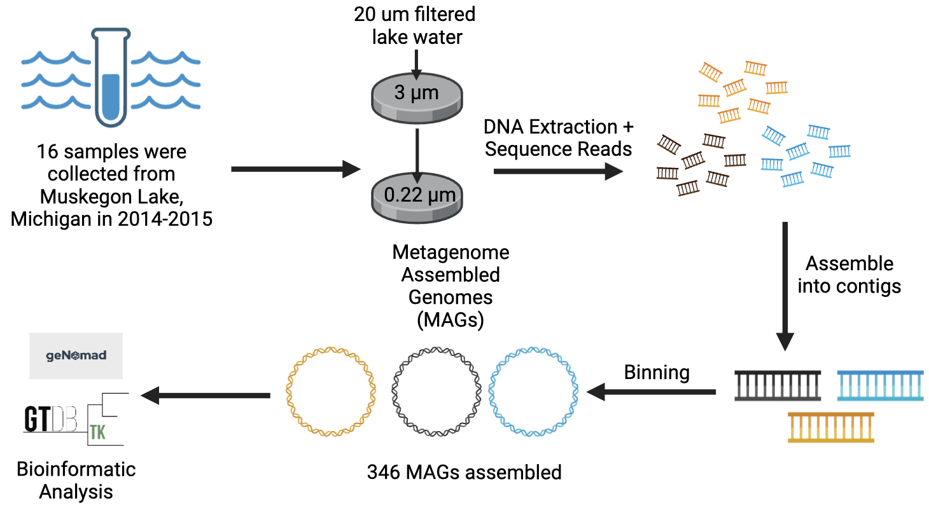
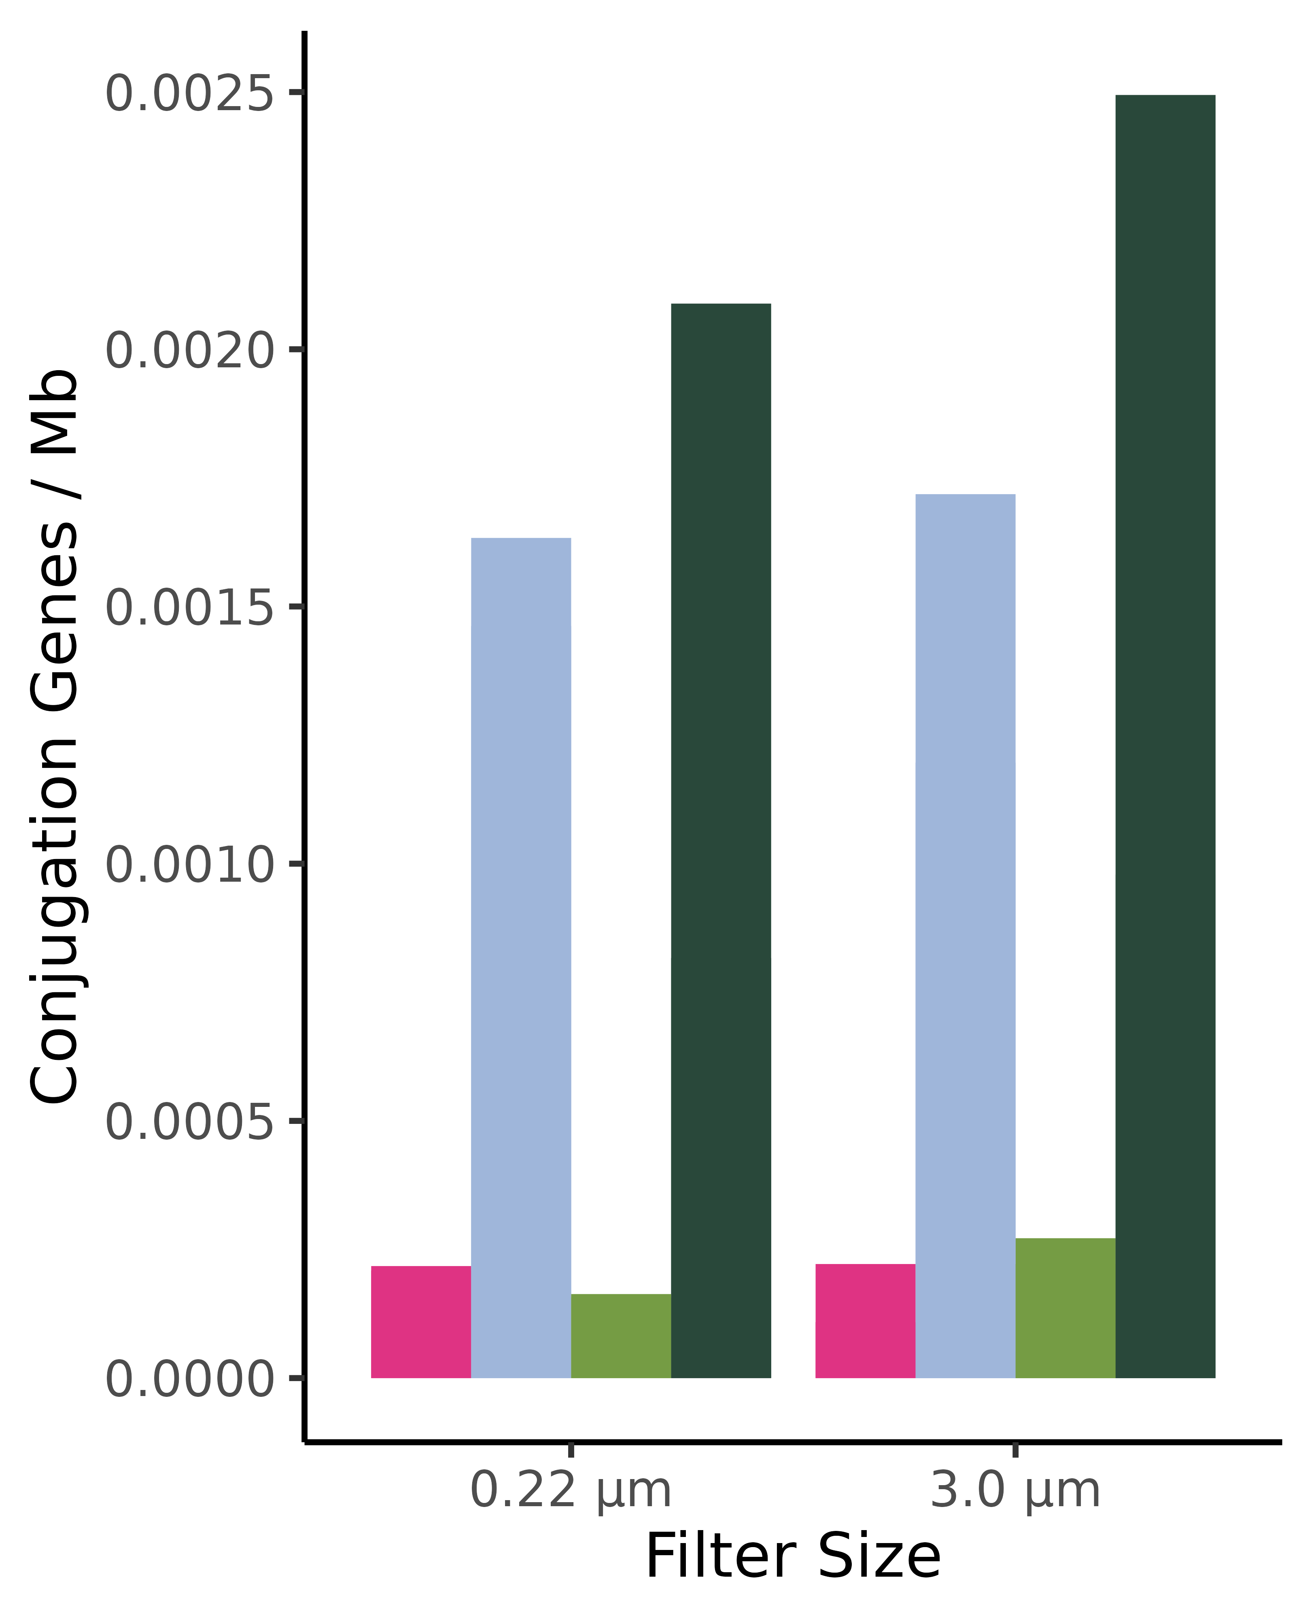
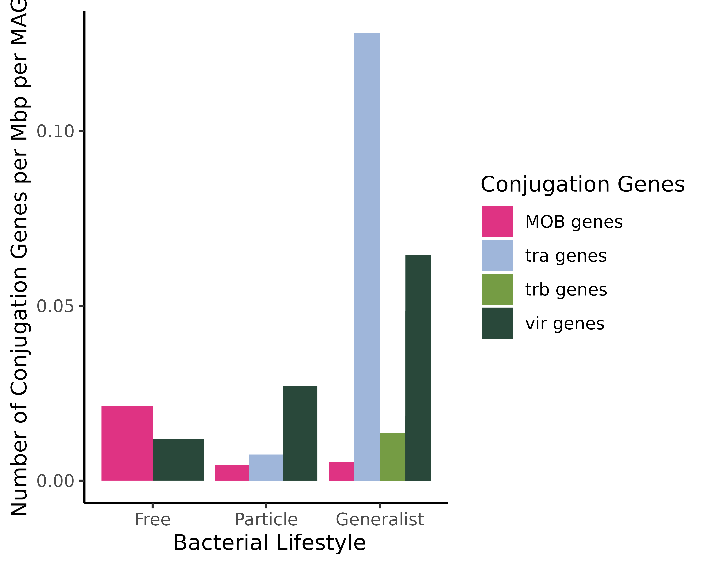
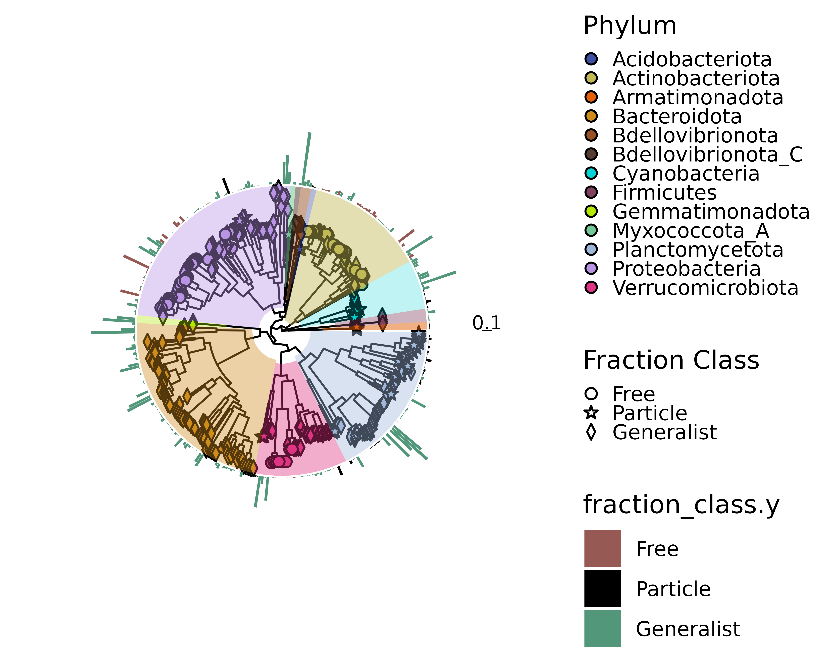
Bacterial Lifestyles Influence Mobile Genetic Elements in Aquatic Ecosystems
Sophia Aredas; Marian Schmidt, Ph.D.
Department of Microbiology, Cornell University, Ithaca, New York 14853
EXPLORING MOBILE GENETIC ELEMENTS IN FRESHWATER BACTERIA
HYPOTHESIS AND
OBJECTIVE
MATERIALS AND
METHODS
Aquatic bacteria have distinct, dynamic lifestyles that can be categorized into three lifestyles: truly free-living (FL), particle-attached (PA), and bacteria that alternate between the two lifestyles (generalists). Particles are hotspots of microbial activity whereas the surrounding water column has less nutrient availability.
Mobile genetic elements (MGEs) such as plasmids and bacteriophages are significant drivers of horizontal gene transfer (HGT) within microbial communities. Yet the role of MGEs in the environment is not well understood, especially within bacterial lifestyles.
If particles serve as hotspots of microbial activity and help to facilitate direct cell-to-cell contact, we hypothesize that PA and generalist microbes have enhanced opportunities to engage in HGT and will have higher rates of MGEs.
Objective:
Analyze both the assembled contigs and 346 MAGs to explore mobile genetic elements between each bacterial lifestyle bioinformatically.
Rough draft of biorender I will make it higher resolution and fit better
I am also going to add more highlight the difference in filtration size and change colors!
Particle Associated
Free living
CONJUGATION GENES DIFFER AT THE
ASSEMBLY AND MAG VIEW
PHAGE-ENCODED GENES ARE UBITQUITOUSLY FOUND ON THE PHYLOGENY TREE
B)
A)
Pagel’s Lambda: 0.242194
(p-value = 0.00922661)
Bloomberg’s K : 0.00182091
(p-value : 0.906907)
(based on 999 randomizations)
Or maybe another title option is how do conjugation genes vary between lifestyle?
I am thinking of a more active title but I just wanted to lay out my poster !! Its really rough but I am still thinking!!
Figure 1:
Number of conjugation genes per Mb found on the filter paper size at the assembly level. Conjugation genes are roughly equally distributed in each fraction.
B) At the MAG level, MOB and vir genes were found in all lifestyles. Tra genes were only found in particle and generalist fractions.
Figure 2: Phage genes have a relatively low phylogenetic signal but much less variable under Brownian Motion due to conservatism in evolution
DISCUSSION
FUTURE DIRECTIONS
ACKNOWLEDGEMENTS
MGEs such as plasmids and phages play important roles in microbial evolution by providing fundamental sources of diversity.
At the assembly level, we find the same distribution of conjugation genes, which facilitates the dissemination of plasmids.
At the MAG level, the generalists have the greatest number of conjugation genes and phage-encoded genes.
No antibiotic resistance genes were found by geNomad.
Conduct further bioinformatic analysis with bakta and MetaMobilePicker to annotate MAGs to find specific antibiotic resistance genes and transposable elements to understand ecology and community dynamics.
Special thanks to Dr. Marian Schmidt, Gus Pendleton, and Sophia Richter
Thank you to BBM for the travel scholarship!
I will word this better but this is the essence!!
REFERENCES
Camargo, Antonio Pedro, Simon Roux, Frederik Schulz, Michal Babinski, Yan Xu, Bin Hu, Patrick S. G. Chain, Stephen Nayfach, and Nikos C. Kyrpides. 2023. “Identification of Mobile Genetic Elements with geNomad.” Nature Biotechnology, September. https://doi.org/10.1038/s41587-023-01953-y.
Haudiquet, Matthieu, Jorge Moura De Sousa, Marie Touchon, and Eduardo P. C. Rocha. 2022. “Selfish, Promiscuous and Sometimes Useful: How Mobile Genetic Elements Drive Horizontal Gene Transfer in Microbial Populations.” Philosophical Transactions of the Royal Society B: Biological Sciences 377 (1861): 20210234. https://doi.org/10.1098/rstb.2021.0234.
Schmidt, Marian L, Bopaiah A Biddanda, Anthony D Weinke, Edna Chiang, Fallon Januska, Ruben Props, and Vincent J Denef. 2020. “Microhabitats Are Associated with Diversity– Productivity Relationships in Freshwater Bacterial Communities.” FEMS Microbiology Ecology 96 (4): fiaa029. https://doi.org/10.1093/femsec/fiaa029.
I will word this better but this is the gist^!!
Notes:
Probably should mention 346

