Slide 1
Relative Risk Regression
A Python Implementation
By David Marsden

Slide 2
Presentation Outline
Statistical Advantages and Methods
Python Implementation
Illustration with External Dataset
Monte Carlo Simulations of Relative Risk Regression

Slide 3
Relative Risk & Odds Ratio
Both measure associations with binary outcomes
Relative risk (RR) is preferred for many epidemiological analyses
But logistic regression is commonly used
Logistic regression estimates the odds ratio (OR)

Slide 4
Why is Relative Risk Better?
Easy to understand
Increase in probability of outcome vs. increase in odds
ORs frequently mis-interpreted as RR (by journalists, the general public and sometimes academics who should know better!)
ORs exaggerate the RR

Slide 5
Relative Risk Regression
Two good statistical methods:
Log-binomial model
Poisson model with empirical variance (aka “robust” or “sandwich”)
Potential problems with the log-binomial method:
May not converge properly
Confidence intervals may be too narrow

Slide 6
Poisson RR Model Details
Generalized Linear Model (GLM)
Log link function
Poisson random component
Empirical variance estimation
Can use software for generalized estimating equations (GEEs)

Slide 7
Poisson RR Model Diagnostics
Can generate predicted probabilities greater than one
Otherwise diagnostics are similar to other GLMs (e.g. outliers)

Slide 8
Software Considerations
RR models can be fit with GEE software
Many researchers are unfamiliar with GEEs and relative risk regression
Convenient software encourages lesser-known statistical methods

Slide 9
Python Implementation
Made a wrapper for the gee function from the statsmodel package
Designed to be easy to use
Prints diagnostic info unique to the Poisson RR model
I.e. regarding observations with predicted probabilities greater than one
Prints RRs and 95% confidence intervals for RR

Slide 10
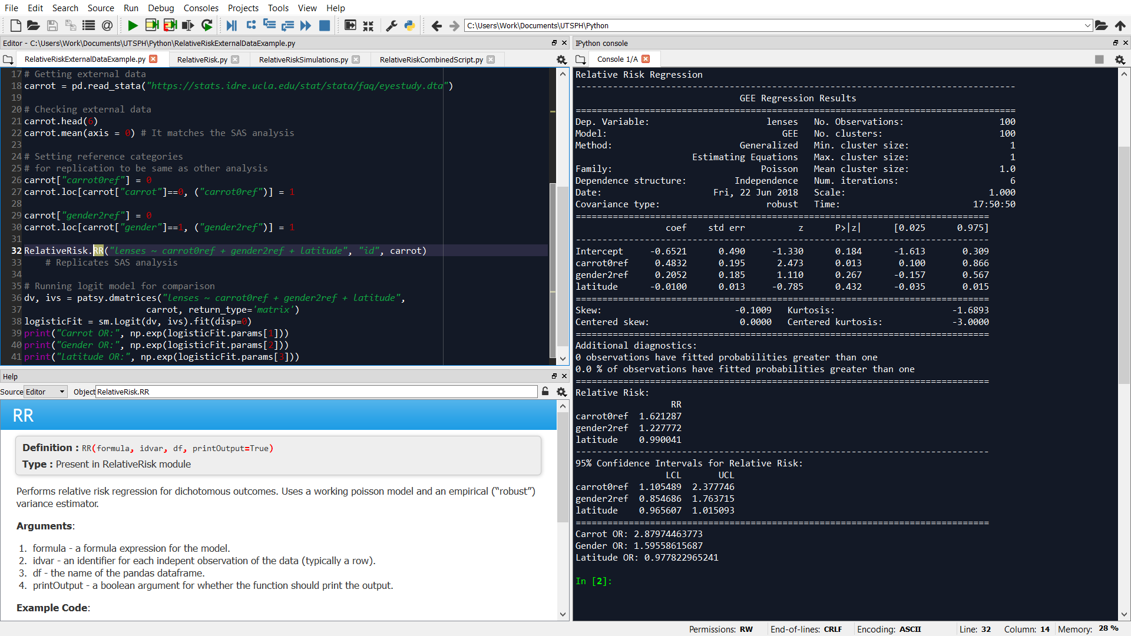
Screenshot

Slide 11
Illustration with Carrot Data
Fictional data set with risk factors for needing glasses
Used to illustrate relative risk regression in SAS and Stata
Successfully replicated this analysis with my python implementation
Example function call:
RelativeRisk.RR("lenses ~ carrot0ref + gender2ref + latitude", "id", carrot)

Slide 12
Sample Output from Carrot Analysis
coef std err z P>|z| [0.025 0.975]
------------------------------------------------------------------------------
Intercept -0.6521 0.490 -1.330 0.184 -1.613 0.309
carrot0ref 0.4832 0.195 2.473 0.013 0.100 0.866
gender2ref 0.2052 0.185 1.110 0.267 -0.157 0.567
latitude -0.0100 0.013 -0.785 0.432 -0.035 0.015

Slide 13
Sample Output (cont.)
Additional diagnostics:
0 observations have fitted probabilities greater than one
0.0 % of observations have fitted probabilities greater than one

Slide 14
Sample Output (cont.)
Relative Risk:
RR
carrot0ref 1.621287
gender2ref 1.227772
latitude 0.990041
------------------------------------------------------------------------------
95% Confidence Intervals for Relative Risk:
LCL UCL
carrot0ref 1.105489 2.377746
gender2ref 0.854686 1.763715
latitude 0.965607 1.015093

Slide 15
Carrot Analysis Results
 | RR | 95% CI | p-value | OR
Carrot | 1.62 | 1.11 to 2.38 | .01 | 2.88
Gender | 1.23 | 0.85 to 1.76 | .27 | 1.60
Latitude | 0.99 | 0.97 to 1.02 | .43 | 0.98

Slide 16
Simulation Methods
2 independent variables, 1 error term and 1 binary dependent variable
1 dichotomous IV: X₁ ~ Bernoulli (0.25). True RR = 1.75
1 continuous IV: X₂ ~ Normal (0, 1). True RR = 1.25
Error term: ε ~ Normal (0,1). True RR = 1.75
Set maximum risk per individual to be 1
Checked for quasi-complete separation
Different unexposed risks (i.e. risk when IVs and ε = 0) and sample sizes
Generated 10,000 data sets for each scenario

Slide 17
Simulation Results – Categorical Coefficient
Sample Size (n) | Unexposed Risk | Mean Exposed Cases | RMSE | 95% CI Coverage | Bias | OR Biasª
500 | 25% | 55 | 0.13 | 93.7% | -0.051 | 0.30
500 | 15%^{b} | 33 | 0.18 | 95.3% | -0.011 | 0.18
500 | 10% | 22 | 0.23 | 95.0% | -0.007 | 0.11
500 | 5% | 11 | 0.35 | 95.6% | -0.010 | 0.04
1,000 | 15% | 66 | 0.12 | 95.2% | -0.012 | 0.18
250 | 15% | 16 | 0.25 | 95.4% | -0.018 | 0.17
The bias from using the OR as an estimate of the RR, or the mean difference between log OR and log RR
Estimates depicted in the following figure

Slide 18
Simulation Results – Continuous Coefficient
Sample Size (n) | Unexposed Risk | Mean Exposed Cases | RMSE | 95% CI Coverage | Bias | OR Biasª
500 | 25% | 55 | 0.06 | 93.7% | -0.019 | 0.11
500 | 15% | 33 | 0.09 | 94.0% | -0.003 | 0.07
500 | 10% | 22 | 0.11 | 94.5% | -0.002 | 0.04
500 | 5% | 11 | 0.17 | 93.5% | -0.004 | 0.02
1,000 | 15% | 66 | 0.06 | 94.8% | -0.003 | 0.07
250 | 15% | 16 | 0.12 | 93.8% | -0.003 | 0.07
a. The bias from using the OR as an estimate of the RR, or the mean difference between log OR and log RR

Slide 19
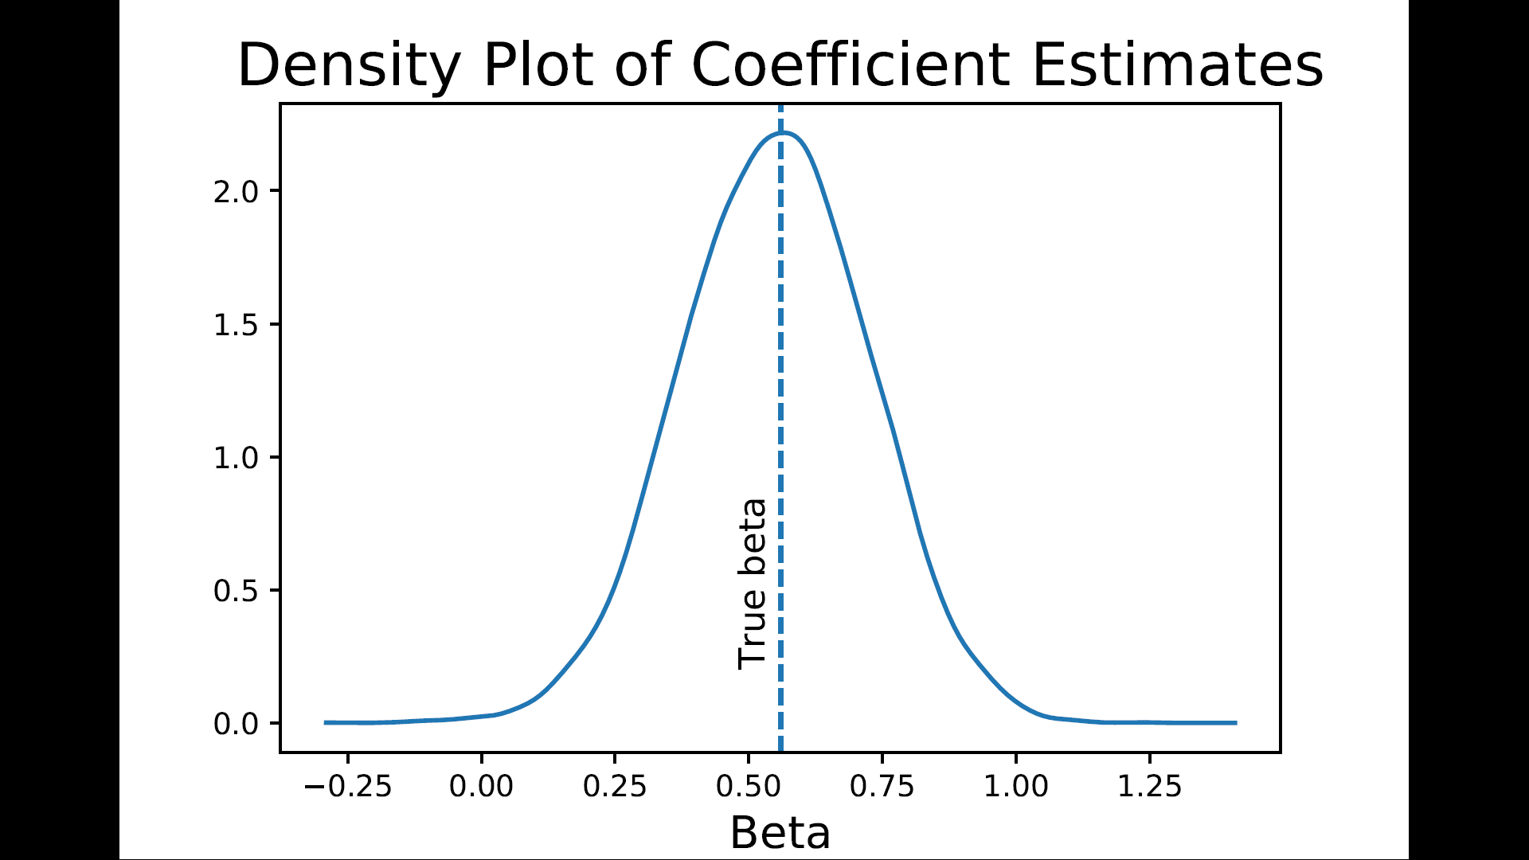

Slide 20
Simulation Discussion
95% CI coverage probabilities are very close to 95% (range: 93.5% to 95.6%)
Relative risk regression is approximately unbiased in almost all cases
Relative risk regression bias is always smaller than “OR bias”
I.e. unsurprisingly, the OR is not an unbiased estimator of the RR
Estimates for the continuous IV are better than for the categorical IV
Smaller bias and RMSE

Slide 21
Concluding Remarks
Relative risk regression is a capable and feasible statistical method
Relative risk regression is already possible in standard statistical packages
Made even more accessible with convenient software implementations

Slide 22
Recommended Resources
Stata tutorial: https://stats.idre.ucla.edu/stata/faq/how-can-i-estimate-relative-risk-using-glm-for-common-outcomes-in-cohort-studies/
SAS tutorial: https://stats.idre.ucla.edu/sas/faq/how-can-i-estimate-relative-risk-in-sas-using-proc-genmod-for-common-outcomes-in-cohort-studies/
Detailed statistical discussion: Lumley, T., Kronmal, R., & Ma, S. (2006). Relative risk regression in medical research: models, contrasts, estimators, and algorithms.
Intro and bibliography: https://www.mailman.columbia.edu/research/population-health-methods/relative-risk-regression

Slide 23
Source code
Available online:
https://github.com/MarsdenDavidG/RelativeRiskRegression
Any questions?

