Slide 1
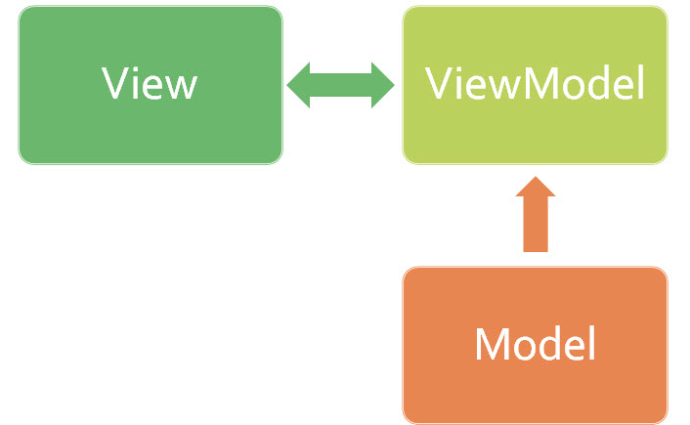
MVVM
Pattern
Presenter Marsha J. Brooks

Slide 2
Model–view–viewmodel (MVVM)
is a software architectural pattern.
MVVM facilitates a separation of development of the
graphical user interface – be it via a markup language or
GUI code – from development of the business logic or
back-end logic (the data model).
The MVVM pattern is a variation on the MVC and MVP patterns based on the presentation model of XAML. XAML offers a very rich binding mechanism, and the MVVM pattern uses this binding mechanism as the "goo" that holds everything together.
The difference between Model-View-Controller(MVC) and Model-View-View Model is the fact that:
MVVM is used to two-way bind data within views. This is usually a client-side implementation.
MVC is a way of separating concerns on the server-side

Slide 3
The Benefits
MVVM enables a great developer-designer workflow, providing
these benefits:
During the development process, developers and designers can work more independently and concurrently on their components. The designers can concentrate on the view, and if they are using Expression Blend, they can easily generate sample data to work with, while the developers can work on the view model and model components.
The developers can create unit tests for the view model and the model without using the view. The unit tests for the view model can exercise exactly the same functionality as used by the view.
It is easy to redesign the UI of the application without touching the code because the view is implemented entirely in XAML. A new version of the view should work with the existing view model.
If there is an existing implementation of the model that encapsulates existing business logic, it may be difficult or risky to change. In this scenario, the view model acts as an adapter for the model classes and enables you to avoid making any major changes to the model code.

Slide 4
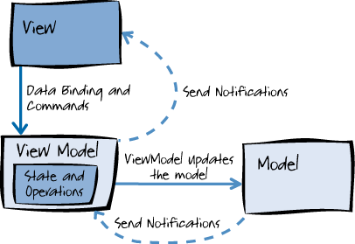
relationship between components
The components are decoupled from each other, thus enabling:
Components to be swapped
Internal implementation to be changed without affecting the others
Components to be worked on independently
Isolated unit testing
view sees view model, view model sees model, mode does not see view model, and view model does not see view.
View Model isolates the view from the model classes and allows the model to evolve independently of the view.

Slide 5
View
Defines the structure, layout, and appearance of what the
user sees
on the screen, defined with XAML, and does not contain business logic.
a page in the application, a sub-component of a parent view, or a
DataTemplate for an object in an ItemsControl.
A view can have its own view model
Can inherit its parent's view model.
Gets data from its view model through bindings, or invoking methods on the view model.
At run time, the view changes when UI controls respond to view model properties
raising change notification events.
executing code on the view model in response to interactions on the view, such as a button click or item selection:
control is a Command Source: the control’s Command property can be data-bound to an Icommand
property on the view model.
control’s command is invoked, the code in the view model will be executed.
In addition to commands, behaviors can be attached to an object in the view and can listen for either a command to be invoked or event to be raised. In response, the
behavior can then invoke an ICommand on the view model or a method on the view model.

Slide 6
Model
an implementation of the application’s
domain model
combination data model and business and
validation logic
Examples of model objects include repositories, business objects, data transfer objects (DTOs), Plain Old CLR Objects (POCOs), and generated entity and proxy objects.

Slide 7
Connecting View Models to Views
Purpose: view to have a view model assigned to its DataContext property.
There are many approaches to connecting a view model to a view, including
direct relations
container-based approaches
Views is connected to view models in a code-behind file, or in the view itself.
Code-Behind
connecting a view model to a view in a code-behind file is discouraged as it can cause problems for designers in both Visual Studio and Microsoft Expression Blend® design software
A view can have code in the code-behind file that results in the view model being assigned as its DataContext property.
This could be as simple as a view instantiating a new view model and assigning it to its DataContext, or injecting a view
model into a view using an inversion-of-control container.
View
the view model can be instantiated in the view as the view’s DataContext, if the constructor has no arguments.
Using a view model locator.
a resource which exposes the application’s view models as properties that individual views can data bind to. The application has a single class that is responsible for connecting view models to views, it leaves developers free to choose to manually perform the connection within the view model locator, or by using a dependency injection container.

Slide 8
Review
Model: The Model encapsulates the business logic and data that is used by the application, Model should not have any presentation logic. The Model is everything that is not Presentation
ViewModel: The ViewModel encapsulates the presentation logic and the data that is used by the View; the "goo" that holds things together. ViewModel is responsible for taking the data objects that are available in the Model and making them available as properties to which the View can data bind. It also provides properties that are used for the presentation logic of the application and handles any interaction between the View and the Model, by exposing methods or commands that the View can call. The ViewModel then uses those methods to make calls into the Model.
View: The View is what the user sees on the screen -- all of the UI elements. This is the collection of XAML elements that make up the user interface (user controls, buttons, labels, text boxes) as well as the supporting items that assist these elements (styles, animations, control templates)

Slide 9
CODE

Slide 10
Write a Model
//write a model
public class Model
{
public string CurrentName { get; set; }
public List<string> AddedNames { get; } = new List<string>()
}
Associate Model with View
//associate model with the view
public MainWindow()
{
InitializeComponent();
DataContext = new Model();
}
Update to reflect the CurrentName Model Property and the list to be the AddedNames property.
//update the text box and label to reflect the
CurrentName model property and the list box to be the AddedNames property.
Below is the new XAML for the view, with change in bold.
<TextBlock Text="Added Names" DockPanel.Dock="Top" Margin="5,3"/>
<ListBox ItemsSource="{Binding AddedNames}"> <!-- ....... -->
<TextBlock Grid.Row="0" Text="Name" Margin="5,3"/>
<TextBox Grid.Row="0" Grid.Column="1" Text="{Binding CurrentName,
UpdateSourceTrigger=PropertyChanged}" Margin="5,3"/>
<TextBlock Grid.Row="1" Text="Your name is:" Margin="5,3"/>
<TextBlock Grid.Row="1" Grid.Column="1" Text="{Binding CurrentName}" Margin="5,3"/>

Slide 11
//Enter INotifyPropertyChanged and INotifyCollectionChanged interfaces. // ViewModels should implement these interfaces to notify the UI they have changed. public class Model : INotifyPropertyChanged { #region CurrentName public string CurrentName { get { return mCurrentName; } set { if (value == mCurrentName) return; mCurrentName = value; OnPropertyChanged(); } } string mCurrentName; #endregion public ObservableCollection<string> AddedNames { get; } = new ObservableCollection<string>(); public event PropertyChangedEventHandler PropertyChanged; void OnPropertyChanged([CallerMemberName]string propertyName = null) { PropertyChanged?.Invoke(this, new PropertyChangedEventArgs(propertyName)); } }
Notify Change Interfaces

Slide 12
ICommand
/*Button and other actionable items (such as MenuItem) work through an interface named ICommand.
One glaring omission of WPF is that it doesn't provide an out of the box, simple, model friendly
ICommand implementation.
One could refer here to the seminal RelayCommand by Josh Smith... but since it's a very simple
interface and I don't want to
*/use any third party, we are just going to implement it inline.... Add this to the Model class:
Hide Shrink Copy Code
public Model()
{
AddCommand = new AddNameCommand(this);
}
class AddNameCommand : ICommand
{ Model parent;
public AddNameCommand(Model parent)
{ this.parent = parent;
parent.PropertyChanged += delegate
{ CanExecuteChanged?.Invoke(this, EventArgs.Empty); };
}
public event EventHandler CanExecuteChanged;
public bool CanExecute(object parameter)
{ return !string.IsNullOrEmpty(parent.CurrentName);
}
public void Execute(object parameter)
{ parent.AddedNames.Add(parent.CurrentName);
; parent.CurrentName = null;
} } public ICommand AddCommand { get; private set; }
//let the button know about the command with that simple xaml change (in bold).
Hide Copy Code
<Button Grid.Row="2" Grid.ColumnSpan="2" HorizontalAlignment="Left" Content="Add Me"
Command="{Binding AddCommand}"/>

Slide 13
References
https://msdn.microsoft.com/en-us/library/hh848246.aspx
https://jeremybytes.blogspot.com/2012/04/overview-of-mvvm-design-pattern.html
https://www.codeproject.com/Articles/1112919/MVVM-for-beginners

