Slide 1

Sentiment Analysis on Videogames
Data Mining and Machine Learning Project
a.a. 2019-2020
Gianluca Serao
Lorenzo Barigliano

Slide 2
Agenda
Introduction
Data Pre-processing
Classification
Implementation
Test

Slide 3
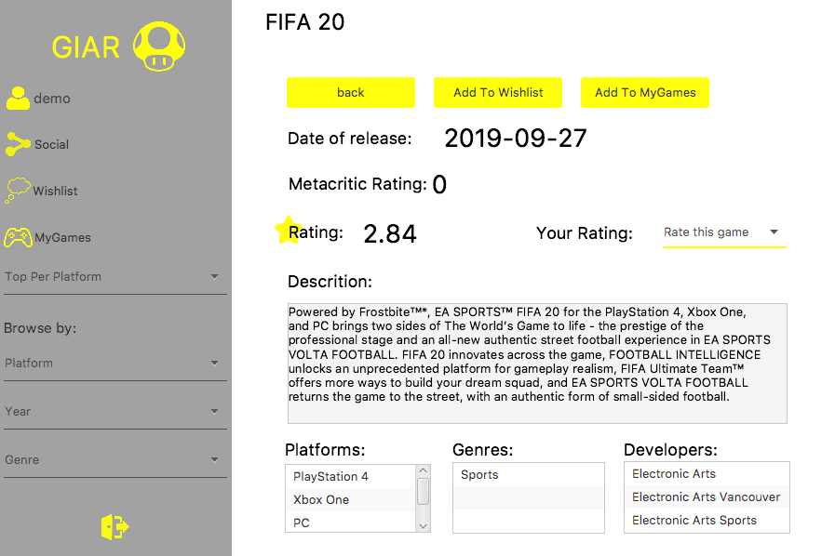
Introduction
GIAR is an application that collects information and ratings about videogames. A user can search a game by name and access to the information about the game.

Slide 4

Introduction
Project goal
Implement a sentiment analysis that gives to the user the players community opinions on a game.
For each videogame the application will show the amount of positive and negative opinions.

Slide 5

Analysis steps
Introduction
The opinions are mined from Twitter.
The analysis is a three step process:
Fetching tweets through the Twitter API.
Tweets pre-processing (Cleaning, Tokenization, Stop Words Removal, Stemming, BOW representation).
Classification (Positive, Negative and None).

Slide 6

Data pre-processing
Data acquisition
Tweets are retrieved searching for the game name. The query is performed selecting English tweets.
Tweets about several games.

Slide 7
Data pre-processing
Data cleaning
@MainManPepe @MattHDGamer By uninstalling Fifa 20 as it’s terrible 😄
By uninstalling as it’s terrible
Remove from tweets:
Emoji
Hashtags
Mentions
Links
Remove game name.
Cleaning

Slide 8
Data pre-processing
Training-set building
Cleaned tweets are labelled by hand in three classes (Positive, Negative and None).
The training-set is balanced (333 instances per each class).

Slide 9

Data pre-processing
Weka pre-processing
Tokenization: Used alphabetic tokens (discards numbers, special characters and punctuation).
Stop-words filtering: List of common English stop-words and console names (Playstation, Xbox, Pc).
Stemming: Snowball English stemmer.

Slide 10
Classification
Outline
Train and evaluate with the 10-fold cross validation different classifiers.
Select the best two classifiers.
Perform a paired t-test to choose the best.

Slide 11
Classification
Tests summary
Classifier | Accuracy | K-statistic | Precision | Recall | F-Measure | ROC
Naïve Bayes Multinomial | 81,1812% | 0,7177 | 0,825 | 0,812 | 0,814 | 0,938
Random Forest | 81,0811% | 0,7162 | 0,818 | 0,811 | 0,810 | 0,933
SVM | 77,0771% | 0,6562 | 0,771 | 0,771 | 0,770 | 0,828
Naive Bayes | 75,3754% | 0,6306 | 0,792 | 0,754 | 0,757 | 0,905
J48 | 67,2673% | 0,509 | 0,680 | 0,673 | 0,674 | 0,825
1-NN | 63,964 % | 0,4595 | 0,645 | 0,640 | 0,642 | 0,850

Slide 12
Classification
Models evaluation
Naïve Bayes Multinomial Text
Random Forest
positive | negative | none
291 | 33 | 9 | positive
84 | 243 | 6 | negative
33 | 23 | 277 | none
positive | negative | none
287 | 27 | 19 | positive
67 | 237 | 29 | negative
36 | 17 | 280 | none
Classifier | Accuracy | Precision | Recall | F-Measure | ROC
Naïve Bayes Multinomial | 81,1812% | 0,825 | 0,812 | 0,814 | 0,938
Random Forest | 81,0811% | 0,818 | 0,811 | 0,810 | 0,933

Slide 13
Classification
Model selection
Performed the paired t-test between the Naïve Bayes Multinomial and the Random Forest Classifier. (Sorted by percent correct)
The test is performed with a confidence level of 0.05.
No statistic significance.
Selected the fester to build model: Naïve Bayes Multinomial Text.
Dataset | Random Forest | Naive Bayes Multinomial
Training-set | 80.2507 | 80.7201
 | (v/ /*) | (0/1/0)

