Slide 1
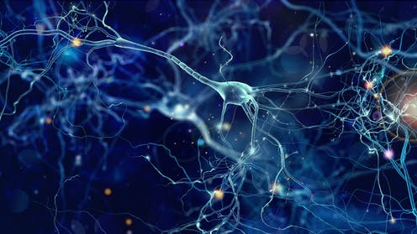
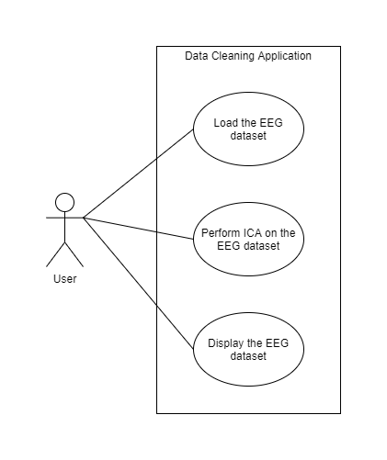
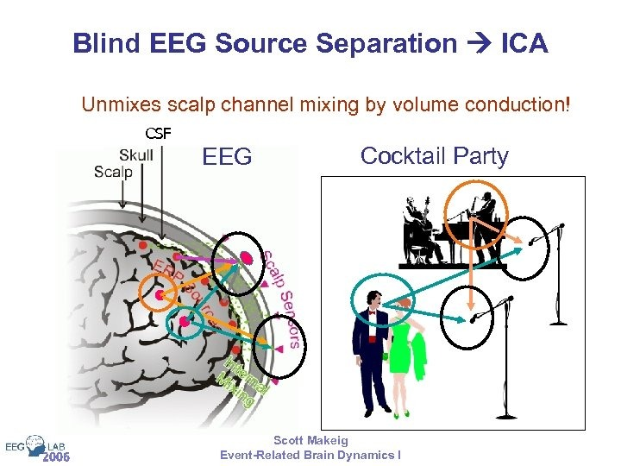
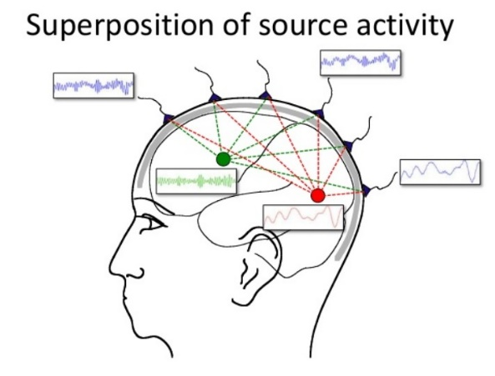
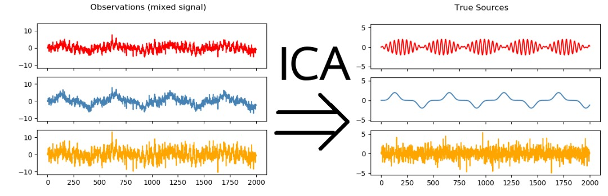
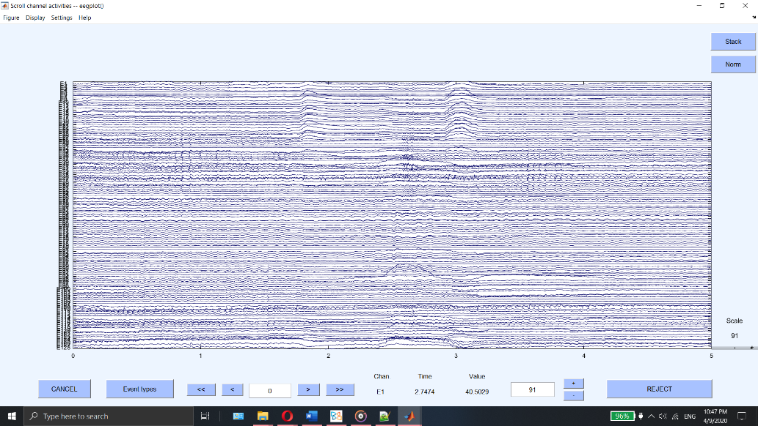
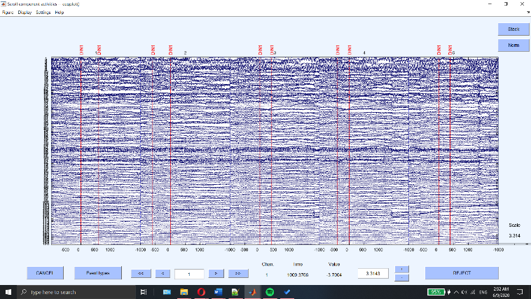
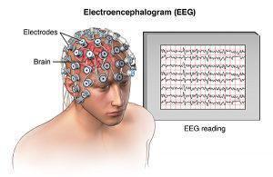
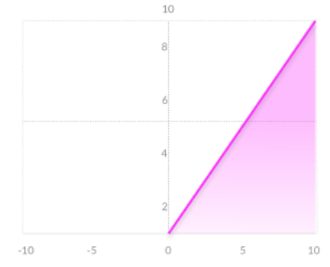
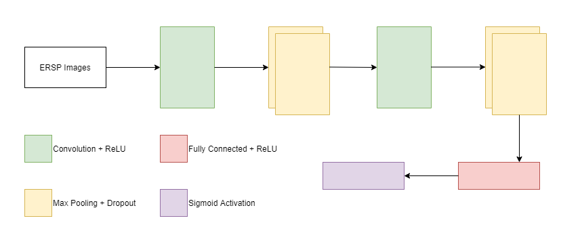
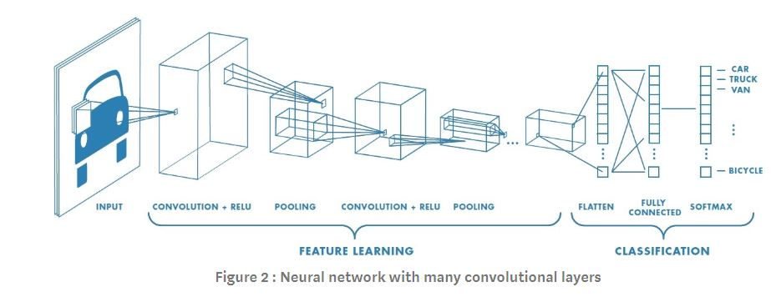
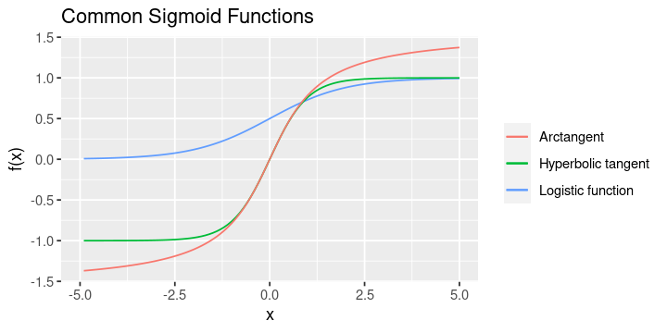
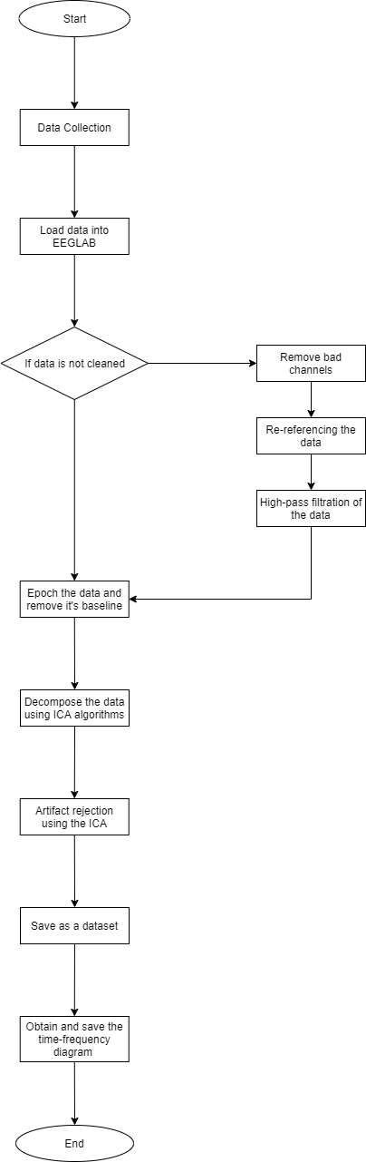
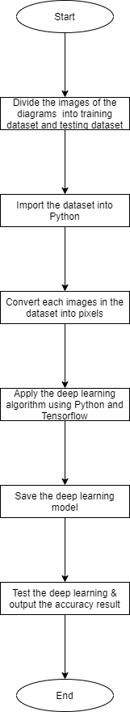
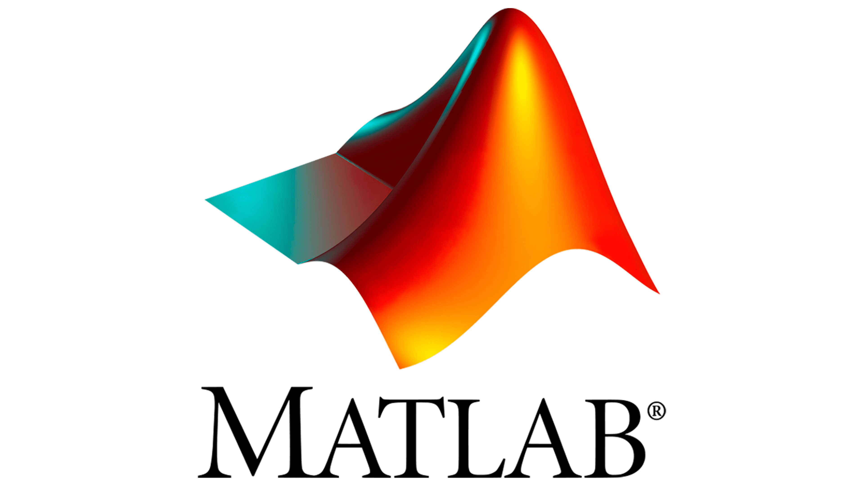
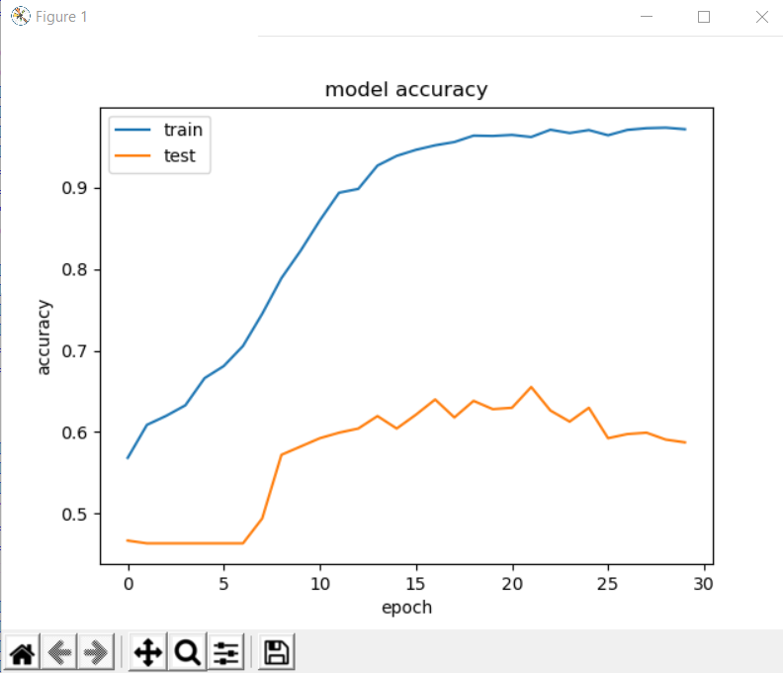
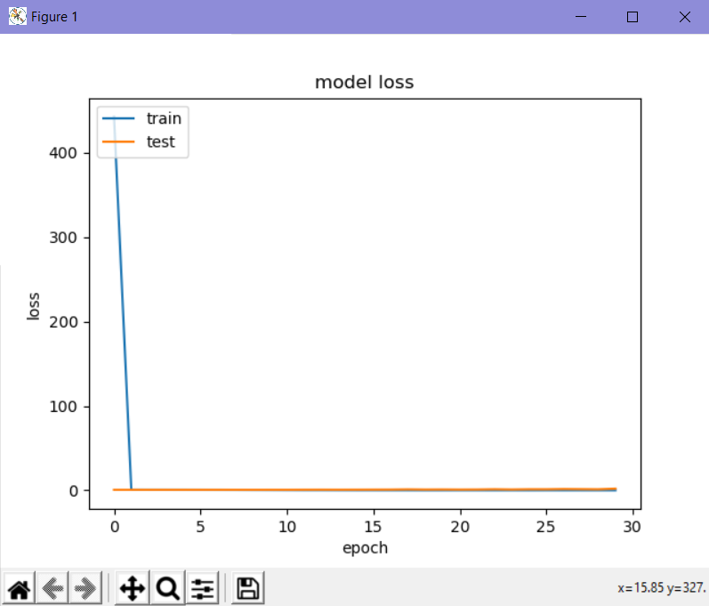
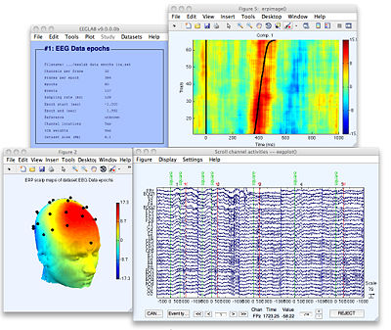



1617: IDENTIFICATION OF DYSLEXIA FROM EEG SIGNALS USING DEEP LEARNING
Marsha Binti Mohamad Muhsin, 1171101715
Supervisor: Dr. Vijayakumar
Abstract
Implementation / Testing / Evaluation
Dyslexia is a neurobiological learning disorder characterized by the disability in identifying speech sounds and learning how it is related to letters and words (Dyslexia, 2017). There are various ways to identify dyslexia but the one we are trying to look into is identifying the markers or signatures of dyslexia in EEG signals using deep learning architecture. Deep learning is an implementation of the artificial neural network that has multiple hidden layers. For this project, a MATLAB application was first created to preprocess the EEG signals into a suitable form so that it can be used as an input for the deep learning network. The deep learning framework uses the Convolution Neural Network (CNN) architecture and has been implemented using the Python language and is supported by the TensorFlow package. Our results can be improved with a larger training dataset.
Problem Statement / Objectives
Figure 5.1: Use Case Diagram for MATLAB Application
Figure 5.2: ICA
Problem Statement
EEG is generally too large to be clean by a person
EEG data is hard to be interpreted
Finding patterns from the EEG data that can help identify the dyslexia
Objectives
Obtain the EEG data
Design a system that can automatically clean and produce time-frequency images from raw EEG data
Design and implement deep learning framework for the identification of dyslexics
Background study / Literature Review
Figure 5.3: Channel Data Plot
Figure 5.4: Component Data Plot
Codes : https://github.com/MarshaMuhsin/FYP
Testing Accuracy = 59.3%
Figure 2.1: EEG Scan
Figure 2.2: ReLU Activation Function Graph
Figure 2.3: Sigmoid Activation Function Graph
Design/Methodology
Conclusion
In general, we have learned brain signals concepts, how EEG data cleaning works using EEGLAB and deep learning concepts. As of now, research showed how brain wave of a dyslexia affected patient is different than a normal functioning brain. Thus, finding the appropriate tools by research to help automate the cleaning of the EEG data. Using the results from the research a MATLAB application was created to clean the EEG data using EEGLAB functions. After the cleaning process is done, the classification model was created using CNN architecture in TensorFlow and Keras. However, the results might be further improved using larger datasets. In the future, we hoped to understand dyslexia by identifying unique signatures from different parts of the brain by utilising deep learning from EEG data gathered from the volunteers.
Figure 4.1 Flowchart of Cleaning Process of EEG Data
Figure 4.2: Building the deep learning model
FACULTY OF COMPUTING AND INFORMATICS
Notes:
Empty Template

