Slide 1
Diabetes prediction using naïve Bayes
SUBJECT : DATA MINING AND WAREHOUSING(05cs6005)
Presented by,
Marsha Mariya Kappan

Slide 2
introduction
We use Naïve Bayes to predict fairly correctly from the data provided, the chances of a person being a diabetic or not.
The model predicts the class label according to the features given.

Slide 3
dataset
# | Concentration of glucose | Diabetes history | Insulin level | age | Class label
1 | normal | no | normal | young | no
2 | normal | yes | normal | midage | no
3 | high | yes | high | old | yes
4 | normal | no | normal | old | no
5 | high | no | normal | old | yes
6 | normal | yes | high | midage | yes
7 | normal | no | normal | young | no
8 | high | no | high | old | yes
9 | normal | yes | normal | young | no
10 | normal | yes | high | old | yes

Slide 4
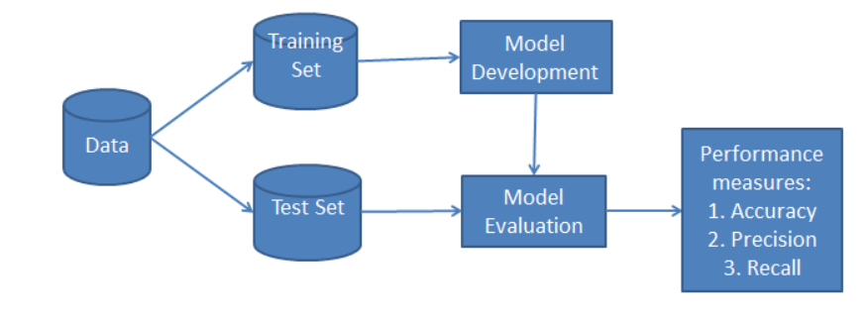
Naive Bayes Classification
Here we are classifying the dataset using Naive Bayes Classifier using Python's Scikit-learn package.
The classification has two phases,
1) a learning phase - classifier trains its model on a given dataset
2) the evaluation phase - it tests the classifier performance.

Slide 5
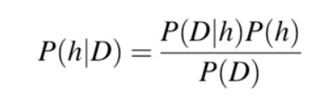
What is Naive Bayes Classifier
Naive Bayes is a statistical classification technique based on Bayes Theorem. It is one of the simplest supervised learning algorithms.
P(h): the probability of hypothesis h being true (regardless of the data). This is known as the prior probability of h.
P(D): the probability of the data (regardless of the hypothesis). This is known as the prior probability.
P(h|D): the probability of hypothesis h given the data D. This is known as posterior probability.
P(D|h): the probability of data d given that the hypothesis h was true. This is known as posterior probability.

Slide 6
Types of Naive Bayes Classifier:
Multinomial Naive Bayes:
This is mostly used for document classification problem, i.e whether a document belongs to the category of sports, politics, technology etc. The features/predictors used by the classifier are the frequency of the words present in the document.
Bernoulli Naive Bayes:
This is similar to the multinomial naive bayes but the predictors are boolean variables. The parameters that we use to predict the class variable take up only values yes or no, for example if a word occurs in the text or not.
Gaussian Naive Bayes:
When the predictors take up a continuous value and are not discrete, we assume that these values are sampled from a gaussian distribution.

Slide 7
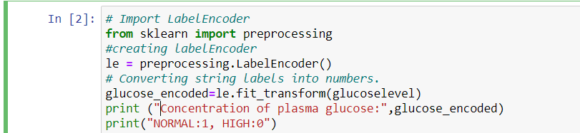
Classifier Building in Scikit-learn
Defining Dataset
Here we use dataset with five columns: concentration of plasma glucose, diabetes history, and insulin level, age, diabetes. The first four are features and the other(diabetes) is the class label.
Encoding Features
First, we need to convert the string labels into numbers. For example: ‘young', ‘midage', ‘old' as 0, 1, 2. This is known as label encoding.
Scikit-learn provides LabelEncoder library for encoding labels with a value 0,1,2,…..

Slide 8
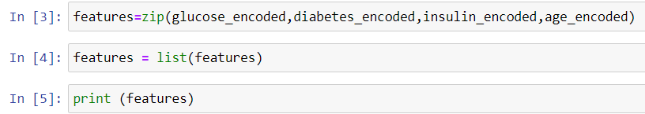
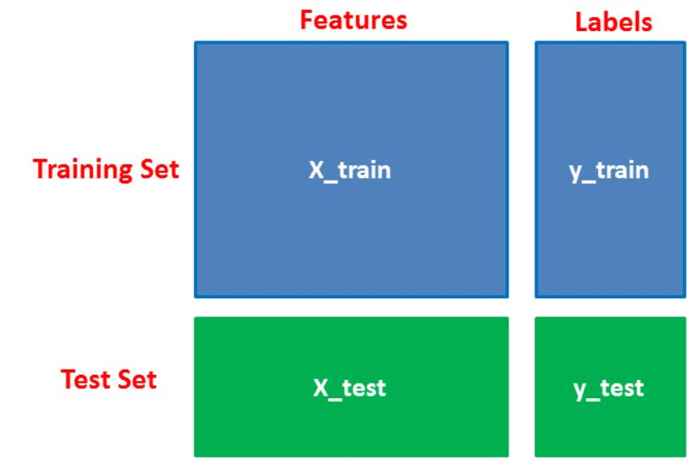
Combine features
combine the four features (concentration of plasma glucose, diabetes history, and insulin level, age) in a single variable (list of tuples).
Splitting Data into train and test sets

Slide 9
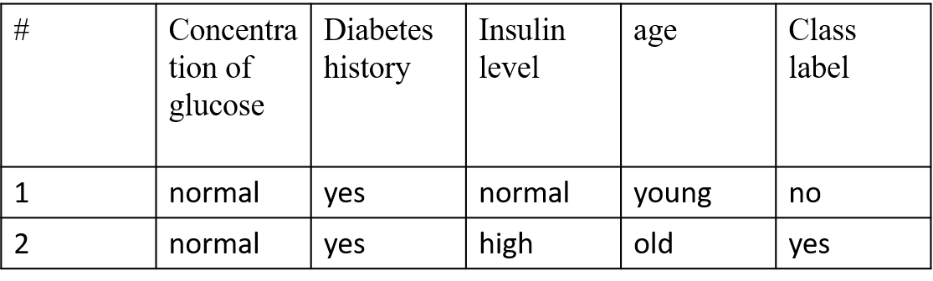
DATASET
# | Concentration of glucose | Diabetes history | Insulin level | age | Class label
1 | normal | no | normal | young | no
2 | normal | yes | normal | midage | no
4 | normal | no | normal | old | no
5 | high | no | normal | old | yes
6 | normal | yes | high | midage | yes
7 | normal | no | normal | young | no
8 | high | no | high | old | yes
10 | normal | yes | high | old | yes
Validation set
# | Concentration of glucose | Diabetes history | Insulin Level | Age | Class label
3 | high | yes | high | old | yes
9 | normal | yes | normal | young | no
Training dataset
Test Dataset

Slide 10
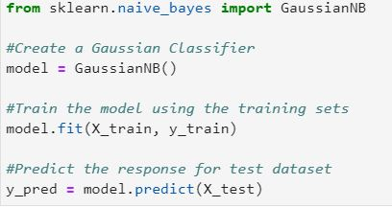
Generating Model
Generate a model using Naive Bayes classifier in the following steps:
Create naive Bayes classifier
Fit the dataset on classifier
Perform prediction

Slide 11
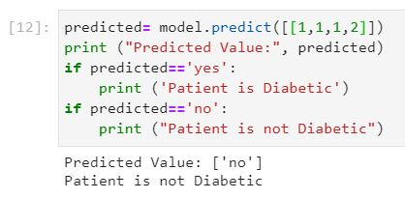
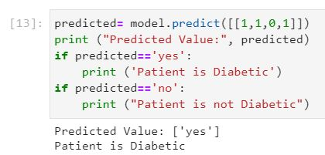
Test data
So the model correctly classified the data

Slide 12
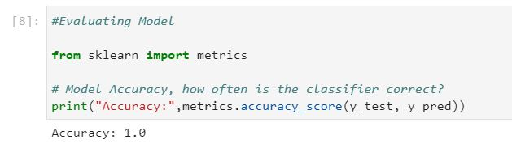

Evaluating the model
Predict the class if X=(glucose=normal, diabetes history=yes, insulin level=normal, age=mid age)

Slide 13
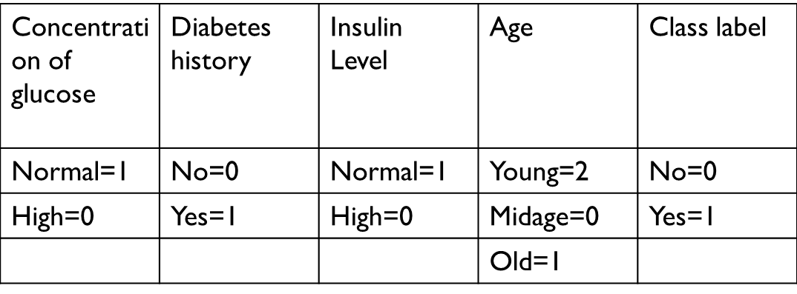
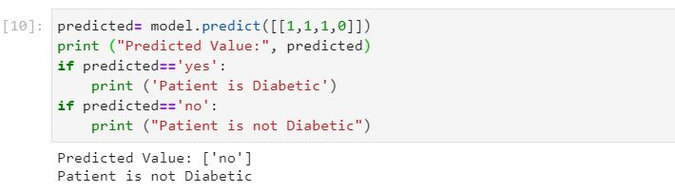
Predict the class if X=(glucose=normal, diabetes history=yes, insulin level=normal, age=mid age)
Input: (1,1,1,0)
So X belongs to class ‘no’.
That is patient is not Diabetic.

Slide 14
conclusion
In this project we use the information given to train a Bayes network.
This model predicted fairly correctly from the data provided the chances of a person being a diabetic or not.
Here we have classified people into 2 categories based on the symptoms .
That is the persons with diabetes and those who don’t have diabetes.
Each time when a data is given the model predicts the Class Label correctly.
Naïve Bayes Classifier perform well on the given dataset.
It classifies the data correctly.

Slide 15


