Slide 1
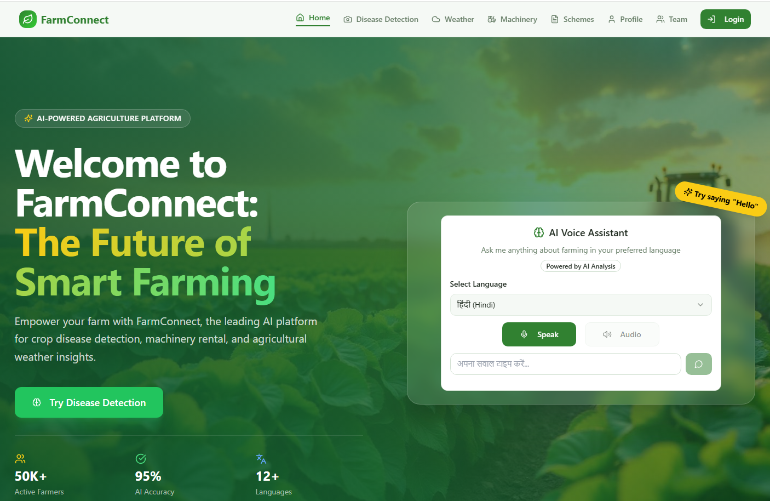
Major Project External Evaluation
FARM CONNECT: PATHWAY TO PROGRESS
Team: Marshal Alone, Vaishnavi Getme, Aditya Kawale, Sanskruti Patil, Mrunali Umak
Guide: Prof. Tejas Dhule | Session: 2025-26
Progress status: Semester 7 MVP complete | Semester 8 pending closure

Slide 2
Agenda
1. Problem and project scope
2. Semester 7 implementation progress
3. Module demonstration (with live screenshots)
4. Testing status and current metrics
5. Semester 8 pending work and timeline
6. Conclusion and demo flow
Department of CSE, NIT Nagpur | Demo: https://farmbro.vercel.app/

Slide 3
Problem and Solution Fit
Information is fragmented across multiple platforms.
Disease detection is often delayed, increasing crop risk.
Language barriers reduce access to digital advisories.
Equipment access is expensive for small farmers.
Farm Connect combines disease AI, weather, schemes, and machinery services in one platform.
Department of CSE, NIT Nagpur | Demo: https://farmbro.vercel.app/

Slide 4
Semester 7 Progress (MVP Delivered)
Completed UI/UX, routing, and responsive frontend foundation.
Implemented core modules: Disease, Weather, Schemes, Machinery listing.
Integrated AI providers: Groq (default) and Gemini (optional).
Implemented authentication and profile baseline.
Deployed live demo on Vercel with cloud database connectivity.
Prepared architecture, API, and ML technical documentation.
7/10
Major Scope Items at MVP Stage
70%
Overall Scope Completion
2
AI Providers Integrated
Department of CSE, NIT Nagpur | Demo: https://farmbro.vercel.app/

Slide 5
Architecture and Tech Stack
Frontend: React 18, TypeScript, Tailwind, Vite
Backend: Node.js, Express.js
Database: MongoDB Atlas
AI Services: Groq + Gemini
APIs: WeatherAPI, Web Speech API
Deployment: Vercel + cloud services
System Architecture
Frontend
React + TS
Backend
Node + Express
Database
MongoDB
AI
Groq + Gemini
Weather API
Voice APIs
Department of CSE, NIT Nagpur | Demo: https://farmbro.vercel.app/

Slide 6
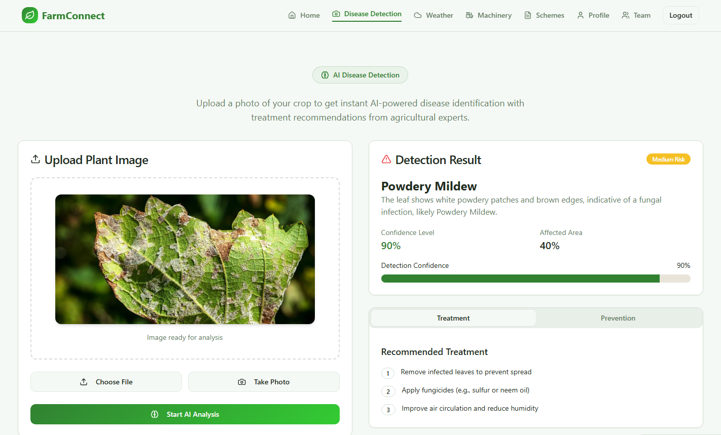
Module Demo: AI Disease Detection
Crop image upload and AI-based diagnosis.
Outputs: disease, confidence, treatment, prevention.
MVP flow is fully demo-ready in Semester 7.
Semester 8: custom TFJS model production hardening.
Department of CSE, NIT Nagpur | Demo: https://farmbro.vercel.app/

Slide 7
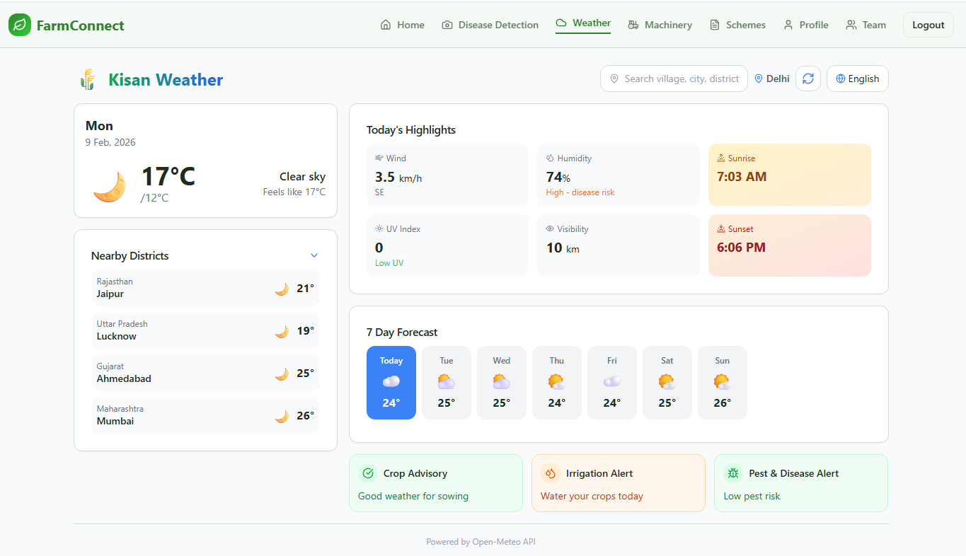
Module Demo: Smart Weather Dashboard
Live weather and 7-day forecast.
Location-aware farming advisories and alerts.
Supports practical crop planning decisions.
Department of CSE, NIT Nagpur | Demo: https://farmbro.vercel.app/

Slide 8
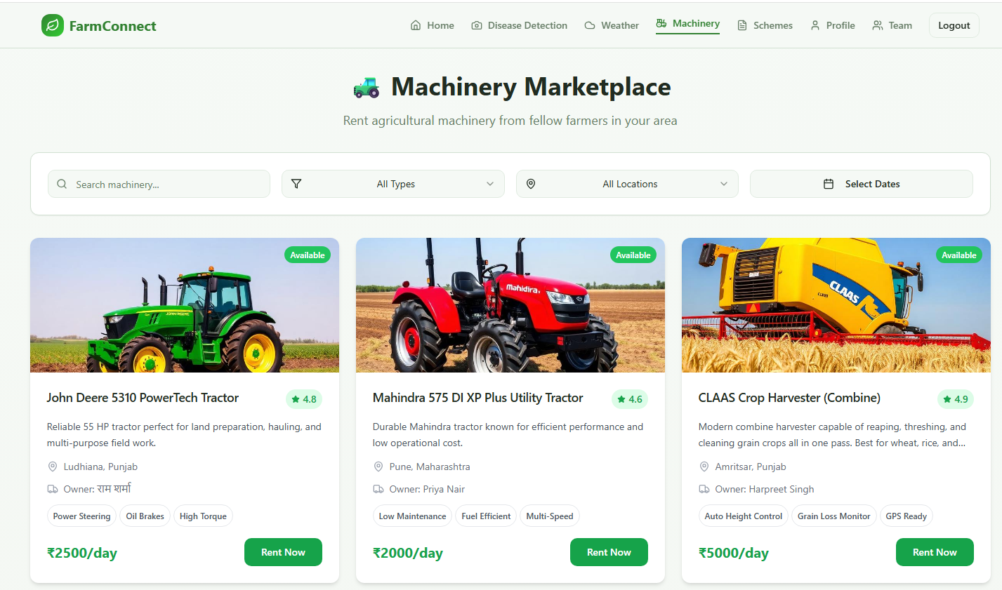
Module Demo: Machinery Marketplace
Machinery listing, search, and filters are implemented.
MVP supports discovery and browsing by farmers.
Semester 8: booking lifecycle and owner dashboard closure.
Department of CSE, NIT Nagpur | Demo: https://farmbro.vercel.app/

Slide 9
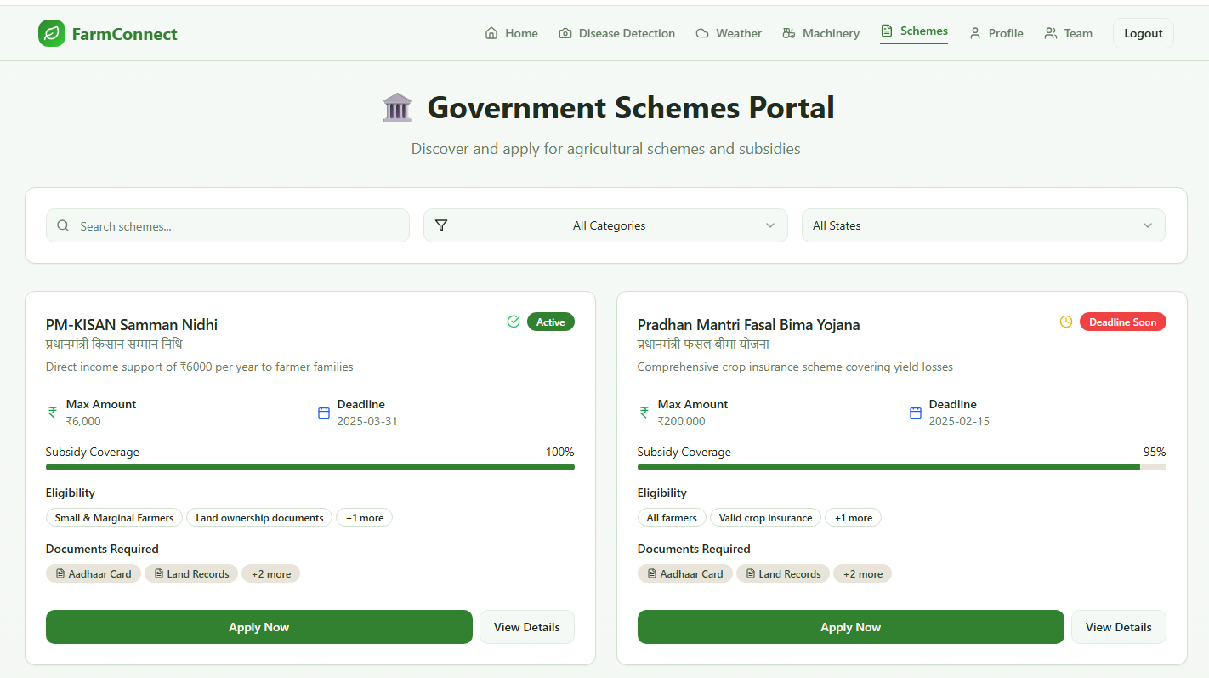
Module Demo: Schemes Portal and Voice Assistant
Schemes portal supports discovery and filtering.
Voice assistant supports multilingual interaction.
Semester 8: deeper voice validation and integration QA.
Department of CSE, NIT Nagpur | Demo: https://farmbro.vercel.app/

Slide 10
Testing Status and Preliminary Results
UI/UX usability testing completed on desktop and mobile.
Core flow smoke testing completed for implemented modules.
API route-level manual verification completed.
MVP stability validated for external demo.
Semester 8 pending: security, load, integration, UAT.
15+
API Routes Smoke-Tested
MVP
Current Delivery Level
S8
Planned Quality Closure
Department of CSE, NIT Nagpur | Demo: https://farmbro.vercel.app/

Slide 11
Semester 8 Pending Work and Timeline
Phase 1 (Feb-Mar 2026)
Complete booking workflow, owner dashboard, and messaging closure.
Phase 2 (Mar-Apr 2026)
Integrate custom TFJS model option, ratings/reviews, and PWA reliability improvements.
Final Phase (May 2026)
Security/load/integration testing, final docs, final demo video, and submission.
Department of CSE, NIT Nagpur | Demo: https://farmbro.vercel.app/

Slide 12
Budget and Resource Utilization
Vercel hosting: free tier
MongoDB Atlas: free tier
Groq API and Gemini API: configured for development usage
Weather API: free tier integration
Development and testing done on team devices
Overall approach remains cost-effective and scalable
Department of CSE, NIT Nagpur | Demo: https://farmbro.vercel.app/

Slide 13
Live Demo Flow (2-3 Minutes)
1. Open https://farmbro.vercel.app/ and show home page
2. Disease Detection: upload leaf image and show analysis
3. Weather Dashboard: show location forecast and advisories
4. Machinery Marketplace: show listing and filter flow
5. Schemes Portal and Voice Assistant quick walkthrough
6. Close with Semester 8 roadmap and pending quality work
Department of CSE, NIT Nagpur | Demo: https://farmbro.vercel.app/

Slide 14
Conclusion
Semester 7 outcome: functional, deployable MVP delivered.
Semester 8 focus: complete pending workflows and quality hardening.
Project is on track for final academic completion in two-semester plan.
Thank You
Department of CSE, NIT Nagpur | Demo: https://farmbro.vercel.app/

