Slide 1
Marching cubes algoritam
Računalna animacija - Projekt

Slide 2
O projektu
Implementirati marching cubes algoritam i napaviti jednostavnu „igru” za interakciju
Unity Engine

Slide 3
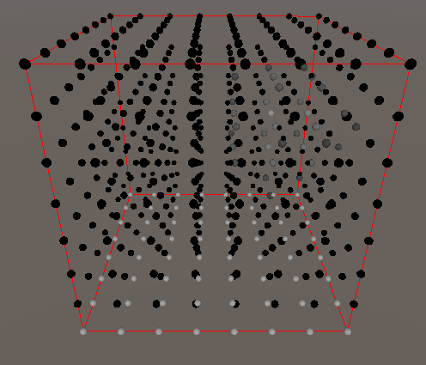
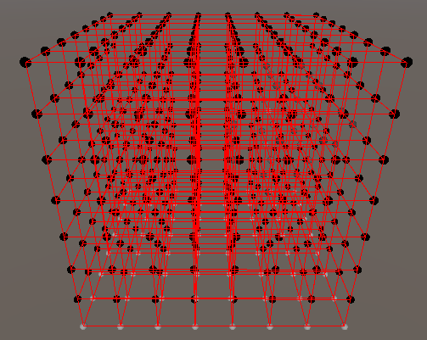
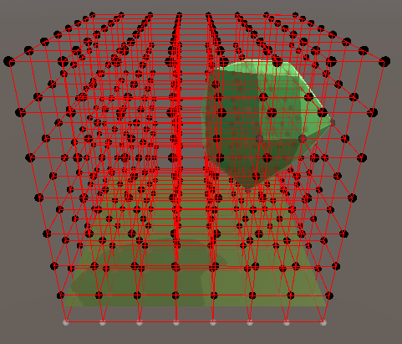
Marching cubes
Algoritam za izradu poligonalne mreže na temelju 3D polja skalara
Koristan za prikaz tla (Terrain), u nekim slučajevima pogodniji od „2D” tla sa heightmap-om (npr. prikaz špilja)
Definira se granična vrijednost za skalare – da li točka je unutar poligona

Slide 4
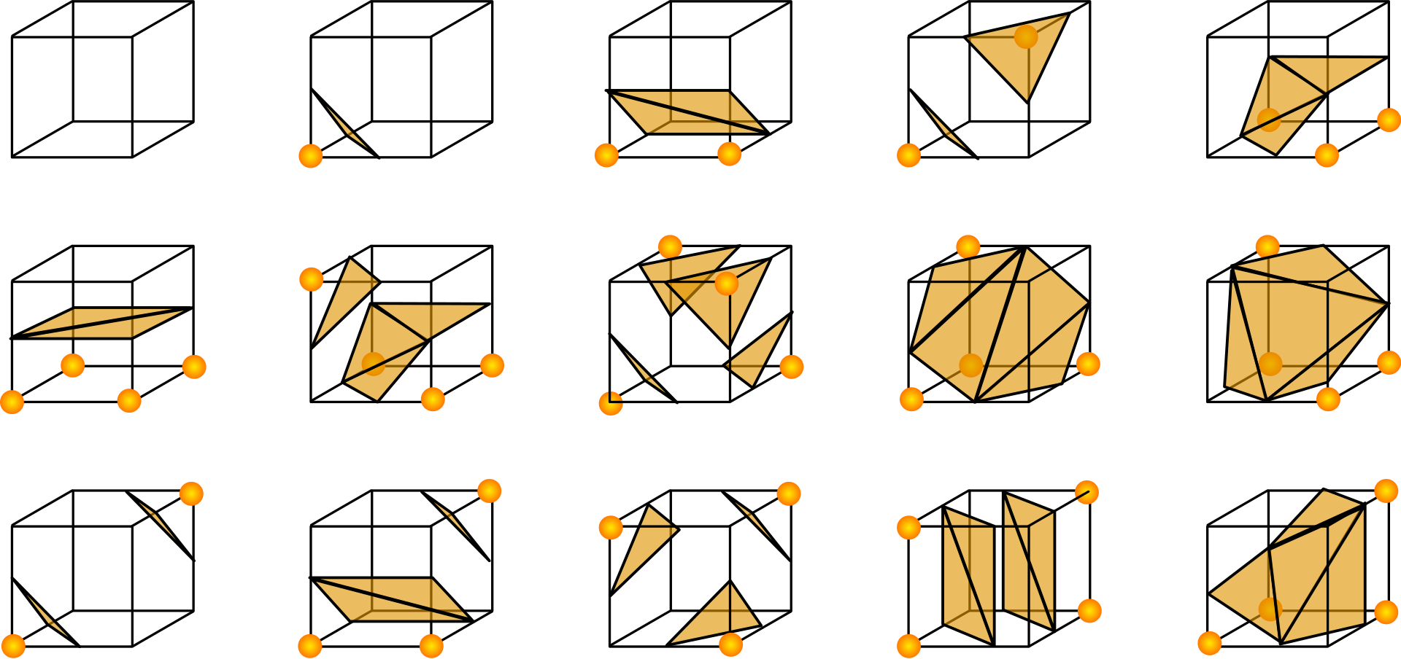
Marching cubes
14 osnovnih slučajeva kockica + prazna kocka
Odrediti točke trokuta na bridovima (moguća je i interpolacija na temelju vrijednosti vrhova)
Odrediti trokute
Realizirano korištenjem postojećih tablica

Slide 5
void March(Vector3Int cubeInx, Vector3 point, List<Vector3> verts, List<int> tris)
{
int flaginx = 0;
for (int i = 0; i < 8; i++)
{
Vector3Int ci = cubeInx + CubeVertexOffset[i];
cubeValues[i] = Values[ci.x, ci.y, ci.z];
if (cubeValues[i] <= Surface)
flaginx |= 1 << i;
}
int edgeFlag = CubeEdgeFlags[flaginx];
if (edgeFlag == 0)
return;
for (int i = 0; i < 12; i++)
{
if ((edgeFlag & (1 << i)) != 0)
{
float offset = GetOffset(cubeValues[EdgeConnection[i, 0]], cubeValues[EdgeConnection[i, 1]]);
EdgeVertex[i].x = point.x + (VertexOffset[EdgeConnection[i, 0], 0] + offset * EdgeDirection[i, 0]) * SegmentSize;
EdgeVertex[i].y = point.y + (VertexOffset[EdgeConnection[i, 0], 1] + offset * EdgeDirection[i, 1]) * SegmentSize;
EdgeVertex[i].z = point.z + (VertexOffset[EdgeConnection[i, 0], 2] + offset * EdgeDirection[i, 2]) * SegmentSize;
}
}
for (int i = 0; i < 5; i++)
{
if (TriangleConnectionTable[flaginx, 3 * i] < 0) break;
int idx = verts.Count;
for (int j = 0; j < 3; j++)
{
int vert = TriangleConnectionTable[flaginx, 3 * i + j];
tris.Add(idx + WindingOrder[j]);
verts.Add(EdgeVertex[vert]);
}
}
}

Slide 6
private static readonly int[,] EdgeConnection = new int[,]
{
{0,1}, {1,2}, {2,3}, {3,0},
{4,5}, {5,6}, {6,7}, {7,4},
{0,4}, {1,5}, {2,6}, {3,7}
};
private static readonly int[,] TriangleConnectionTable = new int[,]
{
{-1, -1, -1, -1, -1, -1, -1, -1, -1, -1, -1, -1, -1, -1, -1, -1},
{0, 8, 3, -1, -1, -1, -1, -1, -1, -1, -1, -1, -1, -1, -1, -1},
{0, 1, 9, -1, -1, -1, -1, -1, -1, -1, -1, -1, -1, -1, -1, -1},
//.. ~250 linija koje definiraju trokute
private static readonly int[] CubeEdgeFlags = new int[]
{
0x000, 0x109, 0x203, 0x30a, 0x406, 0x50f, 0x605, 0x70c, 0x80c, 0x905, 0xa0f, 0xb06, 0xc0a, 0xd03, 0xe09, 0xf00,
0x190, 0x099, 0x393, 0x29a, 0x596, 0x49f, 0x795, 0x69c, 0x99c, 0x895, 0xb9f, 0xa96, 0xd9a, 0xc93, 0xf99, 0xe90,
0x230, 0x339, 0x033, 0x13a, 0x636, 0x73f, 0x435, 0x53c, 0xa3c, 0xb35, 0x83f, 0x936, 0xe3a, 0xf33, 0xc39, 0xd30,
0x3a0, 0x2a9, 0x1a3, 0x0aa, 0x7a6, 0x6af, 0x5a5, 0x4ac, 0xbac, 0xaa5, 0x9af, 0x8a6, 0xfaa, 0xea3, 0xda9, 0xca0,
0x460, 0x569, 0x663, 0x76a, 0x066, 0x16f, 0x265, 0x36c, 0xc6c, 0xd65, 0xe6f, 0xf66, 0x86a, 0x963, 0xa69, 0xb60,
0x5f0, 0x4f9, 0x7f3, 0x6fa, 0x1f6, 0x0ff, 0x3f5, 0x2fc, 0xdfc, 0xcf5, 0xfff, 0xef6, 0x9fa, 0x8f3, 0xbf9, 0xaf0,
0x650, 0x759, 0x453, 0x55a, 0x256, 0x35f, 0x055, 0x15c, 0xe5c, 0xf55, 0xc5f, 0xd56, 0xa5a, 0xb53, 0x859, 0x950,
0x7c0, 0x6c9, 0x5c3, 0x4ca, 0x3c6, 0x2cf, 0x1c5, 0x0cc, 0xfcc, 0xec5, 0xdcf, 0xcc6, 0xbca, 0xac3, 0x9c9, 0x8c0,
0x8c0, 0x9c9, 0xac3, 0xbca, 0xcc6, 0xdcf, 0xec5, 0xfcc, 0x0cc, 0x1c5, 0x2cf, 0x3c6, 0x4ca, 0x5c3, 0x6c9, 0x7c0,
0x950, 0x859, 0xb53, 0xa5a, 0xd56, 0xc5f, 0xf55, 0xe5c, 0x15c, 0x055, 0x35f, 0x256, 0x55a, 0x453, 0x759, 0x650,
0xaf0, 0xbf9, 0x8f3, 0x9fa, 0xef6, 0xfff, 0xcf5, 0xdfc, 0x2fc, 0x3f5, 0x0ff, 0x1f6, 0x6fa, 0x7f3, 0x4f9, 0x5f0,
0xb60, 0xa69, 0x963, 0x86a, 0xf66, 0xe6f, 0xd65, 0xc6c, 0x36c, 0x265, 0x16f, 0x066, 0x76a, 0x663, 0x569, 0x460,
0xca0, 0xda9, 0xea3, 0xfaa, 0x8a6, 0x9af, 0xaa5, 0xbac, 0x4ac, 0x5a5, 0x6af, 0x7a6, 0x0aa, 0x1a3, 0x2a9, 0x3a0,
0xd30, 0xc39, 0xf33, 0xe3a, 0x936, 0x83f, 0xb35, 0xa3c, 0x53c, 0x435, 0x73f, 0x636, 0x13a, 0x033, 0x339, 0x230,
0xe90, 0xf99, 0xc93, 0xd9a, 0xa96, 0xb9f, 0x895, 0x99c, 0x69c, 0x795, 0x49f, 0x596, 0x29a, 0x393, 0x099, 0x190,
0xf00, 0xe09, 0xd03, 0xc0a, 0xb06, 0xa0f, 0x905, 0x80c, 0x70c, 0x605, 0x50f, 0x406, 0x30a, 0x203, 0x109, 0x000
};

Slide 7
public Mesh MarchCubes()
{
List<Vector3> verts = new List<Vector3>(128);
List<int> tris = new List<int>(256);
Vector3 drawPos = Vector3.zero;
Vector3 o = drawPos;
for (int i = 0; i < Values.GetLength(0) - 1; i++)
{
drawPos.y = o.y;
for (int j = 0; j < Values.GetLength(1) - 1; j++)
{
drawPos.z = o.z;
for (int k = 0; k < Values.GetLength(2) - 1; k++)
{
March(new Vector3Int(i, j, k), drawPos, verts, tris);
drawPos.z += SegmentSize;
}
drawPos.y += SegmentSize;
}
drawPos.x += SegmentSize;
}
//March(Vector3Int.zero, transform.position, verts, tris);
//March(Vector3Int.right, transform.position, verts, tris);
Mesh mesh = new Mesh();
mesh.SetVertices(verts);
mesh.SetTriangles(tris, 0);
mesh.RecalculateNormals();
return mesh;
}

Slide 8
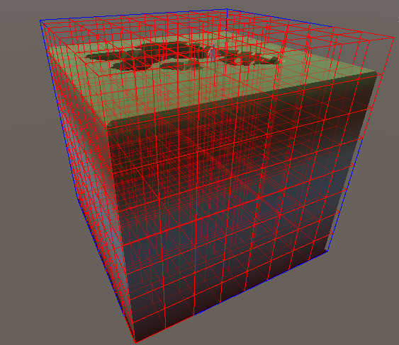
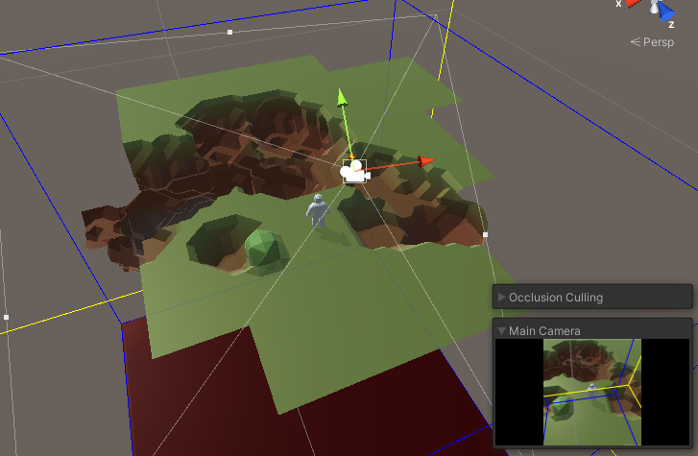
Segmentiranje polja
Nudi bolje performanse kod uređivanja polja i poligona
Izmjenjuju se samo manji dijelovi poligona
Omogućava Occlusion Culling

Slide 9
void Start()
{
Chunks = new MarchingCubesChunk[Width, Height, Depth];
Vector3 p = MinPoint;
Vector3 o = p;
for(int i = 0; i < Chunks.GetLength(0); i++)
{
p.y = o.y;
for(int j = 0; j < Chunks.GetLength(1); j++)
{
p.z = o.z;
for(int k = 0; k < Chunks.GetLength(2); k++)
{
GameObject g = new GameObject("Chunk_" + i + "_" + j + "_" + k);
Transform t = g.transform;
t.position = p;
t.parent = transform;
var ch = Chunks[i, j, k] = g.AddComponent<MarchingCubesChunk>();
var mr = g.GetComponent<MeshRenderer>();
mr.sharedMaterial = ChunkMaterial;
#if UNITY_EDITOR
ch.DebugDraw = false;
#endif
p.z += SegmentSize * (ChunkSize.z - 1);
}
p.y += SegmentSize * (ChunkSize.y - 1);
}
p.x += SegmentSize * (ChunkSize.x - 1);
}
}

Slide 10
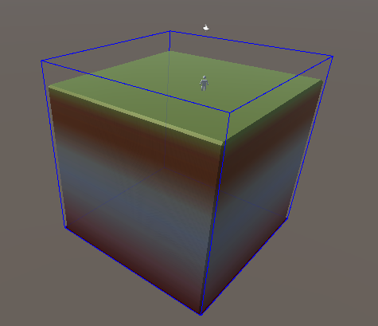
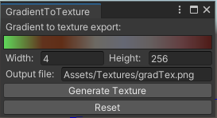
Bojanje dobivenih poligona
UV mape nema!
Može se postići triplanarnim mapping-om
Mreže su obojane gradijentom koji se evaluira s visinom (y koord.) točaka
!! Pokazati Shader Graph !!

Slide 11
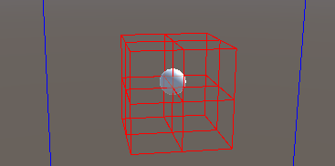
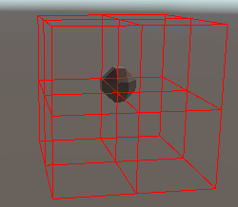
Crtanje po polju
U projektu: eksplozije, kopanje i stvaranje tla
Crtanje s kuglama
Kugla utječe na vrijednosti polja
Odrede se segmenti koje kugla pokriva
Svaki segment mijenja vrijednosti polja koje kugla sadrži
Nakon toga se segment ponovo nacrta

Slide 12
Crtanje po polju – odabir segmenata
public void DrawInSphereLossy(Vector3 pos, float radius, float value)
{
Vector3Int ZpInx = ChunckPos(pos + Vector3.forward * radius);
Vector3Int ZnInx = ChunckPos(pos - Vector3.forward * radius);
Vector3Int XpInx = ChunckPos(pos + Vector3.right * radius);
Vector3Int XnInx = ChunckPos(pos - Vector3.right * radius);
Vector3Int YpInx = ChunckPos(pos + Vector3.up * radius);
Vector3Int YnInx = ChunckPos(pos - Vector3.up * radius);
for (int i = XnInx.x; i <= XpInx.x; i++)
{
if (i < 0 || i >= Width)
continue;
for (int j = YnInx.y; j <= YpInx.y; j++)
{
if (j < 0 || j >= Height)
continue;
for (int k = ZnInx.z; k <= ZpInx.z; k++)
{
if (k < 0 || k >= Depth)
continue;
Chunks[i, j, k].DrawInSphereLossy(pos, radius, value);
}
}
}
}

Slide 13
Crtanje po polju – za pojedini segment
public void DrawInSphereLossy(Vector3 pos, float radius, float value)
{
value = Mathf.Clamp(value, ValueMin, ValueMax);
Vector3 inxf = ((pos - transform.position) / SegmentSize);
Vector3Int inx = new Vector3Int((int)inxf.x, (int)inxf.y, (int)inxf.z);
int ri = Mathf.CeilToInt(radius * 2f);
bool changed = false;
for (int i = inx.x - ri; i <= inx.x + ri; i++)
{
if (i < 0 || i >= Size.x)
continue;
for (int j = inx.y - ri; j <= inx.y + ri; j++)
{
if (j < 0 || j >= Size.y)
continue;
for (int k = inx.z - ri; k <= inx.z + ri; k++)
{
if (k < 0 || k >= Size.z)
continue;
Vector3 sp = transform.position + new Vector3(i, j, k) * SegmentSize;
float d = Vector3.Distance(pos, sp);
if (d <= radius)
{
Values[i, j, k] = Utils.Map(d, 0, radius, value, value > Surface ? Surface : ValueMin);
changed = true;
}
}
}
}
if (changed)
Redraw();
}

Slide 14
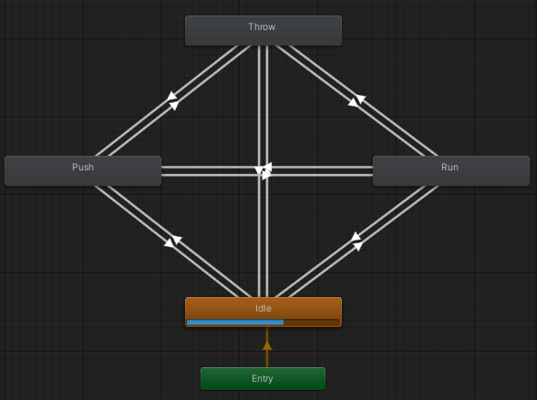

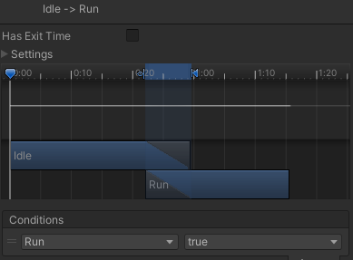
Animacije igrača – stickman-a
Kontrolirano automatom stanja za animacije
Upravljanje parametrima automata

Slide 15
Reference
9. prezentacija „Vizualizacija” od predmeta
Wiki: https://en.wikipedia.org/wiki/Marching_cubes
Sebastian Lague : https://www.youtube.com/watch?v=M3iI2l0ltbE
https://github.com/Scrawk/Marching-Cubes

