Slide 1
Chicago Police Department Resource allocation Strategy
By
Alfred Marshall Arockiaraj
(IBM Data Science Professional Certificate Capstone Project)

Slide 2
Problem: Chicago Police Department (CPD) facing funding cuts
Owing to the recent support for redistributing police funds to more appropriate segments of public safety, the CPD would be facing budget cuts in the future
With a corporate fund of only 4.5 billion dollars (2020), the move however seems inevitable (chicago.gov, 2020)
The study can help the CPD and the policy maker better understand the problems the city deals with, and better allocate the resources in the future.

Slide 3
Objective
The objective is to study the kind of crimes occurring in the city, their location and see if the police can be better prepared to tackle the rise in crime.
The Study undertaken should also recommend the kind of policing required and the timings that they would be most in demand.
This can enable the department to be better prepared in terms of the kind of personnel to train and the facilitate better scheduling for the available ones.

Slide 4
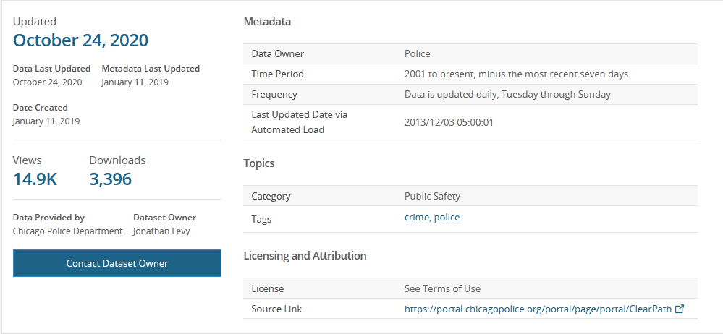
Data used : data.cityofchicago.org

Slide 5
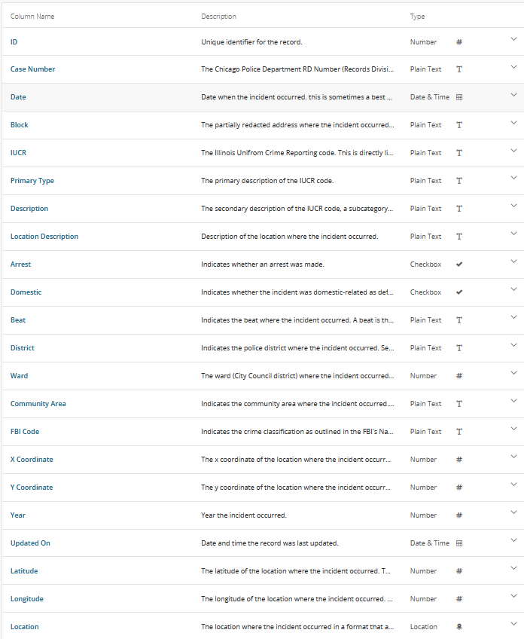
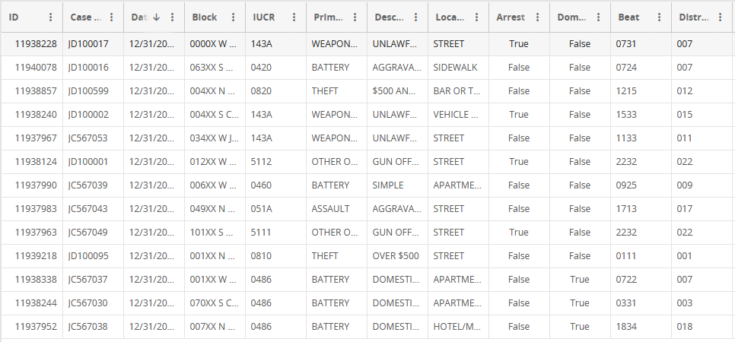
Data used : data.cityofchicago.org
Python, pandas and other imported packages will be used for the study

Slide 6
Features Extractable / Solution capability:
The data consists of the time, location and the type of crime One of the key areas of exploration will be the location. The partial location from the block and the ward can be easily visualized to better understand the problematic areas of the city.
Time data can explore into better scheduling for the city. This will help better plan the city’s response with adequate number of officers.
These two data can then be seen together to see if there is any co-relation between the time of day/month and the location in which these crimes occur. This will equip the police department to better allocate the resources at hand efficiently.
The description of the crime is another area of exploration. Something simple as a word cloud could provide inside into the type of crime beyond just the title, and also describe the frequency with which these crimes occur. The type of personnel to deal with these crimes can then be trained in the future.

Slide 7
Steps to achieve the goals
Find co-relation between location and crime
The location data (both latitude and longitude) and the crime type (called as the primary type) will have to be co-related. this can be done by using the map data. The Idea is to use the data available to visualize the crime on the maps themselves so as to start performing more complicated tasks on them.
Find co-relation between time of day/month and crime
The data-frame is assumed to have easily accessible data about the time/day/month of the recorded crime and the primary type of the crime. This can be tabulated to see if there is any co-relation between the data. One important point of investigation is to check if the time of the month (beginning or end) has more crime comparted to teh other.
Find the co-relation between the type of crime and the locations in which these crimes occur
The resources allocated will have to be managed according to the needs of the city. This can be improved if the data can show some co-relation between the location of the crime and crimes themselves. Simple query like: Is th eplace next to teh bar more or less likely to have DUIs. This will also have to be visualized.
Find similarities between the crime themselves
The crimes themselves could have a pattern. To check this the crimes will have to be clustered into different groups. To perform this K-Means method will have to be leveraged. The number of clusters will have to be iteratively found.
Any additional insight into the crime
Any suggestions for teh improved of better resource handling is also explored.

Slide 8
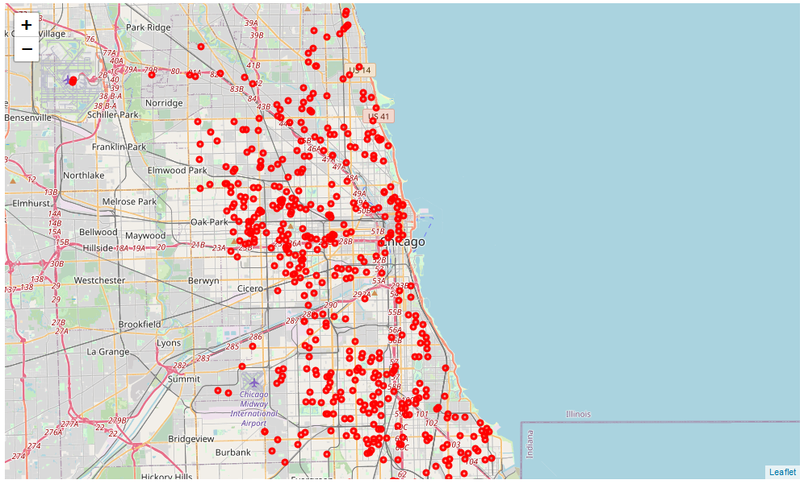
Map of Chicago with all crime superimposed

Slide 9
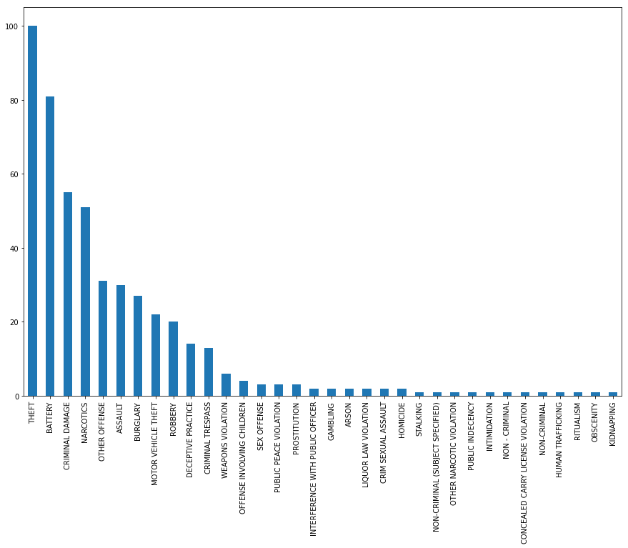
Count of individual crimes committed

Slide 10
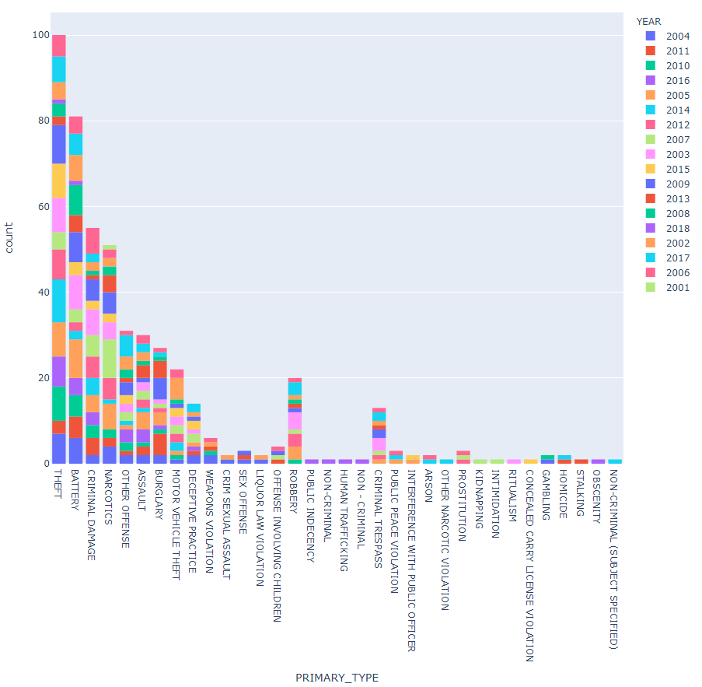
Count of individual crimes committed (over the years)

Slide 11
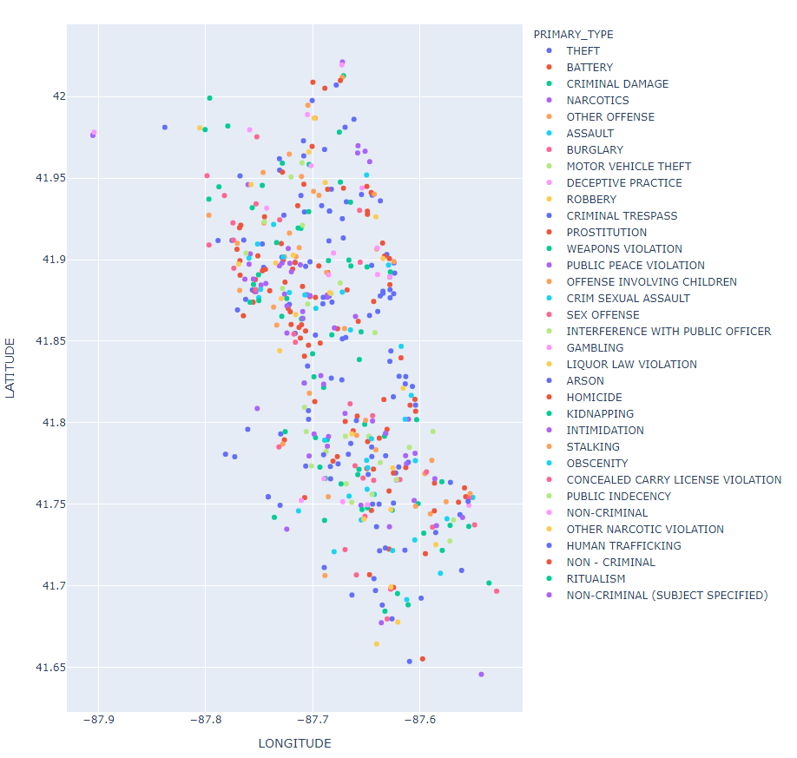
Relationship between the crime and the location
Clearly see that the crime along the Highway is prominent

Slide 12
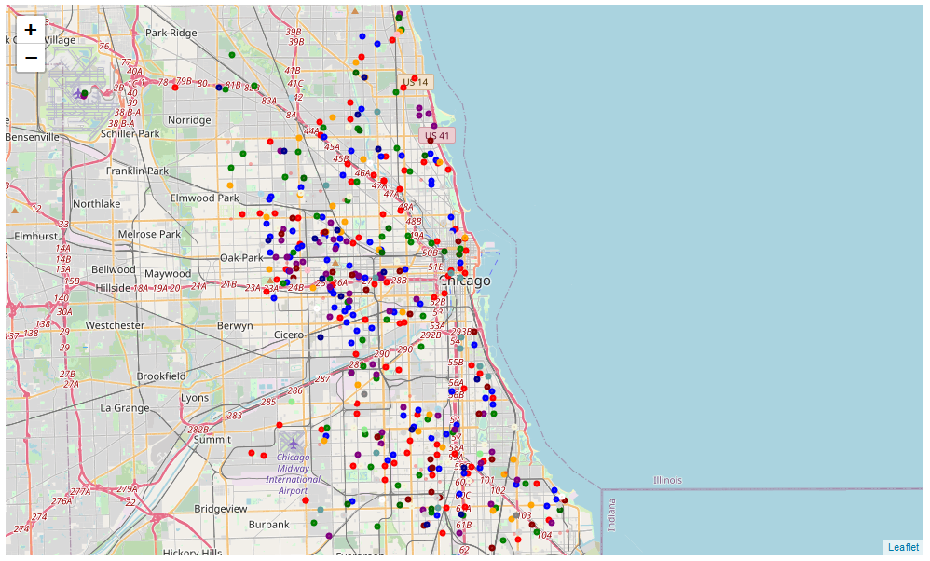
Relationship between the crime and the location – Key areas of interest
These two area face the most number of calls accounting for more than 40% of all crimes

Slide 13
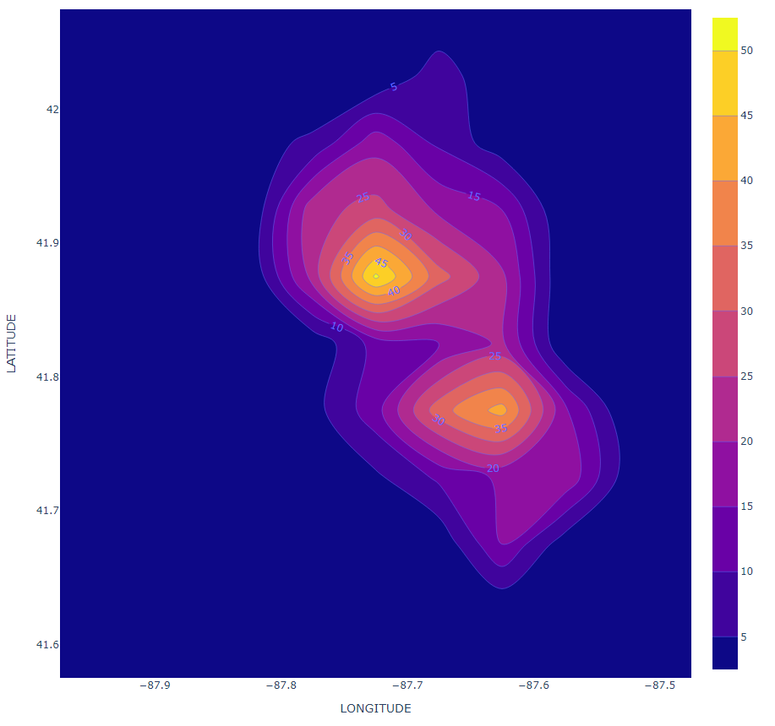
Relationship between the crime and the location – Key areas of interest
Oak park and the borough near the airport have the highest number of recorded crime

Slide 14
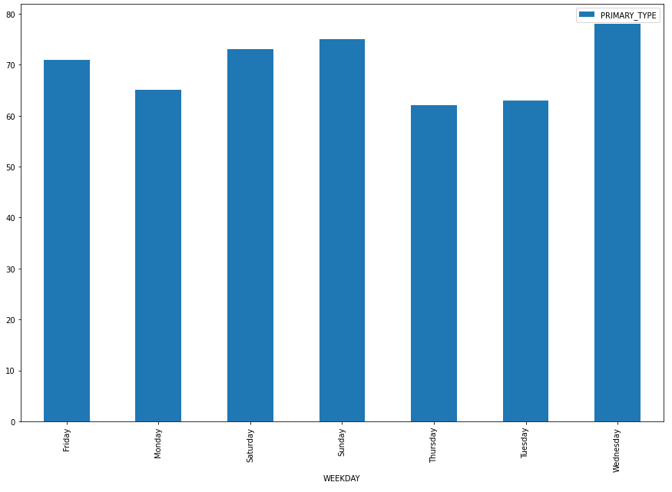
Relationship between time and the crimes
Weekend peak
Mid-week peak
Both are shown to require experienced staff

Slide 15
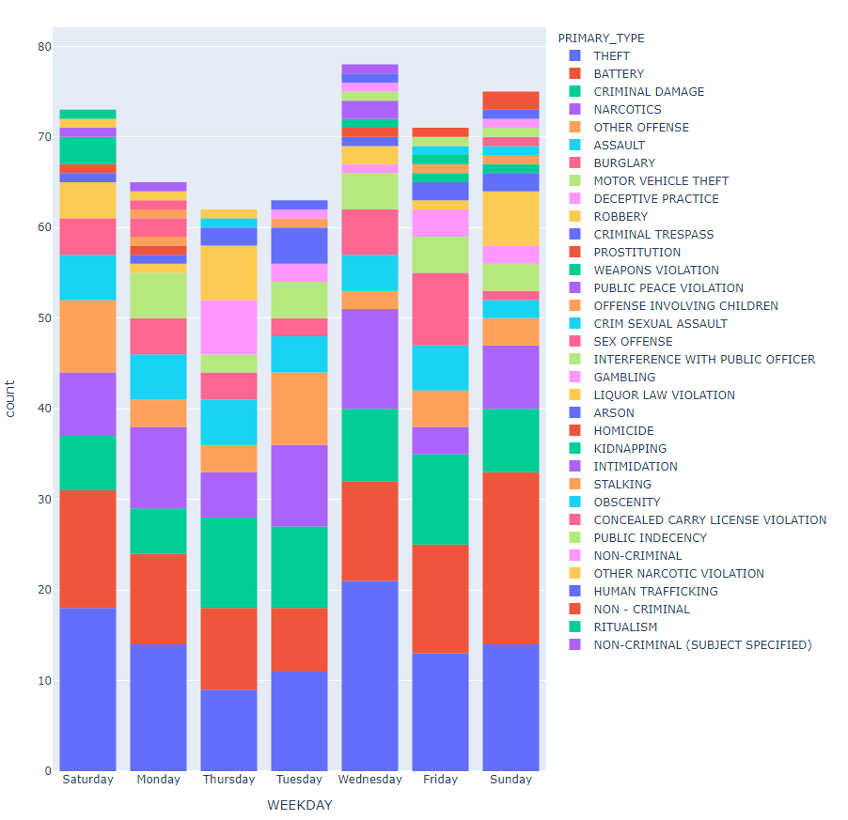
Relationship between time and the crimes

Slide 16
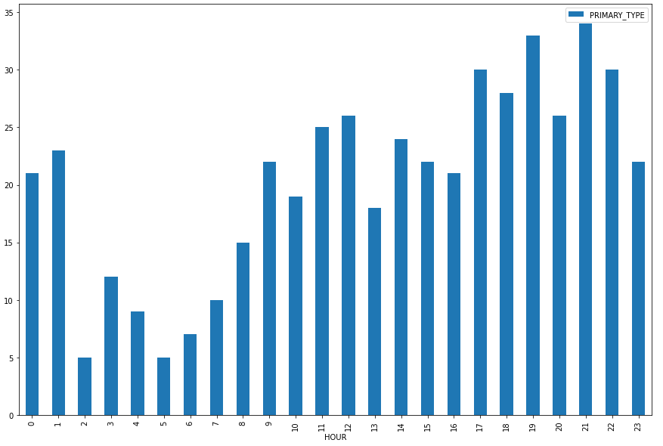
Relationship between time and the crimes
Rise of crime over the second to the third shift

Slide 17
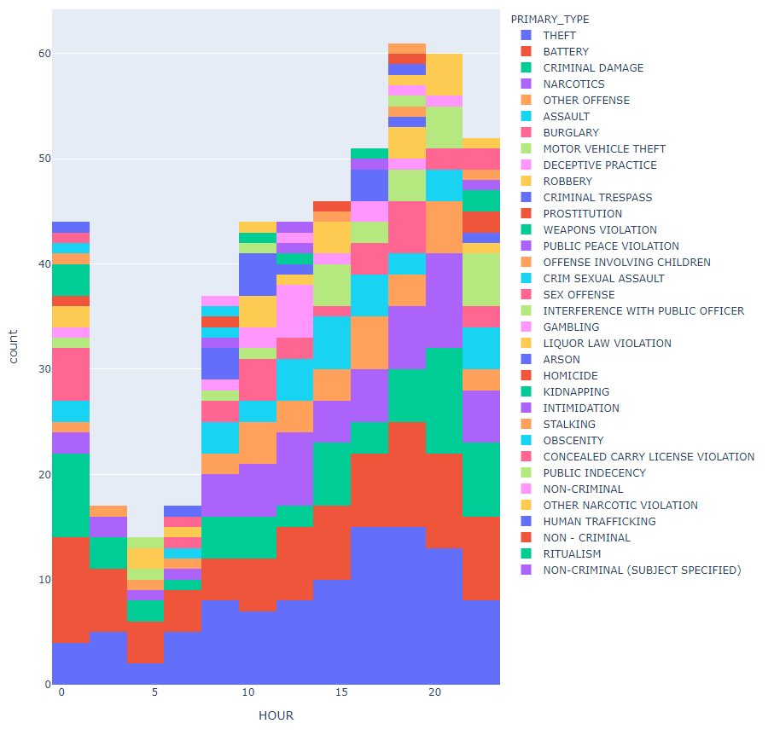
Relationship between time and the crimes

Slide 18

K-Means clustering

Slide 19
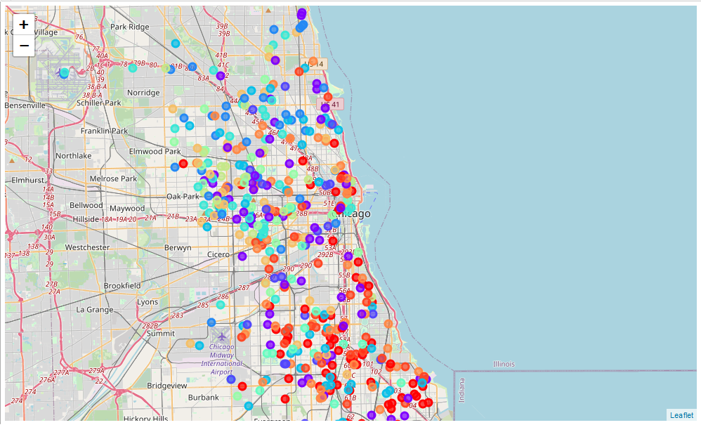
K-Means clustering
Indicating the difference between crime in the north and south sides of the city.
Indicates differently trained officers

Slide 20
Results
While the department spends a lot on gang tasks forces, military surplus gear and tactical training for officers, the majority of the crimes reported in Chicago is theft. especially in sparsely populated area of the airport and waterfront highway. Better surveillance, patrol and funds for the CI program could be a better place to spend the resources
Oak park is one of the most important places in the city that needs attention. A reported 35% of the crimes occur here and better tackling of there crimes could reduce the overall city crime-rate
Weekends and Wednesdays, during the third shift is the most important time for the officers to be vigilant. The steady rise in crime over the month could be crimes of need rather than crimes of passion.
A suspiciously lower among of data is found for the crime reported during the late-night shift
There appears to be clear distinction between the type of crimes that occur in the lower part of the city to the upper part of the city.

Slide 21
Suggestions
The resources available there for can be pivoted towards preventing these crimes through regular patrols. It is also to note that three of the top four are essentially victimless although damage to public property is incurred.
Regular surveillance and patrol are some of the suggestions to reduce the occurrences of theft in these special interest areas.
Oak park is the most crime prone area in the city with nearly 35% of the crimes occurring there. A simple suggestion would be to increase the outreach programs in this neighborhood. Further investigation leads to believe these are more gang related activities owing to the nature of the crimes committed there.
A suggestion would be to co-ordinate resources so as to have more experienced officers working the high spike times.
The crimes of needs (theft committed over the later part of the month) oculd be tackled with better outreach programs that help the community
The police should prepare for battery and other violent charges during the weekend.
The police officers working the areas on the lower half of the city need much different set of skills tha the once working on the upper part of the city.

