Slide 1

FSAE Tire Temperature Visualization
ECE3220 Final Project
Marshall Lindsay
Max Houck

Slide 2
Background Information

Slide 3
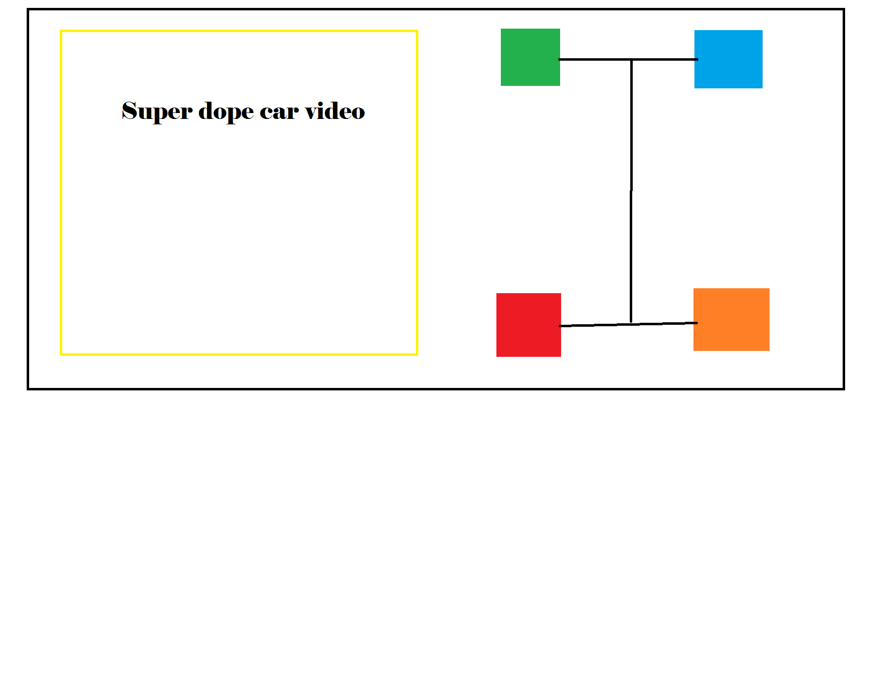
The Vision

Slide 4
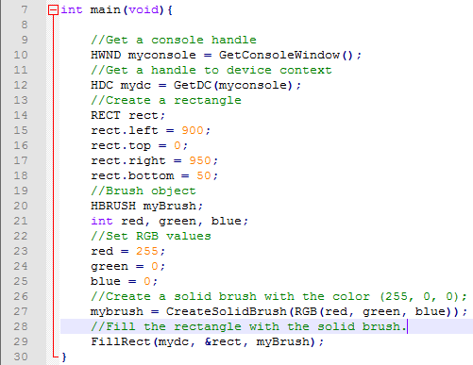

Printing Filled Rectangles
Windows.h
RECT – left, right, top, bottom
HBRUSH (SolidBrush)
RGB(red, green, blue)
FillRect

Slide 5
Linear Interpolation of Data Points
Solid colors are nice, but lack detail.
What is the temperature between the different points?
Solution: Interpolate data points between the measured locations.
Linear interpolation.
Y = mX + b where m = (y1 – y2)/(x1 – x2)
Quadradic interpolation
Y = a(x-h)^2 + c where ‘h’ is the x offset and ‘a’ scales the rate

Slide 6
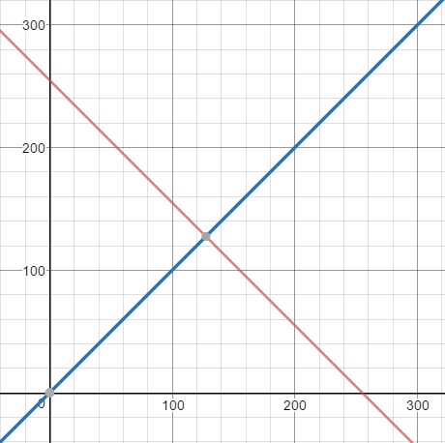

Linear Interpolation Between 2 Points
RED = -RGB + 255
BLUE = RGB
Color(true RGB) = (RED, 0, BLUE)
Pros:
Nice gradient between points
Covers “hot” and “cold” conditions
Cons:
Lacks color
No one wants a 2 color heat map!

Slide 7
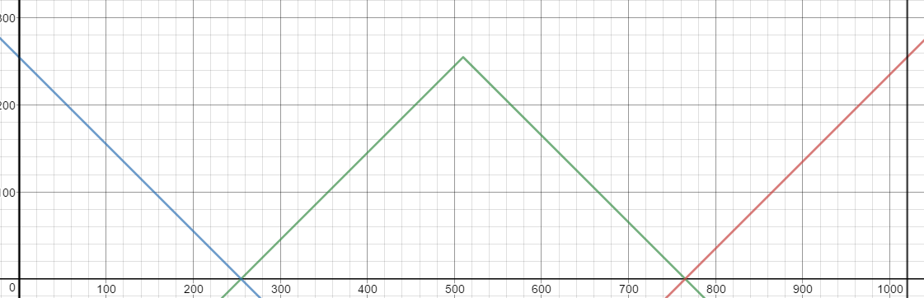

1020 RGB Linear Interpolation
3 colors (Red, Green, Blue) each with a range of 255 –>
1020 different values (Assuming start condition of max blue and end condition of max red).
Pros:
Lots of color.
Not only hot and cold but warm
Cons:
No color between heat zones
Hot? Cold?
No gradient

Slide 8
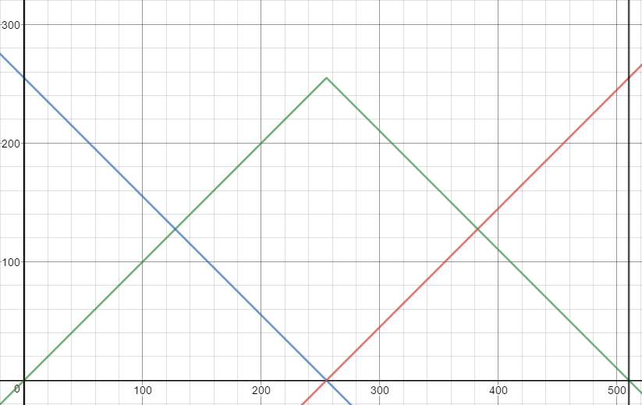
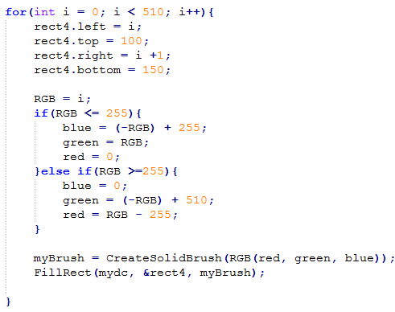

510 RGB Linear Interpolation
Cut the number of RGB values in half.
Pros:
Lots of color and color variants
Easy to tell hot from cold from warm
Great looking gradient between colors
Cons:
None.

Slide 9
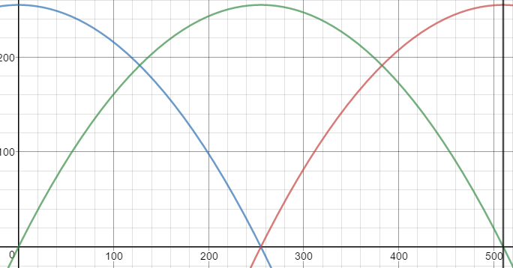
510 Quadratic RGB Interpolation

Slide 10
RGB Gradient Given 3 Celsius Values
Problems
510 gradient assumes constant gradient between all 3 points.
3 Celsius values are (assumed to be) random at any point in time. Therefore the slope between any two points is also random.
Conversion between Celsius and RGB
Converting from RGB to “true” RGB from graphs and equations

Slide 11
Celsius to RGB Conversion
Assumptions:
Max degree Celsius – 110
Min degree Celsius – 0
510 Linear RGB Interpolation
RGB = (Scaling Factor)(Degree C)
Scaling Factor is a ratio
Scaling Factor = #RGB values / #Possible Degree C = 510 / 110

Slide 12
Celsius to RGB Conversion
RealRGB
‘RGB’

Slide 13

RGB Gradient – 3 Celsius Values

