Slide 1

FSAE Tire Temperature Visualization
ECE3220 Final Project
Marshall Lindsay
Max Houck

Slide 2

What is Formula SAE?
Mostly Mechanical, Electrical, Computer Engineering Undergrads
Design and manufacture a ¼ scale formula style racecar every year
Compete in both driving and engineering design events
Headed to competition at FSAE Michigan in 4 days

Slide 3
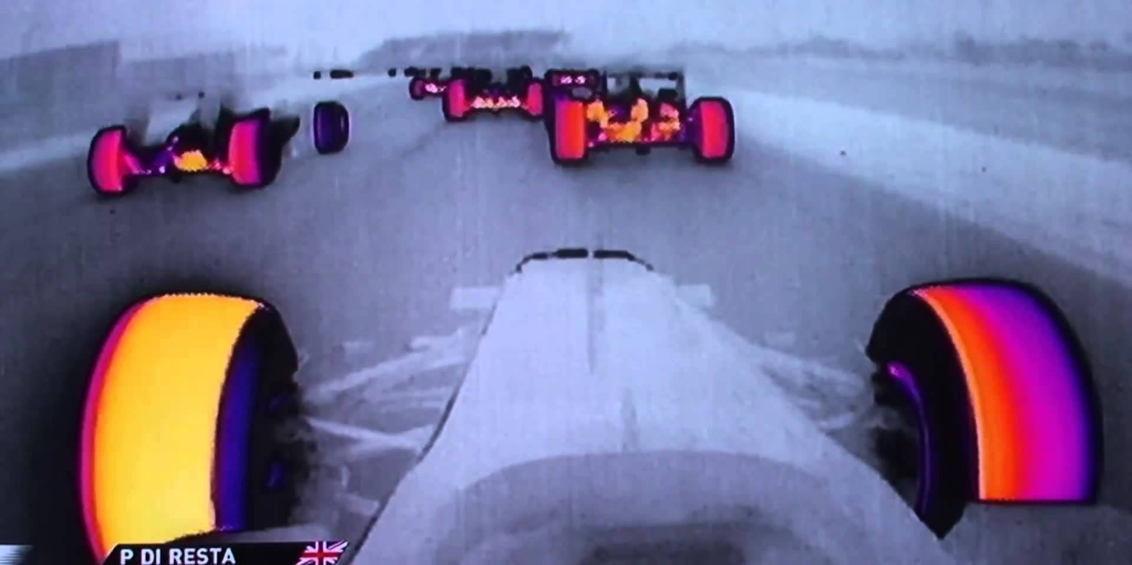

Tire Temperature Sensors
Simple, cheap sensors designed by a previous student and used for data acquisition
Important to ensure suspension is acting properly and the tire is being properly utilized
Raw data is acquired via the car’s datalogging system but is difficult to interpret
Formula 1 IR Cameras
SOLIDWORKS SCREENSHOT
Mizzou Racing Tire Temp Sensors

Slide 4
Implementation
Simple, easy to use graphics package
Data smoothing and filtering algorithms
Expandability, so project can be added onto in the future to make it more useful
Integrate concepts outside the scope of this course
View logged data and also form a basis for real time telemetry

Slide 5
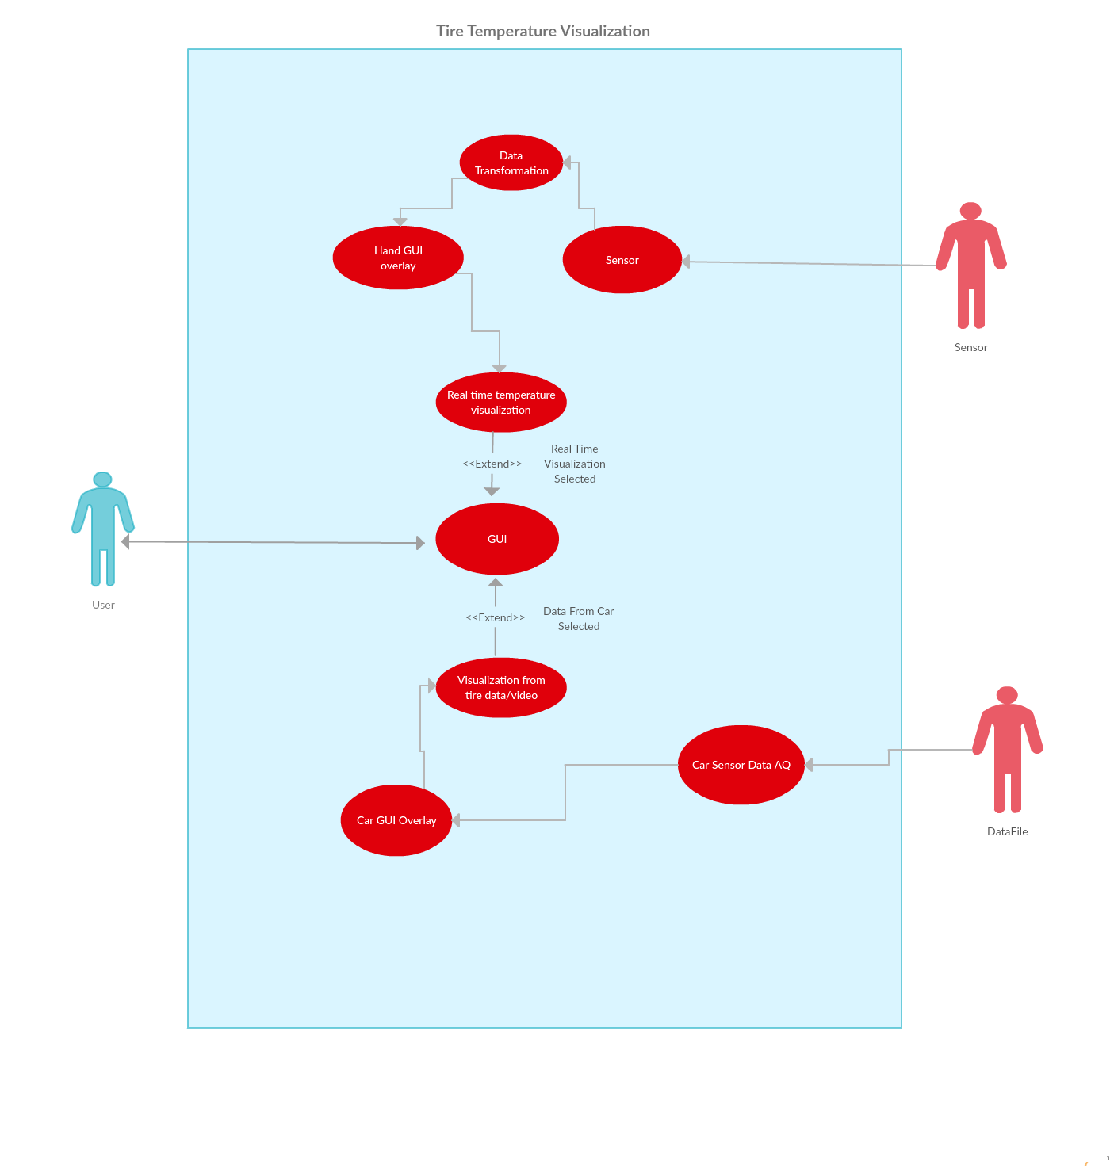
Use Case

Slide 6




Graphics
Implemented using a built-in windows.h library
Very simple to use as a proof of concept
A more complex graphics package may be implemented in the future
Color gradients were created using 510 and 1020 RGB algorithms
Iterations of color gradients
SCREENSHOT OF FINAL PRODUCT

Slide 7
Data Filtering
Several approaches were implemented and tested
Buffered averaging
Linear interpolation
Smooth out erroneous data and make the graphics look nicer, while still maintaining meaningful data

Slide 8
Demo

Slide 9
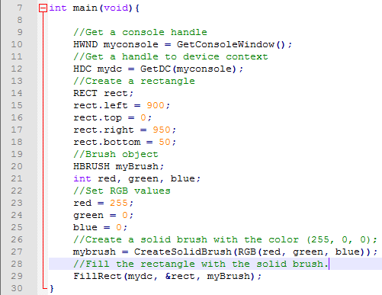
Printing Filled Rectangles
Windows.h
RECT – left, right, top, bottom
HBRUSH (SolidBrush)
RGB(red, green, blue)
FillRect

Slide 10
Linear Interpolation of Data Points
Solid colors are nice, but lack detail.
What is the temperature between the different points?
Solution: Interpolate data points between the measured locations.
Linear interpolation.
Y = mX + b where m = (y1 – y2)/(x1 – x2)
Quadradic interpolation
Y = a(x-h)^2 + c where ‘h’ is the x offset and ‘a’ scales the rate

Slide 11
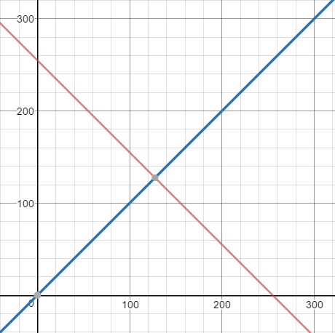
Linear Interpolation Between 2 Points
RED = -RGB + 255
BLUE = RGB
Color(true RGB) = (RED, 0, BLUE)
Pros:
Nice gradient between points
Covers “hot” and “cold” conditions
Cons:
Lacks color
No one wants a 2 color heat map!

Slide 12
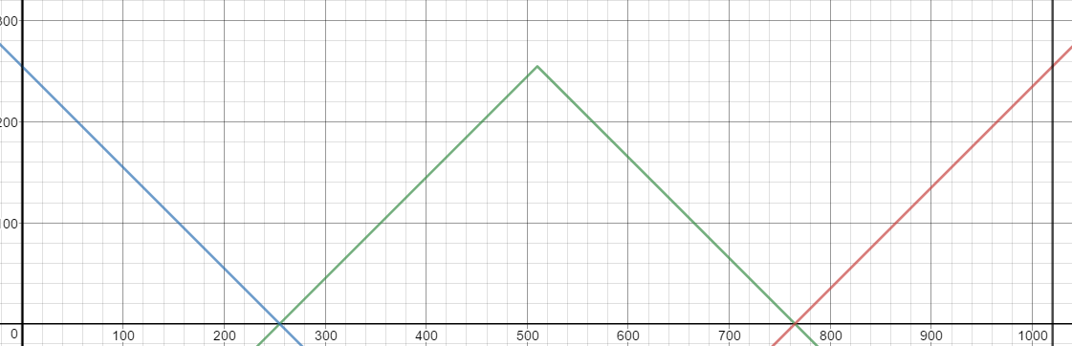

1020 RGB Linear Interpolation
3 colors (Red, Green, Blue) each with a range of 255 –>
1020 different values (Assuming start condition of max blue and end condition of max red).
Pros:
Lots of color.
Not only hot and cold but warm
Cons:
No color between heat zones
Hot? Cold?
No gradient

Slide 13
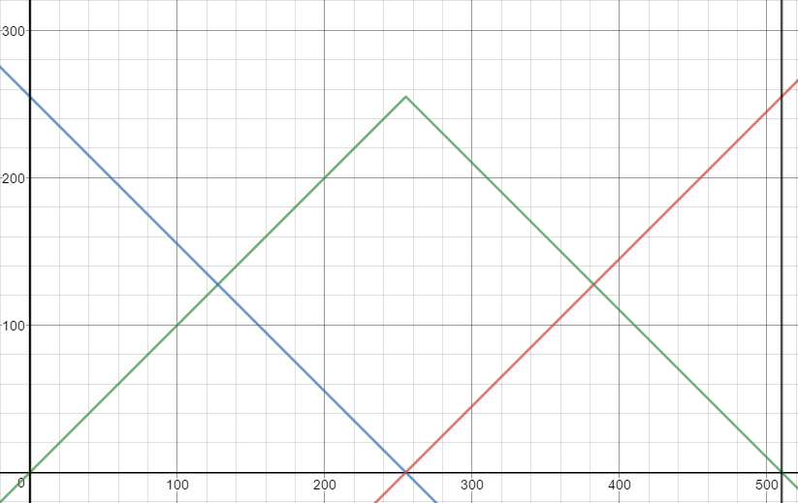
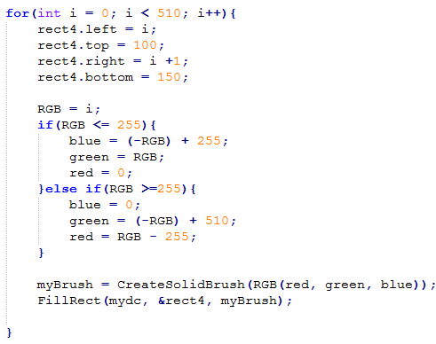
510 RGB Linear Interpolation
Cut the number of RGB values in half.
Pros:
Lots of color and color variants
Easy to tell hot from cold from warm
Great looking gradient between colors
Cons:
None.

Slide 14
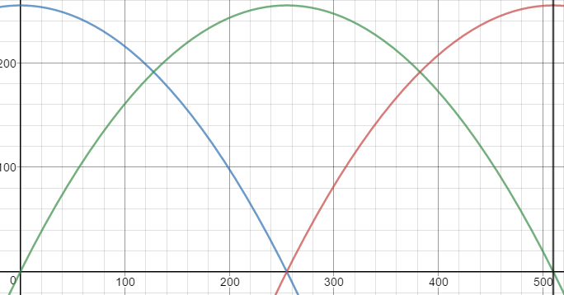
510 Quadratic RGB Interpolation

Slide 15
RGB Gradient Given 3 Celsius Values
Problems
510 gradient assumes constant gradient between all 3 points.
3 Celsius values are (assumed to be) random at any point in time. Therefore the slope between any two points is also random.
Conversion between Celsius and RGB
Converting from RGB to “true” RGB from graphs and equations

Slide 16
Celsius to RGB Conversion
Assumptions:
Max degree Celsius – 110
Min degree Celsius – 0
510 Linear RGB Interpolation
RGB = (Scaling Factor)(Degree C)
Scaling Factor is a ratio
Scaling Factor = #RGB values / #Possible Degree C = 510 / 110

Slide 17
Celsius to RGB Conversion
RealRGB
‘RGB’

Slide 18
RGB Gradient – 3 Celsius Values

