Slide 1

FSAE Tire Temperature Visualization
ECE3220 Final Project
Marshall Lindsay
Max Houck

Slide 2
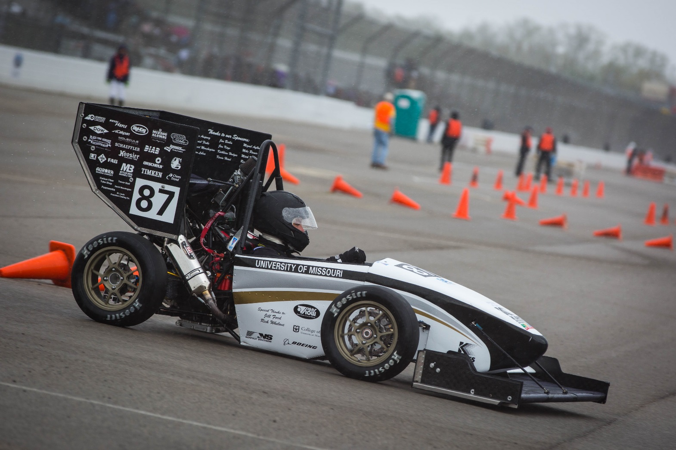
What is Formula SAE?
Mostly Mechanical, Electrical, Computer Engineering Undergrads
Design and manufacture a ¼ scale formula style racecar every year
Compete in both driving and engineering design events
Headed to competition at FSAE Michigan in 4 days

Slide 3
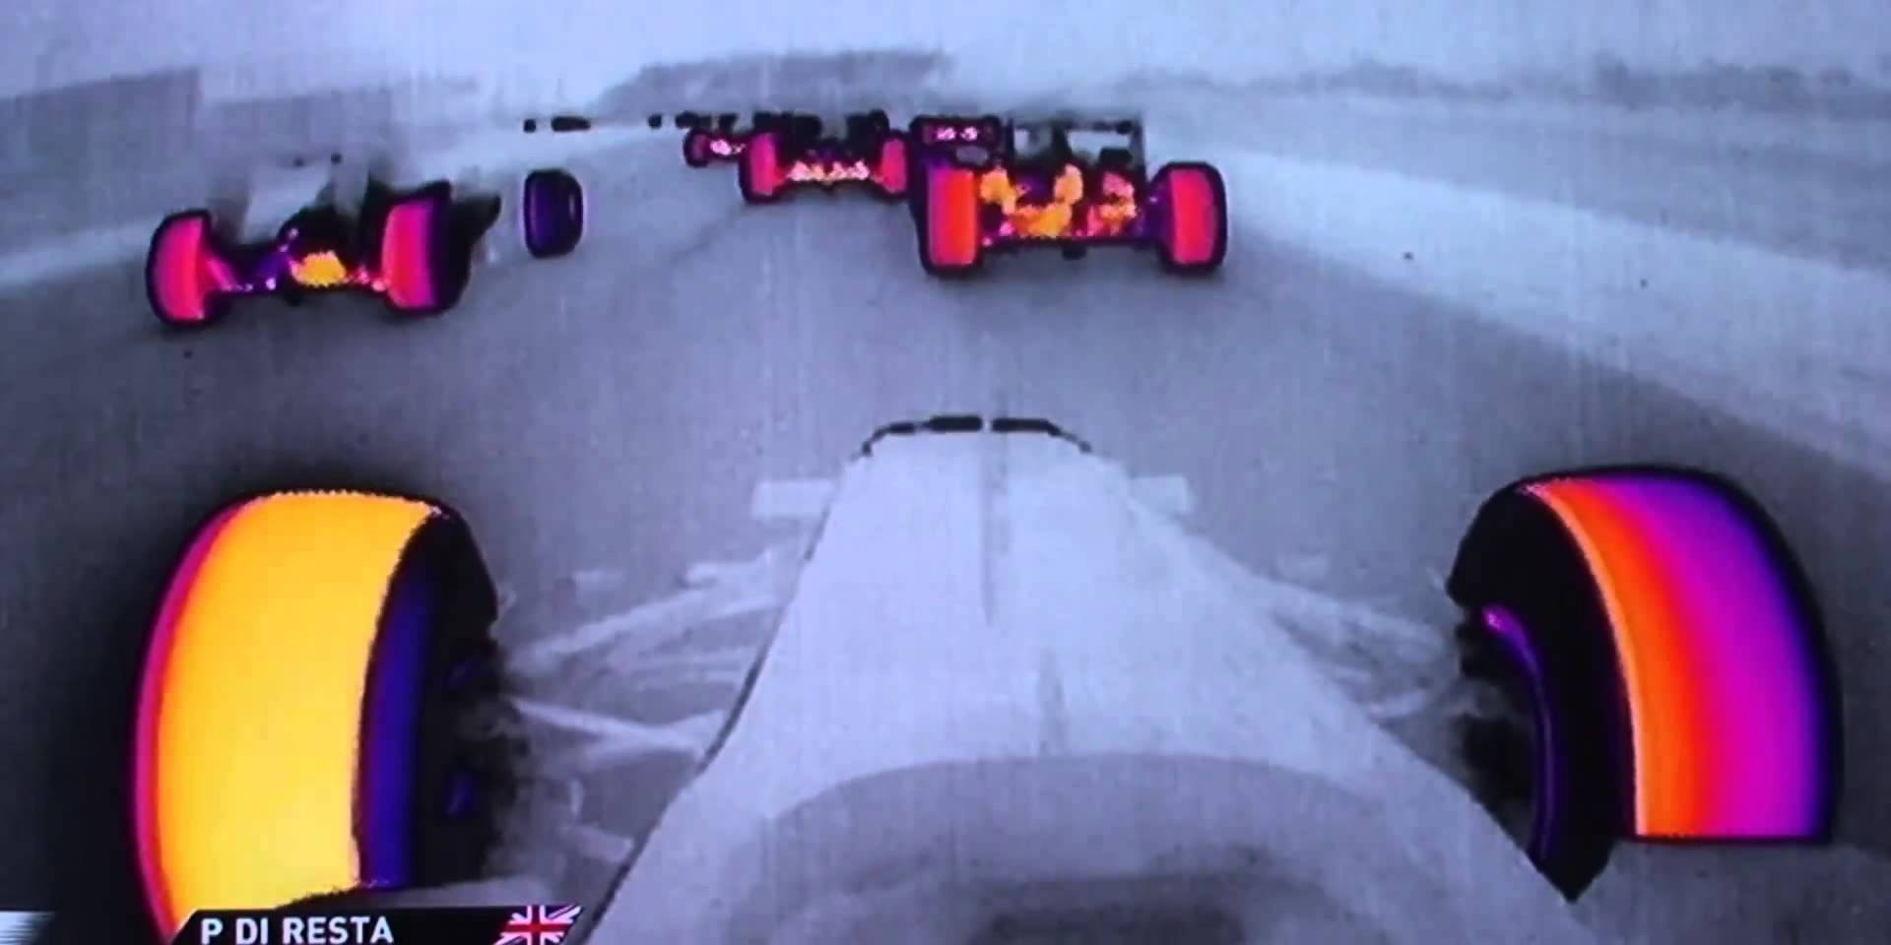

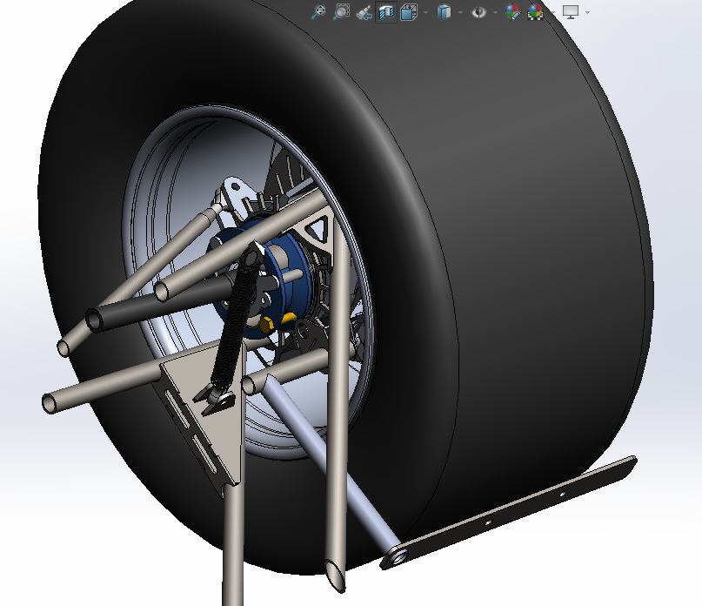
Tire Temperature Sensors
Simple, cheap sensors designed by a previous student and used for data acquisition
Important to ensure suspension is acting properly and the tire is being properly utilized
Raw data is acquired via the car’s datalogging system but is difficult to interpret
Formula 1 IR Cameras
Mizzou Racing Tire Temp Sensors

Slide 4
Implementation
Simple, easy to code graphics package
Data smoothing and filtering algorithms
Expandability, so project can be added onto in the future to make it more useful
Integrate concepts outside the scope of this course
View logged data and also form a basis for real time telemetry

Slide 5




Graphics
Implemented using a built-in windows.h library
Very simple to use as a proof of concept
A more complex graphics package may be implemented in the future
Color gradients were created using 510 and 1020 RGB algorithms
Iterations of color gradients
SCREENSHOT OF FINAL PRODUCT

Slide 6
Data Filtering
Several approaches were implemented and tested
Buffered averaging
Linear interpolation
Smooth out erroneous data and make the graphics look nicer, while still maintaining meaningful data
Works for raw data from .txt file and with incoming real time data

