Slide 1
A Federated Approach
for Classification of Alzheimer's Disease
Task 5: Based on Paper Second Draft
Team: 22
Name: Sameha Kamrul, ID: 23266016
Name: Rifat Alam Pomil, ID: 23266028
Name: Marshia Nujhat, ID: 23266030
Name: Ahmed Mahir Ruhan, ID: 23366025
CSE707: Distributed Computing Systems
Instructor: Annajiat Alim Rasel (AAR)
RA: Md. Sabbir Hossain
ST: Farah Binta Haque

Slide 2
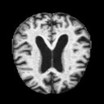
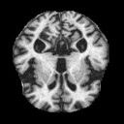
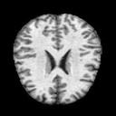
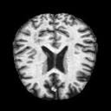
Dataset
6400 MRI images (128, 128)
Collected from Kaggle
4 classes
Class Name | Number of images
Mild Demented | 896
Moderate Demented | 64
Non Demented | 3200
Very Mild Demented | 2240

Slide 3
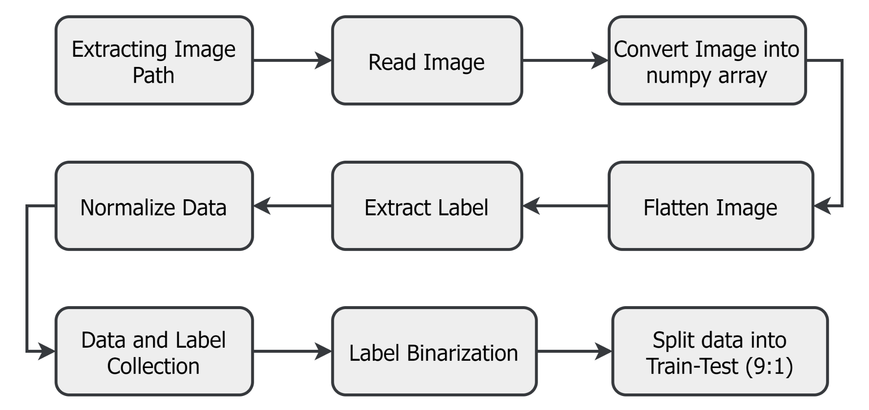
Data Preprocessing
Figure: Dataset Preparation Process

Slide 4
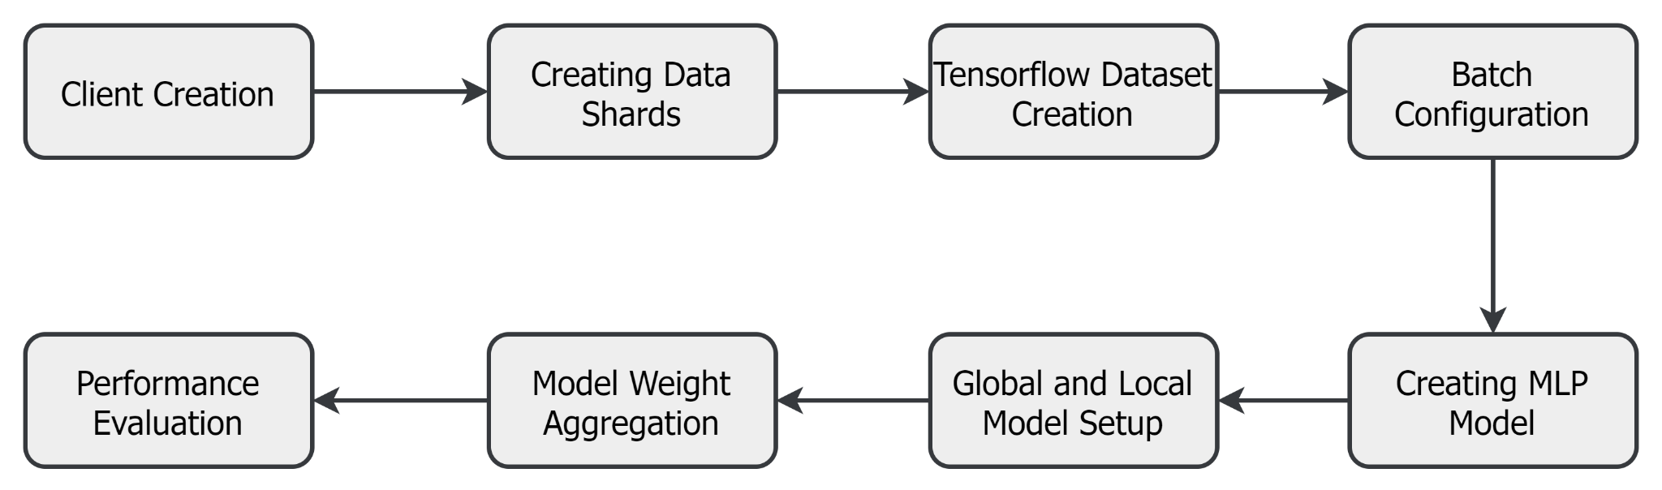
Methodology
Figure: Model Architecture

Slide 5
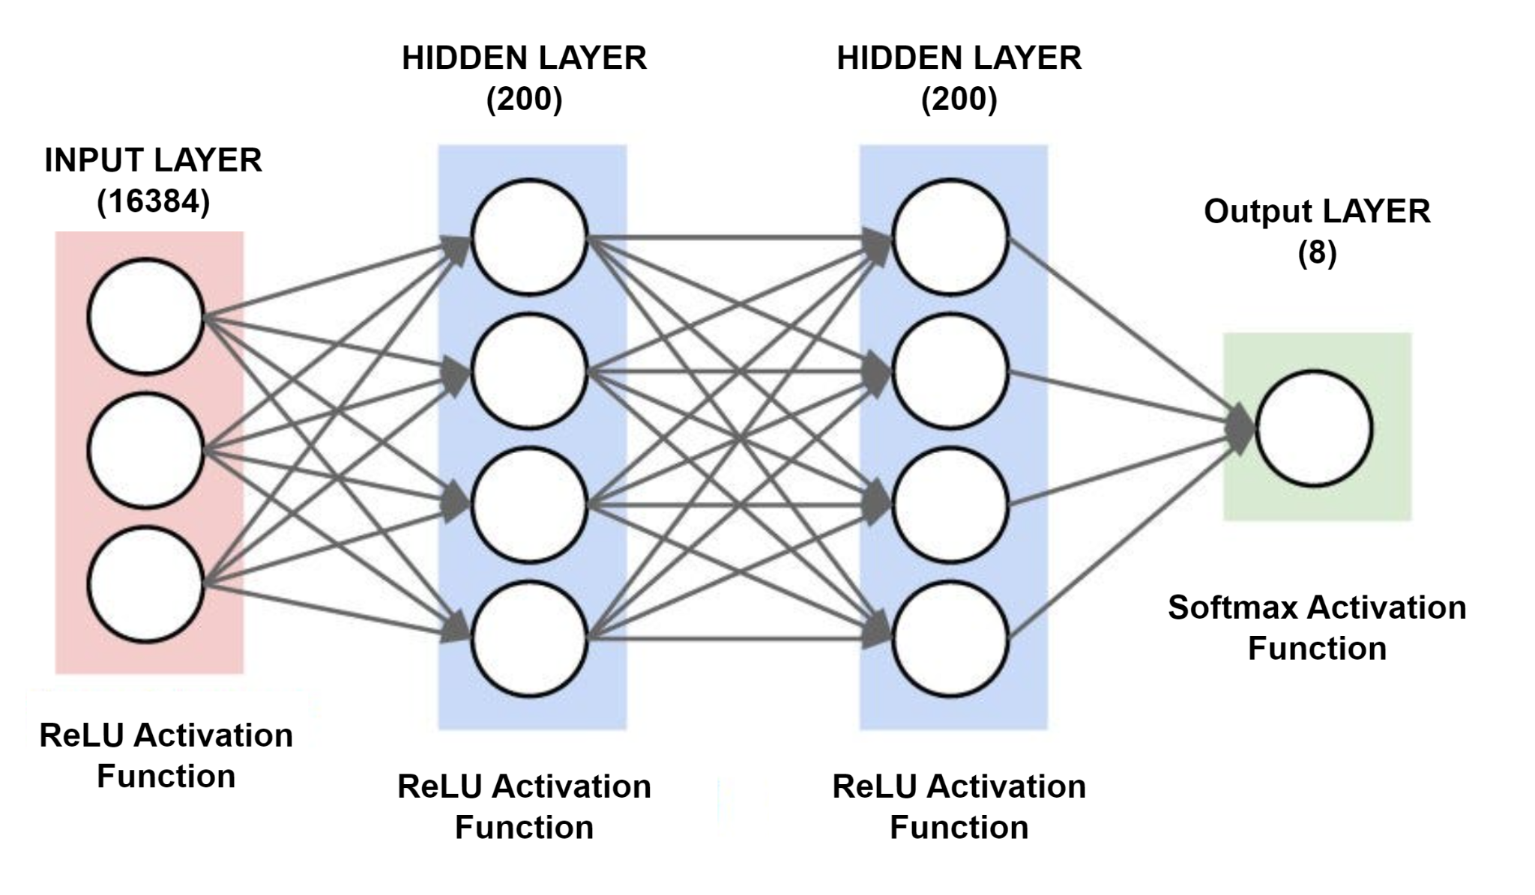
Methodology
Figure: MLP Model

Slide 6
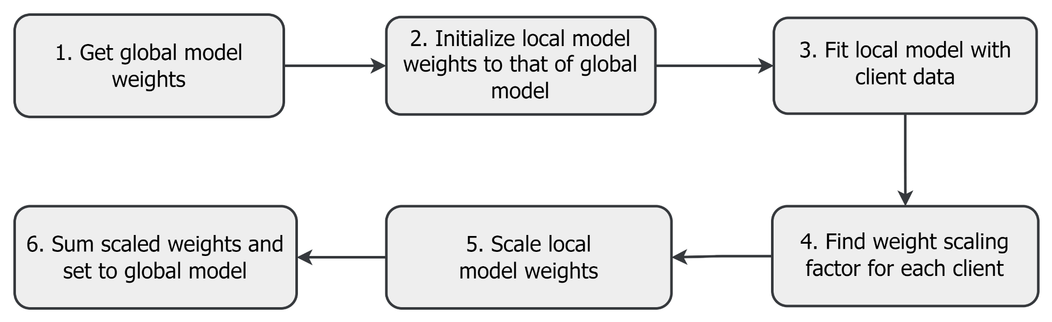
Methodology
Figure: Model Weight Aggregation

Slide 7
Methodology
200 communication rounds
Loss - categorical_crossentropy
Metrics - accuracy
Optimizer - SGD
Learning Rate - 0.01

Slide 8
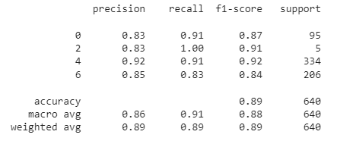
Result Analysis
Figure: Classification Report of Global Model

Slide 9
Result Analysis
Global Model Accuracy on test data | 89%
Global Model Loss on test data | 1.52%

Slide 10
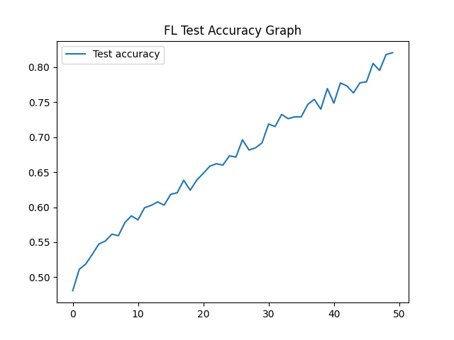
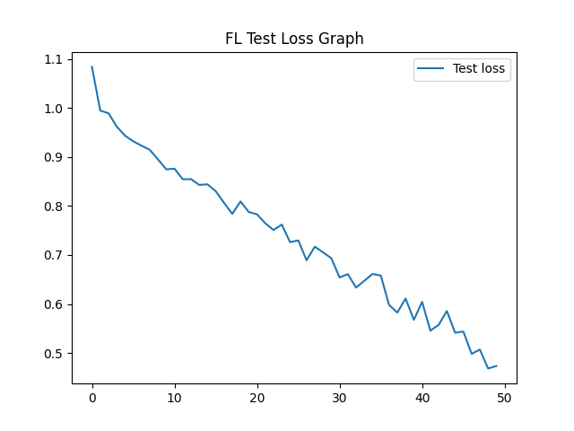
Result Analysis
Figure: Accuracy Graph of Global Model on Test Data
Figure: Loss Graph of Global Model on Test Data

Slide 11
Limitations
Insufficient data
-Imbalanced class dataset
Absence of CNN architecture
-Communication Overhead
Higher learning rate
-Skipping Over Optimal solution

Slide 12
Thank you!

