Slide 1
A Federated Approach for Classification of Alzheimer's Disease
Task 3 : Based on Research Proposal
Team: 22
Name: Sameha Kamrul, ID: 23266016
Name: Rifat Alam Pomil, ID: 23266028
Name: Marshia Nujhat, ID: 23266030
Name: Ahmed Mahir Ruhan, ID: 23366025
CSE707: Distributed Computing Systems
Instructor: Annajiat Alim Rasel (AAR)
RA: Md. Sabbir Hossain
ST: Farah Binta Haque

Slide 2
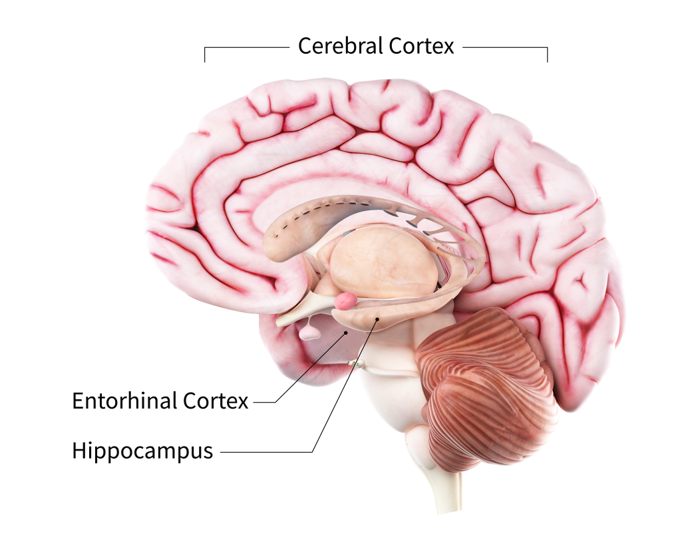
What is Alzheimer’s Disease?
Most common type of dementia.
More common among elderly people.
Effects part of the brain starting from hippocampus and entorhinal cortex and may lead to the cerebral cortex.
Many stages of Alzheimer’s -
Mild, Very mild, Moderate, Severe stage etc.
1/12 people aged above 60 in Bangladesh.
https://www.nia.nih.gov/health/alzheimers-causes-and-risk-factors/what-happens-brain-alzheimers-disease

Slide 3

Why is Early Detection Necessary?
Accurate Diagnosis
Effective Treatment
Detecting other Health Risk Factors
Mental and Social Well Being

Slide 4
Use of ML for Detection
Many Machine Learning techniques widely used for Alzheimer’s disease detection.
Centralized models have achieved high achieving results.
Ex: In the paper, “A CNN based framework for classification of Alzheimer’s disease” by AbdulAzeem Y. et al. proposed a model that achieved 99.6%, 99.8% and 97.8% accuracy on classifications on the ADNI dataset.
Privacy issues with medical data.
Approach needed to prevent sharing of actual data for model training.

Slide 5
Federated Learning
Decentralized and collaborative approach.
Enables the use of local model’s parameters to train a global model while ensuring the privacy and security of data.
Uses a number of clients.
Comparable results with centralized approaches.
Local Weights
Local Weights
Global Model
Local Weights
Local Weights

Slide 6
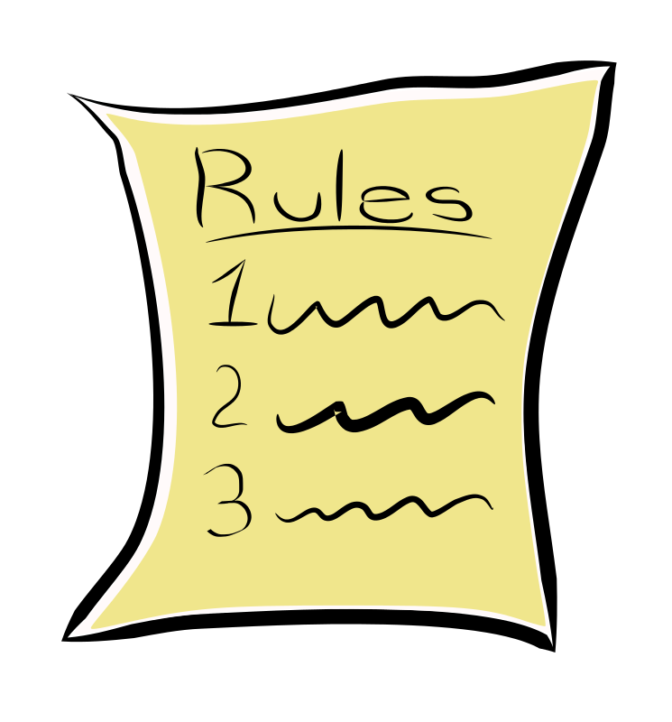
Why use Federated Learning for Detection of Alzheimer’s Disease?
Privacy Concerns
Healthcare Regulations
Richer dataset
Actual data not shared

Slide 7
Our Methodology
Step 1:
Gathering an appropriate dataset with different levels of Alzheimer’s disease.
Step 2:
Preprocessing of Data
Step 3:
Client Creation
Step 4:
Use Federated based model for training the data
Step 5:
Evaluation of classification results and accuracy of the model

Slide 8
Workflow
Mild Demented
Very Mild Demented
Moderate Demented
Non Demented
(Accuracy of how these stages are classified evaluated)
Global model
Model weights
Preprocessed data
Local models/ Clients

Slide 9
Challenges
Scarcity of Alzheimer’s patient data
Imbalanced dataset
Unstructured and non identical data
Privacy attacks and malicious threats
Comparison of accuracy with centralized models
Lack of resources in hospitals

Slide 10
Future Prospects
Can be used in other fields where sharing of information is sensitive.
Scope of retraining model for additional locally available data.
Generalized model which can handle variations in datasets
Standardizing the global models for multiple healthcare organizations

Slide 11
References
https://www.tbsnews.net/bangladesh/health/1-12-bangladeshi-elderly-have-dementia-survey-268675
https://altoida.com/blog/patients-ask-why-is-early-detection-of-alzheimers-important/
Nazir, S., & Kaleem, M. (2023). Federated Learning for Medical Image Analysis with Deep Neural Networks. Diagnostics 2023, 13, 1532. https://www.mdpi.com/2075-4418/13/9/1532

Slide 12
A Federated Approach for Classification of Alzheimer's Disease
THANK YOU!

