Slide 1
Review of the paper,
Federated Learning to Safeguard Patients Data: A Medical Image Retrieval Case
Authors: Singh, G.; Violi, V.; Fisichella, M.
Laboratory ARTS, University Mediterranea of Reggio Calabria,
Department of Information Engineering, University of Pisa,
L3S Research Center, Leibniz University Hannover
CSE707: Distributed Computing Systems
Instructor: Annajiat Alim Rasel (AAR)
RA: Md. Sabbir Hossain
ST: Farah Binta Haque
Team: 22
Name: Marshia Nujhat ID: 23266030

Slide 2
Outline
Section 1: Introduction
Section 2: Research Motivation
Section 3: Research Contribution
Section 4: Methodology
Section 5: Result Analysis
Section 6: Limitations
Section 7: Synthesis
Section 8: Reference

Slide 3
Section 1: Introduction
Decentralized and collaborative approach.
Local model or client parameters used to train global model.
Actual data not shared.
Ensures data security and privacy.
Widely useful for medical data training.
Global Server
Client1
Client2
Client3

Slide 4
Section 2: Research Motivation
Healthcare data collected from various institutions. May contain unstructured and textual data.
Quality of data is a major factor. Robust solution needed.
Resource intensive procedure for Federated learning approach.
Compatible GPUs needed.

Slide 5
Section 3: Research Contribution
Privacy oriented distributed learning solution that does not transmit the actual data back to the main model.
Robust solution. Does not depend on the quality of data.
Ensurance of scalability in terms of variations in client number.
Neural network designed to detect COVID-19 by X-ray images from other pathologies.

Slide 6
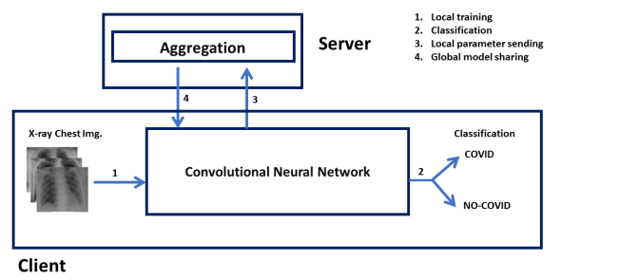
Section 4: Methodology
Reference: https://doi.org/10.3390/bdcc7010018

Slide 7
Section 4: Methodology
Supervised Classification Approach.
Dataset - Consisted of X-ray images of patients with COVID-19, pneumonia and other factors.
60% training, 20% test and 20% validation data.
Two distributions - IID and non-IID
CNN model with 17 Convolutional 2D layers, 1 Flattening, 1 Linear layer.

Slide 8
Section 5: Result Analysis
Scenario | IID | non-IID
FL with 5 clients | 97% | 93%
FL with 10 clients | 90% | 87%
FL with 15 clients | 93% | 85%
Centralized | 98% | 98%

Slide 9
Section 6: Limitations
First Limitation:
Centralized model with better accuracy, 98% for IID and non-IID cases both.
Second Limitation:
Less promising results for datasets that are not identical and independent.

Slide 10
Section 7: Synthesis
Cost of accuracy sometimes compared to centralized models.
To maintain privacy, federated model is an effective approach.
Maintaining same accuracy as centralized model while implementing privacy protection methods like differential privacy, data anonymization still pose a challenge.

Slide 11
Section 8: Reference
Singh, G., Violi, V., & Fisichella, M. (2023). Federated Learning to Safeguard Patients data: a medical Image retrieval case. Big Data and Cognitive Computing, 7(1), 18.
https://doi.org/10.3390/bdcc7010018

Slide 12
THANK YOU!

