Slide 1
A Federated Approach for Classification of Alzheimer's Disease
Task 6 : Based on Completed Paper
Team: 22
Name: Sameha Kamrul, ID: 23266016
Name: Rifat Alam Pomil, ID: 23266028
Name: Marshia Nujhat, ID: 23266030
Name: Ahmed Mahir Ruhan, ID: 23366025
CSE707: Distributed Computing Systems
Instructor: Annajiat Alim Rasel (AAR)
RA: Md. Sabbir Hossain
ST: Farah Binta Haque

Slide 2
Introduction
Early detection: Classification of a disease in an early stage is as important as taking precautions to it.
Disease : Alzheimer is one kind of dementia which progressively leads to short term memory loss
Approach : Federated Learning and Machine Learning

Slide 3
Federated Learning
Enables the use of local model’s parameters to train a global model while ensuring the privacy and security of data.
Decentralized and collaborative approach.
Local model parameters shared with a central or global server.
Comparable results with centralized approaches.

Slide 4
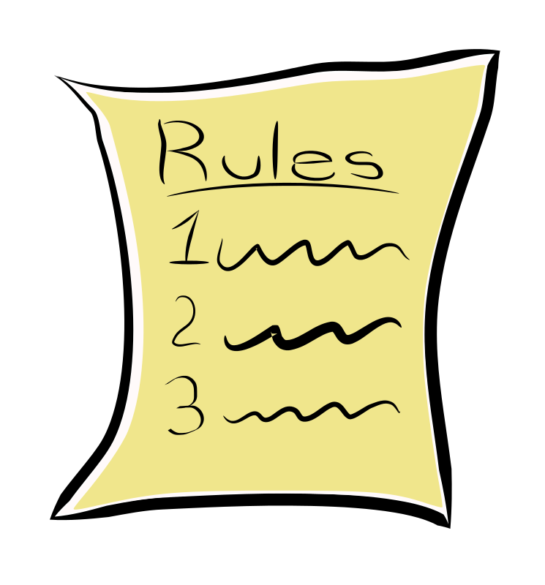
Why use Federated Learning for Detection of Alzheimer’s Disease?
Privacy Concerns
Healthcare Regulations
Richer dataset
Actual data not shared
Local Weights
Local Weights
Global Model
Local Weights
Local Weights

Slide 5
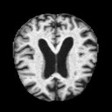
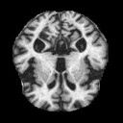
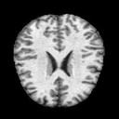
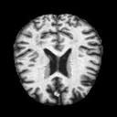
Dataset
6400 MRI images (128, 128)
Collected from Kaggle
4 classes
Class Name | Number of images
Mild Demented | 896
Moderate Demented | 64
Non Demented | 3200
Very Mild Demented | 2240

Slide 6
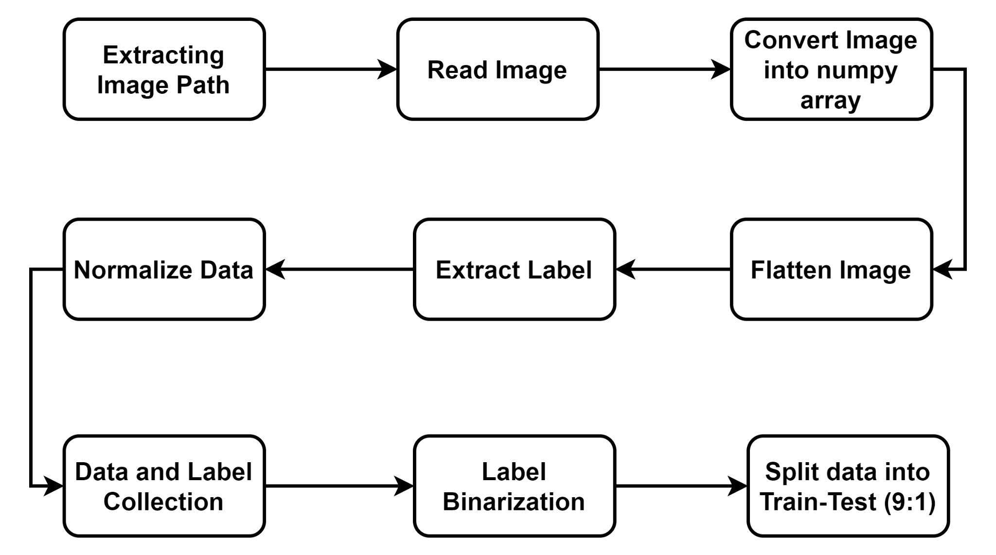
Methodology (Data Pre Processing)

Slide 7
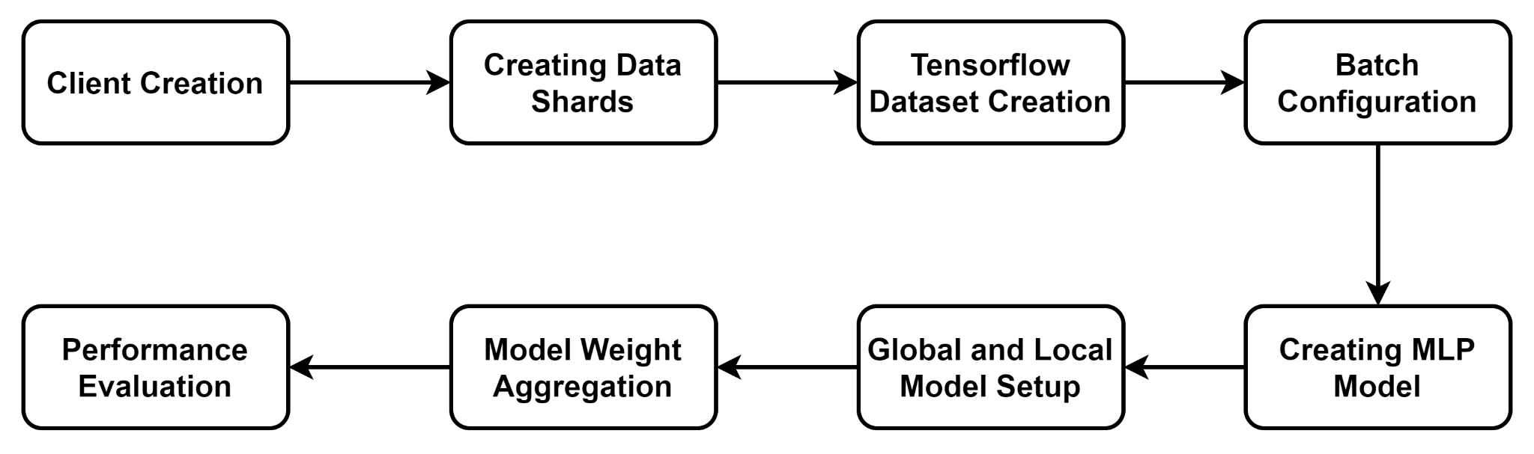
Methodology

Slide 8
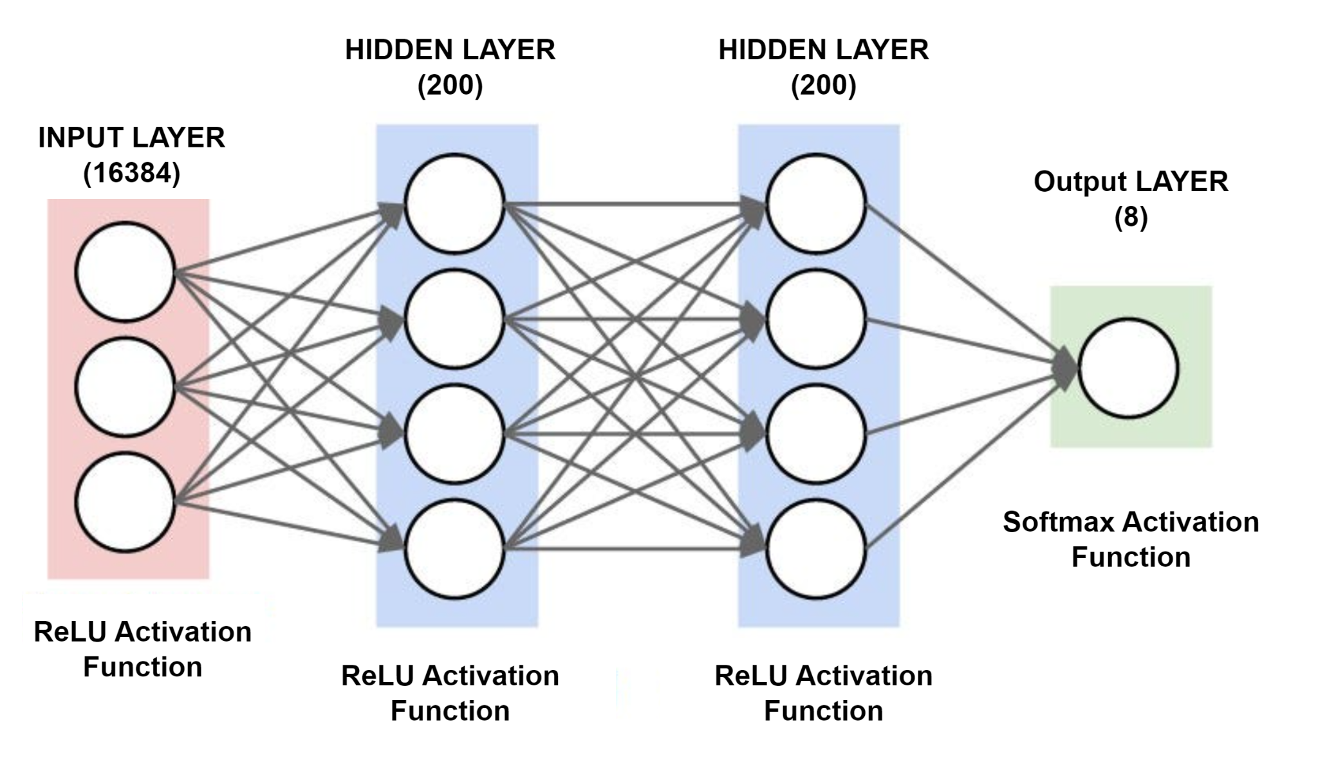
Methodology (Creating the MLP model)

Slide 9
Methodology (Model Weight Aggregation)
1. Get global model weights
2. Initialize local model weights to that of global model
3. Fit local model with client data
6. Sum scaled weights and set to global model
5. Scale local model weights
4. Find weight scaling factor for each client

Slide 10
Methodology
200 communication rounds
Loss - categorical_crossentropy
Metrics - accuracy
Optimizer - SGD
Learning Rate - 0.01

Slide 11
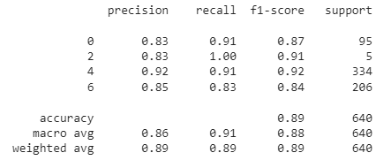
Result Analysis
Figure: Classification Report of Global Model

Slide 12
Result Analysis
Global Model Accuracy on test data | 89%
Global Model Loss on test data | 1.52%

Slide 13
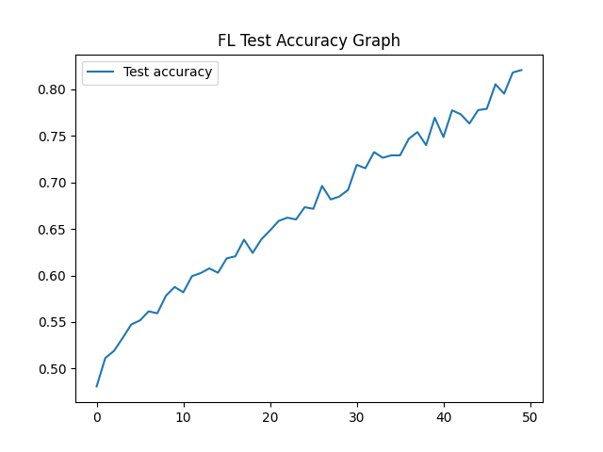
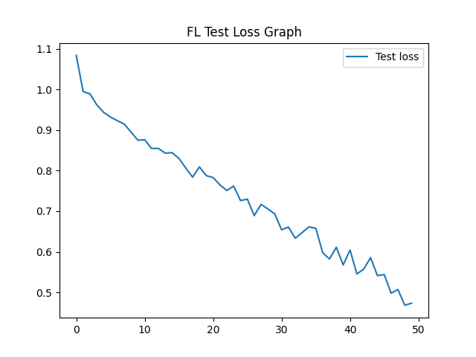
Result Analysis
Figure: Accuracy Graph of Global Model on Test Data
Figure: Loss Graph of Global Model on Test Data

Slide 14
Limitations
Insufficient data
-Imbalanced class dataset
Absence of CNN architecture
-Communication Overhead
Higher learning rate
-Skipping Over Optimal solution

Slide 15
Thank you!

