Slide 1


PRODUCT DESIGN
Version control
V0.1 Oct 14
Project: Site Merchandiser Dashboard Phase 2 (beta 1.1)
PM: April Zhou
App Arch: Wen Liu
Data Arch:
Lead Dev: Lingshan Wang, Hardy Li
QE: Xiaolan Chen
BU: Katie Johnson
Analytics: Bharat Padebettu
Platform:
Sponsor Executive:

Slide 2
PROBLEM STATEMENT
Customer/Persona
Site Merchandiser - As a merchandiser, I want to come to work everyday to drive engagement and sales for eBay by optimizing content / inventory on site
To know how my specific set of favorite pages (BN, Flexi, Events, Deals) performed at a total level, which helps to understand when and how the customer engaged with the page (or not)
To know how the performance trends and hot to interpret the drop or increases week over week with benchmark at site wide data and individual category level.
Identify high performing pages to ensure the content quality (enough inventory on event or deals pages, events/LHN links on Flexihub etc) Identify low performing pages to optimize content/inventory or update creative
To have the internal traffic source breakdown and update SEO keyword when there’s any issue identified
Objective/User story
Drive engagement of users with modules
improve CTR/CER*
Provide users relevant content and products:
drive GMV attribution
Measurement/Success Criteria
Page group performance summary helps determine future decisions and provide guidance for areas to investigate where the SM needs to research next
Curate page content (item price, available quantity, module ranking) and update creatives (match item value prop. e.g. offer of 30% off)
Identify the traffic/engagement efficiency and fix underperforming channel (e.g. fix SEO by changing keyword, brand, modules, report module error/low impression to product team etc)
Actions derived from tool
*CER = Content Engagement Rate which excludes the clicks on header, search bar and footer to help understand the curated content engagement

Slide 3
Home
Choose a scorecard
New a Scorecard
Edit Group
A Scorecard
Choose a group as benchmark
Choose Site, Public or not, add group name
Apply Filters
Scorecard overall metrics / summary by page type
Click page type
breakdown pages
Deep Dive
Trend lines of every metric
Browse Node
Flexihub
Event
Page Performances
by ID
by category
Search name
Search name
Page Type
BN?
Yes
Paste BN IDs
Choose a page
Module Performance
CTR?
Low
Save and Close
Add to Scorecard
High
Learn
Curate Pages

Slide 4
DESIGN – CUSTOMER WORKFLOW of BN
Vertical
Suppress the sponsored listings and Deals modules in the page
Drill down by high traffic
No data
Re-order and Enable other modules on that page that has better coverage in that category instead
Module Errors
Not enough data
Category
Work with the Deals team or the relevant content team to increase coverage in that category
Top Pages
（Top Traffic）
High CTR
Learn
Choose one page by CTR
Low CTR
Curate
（Change Layout/Content）
Go to Spotlight
Single Page
Internal Traffic
?
My Group of Curated Pages
in page search kw
?
Curator
Report to RPP
Module Errors
Last Curated Date
no obvious lift
Request Inventory
WoW, YoY, trend line
Learn
see the lift

Slide 5
AI STATEMENT
Customer/Persona
Objective/User story
Buyer - As a buyer, I want to buy
Measurement/Success Criteria
Actions derived from tool

Slide 6
Home
Choose a scorecard
New a Scorecard
Edit Group
A Scorecard
Choose a group as benchmark
Choose Site, Public or not, add group name
Apply Filters
Scorecard overall metrics / summary by page type
Click page type
breakdown pages
Deep Dive
Trend lines of every metric
Browse Node
Flexihub
Event
Page Performances
by ID
by category
Search name
Search name
Page Type
BN?
Yes
Paste BN IDs
Choose a page
Module Performance
CTR?
Low
Save and Close
Add to Scorecard
High
Learn
Curate Pages

Slide 7
DESIGN - FUNCTIONAL FLOW (wireframe)
Site Merchandiser Browse Node--Top Pages
My Scorecard
Page Group
+New Group
Edit this group
Add a new group
Site
Vertical as benchmark
Group Name Input
Add

Slide 8
DESIGN - FUNCTIONAL FLOW (wireframe)
Site Merchandiser Browse Node--Top Pages
My Page Group
Browse Nodes
Page Group
XX
Save
by BN ID
by Filter
XX site: US
Filters
Browse Node
Flexihub
Event
Page Name | Page Type | Remove
 | Browse Node ID | Browse Node Name | Page Views
by BN ID
by Filter
input single BN ID, or multiple BN IDs with comma
Add to group

Slide 9

DESIGN - FUNCTIONAL FLOW (wireframe)
Site Merchandiser Browse Node--Top Pages
My Page Group
Browse Nodes
Page Group
XX
Save
XX site: US
Browse Node
Flexihub
Event
Page Name | Page Type | Remove
Search flexihub name....
 | Flexihub Name | Event Group ID | Start Date | End Date

Slide 10
DESIGN - FUNCTIONAL FLOW (wireframe)
Site Merchandiser Browse Node--Top Pages
My Page Group
Browse Nodes
Page Group
XX
Save
XX site: US
Browse Node
Flexihub
Event
Page Name | Page Type | Remove
Search event name....
 | Event Name | Event ID | Start Date | End Date

Slide 11
DESIGN - FUNCTIONAL FLOW (wireframe)
Site Merchandiser Browse Node--Top Pages
My Page Group
Browse Nodes
Page Group
XX
+New Group
Edit this group
Overall table
Pages table

Slide 12

DESIGN - FUNCTIONAL FLOW (wireframe)
Site Merchandiser Browse Node--Top Pages
Event Monitor Browse Node--Overview
My Page Group
Browse Nodes
Filter
Filter
Category Tree
Heatmap
Overview
Modules
Path
Page view
Bounce rate
Go to nous
Lexington
Browse Module Deepdive
Top Pages
Clicks
CTR
Module Error
Page View XX XX CTR top/bottom XX.. Spotlight
Top Searched KW
Top Traffic Source
View Single Page Performance in Event Monitor
Click to go to
Spotlight to edit this page
Click to go to
Spotlight to edit this page

Slide 13
DESIGN - FUNCTIONAL FLOW (wireframe)
Event Monitor Browse Node--Modules
Event Monitor Browse Node--Path
Filter
Filter
Switch Tab
Heatmap
Overview
Modules
Path
Heatmap
Overview
Modules
Path
Download
Path Visualization
Module Error Chart
Click to Report to RPP or
Request Inventory
Modules CTR Chart
Top Traffic Source Stack Area Chart
Modules … Chart
Top Searched KW Bar Chart

Slide 14
DESIGN – HIGH FIDELITY MOCKUP
http://mockup.corp.ebay.com/sm/#g=1&p=sm_dashboard

Slide 15
Use Case - Overall (Lauren)
High level objective and narrative
To be able to stimulate interest and entice customers to make a purchase with historical metrics and drivers to help plan future decisions
Knowing the customers behavior enables a SM to manage inventory and optimize the performance
The SM needs to be able to see the highs and lows of where the customer is interacting to be able to continue to action and target those areas
SM involves using intuition and educated decisions from past experience and data to determine which areas they need to pursue to increase engagement
Creative displays, partner with marketing, inform merchants on conversion, etc
The SM should be able to see the variance between customers from desktop, mweb, and apps
The SM needs a compiled view and benchmarks to compare site wide data to individual category level
Key Metrics - These should be save-able/personalizable dashboard saved with the SM’s information
WoW, YoY, QTD, Current Week
Whole site Traffic
Views, Visits, GMV, CTR, Conversion, Bounce Rate, Exit Rate
Funnel of entry
Browse Node Traffic
Total Site
Total Vertical
Category/L2
Flexi-hubs
Total Site
Total Vertical
Category/L2
Events
Total Site
Total Vertical
Category/L2
SEO Traffic
Internal Search Traffic
Actions helped drive these results: will help determine future decisions and provide guidance for areas to investigate where the SM needs to research next. The information provided here is directional and high level
Notes:
Aggregated is emphasized because we don’t want to data for the 1 L1 page, or the 1 L2 page, the merchandiser wants to understand what performance is on a page level and module level for ALL pages under a certain L1 or L2
We do this on category level because that is also how Spotlight is operating

Slide 16
US SM Use Case - Flexihub (Cindy)
I’d like to know how all my Flexihub pages (specific set of favorited pages) performed at a total level. I’d like a quick summary at top showing the below for the selected retail week. This helps me understand when and how the customer engaged with the page (or not).
Page views
Conversion
CTR
Bounce Rate
Clicks
Then I need to understand the trend. How does this compare and was there a significant drop or increase? Use Green for increase with % and red for decrease with %.
wow
yoy
QTD comp
4 week comp
8 week comp
On the same page, a quick glance at traffic by source (Free, Paid, Organic, etc) with wow %, yoy % change in green / red.
Also on the same page, should be a list of all my pages broken out with their metrics, same as summary level data. Also with the same green and red visual cues.
This helps to understand which source or page(s) contributed to the decrease or increase.
Then we can deep dive into the highest and lowest performers.
We should be able to click through to the next level and also up a level as needed.
Scenario: We want to dig into a page that saw a decrease from last week.
We should be able to click into an icon from the Summary page leading us to Event Monitor for that page.
Ideally we can see which modules dropped in clicks from last week. We should use the same green and red visual cues and include % change. Some questions to consider:
Was there a new hero event launched this week? Is it not as compelling as the previous hero event? (Conversely, is the new hero event better this week than last?)
Were vis nav tiles rearranged or updated?
Was the LHN updated?
Was SEO content updated?
Are there any broken links?
Was there a VP pointing to the FH that is expired?
Then also how overall the site traffic performed.
If there was a decrease, another gut check we’d want to make is to determine overall traffic for Electronics.
If overall Electronics traffic dropped, there may be a larger issue at hand.
Actions helped drive these example results:
Traffic is down bc the hero event is not as compelling as the event last week which featured the iPhone 7 launch and was heavily supported by other marketing efforts. Understood, move forward and level set expectations.
Some of the LHN or vis nav links were broken. These are now fixed. Monitor in next week’s result.
Reached out to SEO team to get SEO content updated to include new key terms and brands and models that weren’t included.

Slide 17
US SM Use Case - Events (Cindy)
I’d like to know how all my events performed in one snapshot. A list of event level detail would include:
Conversion
Impressions
CTR
iGMV
Bounce Rate
Click
Sold Qty
How does this compare to last week and last year. Was there a significant drop or increase? Use Green for increase with % and red for decrease with %.
I’d also want to know the source traffic for the event. What is the traffic contribution by:
Flexihub (with specific hubs listed)
VP
Email
Deals
Next, and on the same page, should be a list of all my events broken out with their metrics, same metrics as summary level data. Also with the same green and red visual cues.
This helps to understand which events performed well or not.
For high performing events, ensure there is plenty of inventory and continue to monitor. If it ain’t broke, don’t fix it.
Scenario: We want to dig into low performing events.
For low performing events, optimize inventory
Sort by highest clicks and lowest conv. Is there an issue with qty available? Is pricing competitive?
Did the asset advertise an iPhone 7 but there are no iPhone 7 items in the inventory therefore causing a bounce?
Are the refinements helpful or do they need to be more granular to help customer shop?
Do each of the refinements have enough items to help customer shop? In other words, there should be more than 2 items under cases.
Update creative asset
Clarify value prop - $ or % off. Increase discount. Could be too low.
Add top brands or clarify what inventory is to be expected in event.
Add Free shipping
Actions helped drive these example results:
If there is low qty of an item, work with merchant to see if seller(s) can add more qty.
Same if pricing needs to improve.
Add inventory to match the asset and offer. Elevate them to the top.
Add more inventory of cases.
Update offer, other value props, brands
Moving toward more evergreen events. E.g. Laptops up to $299, 50% off iPhones, etc.

Slide 18
Common Data Layer - Dimensions
Date/Week ID/Year
Traffic Source: Phase I, session level traffic source. session traffic source ID, to be confirm
(Internal) Traffic Source:
Device: pc, mobile
Experience: mweb, core sites
Site
Vertical
Meta Category to L6 Category :
Browse Node ID
Page URL/Page Title
Notes:
source target mapping

Slide 19
Common Data Layer - Dimensions - Flexihub/Event Pages
Date/Week ID/Year
Traffic Source: Phase I, session level traffic source.
(Internal) Traffic Source:
Device: pc, mobile
Experience: mweb, core sites
Site
Page_id: the page_id used for ebay site page tracking
sub_page_id: eventID if page_id in (2051542, 2062648) (event page), eventGroupID if page_id=2051541(Flexihub Page)
Notes:
source target mapping

Slide 20
Common Data Layer - Metrics
Category Summary Level/ （Browse Node,Event, Flexihub) Single Page Level
Page Views: Number of Browse Node Page impressions. If a session has three Browse Page impression then this converts to three page views.
RUV : Registered Unique Visitors, Count of distinct registered users
Visits: Number of sessions that visits Browse Node Page at least once
Bounce Rate: # of Sessions with Browse Page as the only Valid Page (Single Page Sessions) / # of Sessions where landing page is a Browse Page
Exit Rate: # of sessions that Browse Node is the last page/ # of Browse Node Page views
Content Engagement Rate: # of content engaging module clicks on Browse Node page / # of Browse Node page views
Influenced GMB: Amount of purchases that attributed to the a click of on the selected browse page, the attribution is tied to view items pages that comes directly or after a browse node page.
Module Level
Impression: # of times that the module showed up, N/A for Event/Flexihub Pag
CTR: # of clicks on that module/ impression of that module
Clicks: # of clicks on that module
# of Failures : # of times that the error doesn’t show up
*additional dimension on module level: Failure Type and Module Rank
Notes:
Exit Rate: conclude
Source Target Mapping
In case <100, 3/1
spotlight
category drill service update
Category Hierarchy

Slide 21
APPENDIX - RASCI
PM (product manager)
UED
Architect
PMM (product marketing)
CPO (Chief Product Owner)

Slide 22
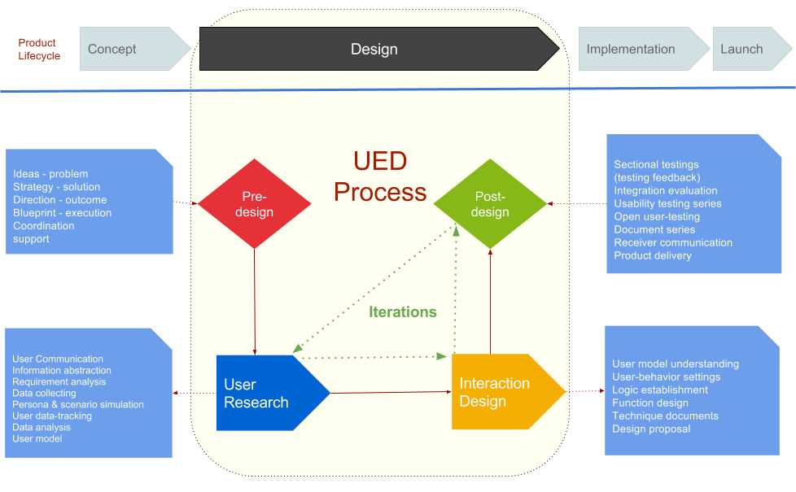
APPENDIX – Product Design Process

Slide 23
APPENDIX – Product UI Standard and Guidelines

