Slide 1

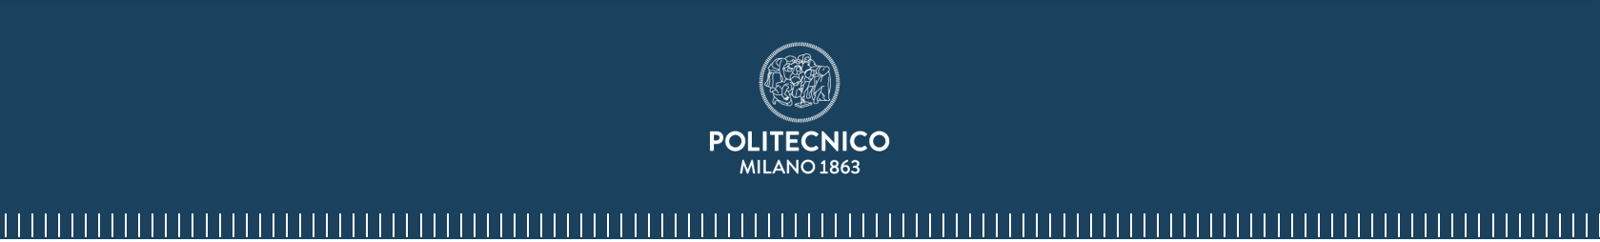
Line of Sight MIMO
Marsona Panci
Mathematical Engineering - Statistical Learning
Information Theory 2023/24
LoS MIMO
Professor Maurizio Magarini
Milano, 18 Luglio 2024

Slide 2
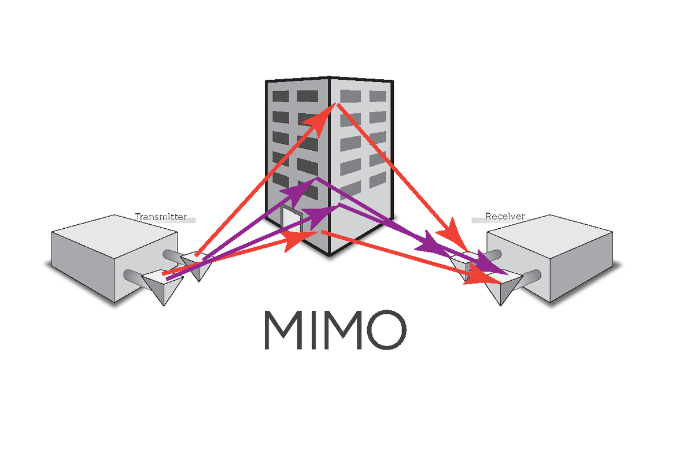
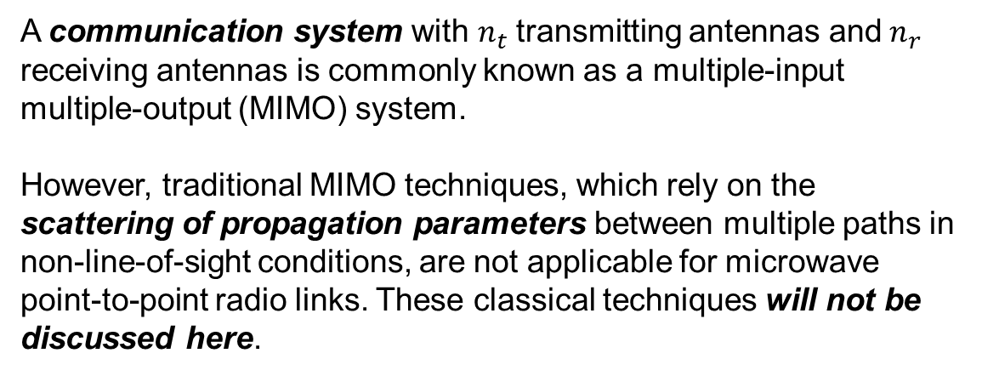
Introduction
A communication system with $n_{t}$ transmitting antennas and $n_{r}$ receiving antennas is commonly known as a multiple-input multiple-output (MIMO) system.
However, traditional MIMO techniques, which rely on the scattering of propagation parameters between multiple paths in non-line-of-sight conditions, are not applicable for microwave point-to-point radio links. These classical techniques will not be discussed here.
1

Slide 3
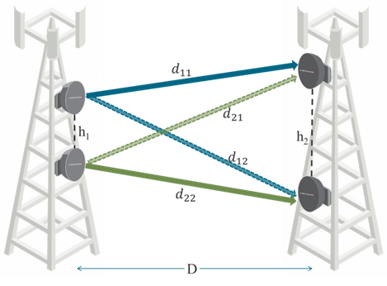
Introduction
For microwave point-to-point radio links, the emphasis is on Line of Sight (LoS) MIMO:
The transmitting and receiving stations must have direct visibility.
The propagation channel consists of a single dominant path.
This specific focus is crucial for the effective application of MIMO in microwave point-to-point links.
2

Slide 4
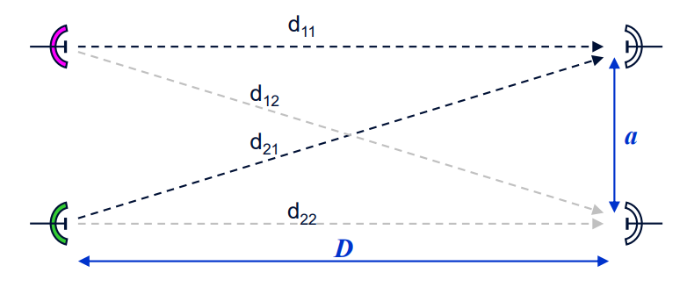


LoS MIMO in Microwave Point-to-Point Links
Study capacity of each LoS MIMO of size N as a function of antennas spacing (a < 10 m) and hop Length (D) for these carrier frequencies (f):
f=18GHz. 5km≤D≤20km
f=38GHz. 2km≤D≤10km
f=80GHz. 1km≤D≤5km
f=115GHz. 500m≤D≤2km
f=170GHz. 100m≤D≤1km
$$n_{1}$$
+
y
x
$$n_{2}$$
+
H
3

Slide 5
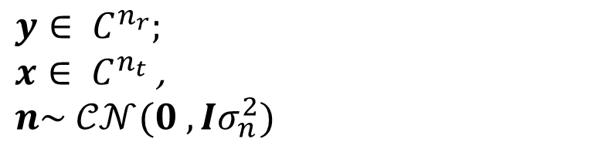
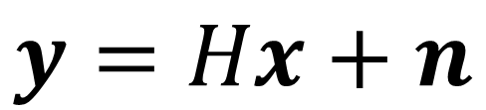
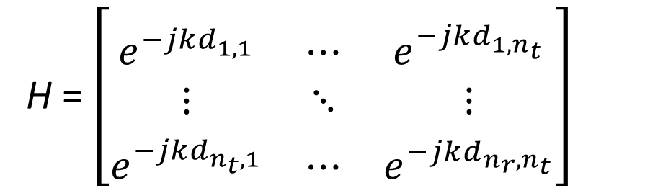
Mathematical Model
Channel equation:
where :
$$y=Hx+n$$
$$y∈ C^{n_{r}};$$
$x∈ C^{n_{t}}$,
$$n\sim 𝒞𝒩(0 , {Iσ}_{n}^{2})$$
H = $\left[\begin{matrix}e^{−jkd_{1,1}^{}} & ⋯ & e^{−jkd_{1,n_{t}}^{}} \\ ⋮ & ⋱ & ⋮ \\ e^{−jkd_{n_{t},1}^{}} & ⋯ & e^{−jkd_{n_{r},n_{t}}^{}}\end{matrix}\right]$
4

Slide 6
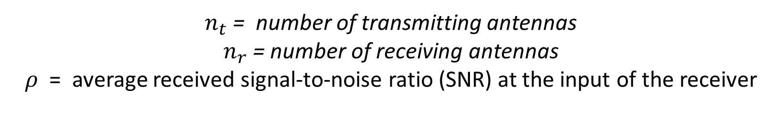
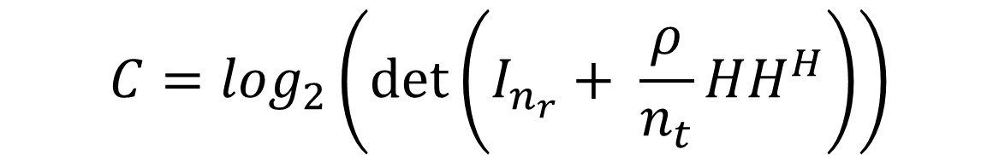
Mathematical Model
Channel Capacity:
$$C=\log_{2}\left(\det\left(I_{n_{r}}+ \frac{ρ}{n_{t}}HH^{H}\right)\right)$$
$n_{t}$ = number of transmitting antennas
$n_{r}$ = number of receiving antennas
$ρ$ = average received signal-to-noise ratio (SNR) at the input of the receiver
Where trasmitted power is equally divided among trasmitting antennas
5

Slide 7
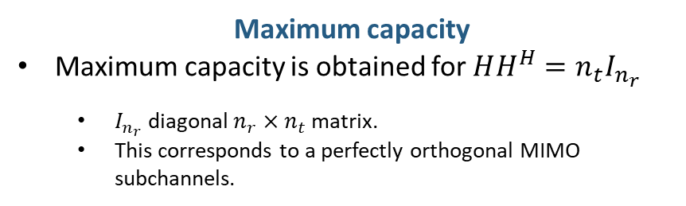
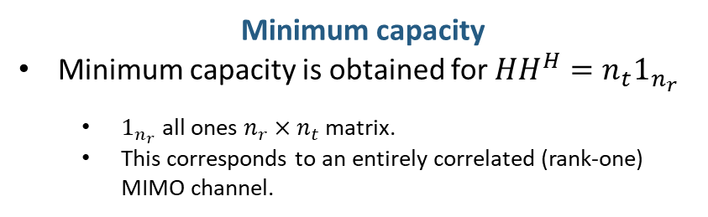
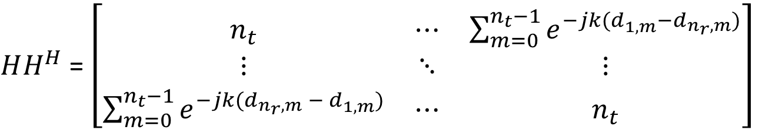
Mathematical Model
$HH^{H}$ = $\left[\begin{matrix}n_{t} & ⋯ & \sum_{m=0}^{n_{t}−1}{e^{−jk{(d}_{1,m}^{}−d_{n_{r},m}^{})}} \\ ⋮ & ⋱ & ⋮ \\ \sum_{m=0}^{n_{t}−1}{e^{−jk{(d_{n_{r},m}^{} − d}_{1,m}^{})}} & ⋯ & n_{t}\end{matrix}\right]$
Minimum capacity
Minimum capacity is obtained for $HH^{H}=n_{t}1_{n_{r}}$
$1_{n_{r}}$ all ones $n_{r}×n_{t}$ matrix.
This corresponds to an entirely correlated (rank-one) MIMO channel.
Maximum capacity
Maximum capacity is obtained for $HH^{H}=n_{t}I_{n_{r}}$
$I_{n_{r}}$ diagonal $n_{r}×n_{t}$ matrix.
This corresponds to a perfectly orthogonal MIMO subchannels.
6

Slide 8
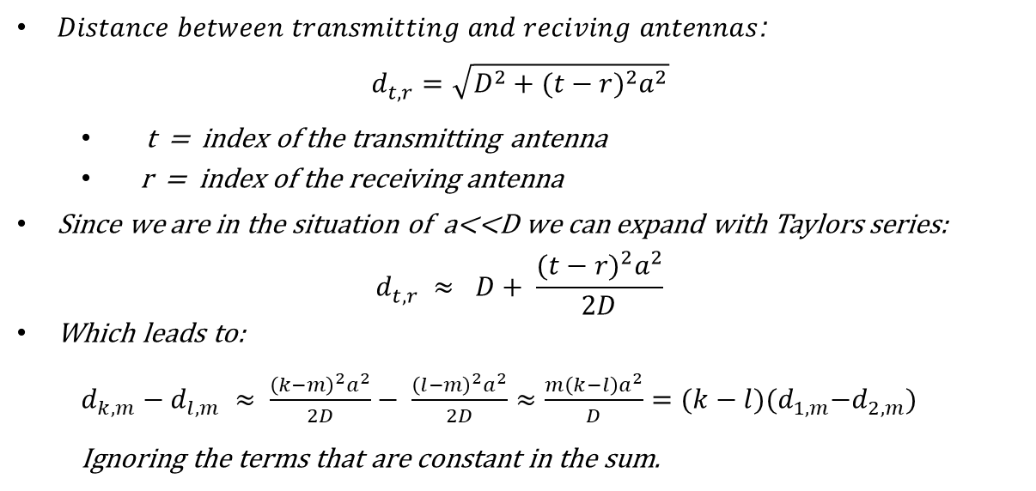




Symmetrical N x N model
$$\left\langle h_{k}, \left.h_{l}\right\rangle \right.=\sum_{m=0}^{n−1}{e^{−j\frac{2π}{λ}{(d}_{k,m}^{}−d_{l,m}^{})}}=0$$
To get the maximum capacity :
$Distance between transmitting and reciving antennas$:
$$d_{t,r}^{}=\sqrt{D^{2}+{{(t−r)}^{2}a}^{2}}$$
t = index of the transmitting antenna
r = index of the receiving antenna
Since we are in the situation of a<<D we can expand with Taylors series:
$$d_{t,r}^{} ≈ D+ \frac{{{(t−r)}^{2}a}^{2}}{2D}$$
Which leads to:
$d_{k,m}^{}−d_{l,m}^{} ≈ \frac{{{\left(k−m\right)}^{2}a}^{2}}{2D}− \frac{{{\left(l−m\right)}^{2}a}^{2}}{2D}≈\frac{m\left(k−l\right)a^{2}}{D}={(k−l)(d}_{1,m}^{}−d_{2,m}^{})$
Ignoring the terms that are constant in the sum.
$$d_{1,1}^{}$$
1
1
a
$$d_{1,2}^{}$$
a
2a
2
2
$$d_{1,3}^{}$$
(n-1)a
3
3
n
n
D
7

Slide 9
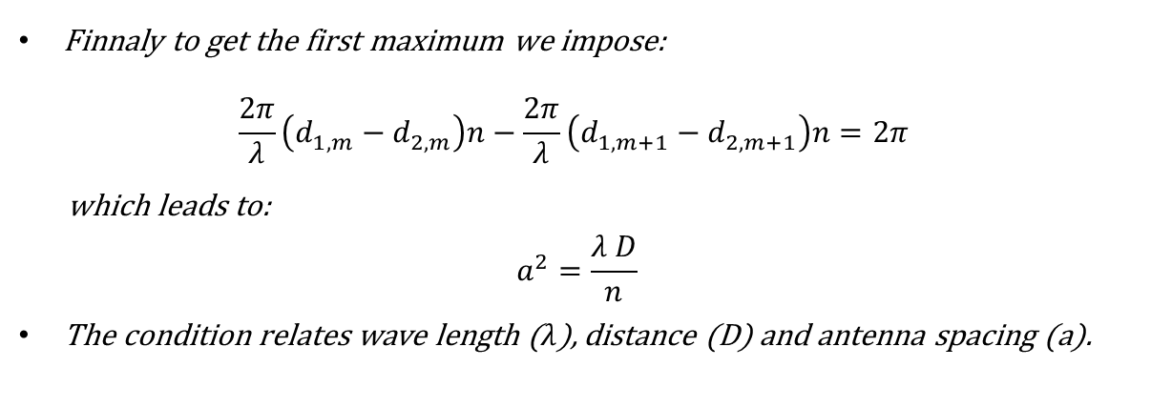
Symmetrical N x N model
$$\left\langle h_{k}, \left.h_{l}\right\rangle \right.=\sum_{m=0}^{n−1}{e^{−j\frac{2π}{λ}{(d}_{k,m}^{}−d_{l,m}^{})}}=0$$
To get the maximum capacity :
$$d_{1,1}^{}$$
Finnaly to get the first maximum we impose:
$$\frac{2π}{λ}\left(d_{1,m}^{}−d_{2,m}^{}\right)n−\frac{2π}{λ}\left(d_{1,m+1}^{}−d_{2,m+1}^{}\right)n=2π$$
which leads to:
$$a^{2}=\frac{λ D}{n}$$
The condition relates wave length ($λ$), distance (D) and antenna spacing (a).
1
1
a
$$d_{1,2}^{}$$
a
2a
2
2
$$d_{1,3}^{}$$
(n-1)a
3
3
n
n
D
8

Slide 10
Computational Model
Assumptions:
The system used for the graphs is a 2x2 MIMO, which does not lose generality.
The average SNR (ρ) is fixed at 10 dB.
Antenna spacing (a) is less than 10 meters.
9

Slide 11
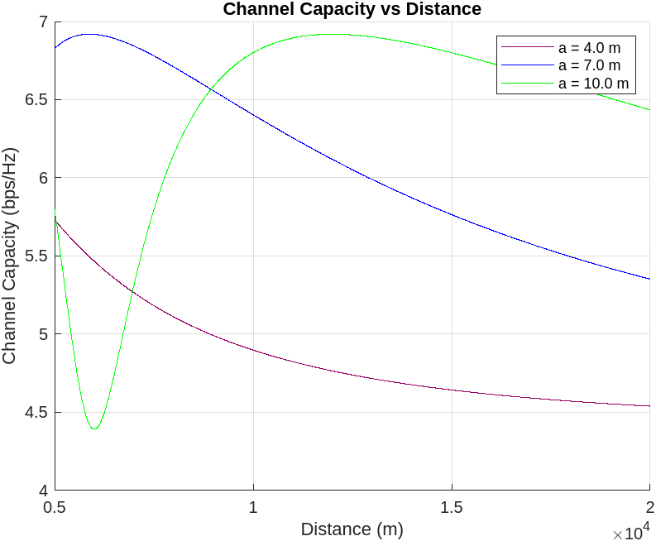
Case of study
A. 18GHz – [5km, 20km]
Analytical maximum of capacity in function
of distance and antenna spacing:
D
a
5 km
6.5 m
20 km
13 m > 10 m
If antenna spacing is in the analytical range we are able to reach maximum capacity
Else rule of thumb: lower the distance
10

Slide 12
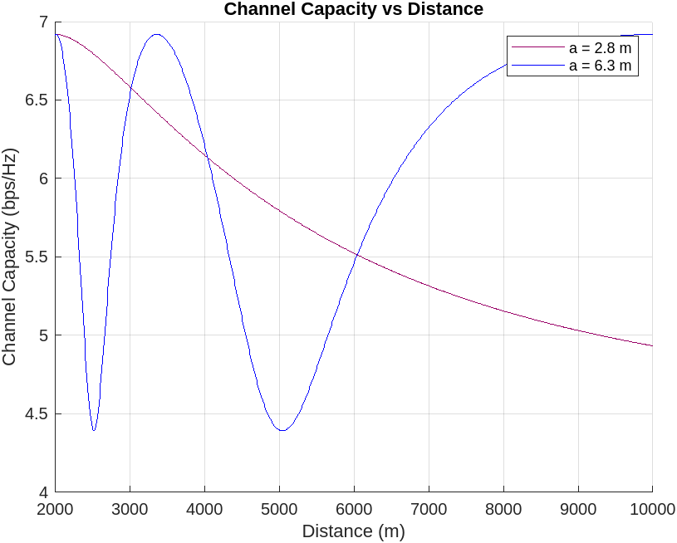
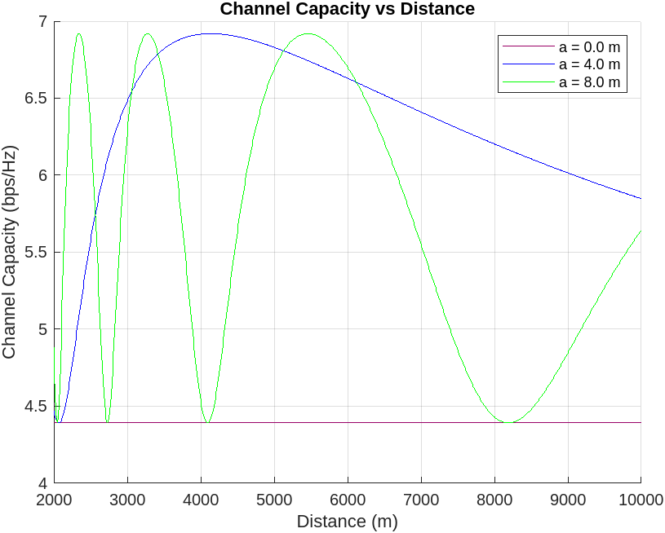
Case of study
B. 38GHz – [2km, 10km]
11

Slide 13
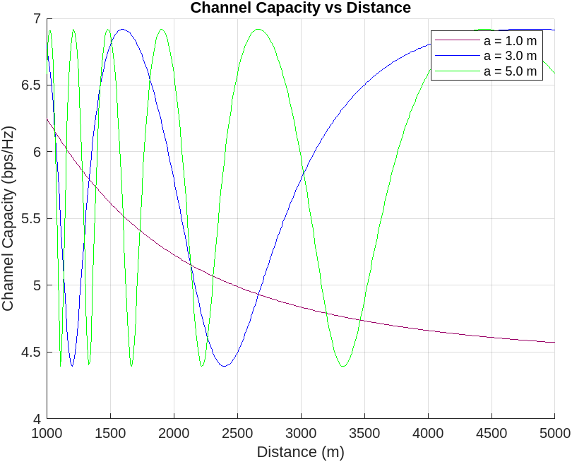
Case of study
C. 80GHz – [1km, 5km]
Higher frequency
Lower antenna spacing
12

Slide 14
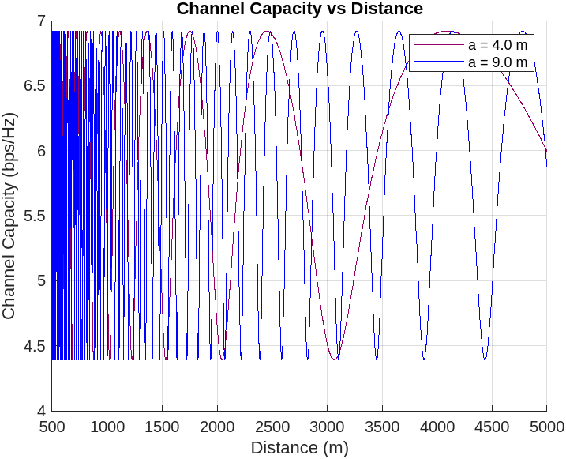
Case of study
D. 115GHz – [0.5km, 2km]
Analytical maximum of capacity in function
of distance and antenna spacing:
D
a
0.5 km
0.8 m
2 km
1.6 m
Higher
spacing
Increasing
instability
13

Slide 15
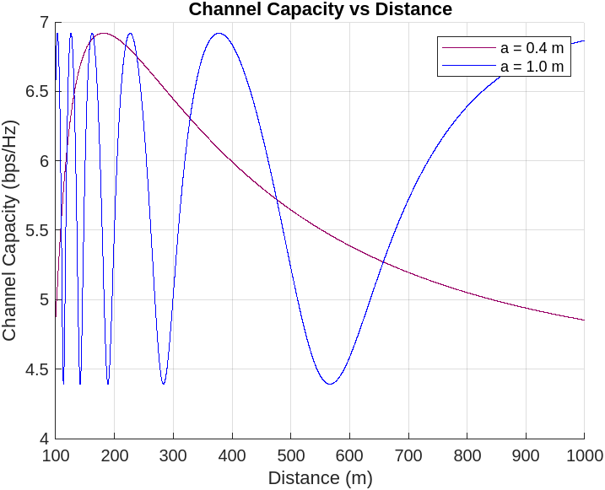
Case of study
E. 170GHz – [0.1km, 1km]
Analytical maximum of capacity in function
of distance and antenna spacing:
D
a
0.1 km
0.3 m
1 km
0.9 m
14

Slide 16
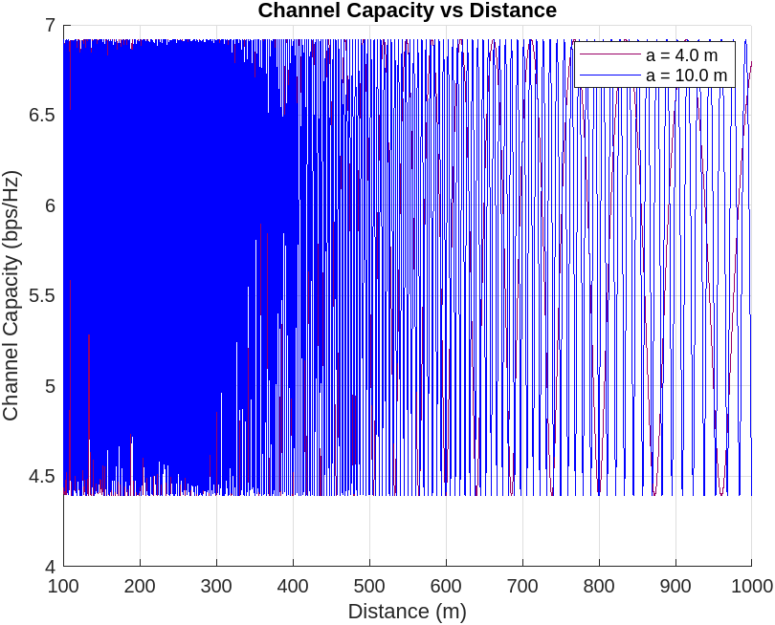
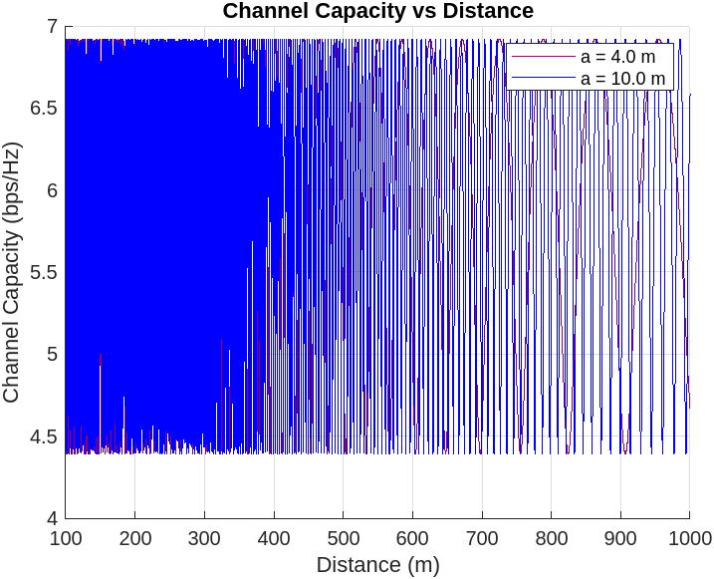
Case of study
E. 170GHz – [0.1km, 1km]
Analytical maximum of capacity in function
of distance and antenna spacing:
D
a
0.1 km
0.3 m
1 km
0.9 m
The channel capacity exhibits high sensitivity to variations in both the distance D and the antenna spacing a
15

Slide 17
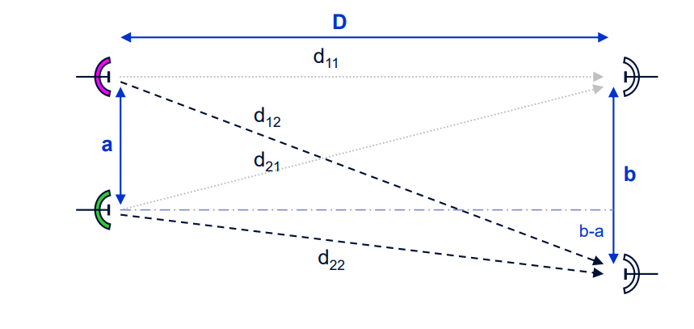
Line of Sight MIMO in Microwave Point-to-Point Links
Due to the installation constraints the antenna spacing on the two sites can be different (a,b):
Study capacity of each Line-of-Sight MIMO of size N as a function of antennas spacing (a < 10 m and b < 10 m) and
hop Length (D) for these carrier frequencies (f):
f=18GHz. 5km≤D≤20km
f=80GHz. 1km≤D≤5km
f=170GHz. 100m≤D≤1km
16

Slide 18
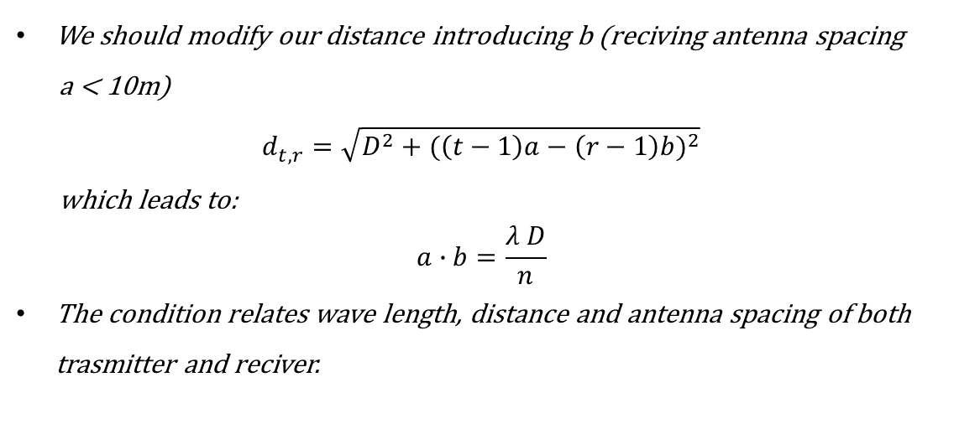



Asymmetrical N x N model – Different antenna spacing
$$\left\langle h_{k}, \left.h_{l}\right\rangle \right.=\sum_{m=0}^{n−1}{e^{−j\frac{2π}{λ}{(d}_{k,m}^{}−d_{l,m}^{})}}=0$$
To get the maximum capacity :
$$d_{1,1}^{}$$
1
1
We should modify our distance introducing b (reciving antenna spacing
a < 10m)
$$d_{t,r}^{}=\sqrt{D^{2}+{(\left(t−1\right)a−\left(r−1\right)b)}^{2}}$$
which leads to:
$$a∙b=\frac{λ D}{n}$$
The condition relates wave length, distance and antenna spacing of both trasmitter and reciver.
a
2a
$$d_{1,2}^{}$$
b
2
2
2b
(n-1)a
3
$$d_{1,3}^{}$$
3
n
(n-1)b
n
D
17

Slide 19
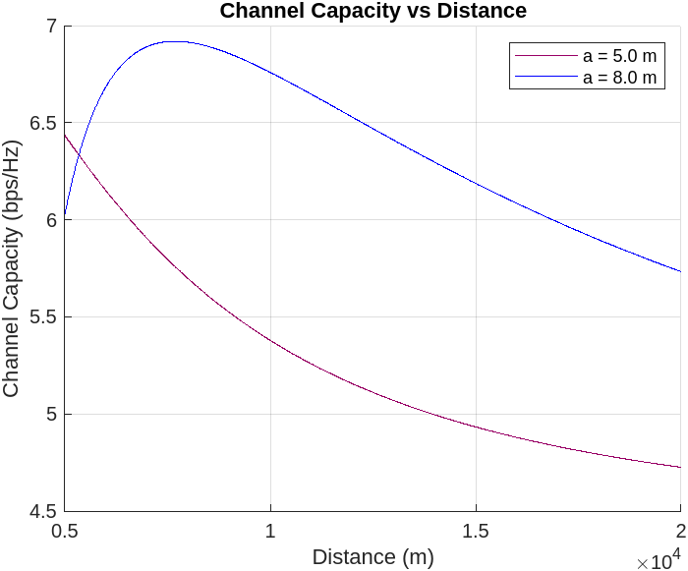
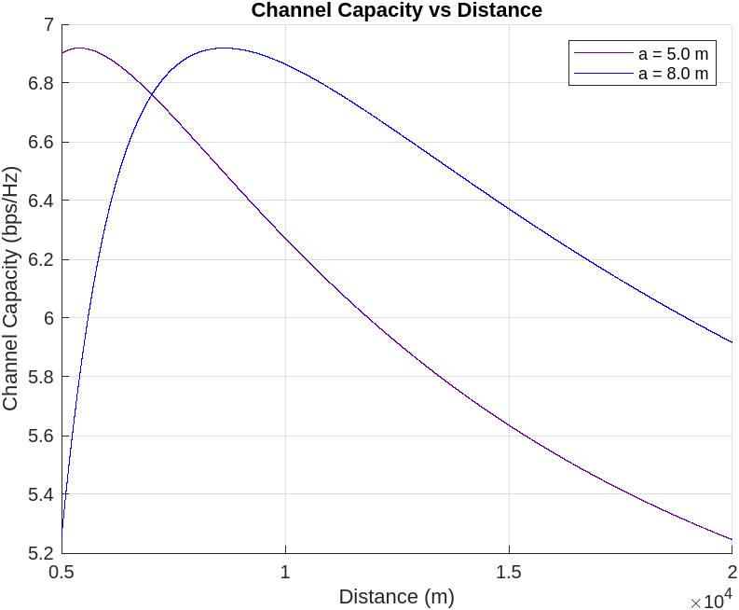
Case of study
A. 18GHz – [5km, 20km]
a = b
b = 9 m
18

Slide 20
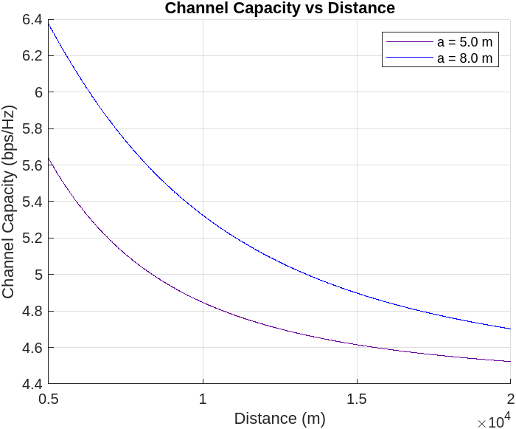
Case of study
A. 18GHz – [5km, 20km]
a = b
b = 3 m
19

Slide 21
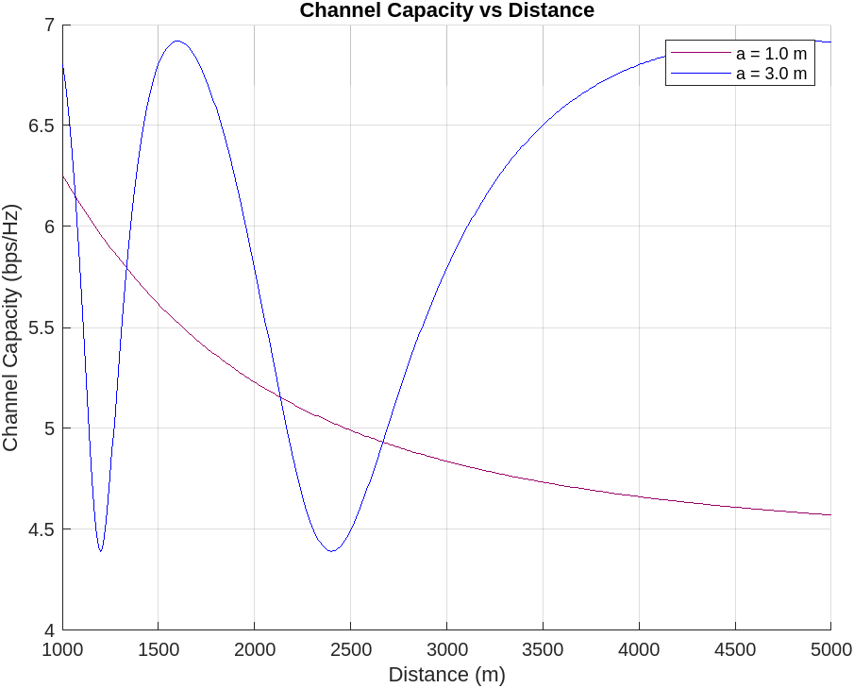
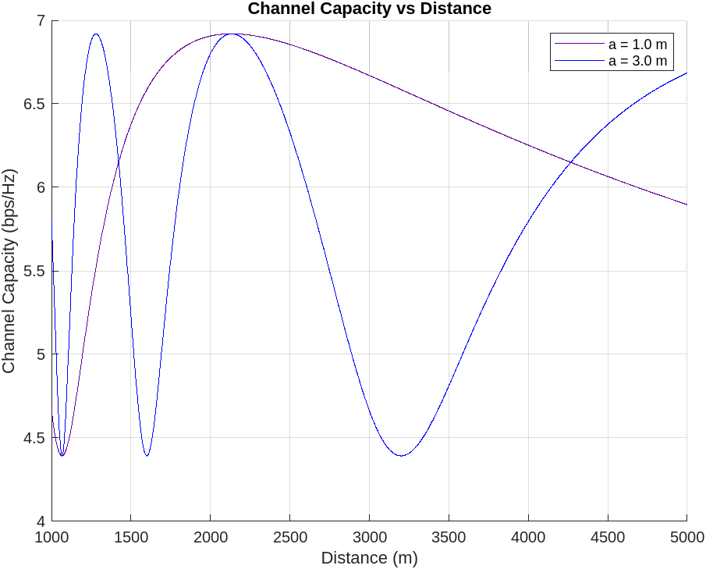
Case of study
B. 80GHz – [1km, 5km]
a = b
b = 4 m
20

Slide 22
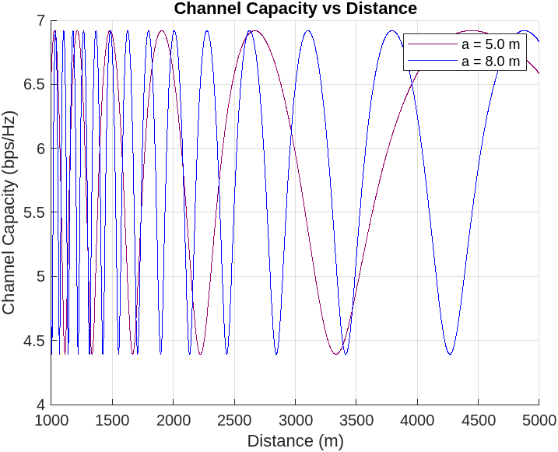
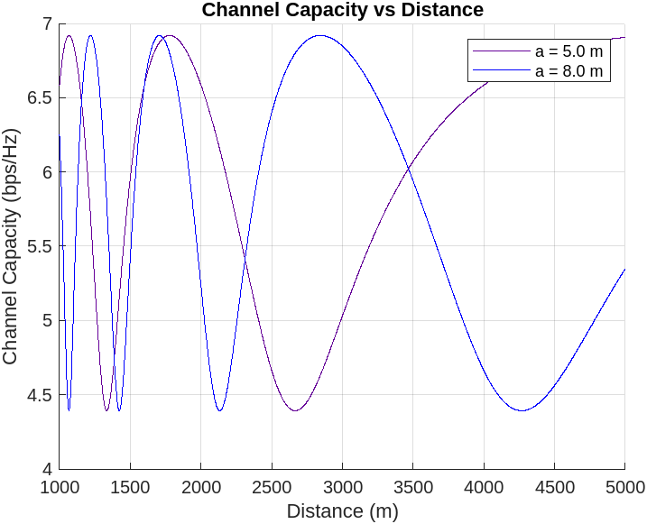
Case of study
B. 80GHz – [1km, 5km]
a = b
b = 2 m
21

Slide 23
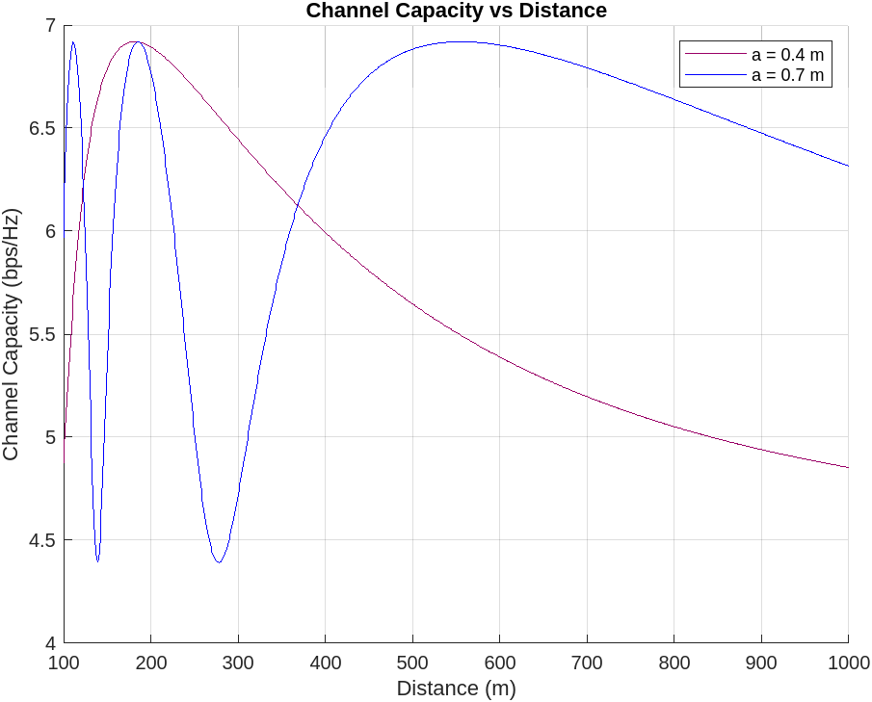
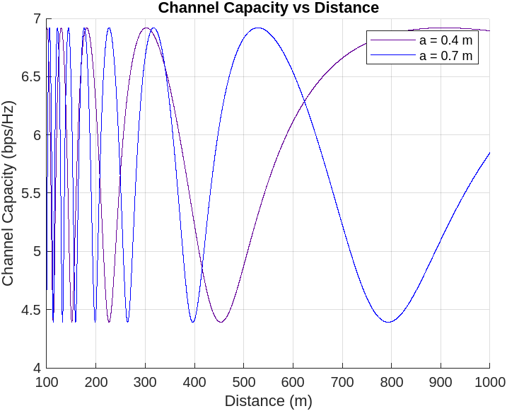
Case of study
C. 170GHz – [0.1km, 1km]
a = b
b = 2 m
22

Slide 24
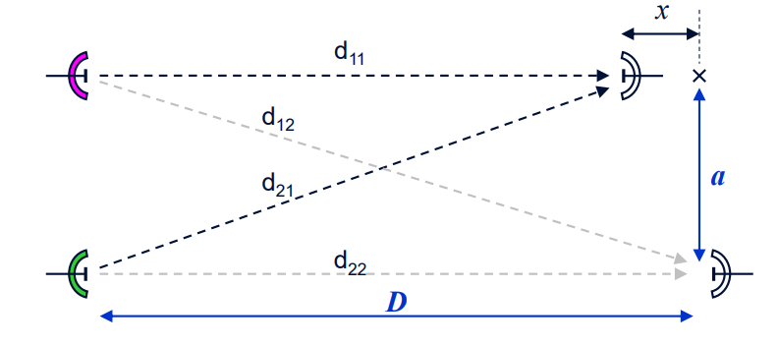
Line of Sight MIMO in Microwave Point-to-Point Links
Oscillations of the antenna tower induced by wind can result in a relative displacement x of the two MIMO antennas along
the direction of propagation.
Study capacity of each Line-of-Sight MIMO of size N as a function of antennas spacing (a < 10 m), hop Length (D)
and displacement (x < 1 m), for these carrier frequencies (f):
f=18GHz. 5km≤D≤20km
f=80GHz. 1km≤D≤5km
f=170GHz. 100m≤D≤1km
23

Slide 25

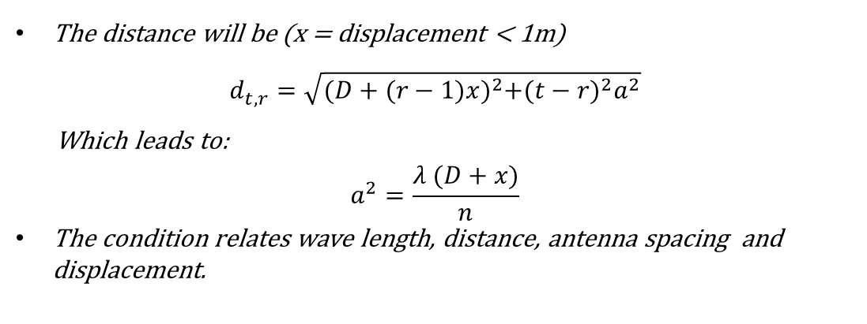

Asymmetrical 2 x 2 model – Displacement of antenna
$$\left\langle h_{k}, \left.h_{l}\right\rangle \right.=\sum_{m=0}^{1}{e^{−j\frac{2π}{λ}{(d}_{k,m}^{}−d_{l,m}^{})}}=0$$
To get the maximum capacity :
$$d_{1,1}^{}$$
The distance will be (x = displacement < 1m)
$$d_{t,r}^{}=\sqrt{{(D+(r−1)x)}^{2}+{(t−r)}^{2}a^{2}}$$
Which leads to:
$$a^{2}=\frac{λ (D+x)}{n}$$
The condition relates wave length, distance, antenna spacing and displacement.
1
1
x
a
$$d_{1,2}^{}$$
a
2
2
D
24

Slide 26
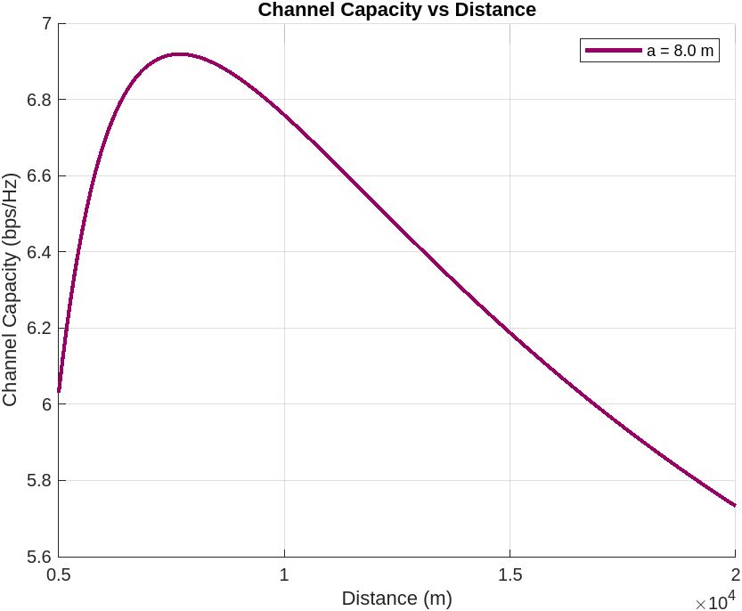
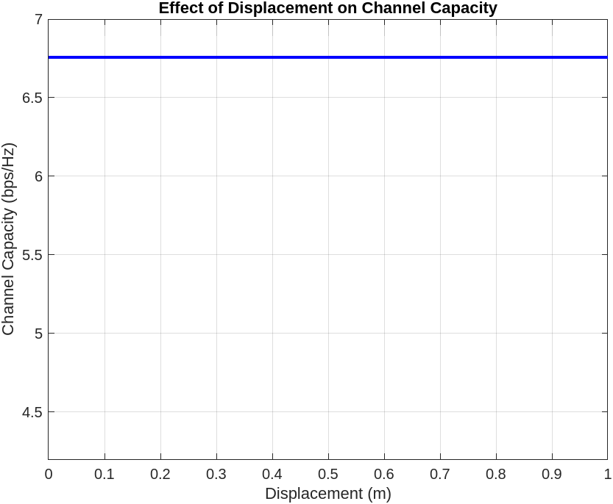
Case of study
A. 18GHz – [5km, 20km]
x=0 m
D = 10 Km
Robust to small displacement
25

Slide 27
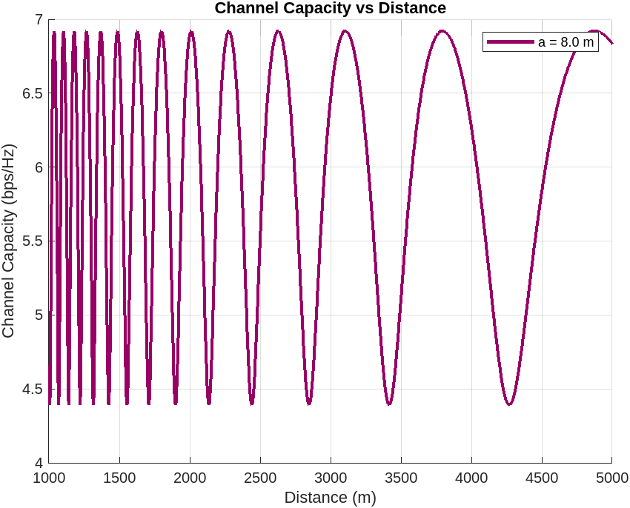
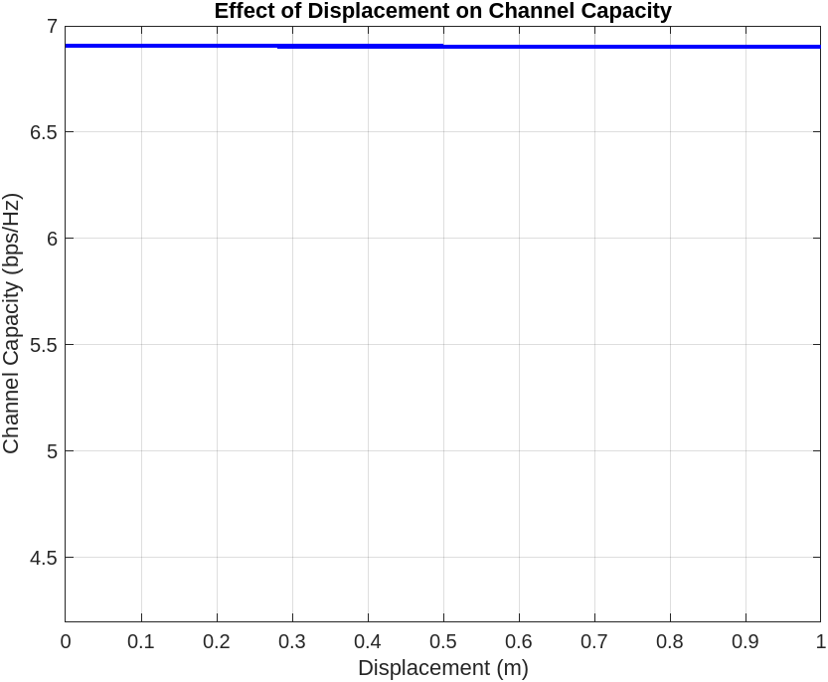
Case of study
B. 80GHz – [1km, 5km]
x=0 m
D = 2 Km
Robust to small displacement
26

Slide 28
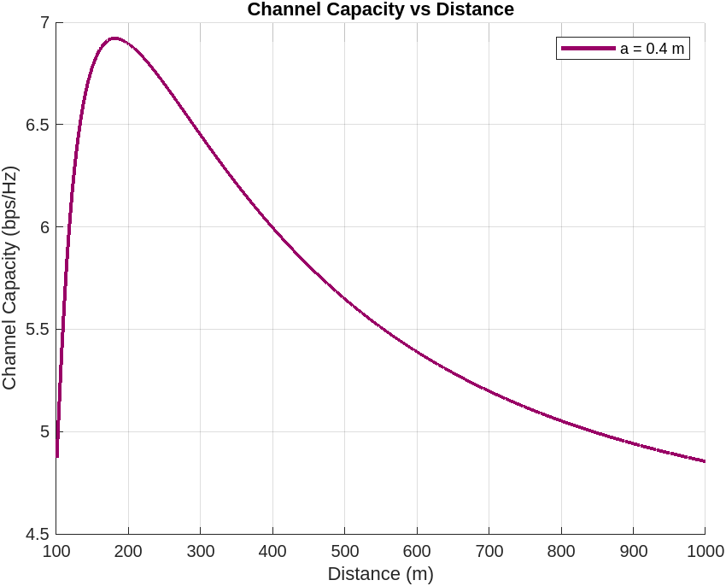
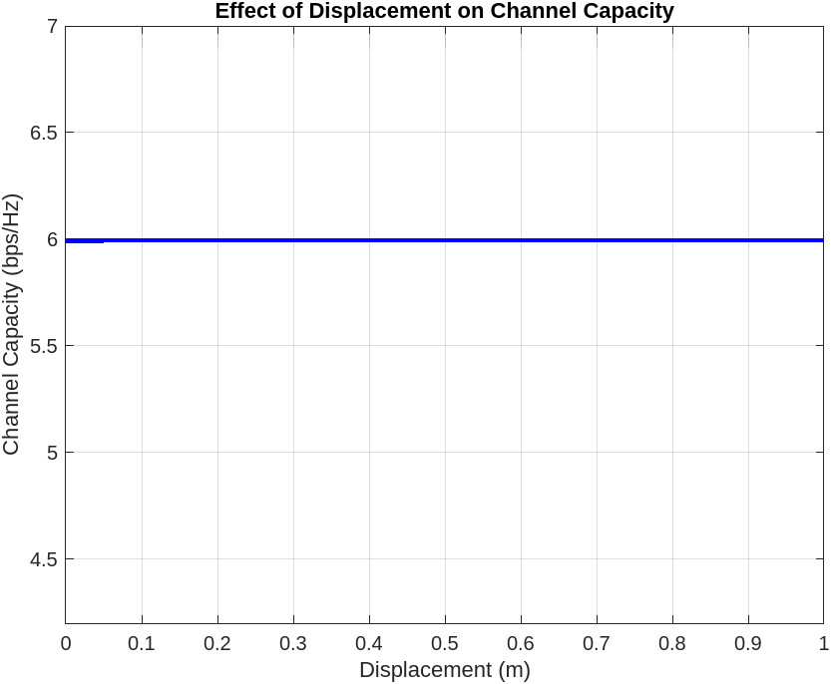
Case of study
C. 170GHz – [0.1km, 1km]
x=0 m
D = 400 m
Robust to small displacement
27

Slide 29
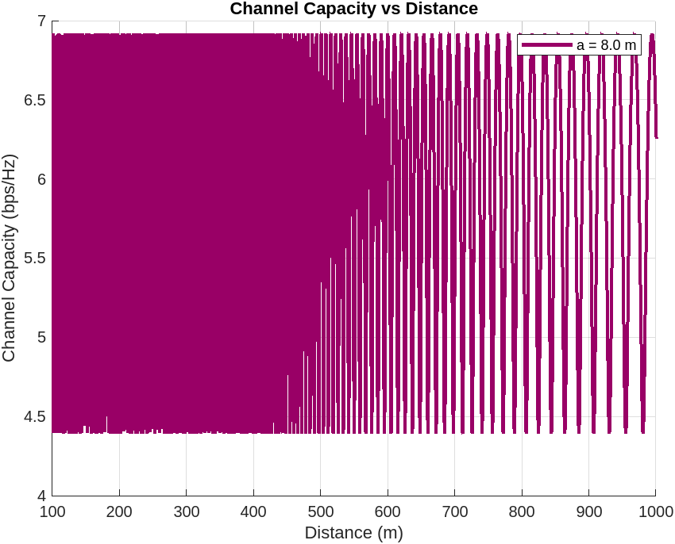
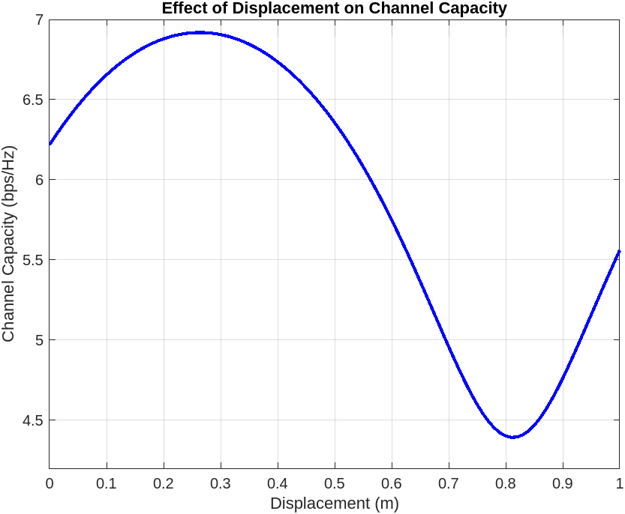
Case of study
C. 170GHz – [0.1km, 1km]
x=0 m
D = 200 m
Very sensitive
28

Slide 30
Conclusions
Low frequencies:
Requires high antenna spacing at both the transmitting and receiving antennas to achieve optimal capacity;
Capacity can be insensitive to differences in spacing of the receiving antenna on the order of meters;
Cover wide distances with constant capacity;
Are robust to antenna displacements.
High frequencies:
Must have low antenna spacing at both the transmitting and receiving antennas to avoid high volatility in capacity;
Capacity can be very sensitive to differences in spacing of the receiving antenna on the order of meters;
Cover smaller distances with constant capacity;
can be sensitive to antenna displacements.
29

Slide 31
References
Larsson P. Lattice array receiver and sender for spatially orthonormal MIMO communication, In Vehicular Technology Conference, volume 1, pages 192196, 2005.
D. Gesbert, H. Bölcskei, D. A. Gore, and A. J. Paulraj. Outdoor MIMO wireless channels: Models and performance prediction. IEEE Trans. on Communications, 50(12):19261934, Dec 2002.
P. F. Driessen and G. Foschini. On the capacity formula for multiple input-multiple output wireless channels: A geometric interpretation. IEEE Trans. Commun, 47(2):173 176, Feb 1999.
Design and Performance Assessment of High-Capacity MIMO Architectures in the Presence of a Line-of-Sight Component. IEEE Trans. on Vehicular Technology, Vol. 56, No. 4, JULY 2007
30

Slide 32
THANK YOU FOR THE ATTENTION!
If you have any question don’t esitate to contact me: marsona.panci@mail.polimi.it

