Slide 1

Irins Technologies
Kakkanad

Slide 2
MISSION AND VISSION
In this project we provides platform for celebrities & brands to host Q&A’s in real time.
It a one to one chat for fans and reviewers to ask question to celebrities.
This chat we can done from web and by mobile App.
This chats could be private and confidential such as social media chats.

Slide 3
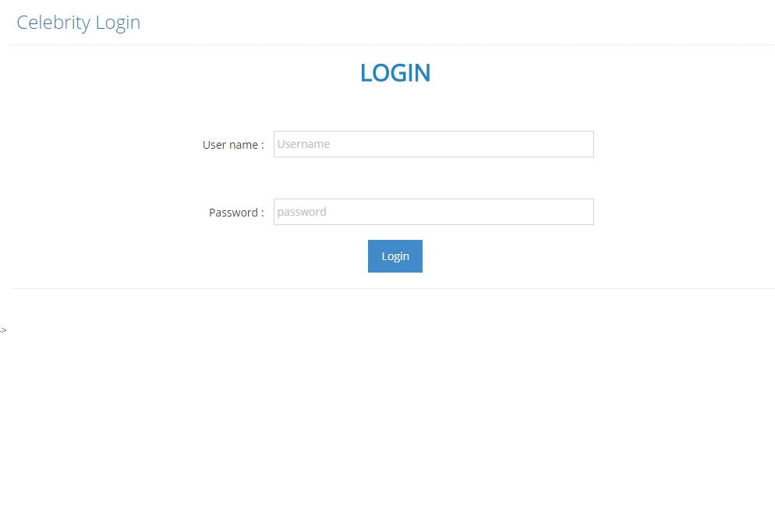
CELEBRITY SECTION

Slide 4
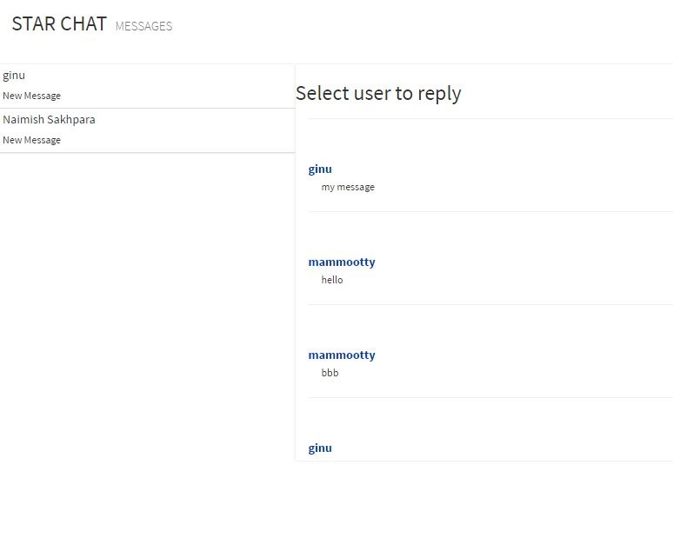

Slide 5
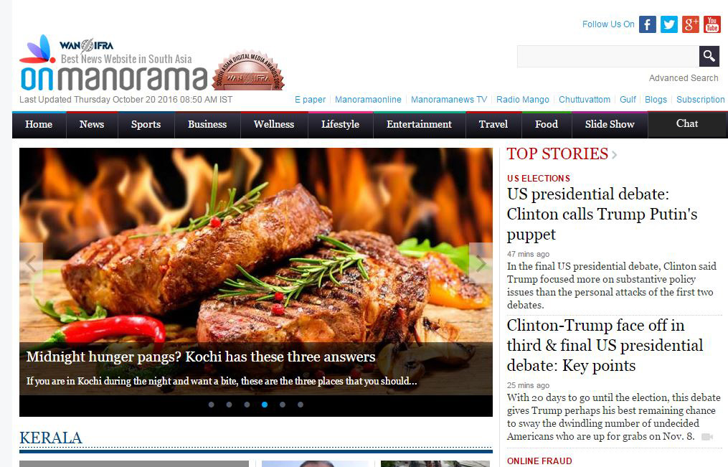
CLIENT SECTION

Slide 6
