Slide 1

SNOWFLAKE × BETA FUND × EVERMIND HACKATHON
KnowU
Remembers more.
Sends less.
A memory-efficient personal AI for Track 1: Cost of Intelligence
Notes:
Timing: 15 seconds.
KnowU is a personal AI that can remember more about you without sending more context on every request.
We built it for the Cost of Intelligence track: make personalization useful, bounded, and measurable.
[Sources]
- Internal repository: README.md
- Internal brand asset: apps/desktop/public/knowu-icon.svg

Slide 2
Personal AI gets more expensive as it learns.
FULL CONTEXT
KNOWU CONTEXT
Profile + history + every conversation, sent again.
Only the memories and evidence this question needs.
Relevant memories
Query-specific facts
Selected-thread evidence
The question—not the entire relationship—sets the context budget.
02
Notes:
Timing: 25 seconds.
The usual personalization pattern keeps appending profile, history, and conversation to every request.
Cost grows even when most of that context is irrelevant.
KnowU flips the rule: the current question determines what is retrieved and how much can be sent.
[Sources]
- Internal repository: README.md — The problem; The solution

Slide 3
KnowU keeps context useful—and bounded.
01
02
03
OBSERVE
PACK
PROVE
Local signals
Relevant memory
Measured inference
Raw activity stays on the Mac. Apps, permitted titles, browser history, and editor saves become visible work threads.
EverOS returns approved memories for the question. The packer spends the remaining budget on the highest-value evidence.
The BYOK model answers once. Snowflake stores aggregate context economics—not raw activity or memory text.
OBSERVE
PACK
PROVE
03
Notes:
Timing: 30 seconds.
First, KnowU observes low-risk local signals and organizes them into visible work threads.
Second, EverOS retrieves only approved memories relevant to the question, while a deterministic packer uses the remaining budget for selected evidence.
Third, the chosen provider answers once and Snowflake records only aggregate context economics so the saving can be audited without exporting raw personal history.
[Sources]
- Internal repository: README.md — Architecture; EverOS integration; Snowflake integration; Privacy model
- Internal repository: docs/architecture.md
- Internal repository: docs/privacy-model.md

Slide 4
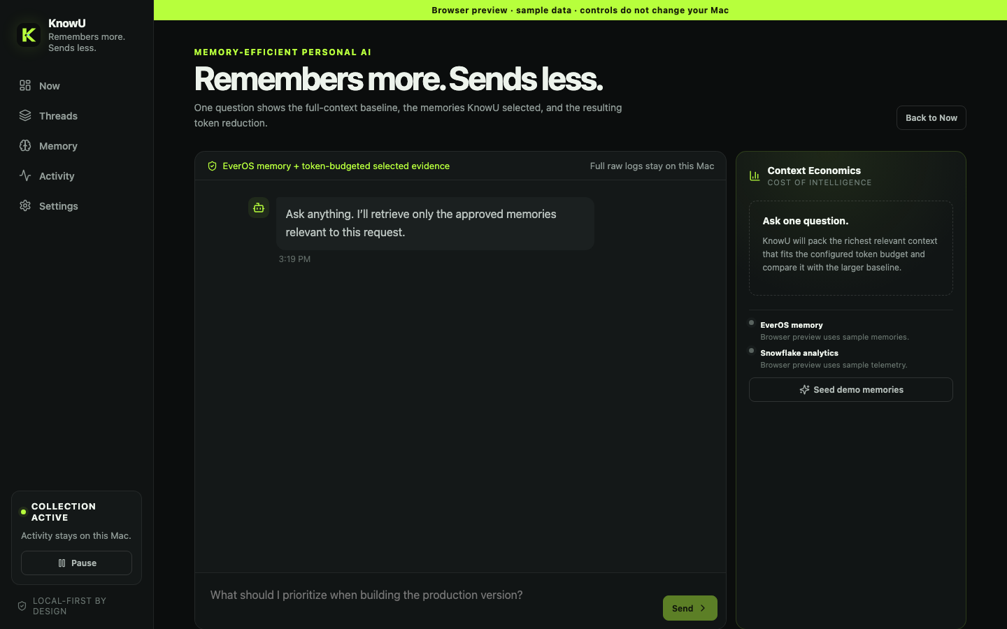
The user sees the context—and the cost.
One question reveals:
which approved memories were retrieved
which selected evidence fit the budget
how Full Context compares with KnowU Context
The baseline is comparison-only; the optimized prompt is the single answer path.
04
Notes:
Timing: 30 seconds.
This is the trust layer: the user can see what KnowU remembered, which context was packed, and what the token comparison means.
The larger prompt is never sent; it is an answer-equivalent comparison baseline.
The optimized prompt is the single path that produces the answer.
[Sources]
- Internal repository: apps/desktop/src/App.tsx
- Internal repository: apps/desktop/src/App.css
- Current local browser-preview capture generated from the running repository

Slide 5
KNOWU / LIVE DEMO
Insert video here
or switch to the live app
Notes:
Timing: 60 seconds.
Suggested live path:
1. Open Now and show the reconstructed KnowU implementation thread.
2. Choose Ask with context and ask: ‘What should I prioritize for the production version?’
3. Point to the retrieved EverOS memories and the selected-thread evidence.
4. Compare Full Context with KnowU Context in Context Economics.
5. Show the aggregate Snowflake telemetry status or prepared query result.
If the live app is risky, replace the framed area with a pre-recorded 50–60 second video.
[Sources]
- Internal repository: README.md — main demo flow
- User-requested live demo / video insertion canvas

Slide 6
TRACK 1 / COST OF INTELLIGENCE
Personal AI should get smarter—not heavier.
KnowU remembers more, sends less, and proves the difference.
LOCAL-FIRST
EVEROS MEMORY
SNOWFLAKE ECONOMICS
Notes:
Timing: 20 seconds.
KnowU makes the assistant more personal without making every request heavier.
It keeps raw behavior local, uses EverOS for relevant approved memory, and uses Snowflake to prove the context economics.
That is the promise: every token should earn its place.
[Sources]
- Internal repository: README.md

