Slide 1

SNOWFLAKE × BETA FUND × EVERMIND HACKATHON
KnowU
Remembers more.
Sends less.
A memory-efficient personal AI built for Track 1: Cost of Intelligence
65%
FEWER INPUT
TOKENS PER ANSWER
MEASURED RUNS
LOGGED TO SNOWFLAKE
9
LOCAL-FIRST · EVEROS PERSONAL MEMORY · SNOWFLAKE CONTEXT ECONOMICS
Notes:
Timing: 15 seconds.
KnowU is a personal AI that remembers more about you while sending less context on every request.
We built it for Track 1, Cost of Intelligence — so the headline is the number: across every measured run, KnowU answers the same question with 65% fewer input tokens.
That is not a projection. It is nine logged inference runs, and every one of them is a row in Snowflake.

Slide 2
THE PROBLEM
Personal AI gets more expensive as it learns.
The usual personalization pattern appends the profile, the history, and the whole conversation to every request.
FULL CONTEXT
KNOWU CONTEXT
Everything it knows, re-sent every time.
Only what this question actually needs.
Static profile
Relevant memories
Full conversation history
retrieved from EverOS for this query
Summarized activity
Query-specific facts
Every stored memory
Prior corrections
compact local aggregates
Thread packet
Selected-thread evidence
This question
as much as the token budget allows
COST SCALES WITH THE RELATIONSHIP
COST SCALES WITH THE QUESTION
Measured in KnowU: as this user's memory grew from 5 to 8 facts, the full-context prompt grew 1,173 → 2,566 tokens. The answer path never followed it up.
02
Notes:
Timing: 25 seconds.
The default way to personalize an assistant is to keep appending — profile, history, every conversation — and send it all again on the next request. Cost grows even when almost none of that context is relevant to what was just asked.
We watched it happen in our own logs: as this user's memory grew from 5 facts to 8, the full-context prompt nearly doubled, 1,173 to 2,566 tokens.
KnowU inverts the rule. The current question decides what gets retrieved and how much is allowed to be sent.

Slide 3
HOW IT WORKS
KnowU keeps context useful — and bounded.
01
02
03
OBSERVE
RETRIEVE
PROVE
Local signals
EverOS memory
Measured inference
Raw activity stays on the Mac. Apps, permitted titles, browser history, and editor saves become visible work threads.
Every question hits EverOS hybrid search first. Approved memories come back ranked; a deterministic packer spends what's left of the budget on evidence.
The BYOK model answers once. Snowflake records aggregate context economics — never raw activity or memory text.
QUESTION
→
EVEROS SEARCH
→
BUDGETED PACK
→
→
→
ONE MODEL CALL
ANSWER
SNOWFLAKE ROW
One question. One answer path. One auditable row of economics.
03
Notes:
Timing: 30 seconds.
Three steps.
Observe — KnowU watches low-risk local signals and organizes them into work threads. The raw material never leaves the machine.
Retrieve — this is the core. Every question goes to EverOS hybrid search before it goes to a model. EverOS returns only the approved memories that are relevant, and a deterministic packer spends whatever budget is left on the highest-value evidence. We retrieve instead of summarizing, which is why the prompt gets smaller without another model call.
Prove — the provider answers once, and Snowflake stores the aggregate economics so the saving is auditable without exporting anyone's personal history.

Slide 4
THE MEMORY LAYER
EverOS remembers. KnowU decides what to send.
KnowU runs on the EverOS Personal Memory API v1. Memory is not a cache we bolted on — it is the retrieval layer the whole product is built around.
EVEROS PERSONAL MEMORY API v1
WHAT CROSSES THE BOUNDARY
POST /api/v1/memories
SENT TO EVEROS
Approved profile facts, interests, projects, patterns, and explicit user corrections are written through as memories.
— Approved profile summary, interests, projects, patterns
— Explicit user corrections, synced on save
POST /api/v1/memories/flush
— The current question, for hybrid retrieval
Triggers extraction so new facts are indexed and retrievable before the next question.
NEVER SENT
POST /api/v1/memories/search
— Raw browser history, URLs, window and page titles
Hybrid retrieval on every single query. This is the call that makes the prompt small.
— Source file contents and Local History snapshots
— Event IDs, browser-profile IDs, credential-like fields
A vendor-isolated MemoryService interface keeps the app free of provider-specific logic.
04
Notes:
Timing: 30 seconds.
This is the layer that makes the number possible.
KnowU is built on the EverOS Personal Memory API v1, and it uses all of it. We write approved facts and corrections through the memories endpoint. We flush to force extraction so new facts are retrievable immediately. And every single question — not every session, every question — goes through hybrid search.
That last call is the whole trick. We are not compressing a big prompt with another model. We are retrieving a small one. Retrieval is cheaper than summarization and it is auditable.
Behind it is a vendor-isolated MemoryService interface, so the product logic never knows which memory backend it is talking to. And the boundary is deliberate: approved memories go to EverOS, raw behaviour never does.

Slide 5
THE RESULT
65% fewer input tokens. Measured, not asserted.
65%
9
58–76%
MEASURED RUNS
PER-QUESTION RANGE
AVERAGE INPUT-TOKEN REDUCTION
ACROSS EVERY LOGGED RUN
10,119
1,124
TOKENS SAVED
SAVED PER QUESTION
TOTAL INPUT TOKENS ACROSS ALL 9 RUNS
Full Context
15,442
KnowU Context
5,323 · 10,119 saved
gpt-5-mini · The sent prompt is the provider's actual reported input usage; the unsent baseline is scaled by the same deterministic ratio and labelled
“provider usage scaled estimate” in the product. No metric is presented as actual when it is estimated. Every run above is a row in Snowflake.
05
Notes:
Timing: 30 seconds. This is the slide the track is asking for.
Nine real inference runs, logged locally and synced to Snowflake. Average input-token reduction: 65%. The worst run was 58%. The best was 76%.
In absolute terms: 15,442 input tokens of full context became 5,323. Ten thousand tokens saved across nine questions — about 1,124 per question.
One point on honesty, because judges will ask. The prompt we actually sent is measured from the provider's own reported usage. The baseline is the prompt we deliberately did not send, scaled by the same deterministic ratio — and the product labels it as an estimate on screen. We never show an estimated number as if it were measured.
Input tokens are the cost driver here. A 65% cut in input tokens is a 65% cut in the input bill, on any model, at any scale.

Slide 6
WHY IT COMPOUNDS
The more it remembers, the more it saves.
Same user, same product, deeper memory. The baseline grew with the profile — and the gap KnowU captures grew faster.
5 MEMORIES
8 MEMORIES
EARLY RUNS · n=6
LATER RUNS · n=3
Full context
1,330
Full context
2,487
KnowU sends
384
KnowU sends
1,007
Saved per question
946
Saved per question
1,480
+56%
more tokens saved per question — from the same user, as the memory got deeper.
Full context grows with everything you have ever done. KnowU's prompt grows only with what this question needs.
The gap is the product. Every additional thing KnowU learns makes the alternative more expensive — and KnowU relatively cheaper.
06
Notes:
Timing: 25 seconds. This is the part that makes it a business, not a trick.
Same user, same app, two points in time. Early on, with 5 memories, full context was about 1,330 tokens and we sent 384 — saving roughly 946 per question.
Later, with 8 memories, full context had grown to about 2,487. We sent 1,007. Saved 1,480.
So as the assistant got more personal, the saving per question grew 56%. That is the opposite of how personalization normally behaves.
The reason is structural: a full-context prompt grows with everything the user has ever done, while KnowU's prompt grows only with what the current question needs. The gap widens on its own. Time is on our side.

Slide 7
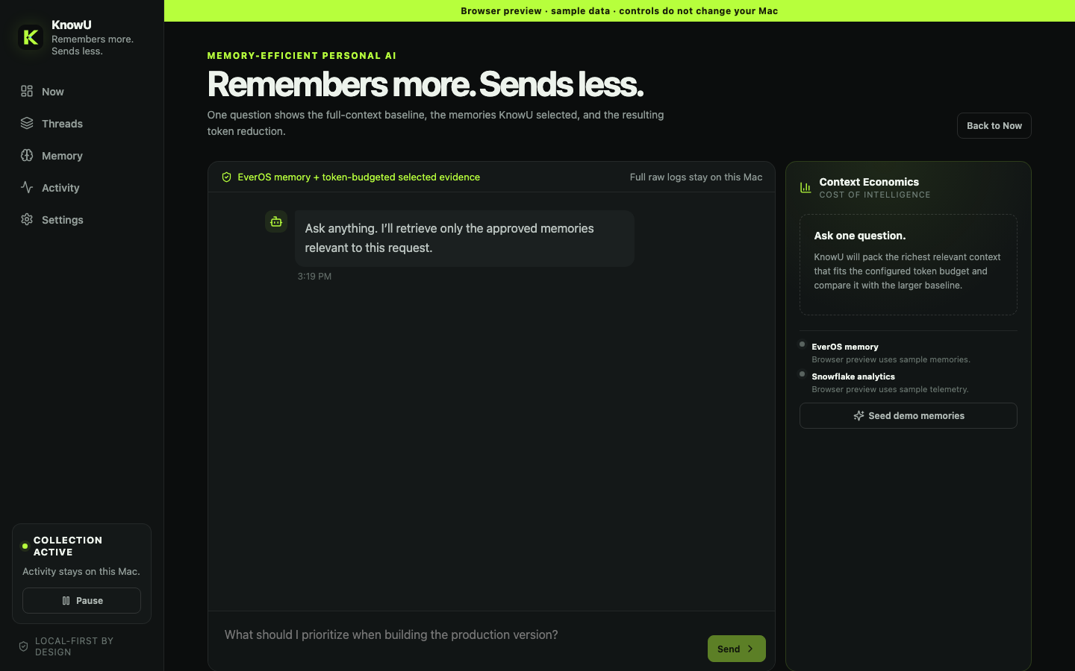
TRUST
Auditable by the user — not just by us.
One question reveals:
which approved memories EverOS returned
which selected evidence fit the token budget
how Full Context compares with KnowU Context
how the tokens were counted, and by whom
The baseline is comparison-only. The optimized prompt is the single path that produces the answer.
Context Economics · retrieved memories, packed units, and the token comparison, in-product
07
Notes:
Timing: 25 seconds.
A cost claim nobody can inspect is a marketing claim. So the comparison lives in the product, not just in this deck.
On one question the user sees which approved memories EverOS returned, which evidence fit the budget, the full-versus-optimized token comparison, and the measurement method that produced those numbers.
And to be precise about what is happening: the larger prompt is never sent to a model. It is an answer-equivalent baseline we build purely for comparison. The optimized prompt is the only thing that actually produces the answer.

Slide 8
THE DATA LAYER
Snowflake turns one saving into an auditable trend.
Every answer writes one aggregate row through the Snowflake SQL API. Nine runs is a demo; the same schema is how you would govern nine million.
INFERENCE_RUNS
CONTEXT_ECONOMICS_SUMMARY
one row per answer
the aggregate view
model, context strategy, and mode
65.5%
average reduction to date
baseline vs optimized input tokens
tokens saved and reduction percentage
10,119
total input tokens avoided
actual provider input/output usage
context budget, units sent vs omitted
9
runs, daily totals and trend
preflight and prompt-cache token counts
latency, memory count, memory provider
measurement method and timestamp
Cost per answer becomes a metric you can chart, alert on, and charge back.
What Snowflake never receives: the question, the answer, memory text, URLs, window titles, or any raw activity row. Numeric telemetry only, by default —
even optional AI_COUNT_TOKENS counting is off unless it is explicitly turned on.
08
Notes:
Timing: 25 seconds.
Every answer writes one aggregate row to Snowflake through the SQL API — model, baseline versus optimized tokens, tokens saved, reduction percentage, real provider usage, budget and units sent, cache counts, latency, and crucially the measurement method.
On top of that sits CONTEXT_ECONOMICS_SUMMARY, which rolls it into daily totals and average reduction. That is what turns a single saving into a trend you can chart, alert on, and charge back.
And note what is not in there. Snowflake never receives the question, the answer, the memory text, URLs, or window titles. It is numeric telemetry only. The token-counting feature that would send prompt text to Snowflake ships turned off.
That is the point: you can prove the economics without exporting anyone's life.

Slide 9
KNOWU / LIVE DEMO
ONE QUESTION · RETRIEVED MEMORIES · TOKEN COMPARISON
Insert video here
or switch to the live app
01
Ask with context
02
EverOS memories retrieved
03
Full vs KnowU tokens
04
Snowflake row written
09
Notes:
Timing: 60 seconds.
Live path:
1. Open Now and show the reconstructed KnowU implementation thread.
2. Choose Ask with context and ask: "What should I prioritize when building the production version?"
3. Point at the memories EverOS returned and the selected-thread evidence that fit the budget.
4. Open Context Economics and read the two numbers out loud — Full Context vs KnowU Context, and the reduction percentage.
5. Show the Snowflake telemetry status, or a prepared CONTEXT_ECONOMICS_SUMMARY result.
If the live app is risky on the venue network, drop a pre-recorded 50-60 second capture into the frame and narrate the same five beats.
Before demoing: export EVEROS_API_KEY and EVEROS_USER_ID in the shell that launches the app, then hit Seed demo memories, so runs log the EverOS provider rather than the local fallback path.

Slide 10
TRACK 1 / COST OF INTELLIGENCE
Personal AI should get
smarter — not heavier.
KnowU remembers more, sends less, and proves the difference.
65%
fewer input tokens per answer across nine measured runs — and the saving grows as the memory deepens.
LOCAL-FIRST
EVEROS MEMORY
SNOWFLAKE ECONOMICS
Notes:
Timing: 20 seconds.
The pitch in one line: KnowU makes the assistant more personal without making every request heavier.
Raw behaviour stays local. EverOS holds the approved memory and answers a hybrid search on every question. Snowflake proves the economics.
Sixty-five percent fewer input tokens across every run we measured — and because the baseline grows with the relationship while our prompt grows only with the question, that gap widens the longer someone uses it.
Every token should have to earn its place.

