Slide 1
Digital system architecture
2A EEEA InSys
2020-2021
Blaise MULLIEZ
blaise.mulliez@toulouse-inp.fr

Slide 2
Foreword
What is expected from you:
Be responsible and autonomous
Be curious (ask questions)
Give feedback
Prerequisites
Combinatonial digital electronic circuits
Sequential electronic circuits – Fundamentals
VHDL – Fundamentals
Lessons objectives:
Understanding why synchronous sequential circuits are used
Using synchronous system design techniques
Using the key parameters of a synchronous system to determine its limits
Finding the best architecture to fulfill specifications
Designing FSM – on paper or in VHDL
Course summary:
Lessons: 2 x 1h45
Lab: 5 x 3h30
Evaluation: Report on lab work
Foreword
1 / 66

Slide 3
Agenda
Why a synchronous design
Asynchronous flaws : races and hazards
Synchronous system : definition
Synchronous design
Setup/hold times, propagation times
Clock skew
Inputs’ synchronization
System architecture and design trade-offs
Design for speed: pipelining and parallelism
Design for area: resource sharing
Design for power
Finite State Machines (FSM)
Definition
VHDL implementation guidelines
Agenda
2 / 66

Slide 4
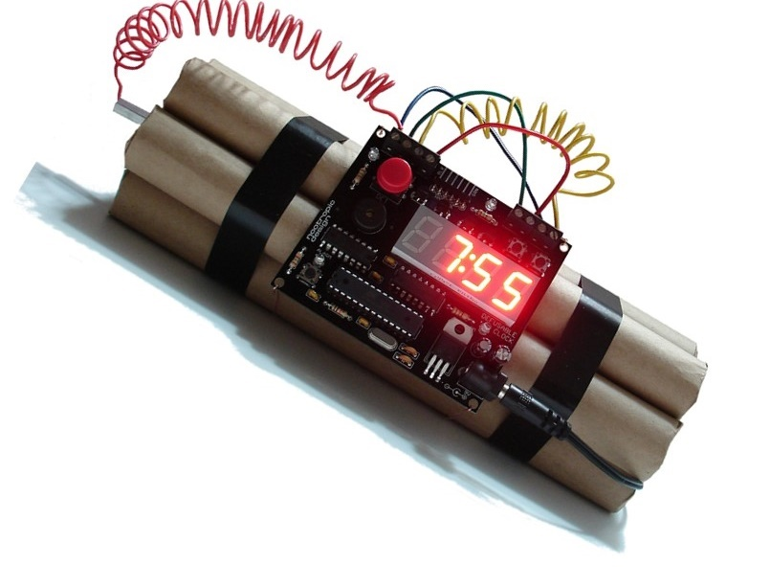
Why a synchronous design ?
Part I

Slide 5
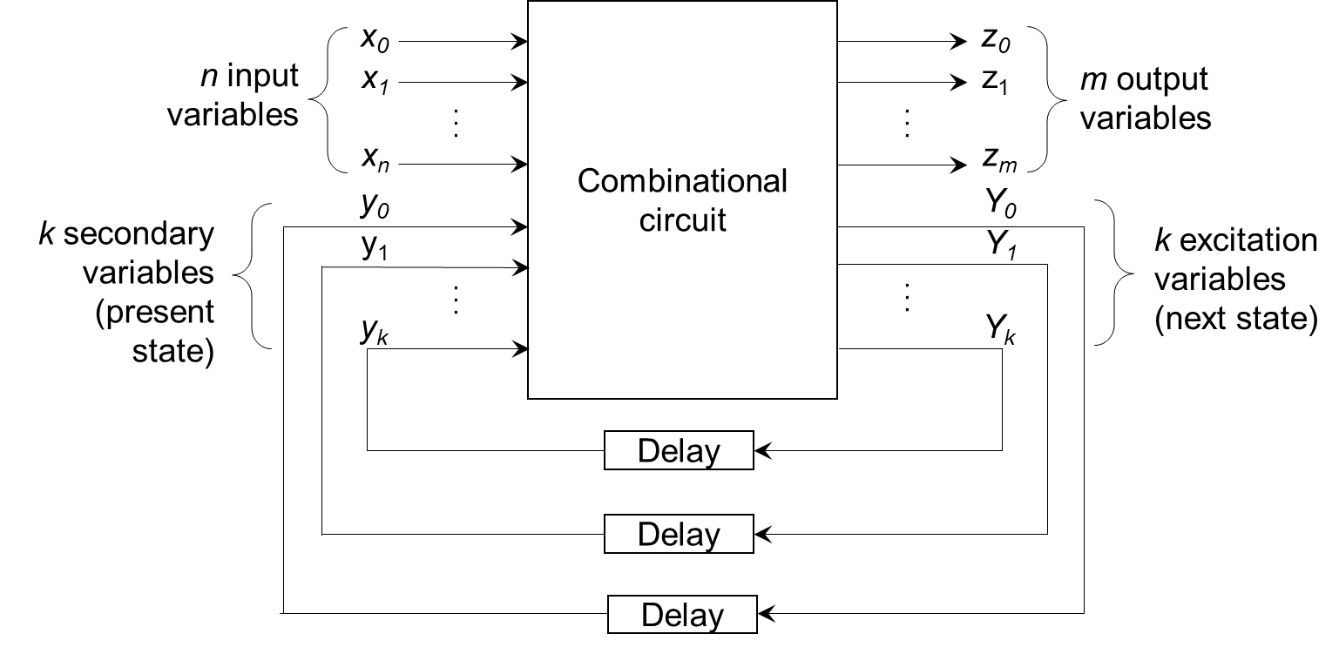
Reminder
Sequential system: system where the output is a function determined by the current and the preceding inputs.
State of a sequential system: minimal representation of past activity and current inputs, complete enough to allow prediction of outputs and update of the state itself.
Why a synchronous design ?
3 / 66

Slide 6
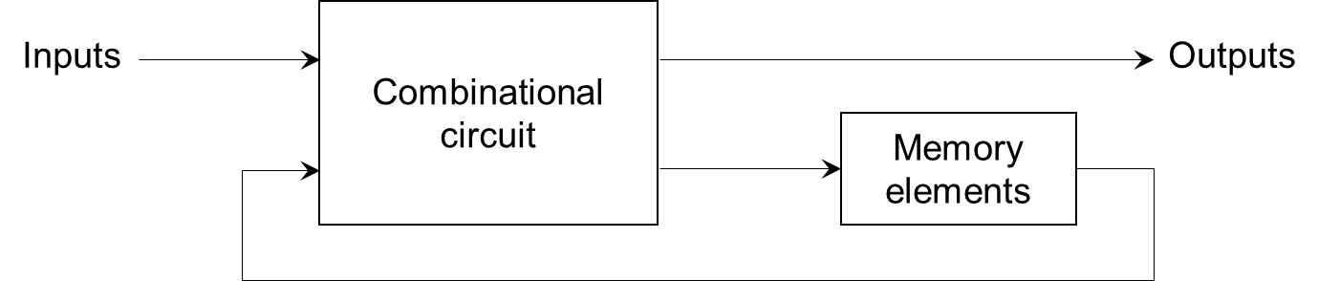
Reminder
In an asynchronous sequential circuit:
The transitions happen at any instant of time
Change of internal state occurs when there is a change in input variables
Delays can be implemented with memory elements
Flaws: RACES and HAZARDS
Why a synchronous design ?
4 / 66

Slide 7
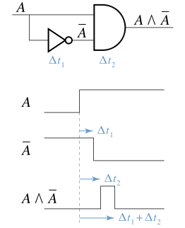
Race conditions
Occurs in an asynchronous circuit when two or more binary state variables change value in response to a change in an input variable.
When unequal delays are encountered, may cause the state variable to change in an unpredictable manner.
Here, ∆t₁ and ∆t₂ represent the propagation delays of the logic elements. When the input value A changes from low to high, the circuit outputs a short spike of duration (∆t₁ + ∆t₂) − ∆t₂ = ∆t₁.
If the final stable state that the circuit reaches does not depend on the order in which the state variables change, the race is called a noncritical race.
Otherwise, a critical race causes an unexpected variable stable state.
Why a synchronous design ?
5 / 66

Slide 8
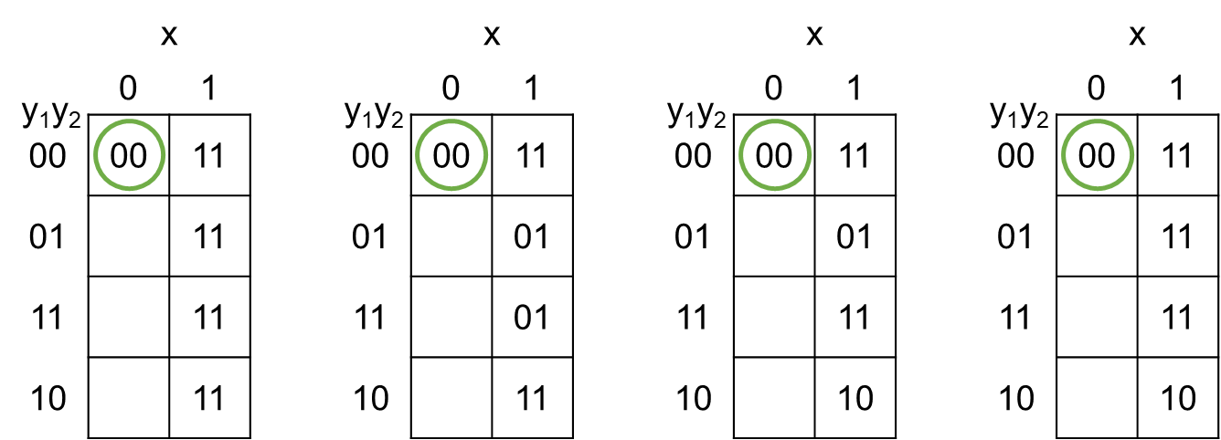
Race conditions - Examples
Non critical races
Critical races
Possible transitions:
0011
00 01 11
00 10 11
Possible transitions:
00 11 01
00 01
00 10 11 01
Possible transitions:
00 11
00 01
00 10
Possible transitions:
00 11
00 01 11
00 10
Why a synchronous design ?
6 / 66

Slide 9
Hazards
Unwanted switching transients that may appear at the output of a circuit because different paths exhibit different propagation delays.
In asynchronous sequential circuits, may result in a transition to a wrong stable state.
Static hazard: when one input variable changes, the output changes momentarily before stabilizing to the correct value.
Static-1 Hazard: the output is currently 1 and after the inputs change, the output momentarily changes to 0,1 before settling on 1
Static-0 Hazard: the output is currently 0 and after the inputs change, the output momentarily changes to 1,0 before settling on 0
Dynamic hazard: output changing more than once as a result of a single input change (often occurs in large circuits where there are different routes to the output from the input).
Functional hazard: caused by a change applied to more than one input. There is no specific logical solution to eliminate them.
Why a synchronous design ?
7 / 66

Slide 10
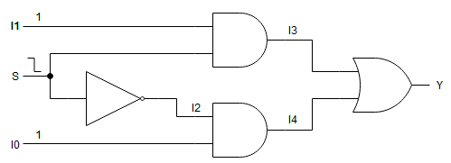
Static hazard example: Mux 21
 | 1 |  |  | 2 |  |  | 3 |  |  | 4
I0
I1
S
I2
I3
I4
Y
Ideal transitions (no delays)
 | 1 |  |  | 2 |  |  | 3 |  |  | 4 |  |  | 5 |  |  | 6
I0
I1
S
I2
I3
I4
Y
Realistic transitions
Glitch
Why a synchronous design ?
8 / 66

Slide 11
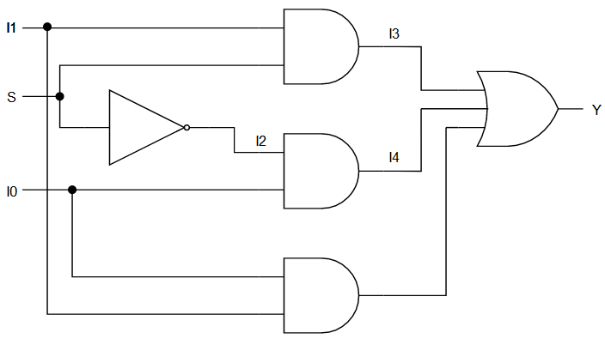
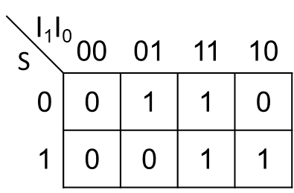
Static hazard example: Mux 21
Fix 1
Solution : include a additional prime impliquant
Costly (in area and power consumption)
Only done in asynchronous sequential circuit (never in synchronous ones), and only when absolutely needed.
Why a synchronous design ?
9 / 66

Slide 12
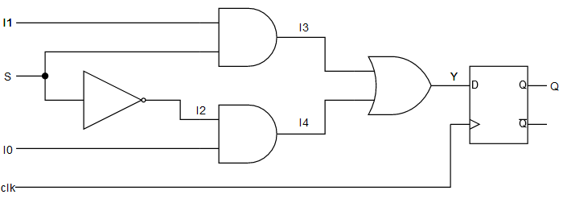
Static hazard example: Mux 21
Fix 2
 | 1 |  |  | 2 |  |  | 3 |  |  | 4 |  |  | 5 |  |  | 6
clk
I0
I1
S
I2
I3
I4
Y
Q
Other (better) solution:
Since, hazard = output oscillation before stabilization to a correct value ≈ time
Solution = waiting for all the inputs change to be propagated through the circuit to save the output value. = waiting for the hazard to occur before saving the output value.
Toward synchronous sequential design
Why a synchronous design ?
10 / 66

Slide 13
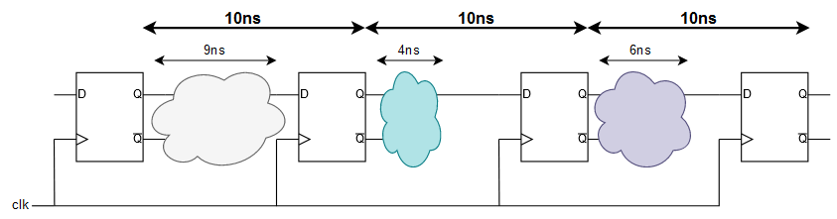
What is a synchronous design?
In a synchronous sequential circuit:
Transition happens at discrete instants of time
The circuit responds only to pulses on particular inputs, called clocks
Storage elements are affected only with the arrival of each pulse
Data wires may glitch between two clock edges
Worst case operation:
The clock frequency is limited by the speed of the slowest stage
This limit must be established in all corner cases (PVT, worst data case)
Why a synchronous design ?
11 / 66

Slide 14
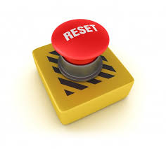
What is a synchronous design?
All flip-flops must be clocked by one common clock to give all combinatonial functions a whole clock cycle to calculate and update their outputs.
Reset only used for initialization
Question: Synchronous reset or asynchronous reset?
Whole system/board/chip reset = asynchronous
Will drive a synchronous initialization block.
Races and hazards are filtered.
Why a synchronous design ?
12 / 66

Slide 15

Synchronous system design
Part II

Slide 16
For a good synchronous design
In a synchronous circuit, a whole clock period can be used to calculate, propagate and update the system outputs.
To build a optimal circuit, three things that must be ensured by the designer :
Determine and minimize propagation times for the clock signal between each sequential elements (flip-flops, registers, memories), called the clock skew
Account for flip-flop setup and hold times
Account for propagation/routing times inside the combinatonial functions
Since no input change must occur between two clock edges, the designer must also reliably synchronize all asynchronous inputs.
Synchronous system design
13 / 66

Slide 17
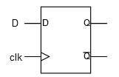
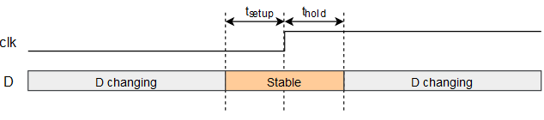
Setup and hold times
Setup Time: time during which the data at the synchronous input (D) must be stable before the active edge of clock
Hold Time: time during which the data at the synchronous input (D) must be stable after the active edge of clock.
Electrical characteristics of the flip-flop.
Setup or hold times violation results in an unpredictable flip-flop output.
Synchronous system design
14 / 66

Slide 18
Timing analysis
t_{clk} – t_{ffpd(max)} – t_{comb(max)} – t_{setup} > 0 → Setup time margin
t_{ffpd(min)} + t_{comb(min)} – t_{hold} > 0 → Hold time margin
These margins are extra times that can be used to make design more robust.
clk
Q
 |  |  |  |  | Propagation delay
 |  |  |  |  |  |  | Combinational path delay
D
 |  |  |  |  |  |  |  |  |  |  |  |  |  |  | Slack |  |  |  | Setup time |  |  | Hold time
Synchronous system design
15 / 66

Slide 19
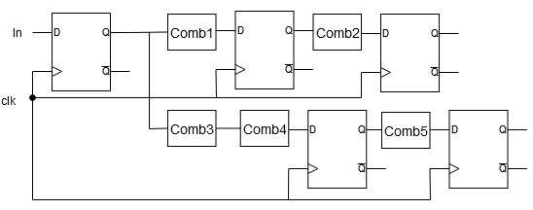
Timing analysis – Exercise 1
The circuit of Fig. 1 is synthesized to a gate level netlist. What is the estimated maximum operating frequency for the circuit, assuming :
A flip-flop setup-time requirement of 0.8 ns
A flip-flop hold-time requirement of 0.2 ns
A flip-flop propagation delay of 1 ns
A comb1 block delay of 6 ns
A comb2 block delay of 10 ns
A comb3 block delay of 5 ns
A comb4 block delay of 4 ns
A comb5 block delay of 2 ns
The maximal time for a data to be propagated is
Max of comb propagation time = 10 ns
+ Flip-flop setup time = 0.8 ns
+ Flip-flop propagation time = 1 ns
Max operating frequency is F_{max}=1/11,8 ns = 84,7 MHz.
Note : hold time violation is impossible since t_{ppfd}>t_{hdff}
Fig. 1
Synchronous system design
16 / 66

Slide 20
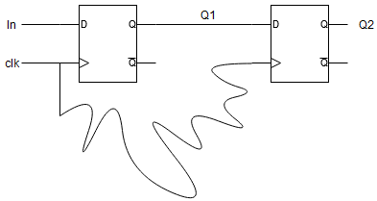
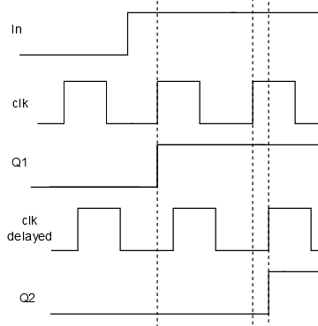
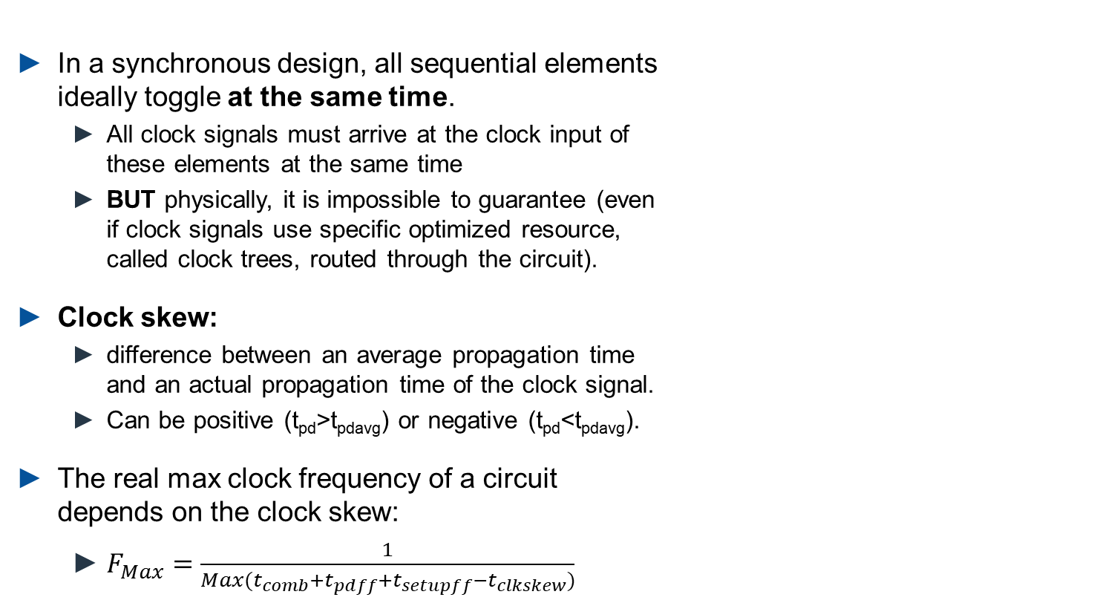
Clock skew
In a synchronous design, all sequential elements ideally toggle at the same time.
All clock signals must arrive at the clock input of these elements at the same time
BUT physically, it is impossible to guarantee (even if clock signals use specific optimized resource, called clock trees, routed through the circuit).
Clock skew:
difference between an average propagation time and an actual propagation time of the clock signal.
Can be positive (t_{pd}>t_{pdavg}) or negative (t_{pd}<t_{pdavg}).
The real max clock frequency of a circuit depends on the clock skew:
$F_{Max}=\frac{1}{Max(t_{comb}+t_{pdff}+t_{setupff}−t_{clkskew})}$
Synchronous system design
17 / 66

Slide 21
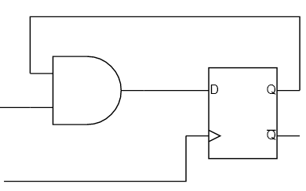
Timing analysis – Exercise 2
Determine the maximum frequency of the following circuit with and without clock skew.
IT’S A TRAP !
The source and destination flip-flops are the same. There is now clock skew here.
The max frequency is therefore 1/(t_{comb}+t_{pdff}+t_{setupff})
Synchronous system design
18 / 66

Slide 22
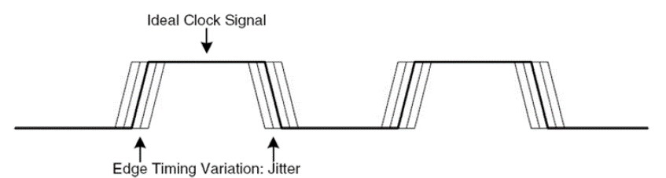
Clock jitter
Clock jitter: instantanous variation of the clock frequency around its nominal value (zero in an ideal world).
Must be taken into account to guarantee the correct functionning of the circuit, especially in PVT corner cases.
Synchronous system design
19 / 66

Slide 23
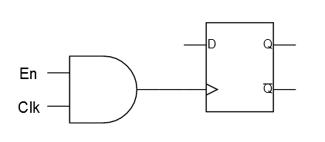
Clock gating
Clock gating: disabling the clock for low power consumption using a clock enable signal.
NEVER GATE THE CLOCK WITH LOGIC GATES! The clock signal would become unpredictable, unprotected (out of its clock tree), the clock skew would increase and the max frequency calculation would be inaccurate.
Synchronous system design
20 / 66

Slide 24
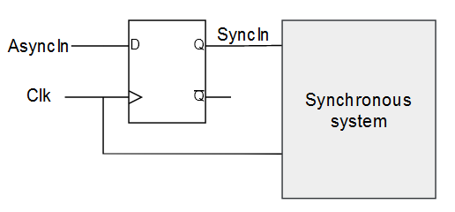
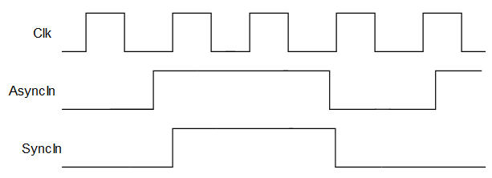
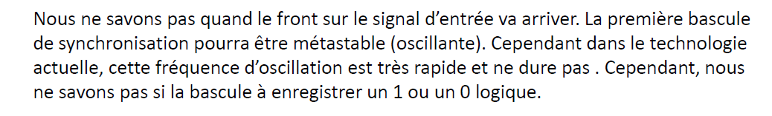
Input synchronization
To design a fully synchronous circuit, inputs must be synchronized to the clock. To do so, flip-flops must be used at the circuit inputs.
In a real world, no knowledge on when the input signal arrives.
Possible setup/hold time violation
Metastability
No guarantee that the input is correctly propagated
Synchronous system design
21 / 66

Slide 25
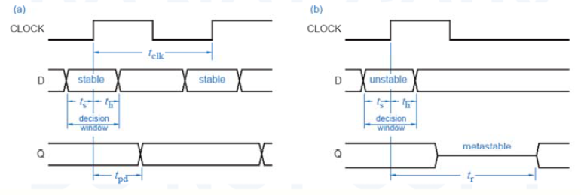
Metastability
Occurs with a setup/hold time violation, leading in the output settling in an unknown value after an unspecified time.
Synchronous system design
22 / 66

Slide 26
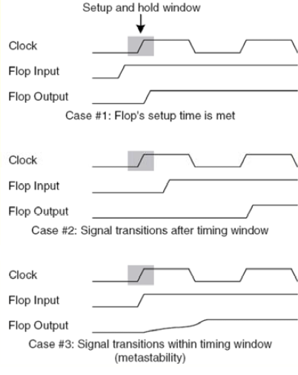
Metastability
If the synchronized input is metastable, it value is unknown (and cannot be processed by the circuit) until a second clock edge.
The clock must be at least twice as fast as the input changes.
Synchronous system design
23 / 66

Slide 27
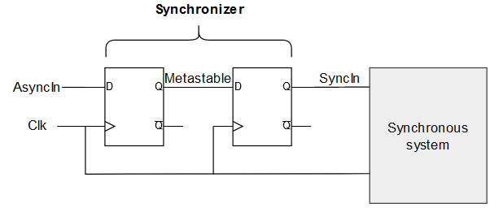
Reliable synchronization techniques
To filter metastability, a second flip-flop is added.
Synchronous system design
24 / 66

Slide 28
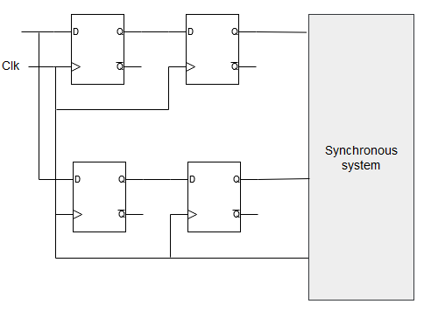
Reliable synchronization techniques
An input must be synchronized only in one place.
If not, different propagation times to the flip-flops, through it and to the following synchronous system may lead to metastability, hazard and/or oscillations.
Synchronous system design
25 / 66

Slide 29
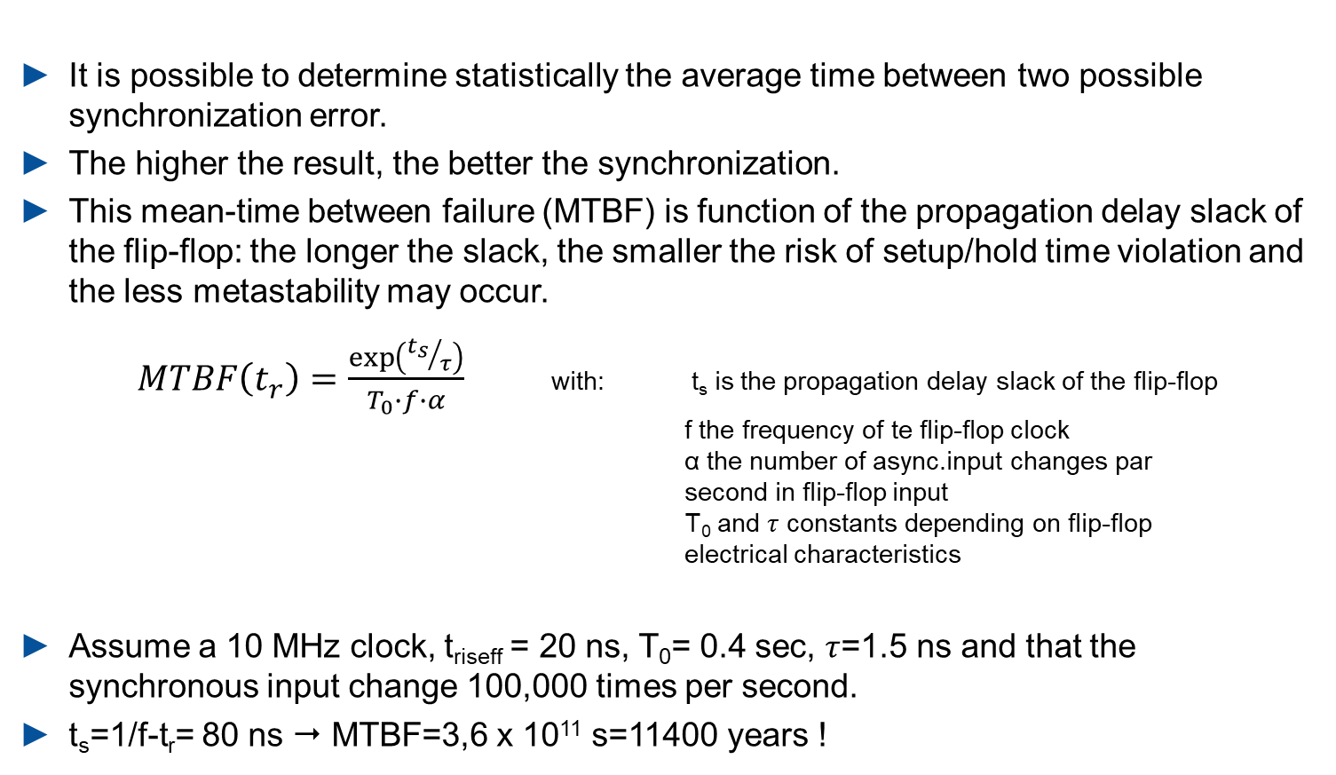
Mean-time between failure
It is possible to determine statistically the average time between two possible synchronization error.
The higher the result, the better the synchronization.
This mean-time between failure (MTBF) is function of the propagation delay slack of the flip-flop: the longer the slack, the smaller the risk of setup/hold time violation and the less metastability may occur.
$MTBF\left(t_{r}\right)=\frac{\exp\left({t_{s}}/τ\right)}{T_{0}∙f∙α}$ with: t_{s} is the propagation delay slack of the flip-flop
f the frequency of te flip-flop clock
α the number of async.input changes par second in flip-flop input
T₀ and $τ$ constants depending on flip-flop electrical characteristics
Assume a 10 MHz clock, t_{riseff} = 20 ns, T₀= 0.4 sec, $τ$=1.5 ns and that the synchronous input change 100,000 times per second.
t_{s}=1/f-t_{r}= 80 ns  MTBF=3,6 x 10¹¹ s=11400 years !
Synchronous system design
26 / 66

Slide 30
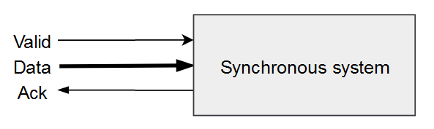
Synchronizing buses
To synchronize buses, dual flip-flops on all wires are not relevant:
May create different propagation times on all bits and increase the chance of metastability.
Good solution:
Synchronize a control signal (Valid) and read the input bits when safe to do so.
 | 1 |  |  | 2 |  |  | 3 |  |  | 4 |  |  | 5 |  |  | 6 |  |  | 7 |  |  | 8 |  |  | 9 |  |  | 10
Valid
Data | Invalid |  |  |  |  |  | Valid |  |  |  |  |  |  |  |  |  |  |  | Invalid
Ack
 | 1 |  |  |  | 2 |  |  |  | 3 |  |  |  | 4 |  |  |  | 5 |  |  |  | 6 |  |  |  | 7 |  |  |  | 8 |  |  |  | 9 |  |  |  | 10
Valid_async
Data_async | Invalid |  |  |  |  |  |  |  | Valid |  |  |  |  |  |  |  |  |  |  |  |  |  |  |  | Invalid
Clock
Valid_sync1
Valid_sync2
Data_sync | Invalid |  |  |  |  |  |  |  |  |  |  |  |  |  |  |  |  | Valid |  |  |  |  |  |  |  |  |  |  |  |  |  |  |  | Invalid
Ack
Synchronous system design
27 / 66

Slide 31
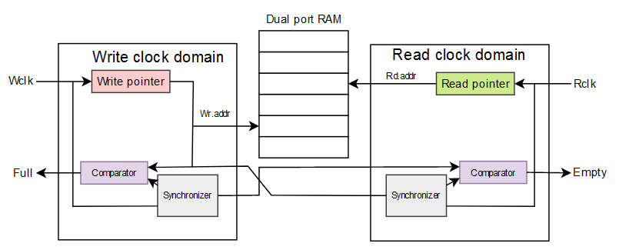
FIFO synchronizer basic concept
For burst transfers or multiple clock domains system:
Implementation of a dual port FIFO (writing on one port, reading on the other) to synchronize the data between the two domains.
Protocol (and possible conflicts) and address counter synchronization are managed by a sequential system belonging to the two clock domains.
 | 1 |  |  |  | 2 |  |  |  | 3 |  |  |  | 4 |  |  |  | 5 |  |  |  | 6 |  |  |  | 7 |  |  |  | 8 |  |  |  | 9 |  |  |  | 10
Valid_async
Data_async | Invalid |  |  |  |  |  |  |  | Valid0 |  |  |  | Valid1 |  |  |  | Valid2 |  |  |  | Valid3 |  |  |  | Invalid
Synchronous system design
28 / 66

Slide 32
Summary
In order to avoid hazards and races, synchronous design techniques are used.
In a synchronous design, a single common clock is used and reset is only used for initialization
The only considerations in synchronous design are the flip-flop setup and hold times, clock skew, combinational delays and asynchronous inputs synchronization.
Asynchronous inputs are commonly synchronized using 2 flip-flops clocked with the synchronous system clock
Synchronization should only be done in one place.
In bus transfer, synchronize only the control signals or use a FIFO.
Synchronous system design
29 / 66

Slide 33

System architecture and design trade-offs
Part III

Slide 34
Common design trade-offs
Performance
Latency
Throughput
Delay (timing)
Area
Gates (ASIC)
Flip-flops/LUTs (FPGA)
Power consumption
Dynamic
Static
Leakage
i
It is possible to influence the synthesis tools to optimize one of these trade-offs.
System architecture and design trade-offs
30 / 66

Slide 35
Design for speed
Design for low latency
Definition : output available as soon as possible
Technique: parallelism, removal of pipelining
Design for High throughput
Definition: high data rate, acceptable latency
Technique: pipelining
Design for timing
Definition: High clock speed, low delay between registers,
Technique: add intermediate registers
System architecture and design trade-offs
31 / 66

Slide 36
Design for area
Avoiding parallelisms
Rolling up pipelines
Ressource (logic) sharing
System architecture and design trade-offs
32 / 66

Slide 37
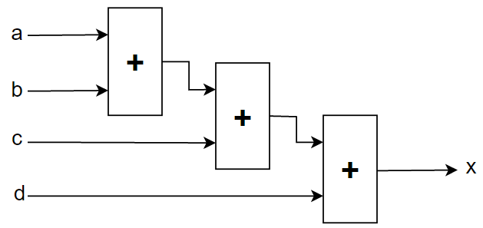
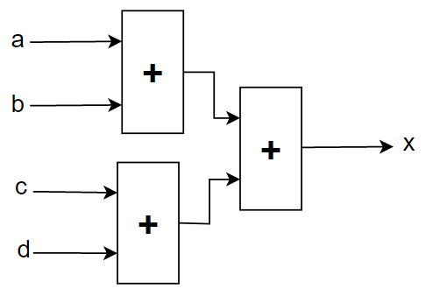
Example 1 : 4 bits adder: x=a+b+c+d
Design for low latency
Parallelism = performing several tasks in the same clock cycle
Drawback: requires more ressources
Delay : 3 x add
Latency : 1 cycle
Throughput : 1 bits/clock
Critical path
Critical path
Delay : 2 x add
Latency : 1 cycle
Throughput : 1 bits/clock
System architecture and design trade-offs
33 / 66

Slide 38
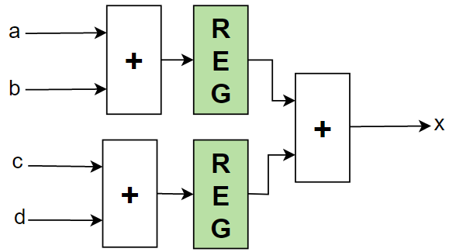

Example 1 : 4 bits adder: x=a+b+c+d
Design for delay / high throughput
To lower the propagation time through the circuit, registers are added.
Intermediate results of comb. functions are saved and a new calculation cycle can start.
Pipeline
Registers can be added to slice combinatorial functions
$$ smaller propagation times between flip-flops $$ higher clock frequency
Delay 1 x add + 1x REG
Latency : 2 cycle
Throughput : 1 bits/clock
System architecture and design trade-offs
34 / 66

Slide 39
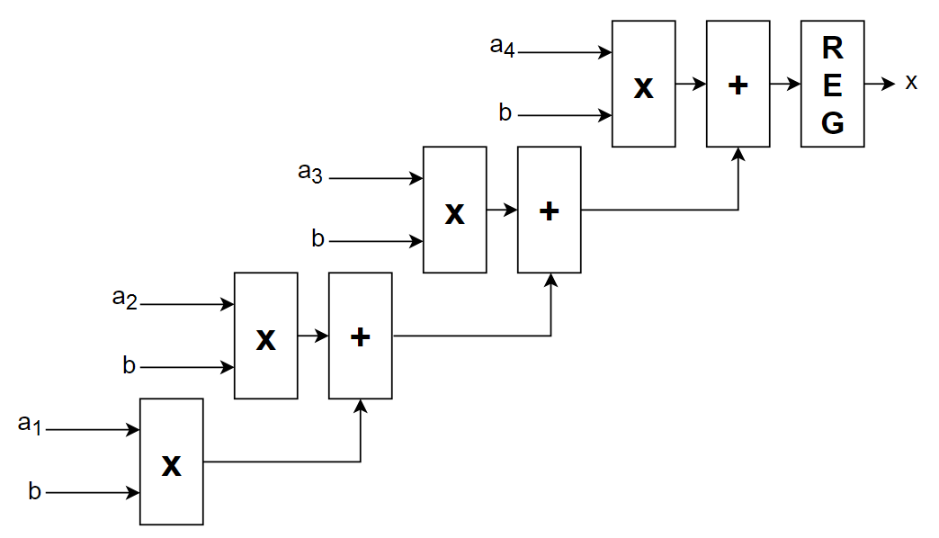


Example 2 : MAC: $x=\sum_{i≤4}{a_{i}∗b}$
Design for low latency : unrolling the loop
Only one cycle clock to update output.
Drawbacks:
Uses lots of ressources
Long critical combinatorial path $$ slower clock
Latency : 1 cycle
Throughput : 1 bits/clock
Delay: 1 x mult + 4 x add + 1x REG
System architecture and design trade-offs
35 / 66

Slide 40
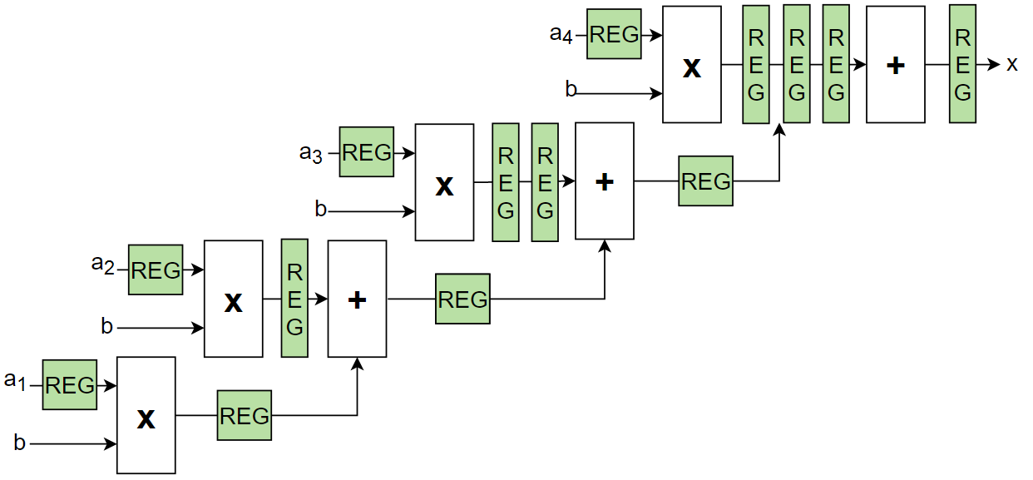
Example 2 : MAC: $x=\sum_{i≤4}{a_{i}∗b}$
Design for delay / High throughput
Register are added. Some data need to be shifted from one register to another one so that all signals are correctly synchronized.
High data throughput : one output update every clock cycle once the pipeline is full.
Drawback: high latency.
System architecture and design trade-offs
36 / 66

Slide 41
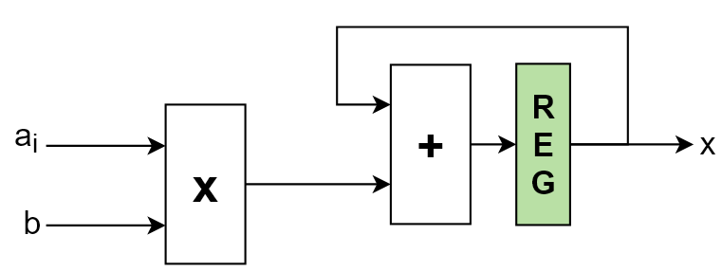
Example 2 : MAC: $x=\sum_{i≤4}{a_{i}∗b}$
Design for area
If resources are available, all calculations can be performed in parallel.
If not, creation of a sequential machine to produce the desired result.
Inputs are given sequentially to a single multiplier.
A single adder with a register performs the accumulation.
Delay: 1 x mult + 1 x add
Latency : 4 cycle
Throughput : 1 bits/4 cycles
System architecture and design trade-offs
37 / 66

Slide 42
Design for power
Power consumption:
Dynamic (switching): due to charging and discharging parasitic capacitances on gates and wires
Static: consumed when no switching
Leakage
As transistors become smaller, MOS gate manufacturing becomes less accurate, leading in leakage current (up to 15% of all power consumption)
Three techniques to reduce power consumption:
Clock gating
Dual-edge triggered flip-flops
Core voltage lowering
System architecture and design trade-offs
38 / 66

Slide 43
Clock gating
Clock gating: disabling the clock for low power consumption using a clock enable signal.
NEVER GATE THE CLOCK WITH LOGIC GATES! The clock signal would become unpredictable, unprotected (out of its clock tree), the clock skew would increase and the max frequency calculation would be inaccurate.
System architecture and design trade-offs
39 / 66

Slide 44
Dual Edge triggered flip-flops
Works on both rising and falling edges.
Allow the use of a clock two times slower for the same data rate.
DETFF are
Either available in the target technology
Either emulated with DLL or redundant flip-flops and gating.
 | 1 |  |  |  | 2 |  |  |  | 3 |  |  |  | 4 |  |  |  | 5
Clock
Q
Single-edge triggered flip-flop
 | 1 |  |  |  | 2 |  |  |  | 3 |  |  |  | 4 |  |  |  | 5
Clock
Q
Dual-edge triggered flip-flop
(same data rate)
System architecture and design trade-offs
40 / 66

Slide 45
Lowering core voltage
Reducing core voltage is only doable within acceptable limits (5 to 10%)
BUT: P=R*I²
Drawback: Performances degrade ! (higher propagation times)
System architecture and design trade-offs
41 / 66

Slide 46
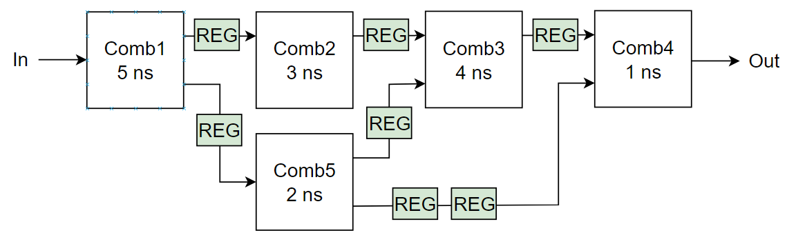
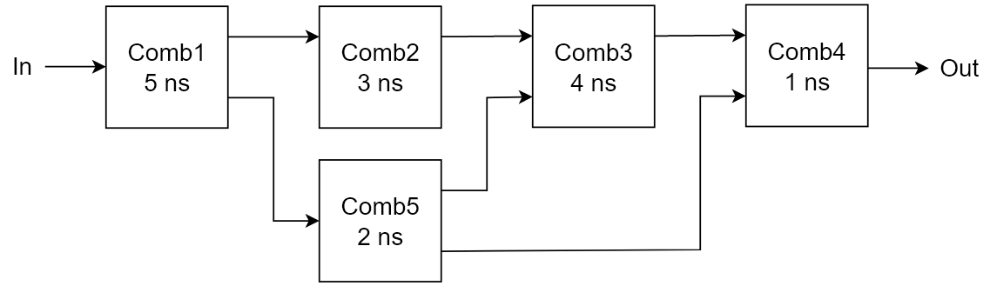
Summary
Pipelining = Latency/Throughput trade-off
Parallelism = Performance/area/power consumtion trade-off
Ressource sharing = area/latency trade-off
Exercise
Pipeline the following datapath for a 3 cycles latency so that you get the maximum operation frequency. How much is the maximum operation frequency ? (assume that the propagation time through a register is 1ns).
F_{max}=1/(max(t_{pdcomb}))+t_{pdff}+t_{pdcomb4})
= 143MHz
System architecture and design trade-offs
42 / 66

Slide 47

FSM Design
Part IV

Slide 48
Definition
FSM = Finite State Machine
Tool to represent a sequential system
If well thought, often an smart and efficient way to design a sequential circuit.
Describes the different states in which the system can be, and the input conditions defining the transition from one state to another.
FSM Design
43 / 66

Slide 49
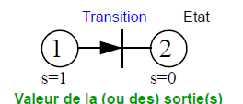
State diagrams
A FSM is graphically represented with a state diagram:
Enumeration of all possible states
Only one state can be active.
In every state, output value are completely defined.
State
Output(s) value
FSM Design
44 / 66

Slide 50
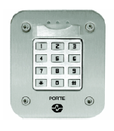
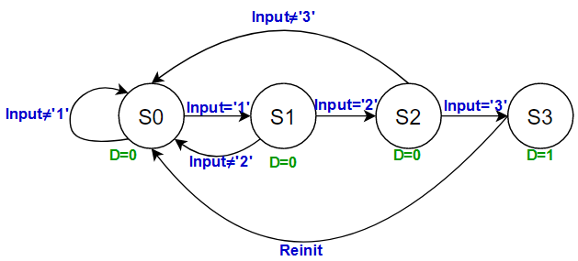
FSM example : sequence detector
Specification: a door opens if the sequence ‘1’, ‘2’, ‘3’ is typed.
States description:
State 0: wait for a ‘1’, door closed (D=0)
State 1 : wait for a ‘2’, door closed (D=0)
State 2 : wait for a ‘3’, door closed (D=0)
State 3 : correct sequence typed, door opens (D=1)
Note: this is Moore machine (see next slides)
FSM Design
45 / 66

Slide 51
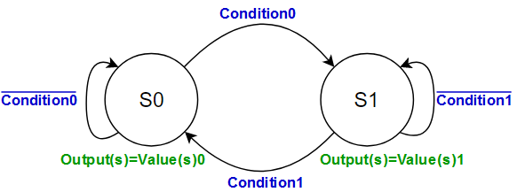
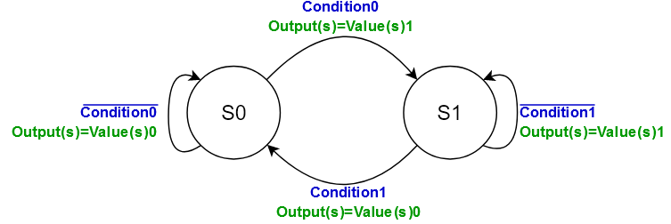
Moore vs Mealy
In a Moore machine, the outputs are set based on the current state.
In a Mealy machine, the outputs are set when the state change happens.
Using Mealy machines sometimes result in state machines with fewer states than a Moore machine would require, because they can eliminate the need for some transitional states.
Moore
Mealy
FSM Design
46 / 66

Slide 52
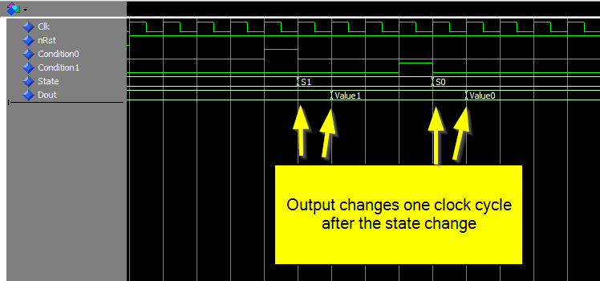
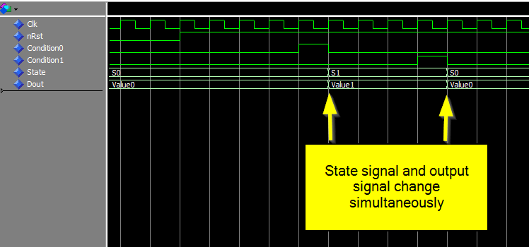
Moore vs Mealy
Moore
Mealy
FSM Design
47 / 66

Slide 53
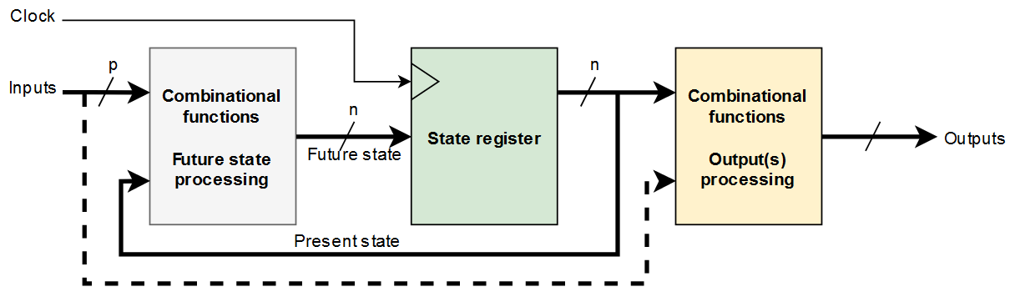
FSM block diagram
Moore (w/o dashed section) and Mealy (w/ dashed section) machines block diagram
3 independant processing parts:
Block F: combinational function processing the future state. VHDL: process/case.
Block State register: sequences the transition from present state to future state. VHDL: process
Block G: combinational function processing the system outputs. May be described as a sequential function. VHDL: combinational affectation or process.
FSM Design
48 / 66

Slide 54
FSM implementation
Two choices:
State coding
Binary coding
One shot
Gray coding
Number of process
One process
Two processes
Three processes
Note : all codes (including test-benches) are available on Moodle.
FSM Design
49 / 66

Slide 55
States coding
Binary encoding: states are enumerated with binary encoded numbers
"000", "001", "010", "011", "100"…
Minimizes the length of the state vector
Usually for FSM with less than 5 states
One-hot encoding: states are represented as bit patterns with exactly 1 '1’:
"000001", "000010", "000100", "001000", "010000"…
Usually faster and uses more registers and less logic. More suitable for FPGA designs where registers are usually abundant
Usually for FSM with 5 to 50 states
Gray coding: the encoding of successive states only differ by one bit:
"000", "001", "011", "010", "110"…
Reduces glitches
Usually for FSM with more than 50 states
If not specified in VHDL code, the synthesis tool determines alone the best solution.
FSM Design
50 / 66

Slide 56
States coding
Declaration:
Entity
Architecture
where “sequential” also can be “gray” or “onehot.”
1 2 3 4 5 6 7 8 | entity FSM is port( rst : in std_logic; clk : in std_logic; inputs : in type_of_inputs; outputs : out type_of_outputs); end FSM;
New type declaration and
enumeration of state names
9 10 11 12 13 14 15 16 17 18 19 | architecture BEH of FMS is type state IS (state0, state1, state2…) ; signal current_state : state ; attribute syn_encoding string; attribute syn_encoding of current_state : signal is “sequential”; begin
Declaration of a signal of the new type
Optional choice of state encoding
FSM Design
51 / 66

Slide 57
Number of process(es)
A FSM can be coded with:
3 processes, like the block diagram: one process for the block F, one for the block G and one for the state register block)
2 processes: one for block F and G together and one for state register block
1 process: all blocks combined
Implemented in a fully synchronous process
Easy to debug
Easier to meet timing requirements during place and route.
FSM Design
52 / 66

Slide 58
One-process coding - Moore
20 21 22 23 24 25 26 27 28 29 30 31 32 33 34 35 36 37 38 39 40 41 | process(rst, clk) begin if rst='1' then current_state <= S0; Dout <= Value0; elsif rising_edge(clk) then case current_state is when S0 => Dout <= Value0; if condition0='1' then current_state <= S1; else current_state <= S0; * end if; when S1 => Dout <= Value1; if condition1='1' then current_state <= S0; else current_state <= S1;* end if; when others => Dout <= Value0; current_state <= S0; end case; end if; end process;
* May be omitted with recent synthesis tools
FSM Design
53 / 66

Slide 59
One-process coding - Moore
Setting the output within the state that it belongs to => the output signal change one clock cycle after the state signal.
Generally not a problem when it comes to the function of the FSM.
But can be a little confusing to make sense of during a debugging session.
FSM Design
54 / 66

Slide 60
One-process coding - Mealy
20 21 22 23 24 25 26 27 28 29 30 31 32 33 34 35 36 37 38 39 40 41 42 43 | process(rst, clk) begin if rst='1' then current_state <= S0; Dout <= Value0; elsif rising_edge(clk) then case current_state is when S0 => if condition0='1' then current_state <= S1; Dout <= Value1; else current_state <= S0;* Dout <= Value0; end if; when S1 => if condition1='1' then current_state <= S0; Dout <= Value0; else current_state <= S1;* Dout <= Value1; end if; when others => Dout <= Value0; current_state <= S0; end case; end if; end process;
* May be omitted with recent synthesis tools
FSM Design
55 / 66

Slide 61
One-process coding - Mealy
Assignment to the output signal Dout inside of the If-statement.
The state and output signals change simultaneously, thus making debugging easier.
FSM Design
56 / 66

Slide 62
Two-process coding
Sequential process controls current State
Synchronous process only controls the State signal (through the use of a NextState signal).
All other related signals are set by the combinatorial process as a result of a changed state or condition.
20 21 22 23 24 25 26 27 28 29 30 31 32 33 34 35 36 37 38 39 40 41 42 43 44 45 | process(rst, clk) begin if rst=‘1’ then current_state <= S0; elsif rising_edge(clk) then current_state <= next_state; end if; end process; process(current_state, Condition0, Condition1) begin case current_state is when S0 => Dout <= Value0; if Condition0=‘1’ then next_state <= S1; else next_state <= S0; * end if; when S1 => Dout <= Value1; if Condition1=‘1’ then next_state <= S0; else next_state <= S1; * end if; when others => Dout <= Value0; next_state <= S0; end case; end process;
* May be omitted with recent synthesis tools
FSM Design
57 / 66

Slide 63
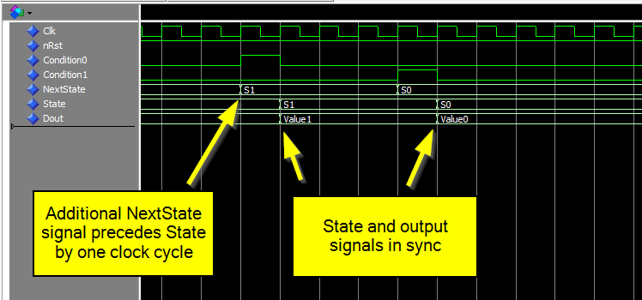
Two-process coding
Sequential process controls current State
Moore machine BUT state signal and Dout in sync
Output update still delayed by one clock cycle with regard to the transition condition.
FSM Design
58 / 66

Slide 64
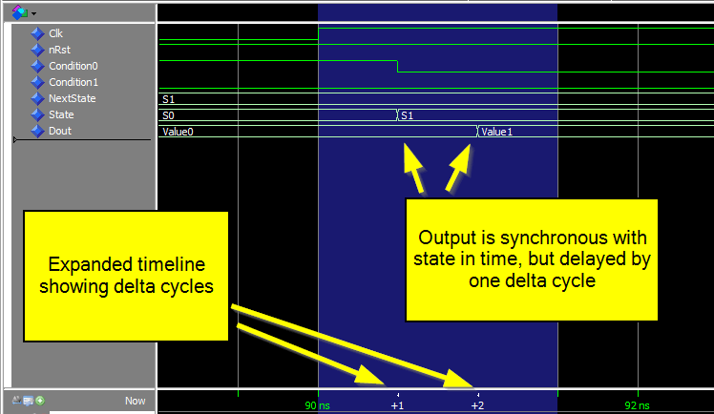
Two-process coding
Sequential process controls current State
Beware when zooming: one delta cycle between state signal and output update.
Delta cycle = zero-time unit used by VHDL simulators to model changes in signal values in combinatorial processes
FSM Design
59 / 66

Slide 65
Two-process coding
Sequential process controls state
No NextState signal.
Sequential process entirely controls the State signal.
Combinatorial process sensitive to state changes, and sets the output signal accordingly.
State and output signals appear to be in sync in the waveform, but output is delayed by a delta cycle.
20 21 22 23 24 25 26 27 28 29 30 31 32 33 34 35 36 37 | process(rst, clk) begin if rst=‘1’ then current_state <= S0; elsif rising_edge(clk) then case current_state is when S0 => if Condition0=‘1’ then current_state <= S1; else current_state <= S0;* end if; when S1 => if Condition1=‘1’ then current_state <= S0; else current_state <= S1;* end if; when others => current_state <= S0; end case; end if; end process
36 37 38 39 40 41 42 43 36 37 | process(current_state) begin case State is when S0 => Dout <= Value0; when S1 => Dout <= Value1; when others => Dout <= Value0; end case; end process; -- OU -- Dout <= Value0 when (State=S0) else Value1;
Moore or Mealy ?
* May be omitted with recent synthesis tools
FSM Design
60 / 66

Slide 66
Two-process coding
Sequential process controls current state and output
Synchronous process controls the current state signal as well as the output signal.
Logically equivalent to the Moore type one-process FSM
No delta cycle delay between the state and output signals
20 21 22 23 24 25 26 27 28 29 30 31 32 33 | process(rst, clk) begin if rst=‘1’ then current_state <= S0 Dout <= Value0 elsif rising_edge(clk) then current_state <= next_state; case current_state is when S0 => Dout <= Value0; when S1 => Dout <= Value1; when others => Dout <= Value0; end case; end if; end process;
34 35 36 37 38 39 40 41 42 43 44 45 46 47 | process(current_state, Condition0, Condition1) begin case current_state is when S0 => if Condition0=‘1’ then next_state <= S1; else next_state <= S0;* end if; when S1 => if Condition1=‘1’ then next_state <= S0; else next_state <= S1;* end if; when others => next_state <= S0; end case; end process;
* May be omitted with recent synthesis tools
FSM Design
61 / 66

Slide 67
Three-process coding
As close as possible to the block diagram
Same results as the two process FSM where sequential process controls current State, but output has its own combinatorial process (slide 57)
20 21 22 23 24 25 26 27 28 29 30 31 32 33 34 35 36 | process(rst, clk) begin if rst=‘1’ then current_state <= S0; elsif rising_edge(clk) then current_state <= next_state; end if; end process; process(current_state) is begin case current_state is when S0 => Dout <= Value0; when S1 => Dout <= Value1; when others => Dout <= Value0; end case; end process;
38 39 40 41 42 43 44 45 46 47 48 49 50 51 | process(current_state, Condition0, Condition1) begin case current_state is when S0 => if Condition0=‘1’ then next_state <= S1; else next_state <= S0; * end if; when S1 => if Condition1=‘1’ then next_state <= S0; else next_state <= S1; * end if; when others => next_state <= S0; end case; end process;
* May be omitted with recent synthesis tools
FSM Design
62 / 66

Slide 68
Which one should I use?
No right or wrong answer.
Some key questions to help you choose:
Do you need a Moore machine or a Mealy machine?
Hybrid machine can also be a solution!
Is the downstream logic that received the output signal synchronous or combinatorial?
What style of coding do you prefer?
One-process FSM most common type among engineers that have a computer science background.
Two- or three-process FSM most common type among engineers that have an electronics background.
For the next project, three-process or two process FSM where Sequential process controls current State preferably used.
FSM Design
63 / 66

Slide 69
Warning
Initial state resolution:
After initialization, initial state may be any one (even an undefined state depending on how states are coded)
Reset needed to force the machine to start in the correct state.
Inferred latches:
When using if or case statement, all conditions must be tested (using else and when others resp.) and affect all output of the process in every condition.
Otherwise, synthesis creates unwanted latches (called inferred latches) to store the value of the unspecified signals.
Modern synthesis tools usually detect the inferred latches and simply don’t implement them. But it’s a good practice to make your statments complete with else or when others.
38 39 40 41 42 43 | process(En, D) is begin if e=‘1’ then q <= d; end if; end process;
No else statement
Inferred latch
FSM Design
64 / 66

Slide 70

Conclusion

Slide 71

Now, you should know…
Why synchronous design are used
How to synchronize the inputs
How setup/hold times, clock skew and propagation times affect your design
What architecture to use for a given purpose
What a Finite State Machine is
How to code one in VHDL
Conclusion
65 / 66

Slide 72

Conclusion
66 / 66

