Slide 1




GRAPH LAPLACIANS FOR ROTATION EQUIVARIANT NEURAL NETWORKS
Master thesis in Computational Science and Engineering
School of Basic Sciences
Department of Mathematics
École Polytechnique Fédérale de Lausanne
Supervised by: Michaël Deferrard (EPFL)
Nathanaël Perraudin (SDSC – ETH)
Piercesare Secchi (Politecnico di Milano)
Pierre Vandergheynst (EPFL)
Notes:
Good afternoon! In the next 30 minutes I will present the work that I did in the last 5 months with Michael and Nathanael. The name I chose for my thesis is Graph Laplacians for rotation equivariant Neural Networks since this was the main goal of the project, even if in the last weeks of work we started investigating other kind of discrete Laplacians. We will see this later.

Slide 2

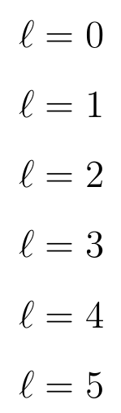
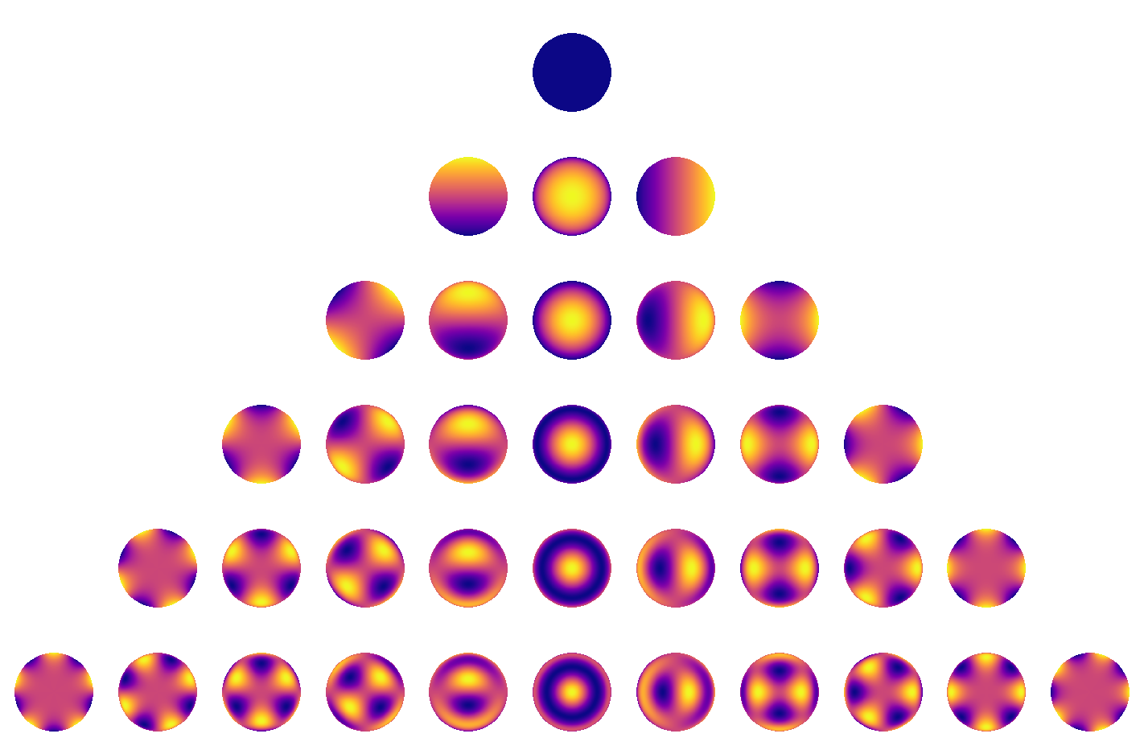
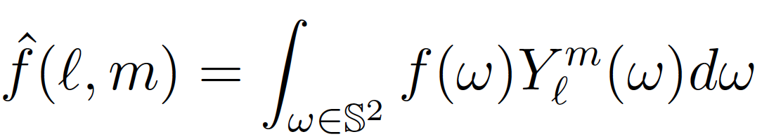
Fourier analysis on the sphere and the spherical harmonics
[1]
[1] Starry: analytic occultation light curves, Luger R. et al., https://rodluger.github.io/starry/v0.3.0/tutorials/basics1.html
Notes:
First, let’s introduce some basic concepts of Fourier analysis on the sphere. Fourier analysis on the sphere consists in using as coordinate system of the space L^2 the orthonormal basis given by the eigenvectors of the of the Laplace-Beltrami operator, called spherical harmonics. Important properties of the spherical harmonics are the following: the eigenspaces have increasing, odd, dimension (1, 3, 5, 7, 9, …) and to index these spherical harmonics we will use the parameter \ell (called degree) that identifies the eigenspace that it belongs to, and the order m that will range in the number of dimensions of that eigenspace. All these eigenspaces are closed with respect to rotations, meaning that if any rotation of a spherical harmonic will result in a linear combination of SH of the same degree. This means that the basis of SHs can block-diagonalize any rotation-invariant operation, such as convolutions.

Slide 3
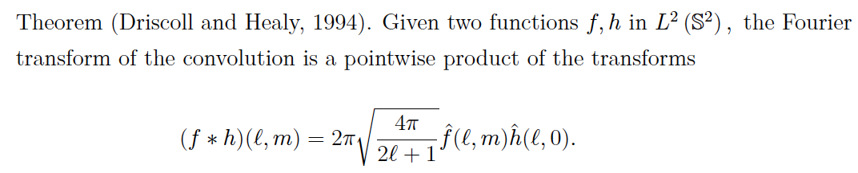
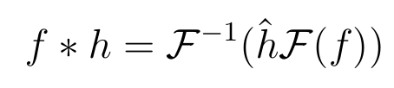

Convolution on the sphere
Convolution on the sphere can be performed in the spectral domain as usual:
Complexity of FFT algorithms is .
Notes:
This theorem states that the fourier transorm of the convolution of two signals is a pointwise product of the transforms, extending a very well nown fact for Euclidean domains. In this work we will do convolutions in two ways: with graphs and with what is called the Finite Element Method. In both cases we will do convolutions in the spectral domain, so this result is very important.

Slide 4

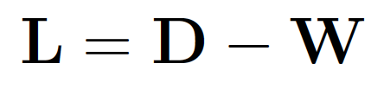
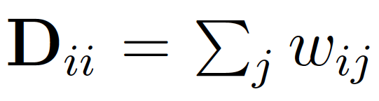


Graph convolutions
Given a weighted adjacency matrix , define the graph Laplacian to be the
following matrix:
L is symmetric, so by the spectral decomposition theorem we can decompose it in:
Convolving on the graph a signal with a kernel is defined as the following matrix multiplication:
Notes:
Ok so since everyone in this room know what a graph is and this notation, I will go straight to defining how to convolve a signal on a graph. This is done by a matrix multiplication with the matrix that I called Omega_G^k, equal to the product of these 3 matrices representing the spectral decomposition of the graph Laplacian L. k(Lambda) is the diagonal matrix such that each one of his elements is equal to the function k applied to the corresponding eigenvalue.

Slide 5
Graph convolutions
Given a weighted adjacency matrix , define the graph Laplacian to be the
following matrix:
L is symmetric, so by the spectral decomposition theorem we can decompose it in:
Convolving on the graph a signal with a kernel is defined as the following matrix multiplication:
Notes:
Here we are using the spectral domain to define it, since the matrix V^T is the matrix that projects f on the eigenbasis of the graph Laplacian (the Fourier matrix), k(Lambda) is the block diagonalization of the convolution operator chosen, (in this case it’s a diagonal matrix) and the matrix V represents the inverse discrete Fourier transform.

Slide 6
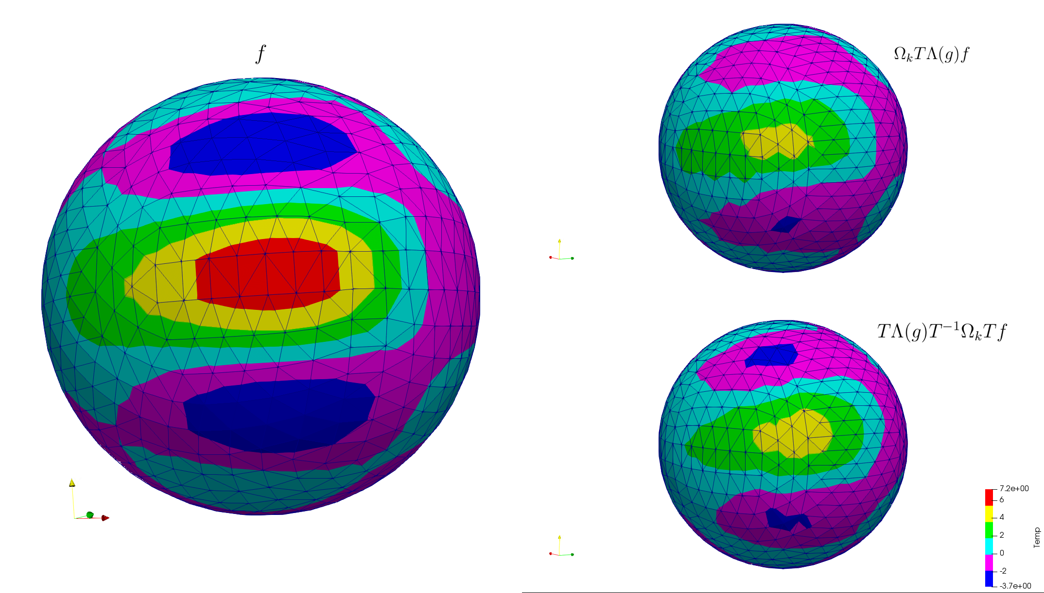
Rotation Equivariant Filtering
Notes:
From now on we will use the word filter instead of convolution. So, forst thing, what does it mean for a filter to be equivariant to rotation? Well, it means that rotation and filtering must commute. Continuous filtering is perfectly equivariant to rotations, meaning that it perfectly commutes with any rotation. However, as soon as we discretize things, we are forced to do approximations. In this figure we see on the let a signal f, and on the top right the results of first rotating the signal and then filtering it, and on the bottom right the result of first filtering it and then rotating it. We can clearly see that there are some differences between the tho signals on the right, meaning that the algorithm used for this filtering is not perfectly equivariant to rotations. For those of you that already know it, to do this we used DeepSphere.

Slide 7

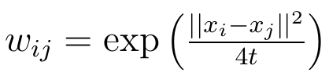

Equivariance of graph filtering
If the graph Fourier transform well approximates the continuous Fourier transform
then the graph Fourier transform will be rotation equivariant.
Heat Kernel Graph (HKG):
Belkin et al. proved that with a random sampling scheme, in probability [2]
Notes:
Om so how can we design a graph such that it is equivariant to rotations? Here we state an important concept that guided us in this work: If the graph Fourier transform well approximates the continuous Fourier transform then the graph Fourier transform will be rotation equivariant. Actually it is not the only way of designing rotation equivariant convolutions. For those of you that know it, the graph of prof. Khasanova and Frossard is an example of rotation equivariant graph that do not use this concept. However, if we decide to pursue this road to build rotation equivariant graphs, then a good graph to use is the Heat Kernel Graph, studied in the works of Belkin and Nyiogi that proved that with a random sampling scheme, it converges spectrally to the Laplace-Beltrami operator on the sphere.

Slide 8
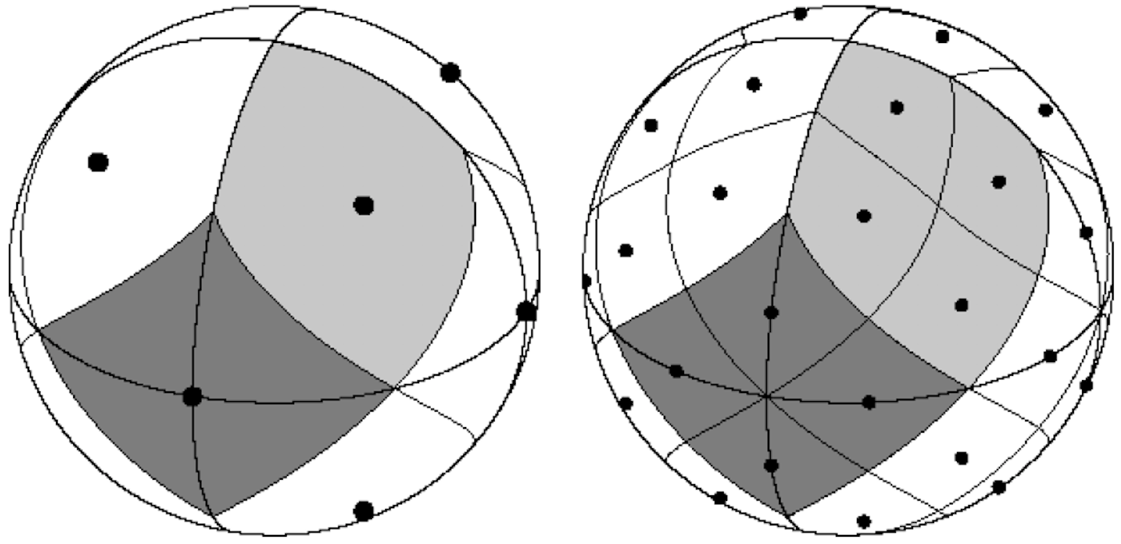

HEALPix: equiarea sampling scheme
The HKG Laplacian eigenvectors well approximate the spherical harmonics
The dot product of the HKG Laplacian eigenvectors and the sampled signal well approximates the corresponding Fourier coefficient.
Notes:
So, if used on a uniform equiarea sampling scheme such as HEALPix, we have that the HKG Laplacin eigenvectors well approximated the sampled spherical harmonics, and because of the equiarea property of the sampling scheme, the dot product between the graph Laplacian eigenvectors and a signal f well approximates the L2 product of the respective continuous signals.

Slide 9

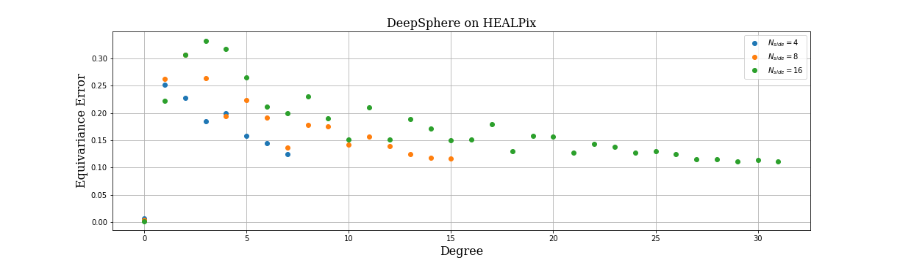
DeepSphere 1.0
DeepSphere is a Spherical Graph Convolutional Neural Network
Each layer implements a polynomial filter of a sparse HKG Laplacian of a spherical signal sampled with HEALPix.
Filtering is
Notes:
This is the reason for which the HEALPix sampling scheme and a sparse version of the HKGL were used in DeepSphere, a graph CNN where each layer implements a graph filtering. We measured the equivariance error of the diffusion filtering of DeepSphere by spherical harmonic degree, showing that it can reach peaks of 30%, and it does not decrease as we sample more and more the sphere.

Slide 10

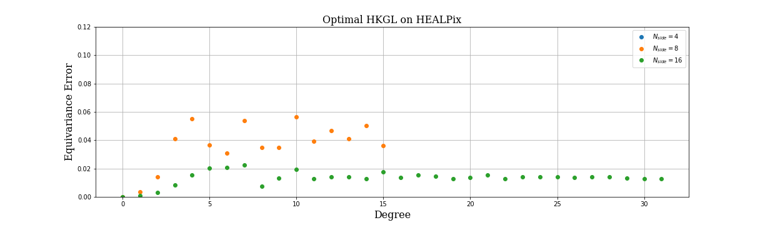
DeepSphere 2.0
DeepSphere 2.0 is an improved version of DeepSphere
Each layer implements a polynomial filter of a sparse (but not too sparse) HKG Laplacian of a spherical signal sampled with HEALPix.
Filtering is
Notes:
A first result of this work was to modify the graph of DeepSphere tuning the kernel width and the number of nighbors of the graph in order to improve the equivariance error. We managed to do so, but we had to pay a price: the computational complexity of this algorithm is not linear any more, but is O(n5/4). However, having payed this price we managed to have an equivariance error that went from 30 to 5 percent, and plus it shows convergence to 0 as we sample more and more the sphere.

Slide 11
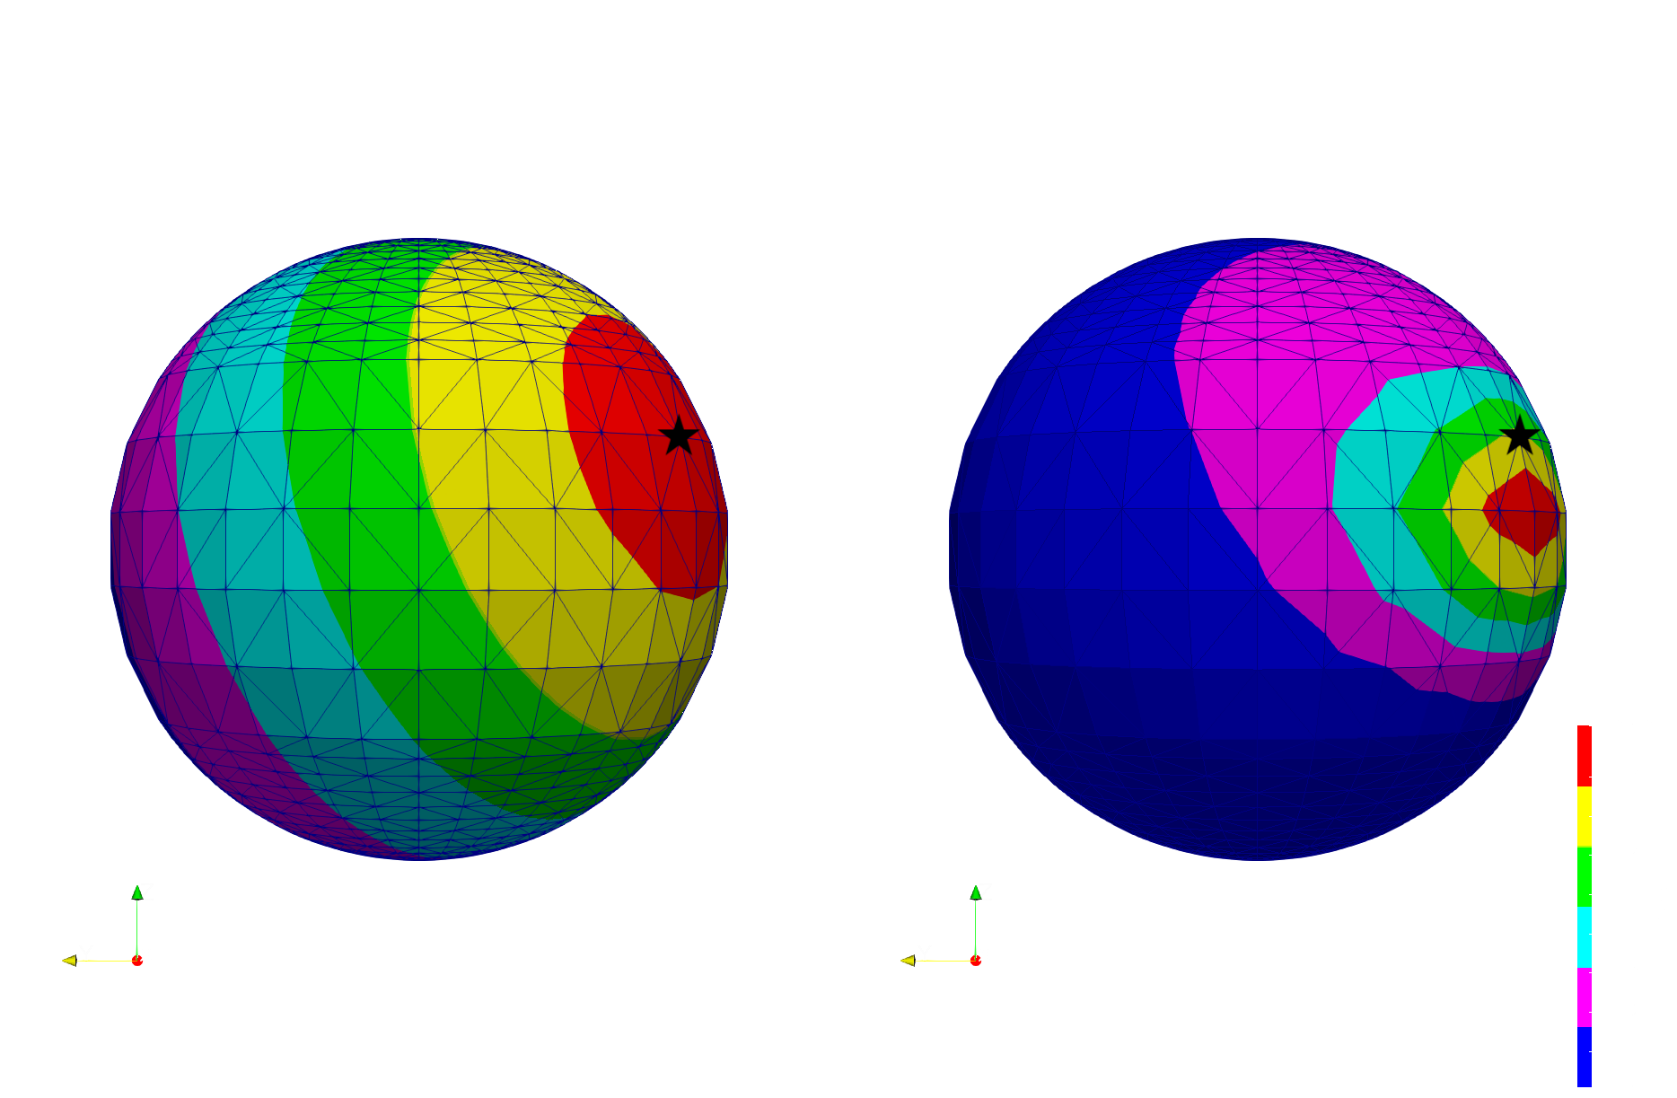
Non-equiarea sampling schemes
Figure: left, FEM diffusion of a point source signal. Right, diffusion obtained with the HKG Laplacian
Notes:
After this first enouraging result, we moved our attention to other sampling schemes of the sphere, less uniform than HEALPix. We observed that in such case, as we were expecting, the HKG does not work well any more. Here we show a source signal diffused using the HKG where the poles were sampled much more than the equator: as a result, the signal diffuses not homogeneusly on the shphere as expected, andas shown in the leftmost figure, but it is kind of attracted to the equator. And this is not a behavor that we want. We need to find an alternative way (or an alternative graph) to filter signals on a sphere that is sampled not uniformly.

Slide 12

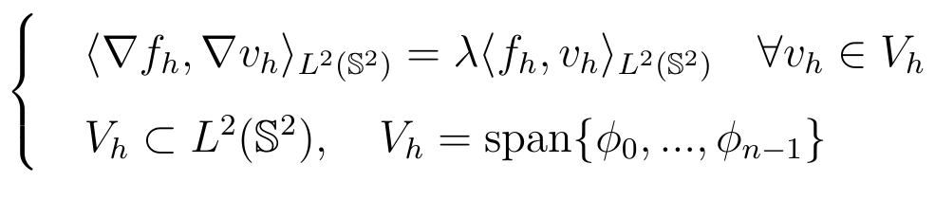
Towards the Finite Element Method
The Galerkin problem is a discretized version of the weak eigenvalue problem, where the ambient space is finite dimensional:
Notes:
Looking for such method, we investigated the Finite Element Method. This is a method very used in numerical mathematics to find the solution of differential problems. Let’s see how to build a discrete Laplacian using the FEM. First, it can be shown that this eigenvalue problem can be rewritten in the following WEAK form. DO IT ON THE BLACKBOARD.

Slide 13
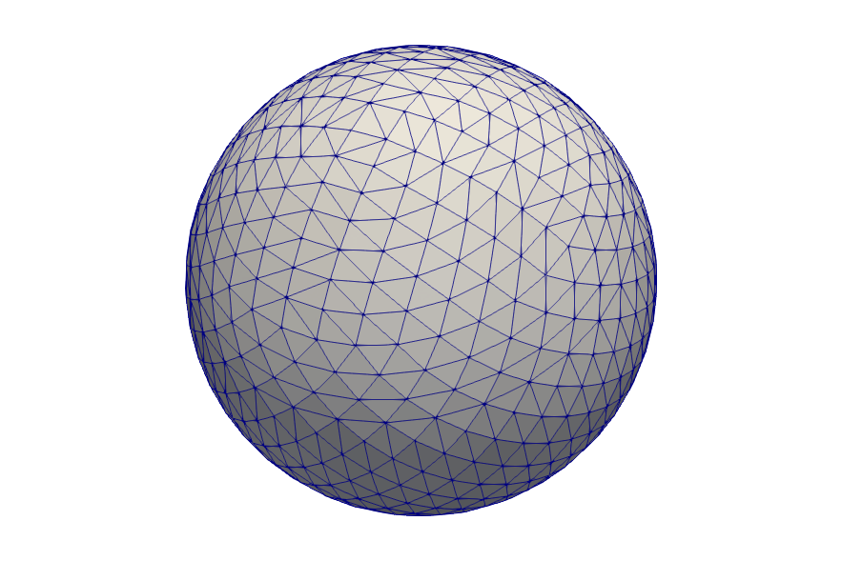
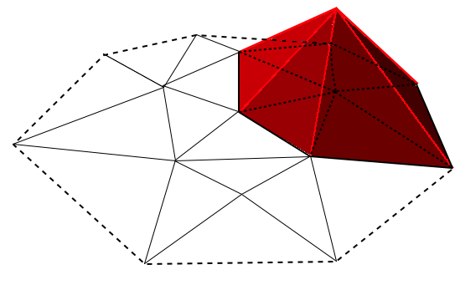
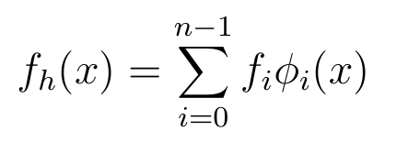
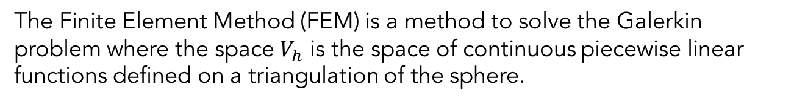
The Finite Element Method (FEM)
The Finite Element Method (FEM) is a method to solve the Galerkin problem where the space $V_{h}$ is the space of continuous piecewise linear functions defined on a triangulation of the sphere.
Notes:
The Finite Element Method (FEM) is a method to solve the Galerkin problem where the space $V_{h}$ is the space of continuous piecewise linear functions defined on a triangulation of the sphere. Suc space has n degrees of freedom, where n is the number of vertices of the triangulation, and it is then spanned by n basis functions. We choose as the ith basis function the functions represented here that is 1 on the ith vertex and is 0 on all the others. We represent each fucntion f_h living in such space as a linear combination of these n basis functions. Observe that the ith coefficient of f is exactluy the value of f evaluated on the ith vertex.

Slide 14


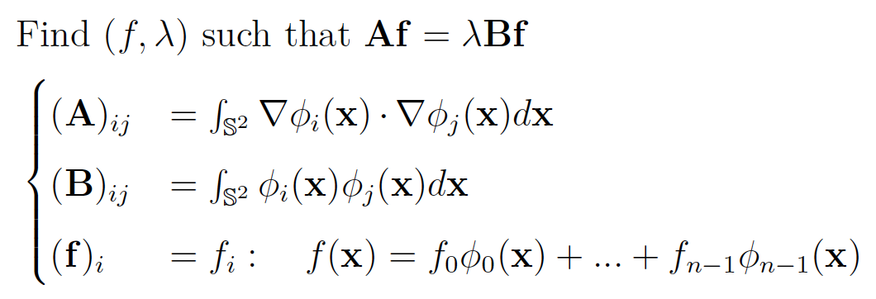
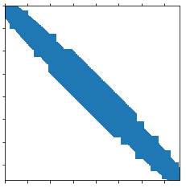
The Finite Element Method (FEM)
Writing the Galerkin problem times, each time with we obtain the following algebraic generalized eigenvalue problem:
Notes:
Writing the Galerkin problem n times, each time with v_h=phi we obtain the following algebraic generalized eigenvalue problem: where the matrix A is called the stiffness matrix, B is the mass matrix. Thanks to the choice of the basis functions phi, these are all sparse matrices: here we see their sparsity pattern in case of the HEALPix sampling scheme with N_side = 8. There are sparse because the support of the basis functions phi we chose is extremely localized: these integrals, corrresponding to the (i,j) entry, will be different from zero only if the supports of the (i,j) basis functions phi intersect, which does not happen often.

Slide 15
FEM convergence
PUT THEOREM HERE
Remark: it’s the only case (together with the random HKG Laplacian) where we have such a theorem.
Notes:
There’s a theorem that states that as the longest edge of the triangulation goes to zero, the FEM solution converges to the continuous one.
Remark: it’s the only case (together with the random HKG Laplacian) where we have such a theorem

Slide 16


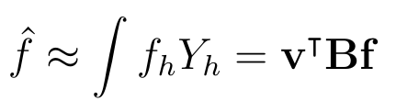
FEM Fourier transform
Equivalent to finding the decomposition
The eigenvectors are such that:
FEM Fourier transform:
Notes:
So, this is equivalent to finding the spectral decomposition of the matrix B^{-1}A which is not symmetric, thus we have a -1 here and it is such that VBV^T=I. Through the FEM the Fourier transform is approximated by the scalar product of the approximated functions f_h, Y_h that is exactly equal to the dot product in Rn of the sampled vectors v, f defined by the mass matrix B.

Slide 17

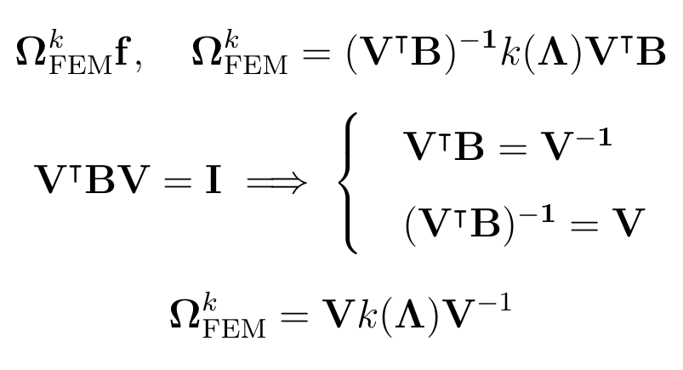
FEM filtering
Filtering a signal with a kernel is defined as the following matrix multiplication, where is the FEM Fourier matrix.
Notes:
Filtering a signal f with a kernel k is defined as the following matrix multiplication, where V^TB is the FEM Fourier matrix.
Blablabla
Here we recognize a form for the filtering matrix Omega that is extremely similar to the graph filtering, but is more general, being the matrix V not orthogonal and thus replacing the transposed with the inverse.

Slide 18

FEM polynomial filtering
is not symmetric.
is full.
.
Notes:
For this reason, a polynomial filter is implemented by a matrix omega that is a polynomial of the FEM Laplacian B^{-1}A. However, this comes at a very high cost: B^{-1} A is not symmetrix, and it is full because of the presence of B^{-1}. A filtering with this matrix would then cost O(n2), more than the FFT algorithms of O(n3/2).

Slide 19

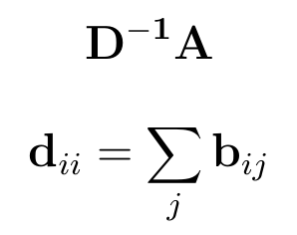

Lumped FEM Laplacian
is not symmetric.
is sparse.
Notes:
A solution very common in the FEM literature is to use the lumped mass matrix D as an approximation of B. In this way D^{-1}A keeps the same sparsity pattern as before, leading to an efficient filtering operation.

Slide 20
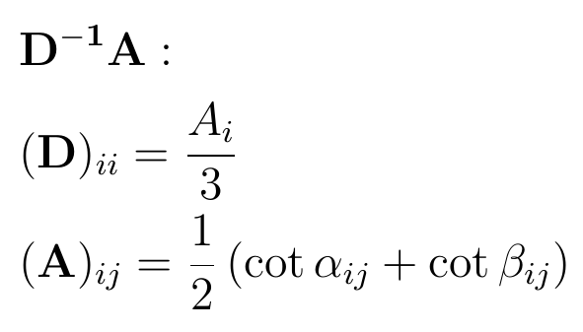
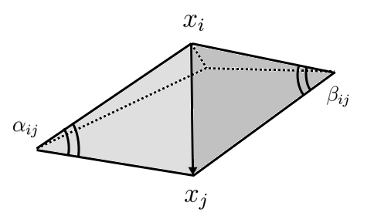
Lumped FEM Laplacian as a graph Laplacian
Notes:
By explicitely solving these integrals, it can be shown that the lumped FEM Laplacian is actually equivalent to another Laplacian, derived from discrete geometry related to the local curvature of the surface, where the entries of the matrices D, A are equal to the follwing geometrical quantities: A_i is the sum of the aire of all the triangles of the triangulation sharing the ith vertex, and alpha, beta are the opposite angles of the triangles sharing the edge (ij).
The FEM Laplacian $B^{−1}A$ shows us that in the general case where the irregularity of the sampling makes it necessary to have a metric represented by the mass matrix B, the discrete Laplacian needs to be full and not symmetric. And when I say that it needs to be like it, I refer to the convergence theorem we stated before. This llumped approximation D^{-1}A and its geometrical meaning show us again the importance of a non symmetric Laplacian in case of a non equiarea sampling scheme, but remember that this is an approximation of the FEM LAplacian that is not even proved to converge to the true continuous Laplace-Beltrami.
Once estabilished this connection between FEM and discrete geometry, other interesting connections can be made with Laplacians obtained through Discrete External Calculus, trying to answer at the question: when is it really necessary to have a non symmetric Laplacian?

Slide 21
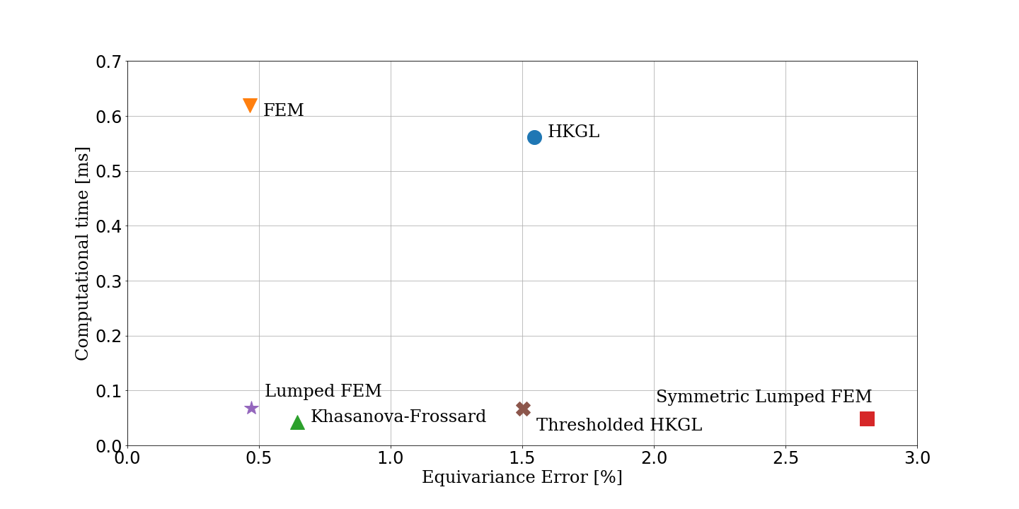
Equivariance error and computational time
Notes:
We conclude by showing how the different discrete Laplacians L illustrated so far compare in terms of equivariance error and computational time of the filter F(f) = Lf. The four sparse discrete Laplacians are one order of magnitude faster than the two full Laplacians. The FEM Laplacian is
able to reduce the equivariance error of the HKGL, and it manages to keep it low - around 0.5% - even when using the sparse, lumped approximation D−1A while reducing the computational time of one order of magnitude. D−1A performs really well, and gets close to the performances of the graph Laplacian of Khasanova and Frossard.

