Slide 1




GRAPH LAPLACIANS FOR ROTATION EQUIVARIANT NEURAL NETWORKS
Master thesis in Computational Science and Engineering
School of Basic Sciences
Department of Mathematics
École Polytechnique Fédérale de Lausanne
Supervised by: Michaël Deferrard (EPFL)
Nathanaël Perraudin (SDSC – ETH)
Piercesare Secchi (Politecnico di Milano)
Pierre Vandergheynst (EPFL)
Notes:
5 months Michael and Nathanael.
Graphs main topic of the project,
we investigated other kind of discrete Laplacians.

Slide 2
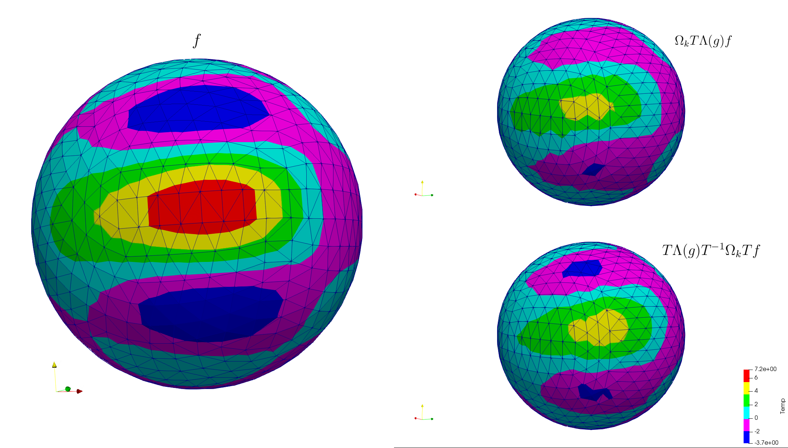
Rotation Equivariant Filtering
Notes:
Filtering=convolution.
equivariant to rotation = rotation and filtering must commute.
discretization:forced to do approximations
the algorithm used for this filtering is not perfectly equivariant to rotations.

Slide 3
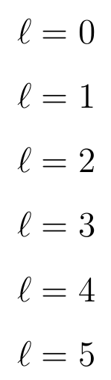
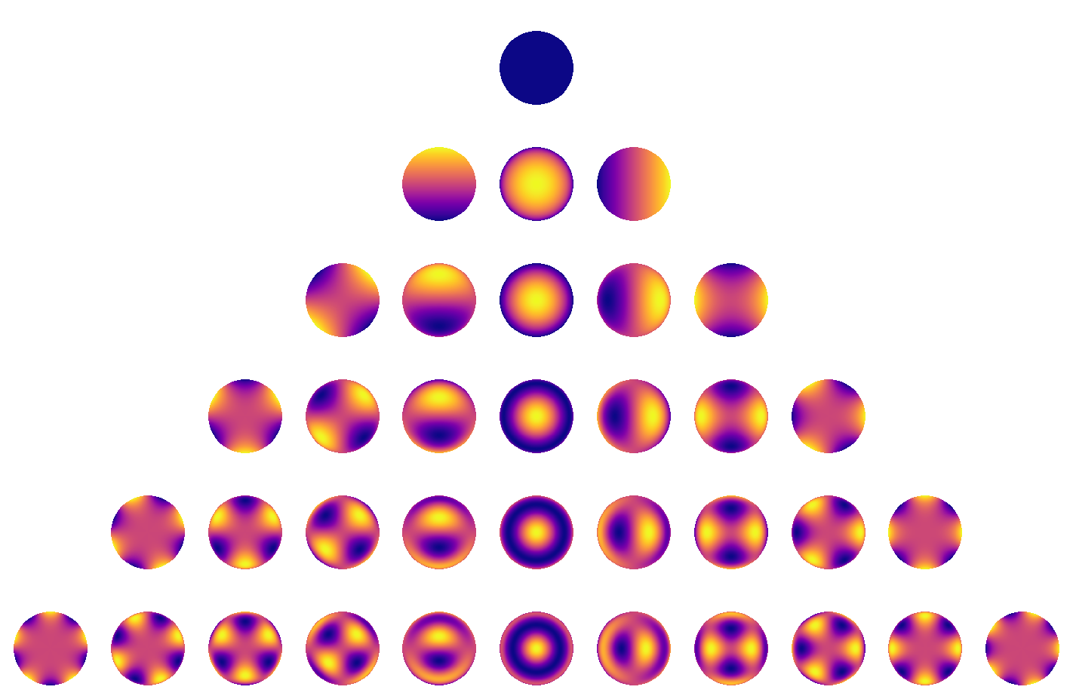


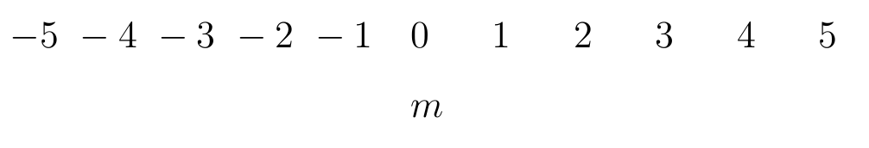
Fourier analysis on the sphere and the spherical harmonics
Dimension of the th eigenspace:
[1]
[1] Starry: analytic occultation light curves, Luger R. et al., https://rodluger.github.io/starry/v0.3.0/tutorials/basics1.html
Notes:
coordinate system
increasing, odd, dimension (1, 3, 5, 7, 9, …)
\ell (called degree) that identifies the eigenspace, order m that will range in the number of dimensions.

Slide 4
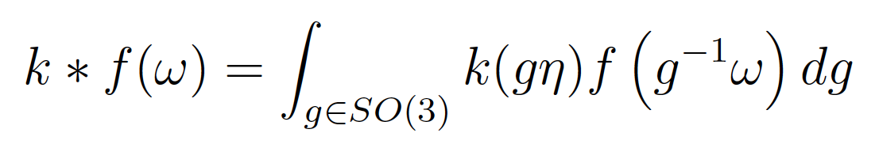
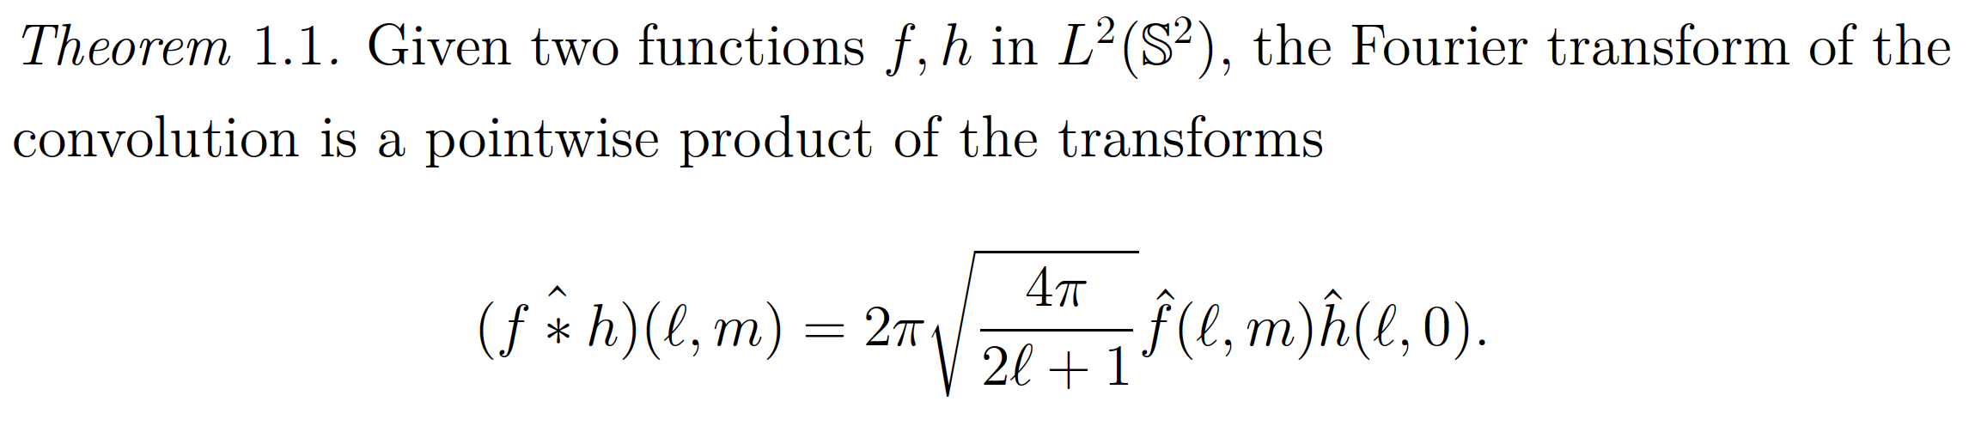
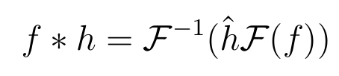

Convolution on the sphere
Definition: .
[2]
Convolutions can be done in the spectral domain as usual:
Complexity of FFT algorithms is .
Convolutions are rotation equivariant operations
[2] Computing Fourier Transforms and Convolutions on the 2-Sphere, Driscoll J.R. and Healy D.M., 1994.
Notes:
Convolution: weighted integral f the product where the kernel is rotated
Same as in euclidean domains
complexity

Slide 5
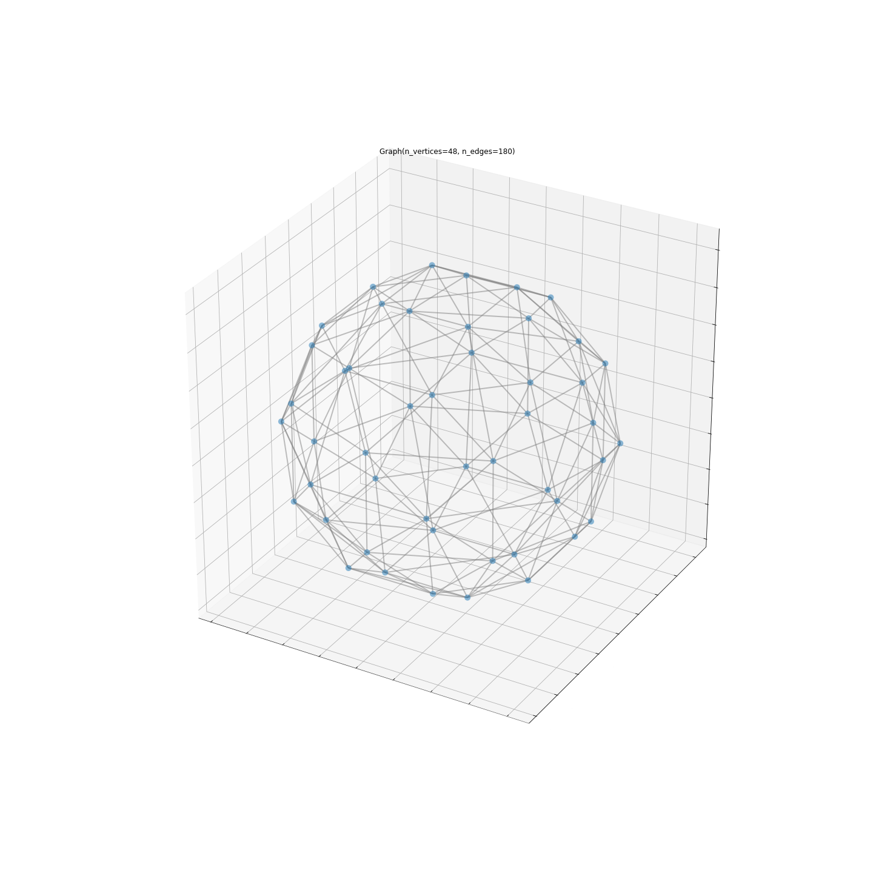

Our tool to perform fast spherical convolutions: graphs.
Adjacency matrix
Notes:
Vertices sampled on the surface of the sphere, connected by edges of different importance.
Everything encoded in adjacency matrix W.

Slide 6
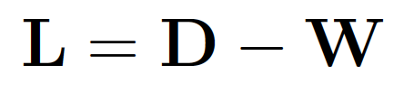
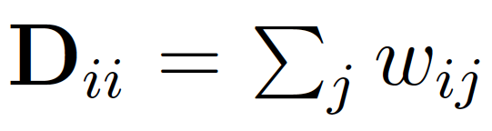



Graph convolutions
Given a weighted adjacency matrix , define the graph Laplacian to be
The graph Laplacian is symmetric:
Convolving on the graph a signal with a kernel is defined as:
Notice the similarity with
Notes:
Discrete Laplacian: we have a fourier basis of its eigenvectors.
To convolve, we project, we multiply elementwise, we come back.

Slide 7

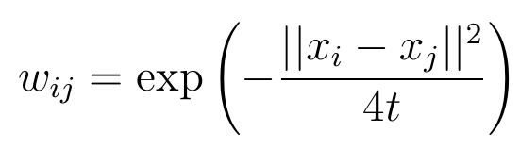

How to build a rotation equivariant graph
KEY CONCEPT: if then the graph Fourier transform will be rotation equivariant.
Heat Kernel Graph (HKG):
Belkin et al. proved that with a random sampling scheme, in probability [3]
[3] Convergence of Laplacian Eigenmaps, Belkin M. and Nyiogi P,, in Advances in Neural Information Processing Systems 19, 2007.
Notes:
it is not the only way: the graph of prof. Khasanova and Frossard
a good graph to use is the Heat Kernel Graph,

Slide 8
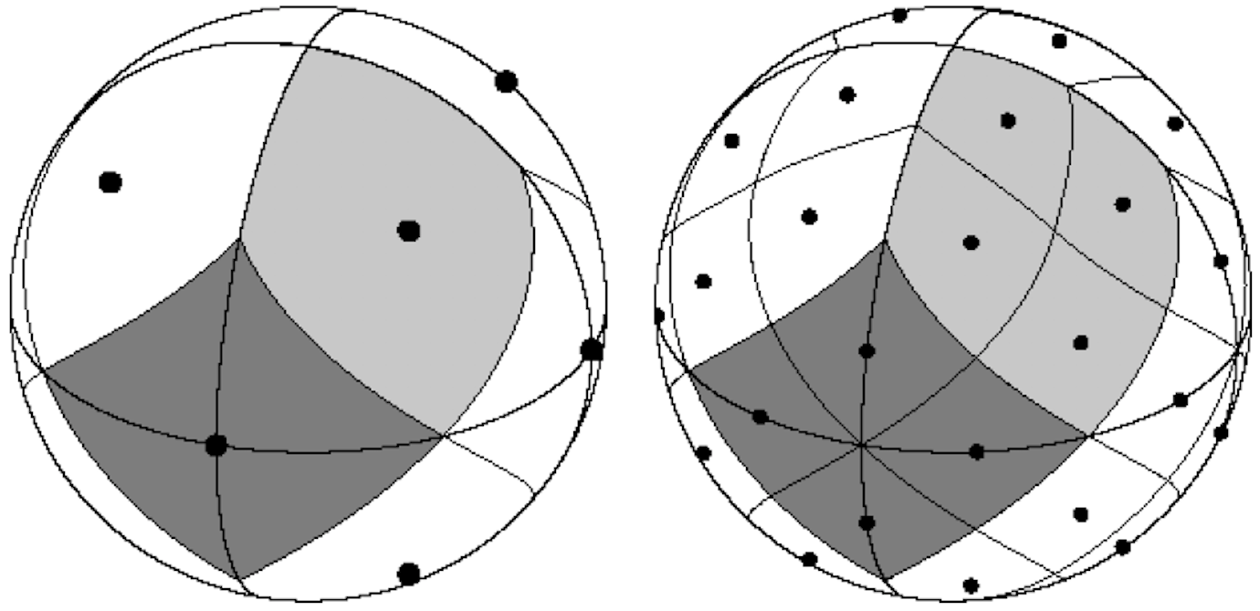

HEALPix: equiarea sampling scheme
The HKG Laplacian eigenvectors well approximate the spherical harmonics:
The dot product of the HKG Laplacian eigenvectors and any sampled signal well approximates the corresponding Fourier coefficient:
Notes:
Uniform: 1.
Equiarea: 2.
HEALPix is both

Slide 9

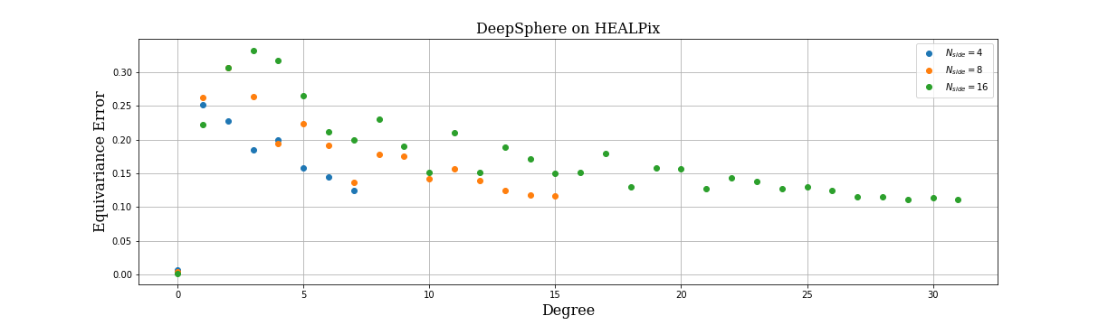
DeepSphere 1.0
DeepSphere[4] is a Spherical Graph Convolutional Neural Network
Each layer implements a polynomial filter of a sparse HKG Laplacian of a spherical signal sampled with HEALPix.
Filtering is
0.10
[4] DeepSphere: Efficient spherical Convolutional Neural Network with HEALPix sampling for cosmological applications, Perraudin N., Defferrard M., Kacprzak T., Sgier R., 2018
Notes:
polynomial: no need of computing VLambdaV^T. spars.e: fast multiplications thus fast filtering
Monochromatic signals

Slide 10

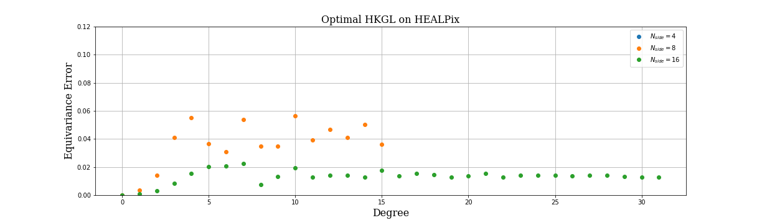
DeepSphere 2.0
DeepSphere 2.0 is an improved version of DeepSphere
Each layer implements a polynomial filter of a sparse (but not too sparse) HKG Laplacian of a spherical signal sampled with HEALPix.
Filtering is
0.10
Notes:
tuning the kernel width, number of neighbors
price: the computational complexity
from 30 to 5 percent
convergence to 0

Slide 11
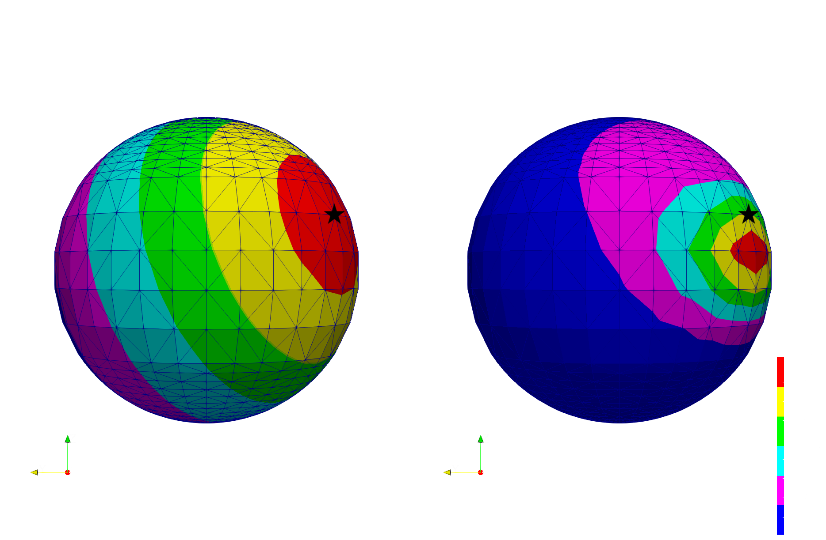
Non-equiarea sampling schemes
Figure: left, FEM diffusion of a point source signal. Right, diffusion obtained with the HKG Laplacian
Notes:
we moved our attention to other sampling schemes of the sphere.
the HKG does not work well any more.
We need to find an alternative way

Slide 12

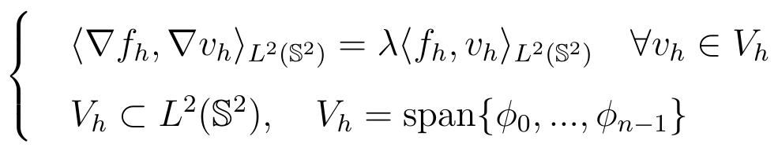
Towards the Finite Element Method (FEM)
The Galerkin problem is a discretized version of the weak eigenvalue problem, where the ambient space is finite dimensional:
Notes:
Looking for such method, we investigated the Finite Element Method.
very used in numerical mathematics to find the solution of differential problems.
Let’s see how to build a discrete Laplacian using the FEM
Strong=weak form
Galerkin: projection on finite dimensional space

Slide 13
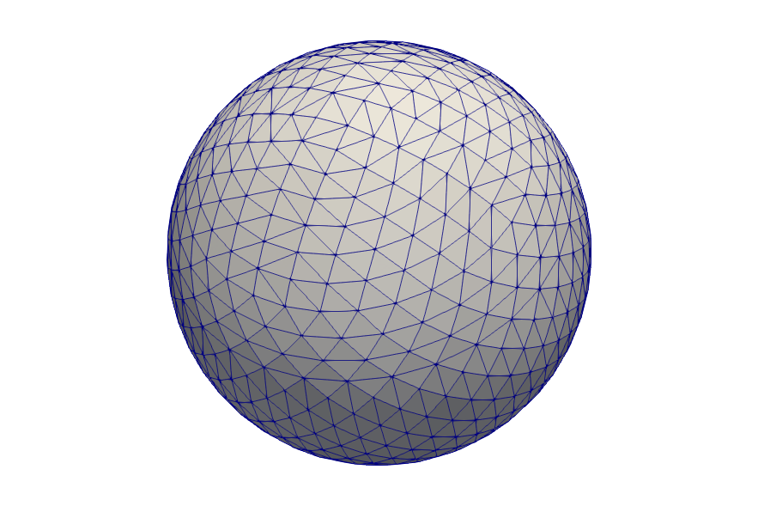
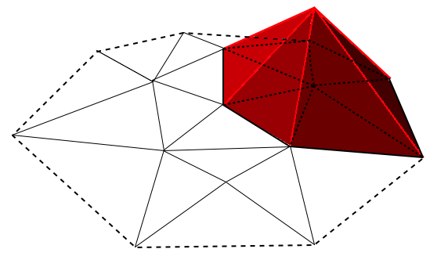
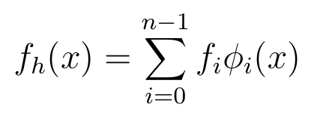
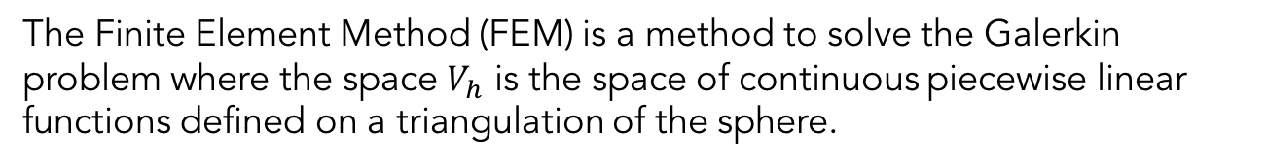
The Finite Element Method (FEM)
The Finite Element Method (FEM) is a method to solve the Galerkin problem where the space $V_{h}$ is the space of continuous piecewise linear functions defined on a triangulation of the sphere.
Notes:
FEM = Galerking with $V_{h}$ continuous piecewise linear functions defined on a triangulation of the sphere.
n degrees of freedom, spanned by n basis functions.
Describe basis function
f_h as a linear combination
f_i=f(x_i)

Slide 14


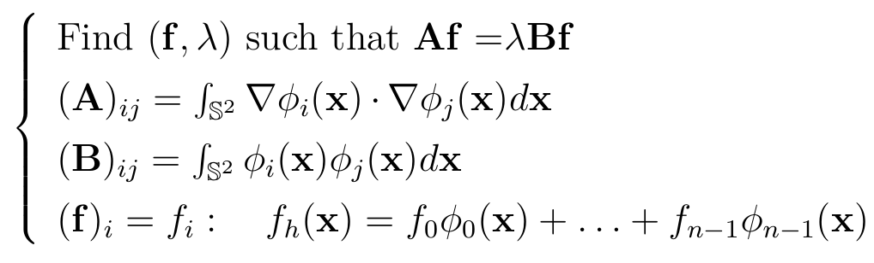
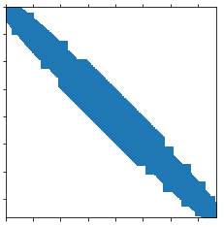
The Finite Element Method (FEM)
Writing the Galerkin problem times, each time with we obtain the following algebraic generalized eigenvalue problem:
Notes:
Galerkin problem n times, each time with v_h=phi
A stiffness matrix, B mass matrix.
Phi -> sparse matrices

Slide 15
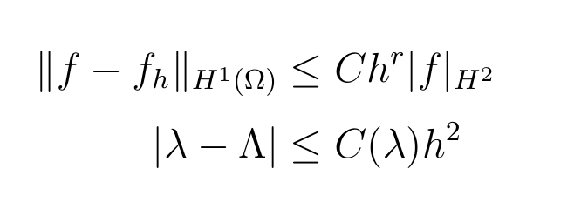
FEM convergence
Remark: it’s the only case (together with the random HKG Laplacian) where we have a convergence theorem.
[5]
[5] A priori estimates for the FEM approximations to eigenvalues and eigenfunctions of the Laplace-Beltrami operator, Bonito et al., 2017.
Notes:
There’s a theorem that states that as the longest edge of the triangulation goes to zero, the FEM solution converges to the continuous one.
Remark: it’s the only case (together with the random HKG Laplacian) where we have such a theorem

Slide 16


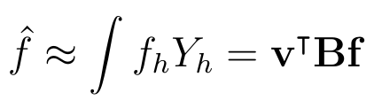
FEM Fourier transform
Equivalent to finding the decomposition
The eigenvectors are such that:
FEM Fourier transform:
Notes:
So, this is equivalent to finding the spectral decomposition of the matrix B^{-1}A
is not symmetric, thus we have a -1 here and it is such that VBV^T=I
Read last line

Slide 17

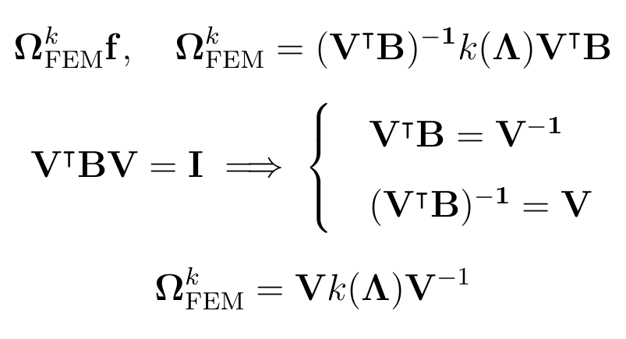
FEM filtering
Filtering a signal with a kernel is defined as the following matrix multiplication, where is the FEM Fourier matrix.
Notes:
Read.
Rewrite
Parallel with graph. More general. Inverse instead of transposed

Slide 18

FEM polynomial filtering
is not symmetric.
is full.
.
Notes:
very high cost: B^{-1}A is full
O(n2), more than the FFT algorithms of O(n3/2).

Slide 19
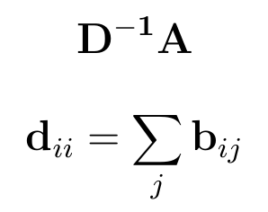


Lumped FEM Laplacian
is not symmetric.
is sparse.
Notes:
D approx B.
D^{-1}A sparse
efficient filtering.

Slide 20
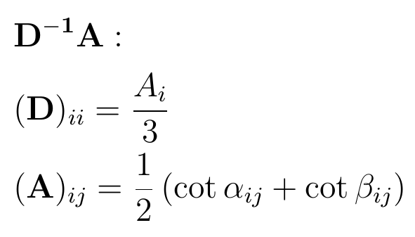
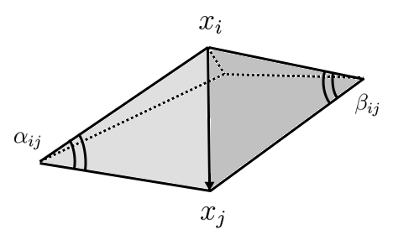
Lumped FEM Laplacian as a graph Laplacian
Notes:
FEM=DEC
irregularity of the sampling – need of a metric B -> B-1A full, not symmetric.
Recall convergence theorem.
DA: non equiarea-> non symmetric
other interesting connections can be made with Laplacians obtained through Discrete External Calculus, trying to answer at the question: when is it really necessary to have a non symmetric Laplacian? Work in progress

Slide 21
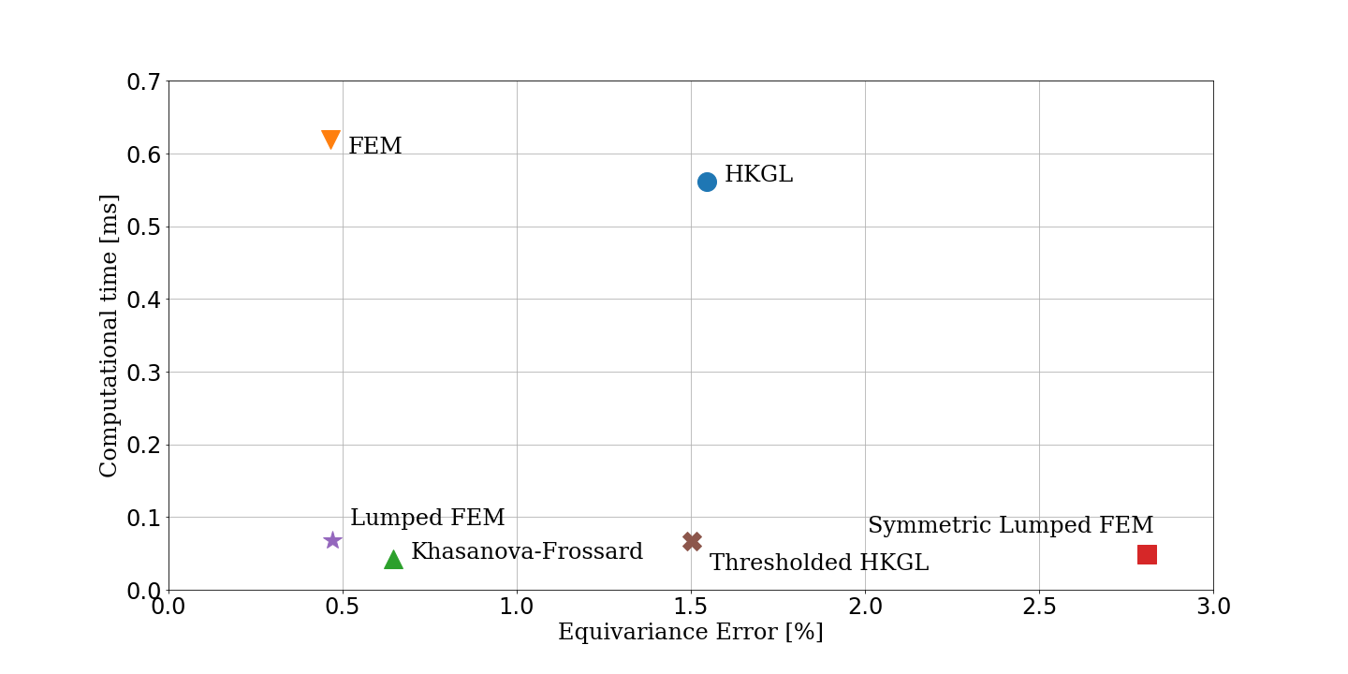
Equivariance error and computational time
Notes:
filter F(f) = Lf.
Future work: better comprehend the limitations of graph filtering, through the study of DEC and other Laplacians. Characterize when it is necessary to have of symmetry and sparsity.

Slide 22
Conclusions
We gained a better understanding of the HKG.
We put that knowledge in practice, improving the Equivariance Error of DeepSphere.
We investigated different Discrete Laplacians, from Differential Geometry to Numerical Mathematics
We used this knowledge to better understand the advantages and limitations of Graph Laplacians when it comes to non uniform sampling of the sphere.
Notes:
filter F(f) = Lf.
Future work: better comprehend the limitations of graph filtering, through the study of DEC and other Laplacians. Characterize when it is necessary to have of symmetry and sparsity.

