Slide 1




GRAPH LAPLACIANS FOR ROTATION EQUIVARIANT NEURAL NETWORKS
Master thesis in Computational Science and Engineering
School of Basic Sciences
Department of Mathematics
École Polytechnique Fédérale de Lausanne
Supervised by: Michaël Deferrard (EPFL)
Nathanaël Perraudin (SDSC – ETH)
Piercesare Secchi (Politecnico di Milano)
Pierre Vandergheynst (EPFL)
Notes:
5 months Michael and Nathanael.
Graphs main topic of the project,
we investigated other kind of discrete Laplacians.

Slide 2
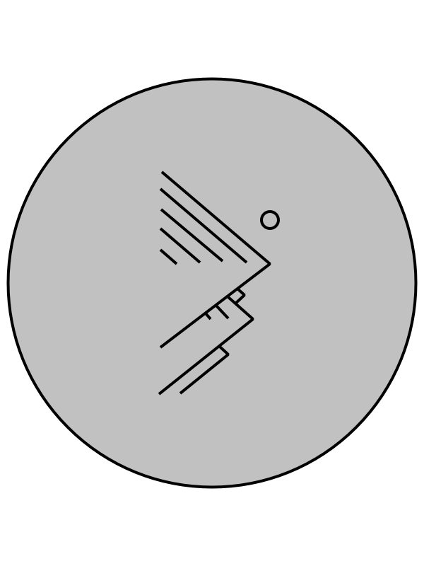
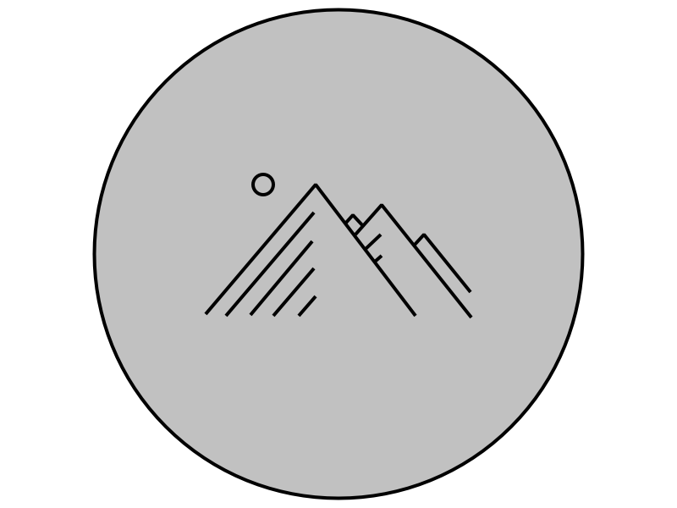
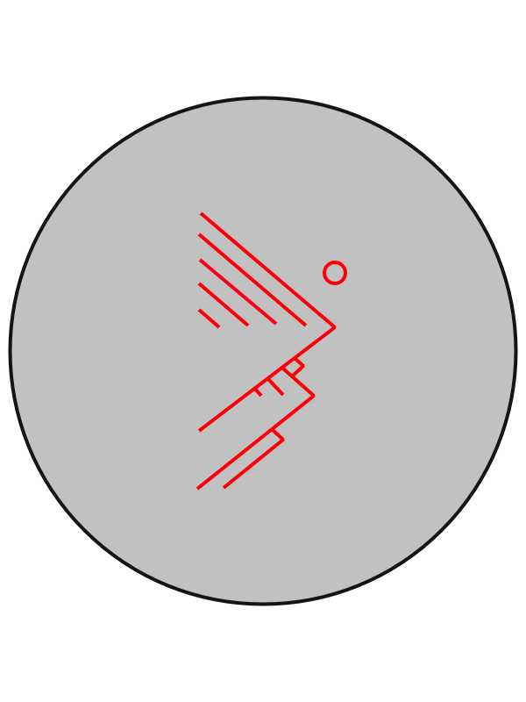
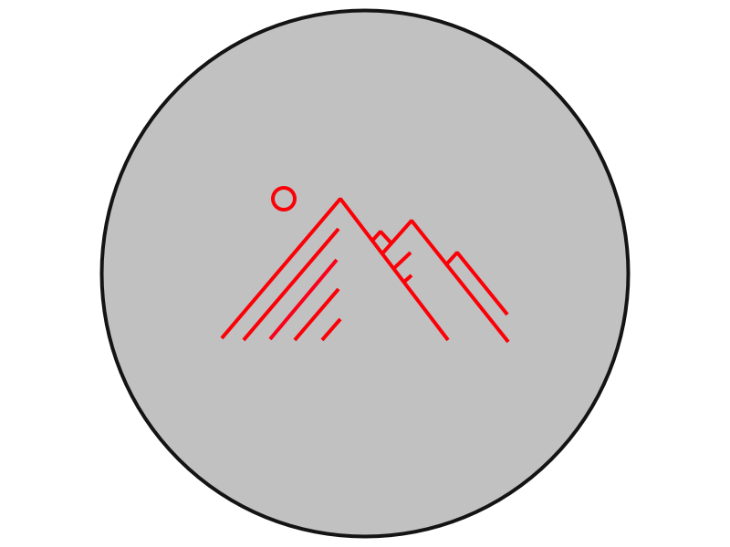
Rotation Equivariant Filtering
rotation
filter
filter
rotation
Notes:
Filtering=convolution.
equivariant to rotation = rotation and filtering must commute.
discretization:forced to do approximations
the algorithm used for this filtering is not perfectly equivariant to rotations.

Slide 3
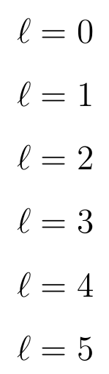
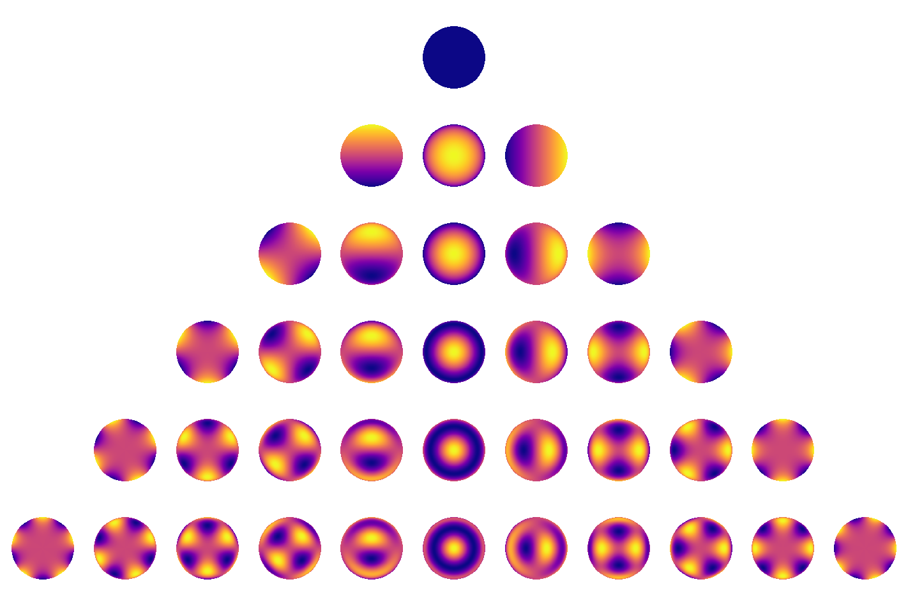


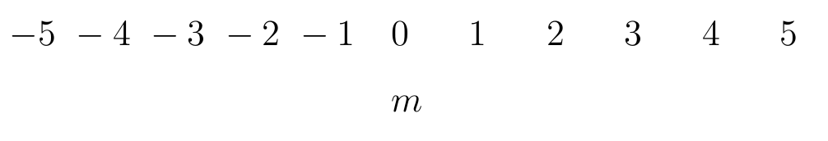
Fourier analysis on the sphere and the spherical harmonics
Dimension of the th eigenspace:
[1]
[1] Starry: analytic occultation light curves, Luger R. et al., https://rodluger.github.io/starry/v0.3.0/tutorials/basics1.html
Notes:
coordinate system
increasing, odd, dimension (1, 3, 5, 7, 9, …)
\ell (called degree) that identifies the eigenspace, order m that will range in the number of dimensions.

Slide 4
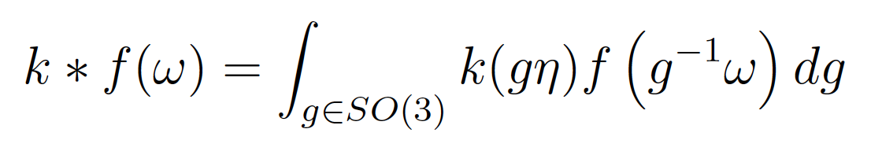
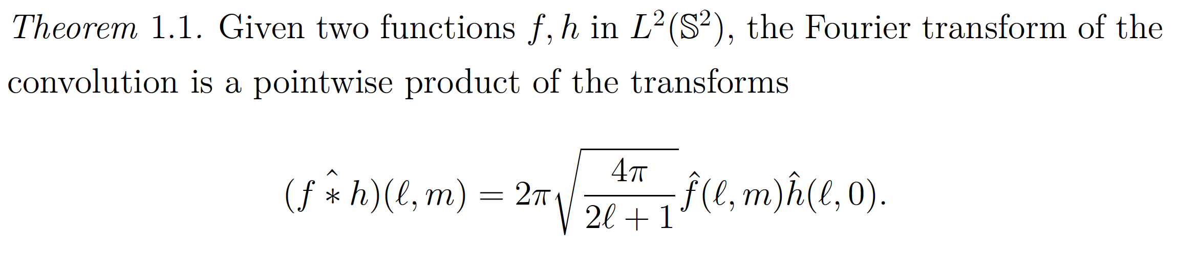
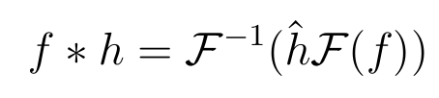

Convolution on the sphere
Definition: .
[2]
Convolutions can be done in the spectral domain as usual:
Complexity of FFT algorithms is .
Convolutions are rotation equivariant operations
[2] Computing Fourier Transforms and Convolutions on the 2-Sphere, Driscoll J.R. and Healy D.M., 1994.
Notes:
Convolution: weighted integral f the product where the kernel is rotated
Same as in euclidean domains
complexity

Slide 5
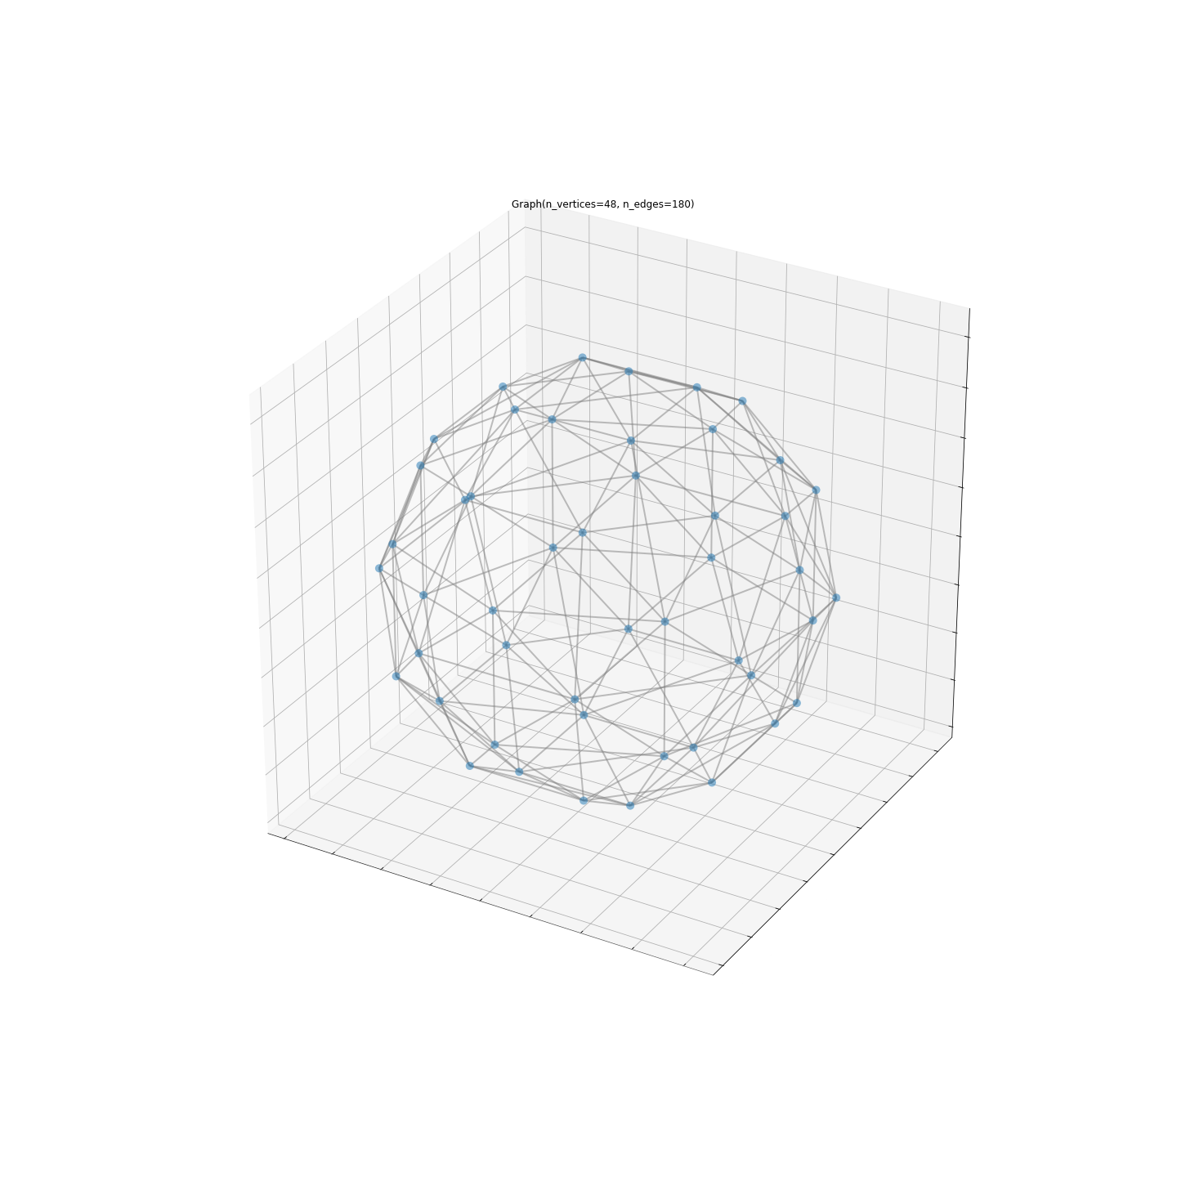

Our tool to perform fast spherical convolutions: graphs.
Adjacency matrix
Notes:
Vertices sampled on the surface of the sphere, connected by edges of different importance.
Everything encoded in adjacency matrix W.

Slide 6
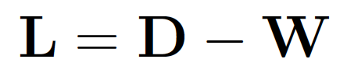
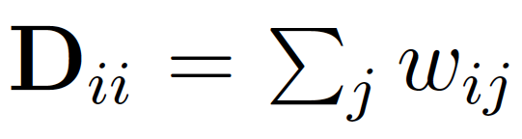



Graph convolutions
Given a weighted adjacency matrix , define the graph Laplacian to be
The graph Laplacian is symmetric:
Convolving on the graph a signal with a kernel is defined as:
Notice the similarity with
Notes:
Discrete Laplacian: we have a fourier basis of its eigenvectors.
To convolve, we project, we multiply elementwise, we come back.

Slide 7
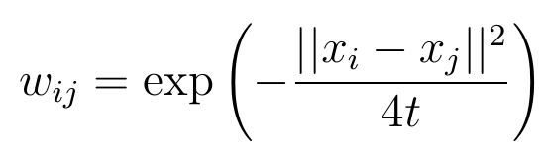

How to build a rotation equivariant graph
Heat Kernel Graph (HKG):
Belkin et al. proved that with a random sampling scheme, in probability [3]
[3] Convergence of Laplacian Eigenmaps, Belkin M. and Nyiogi P,, in Advances in Neural Information Processing Systems 19, 2007.
Notes:
it is not the only way: the graph of prof. Khasanova and Frossard
a good graph to use is the Heat Kernel Graph,

Slide 8

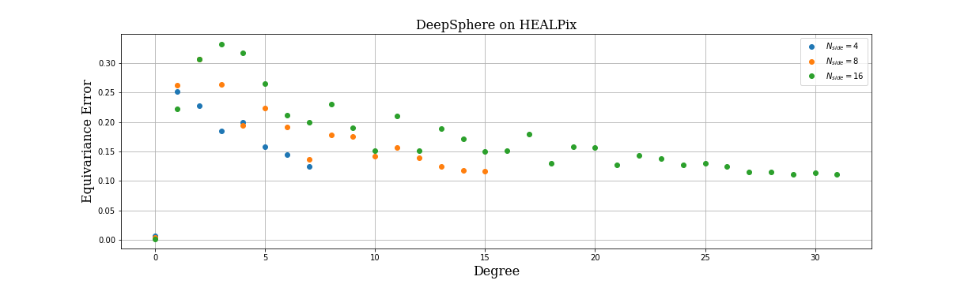
DeepSphere 1.0
DeepSphere[4] is a Spherical Graph Convolutional Neural Network.
Each layer implements multiple polynomial filters of a sparse HKG Laplacian of a spherical signal sampled with HEALPix.
Filtering is .
0.10
[4] DeepSphere: Efficient spherical Convolutional Neural Network with HEALPix sampling for cosmological applications, Perraudin N., Defferrard M., Kacprzak T., Sgier R., 2018
Notes:
polynomial: no need of computing VLambdaV^T. spars.e: fast multiplications thus fast filtering
Monochromatic signals

Slide 9

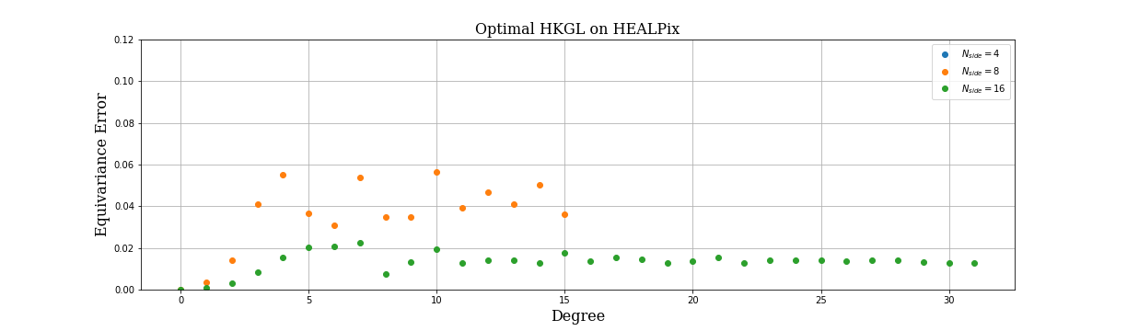
DeepSphere 2.0
DeepSphere 2.0 is an improved version of DeepSphere.
Each layer implements a polynomial filter of a sparse (but not too sparse) HKG Laplacian of a spherical signal sampled with HEALPix.
Filtering is .
0.10
Notes:
tuning the kernel width, number of neighbors
price: the computational complexity
from 30 to 5 percent
convergence to 0

Slide 10
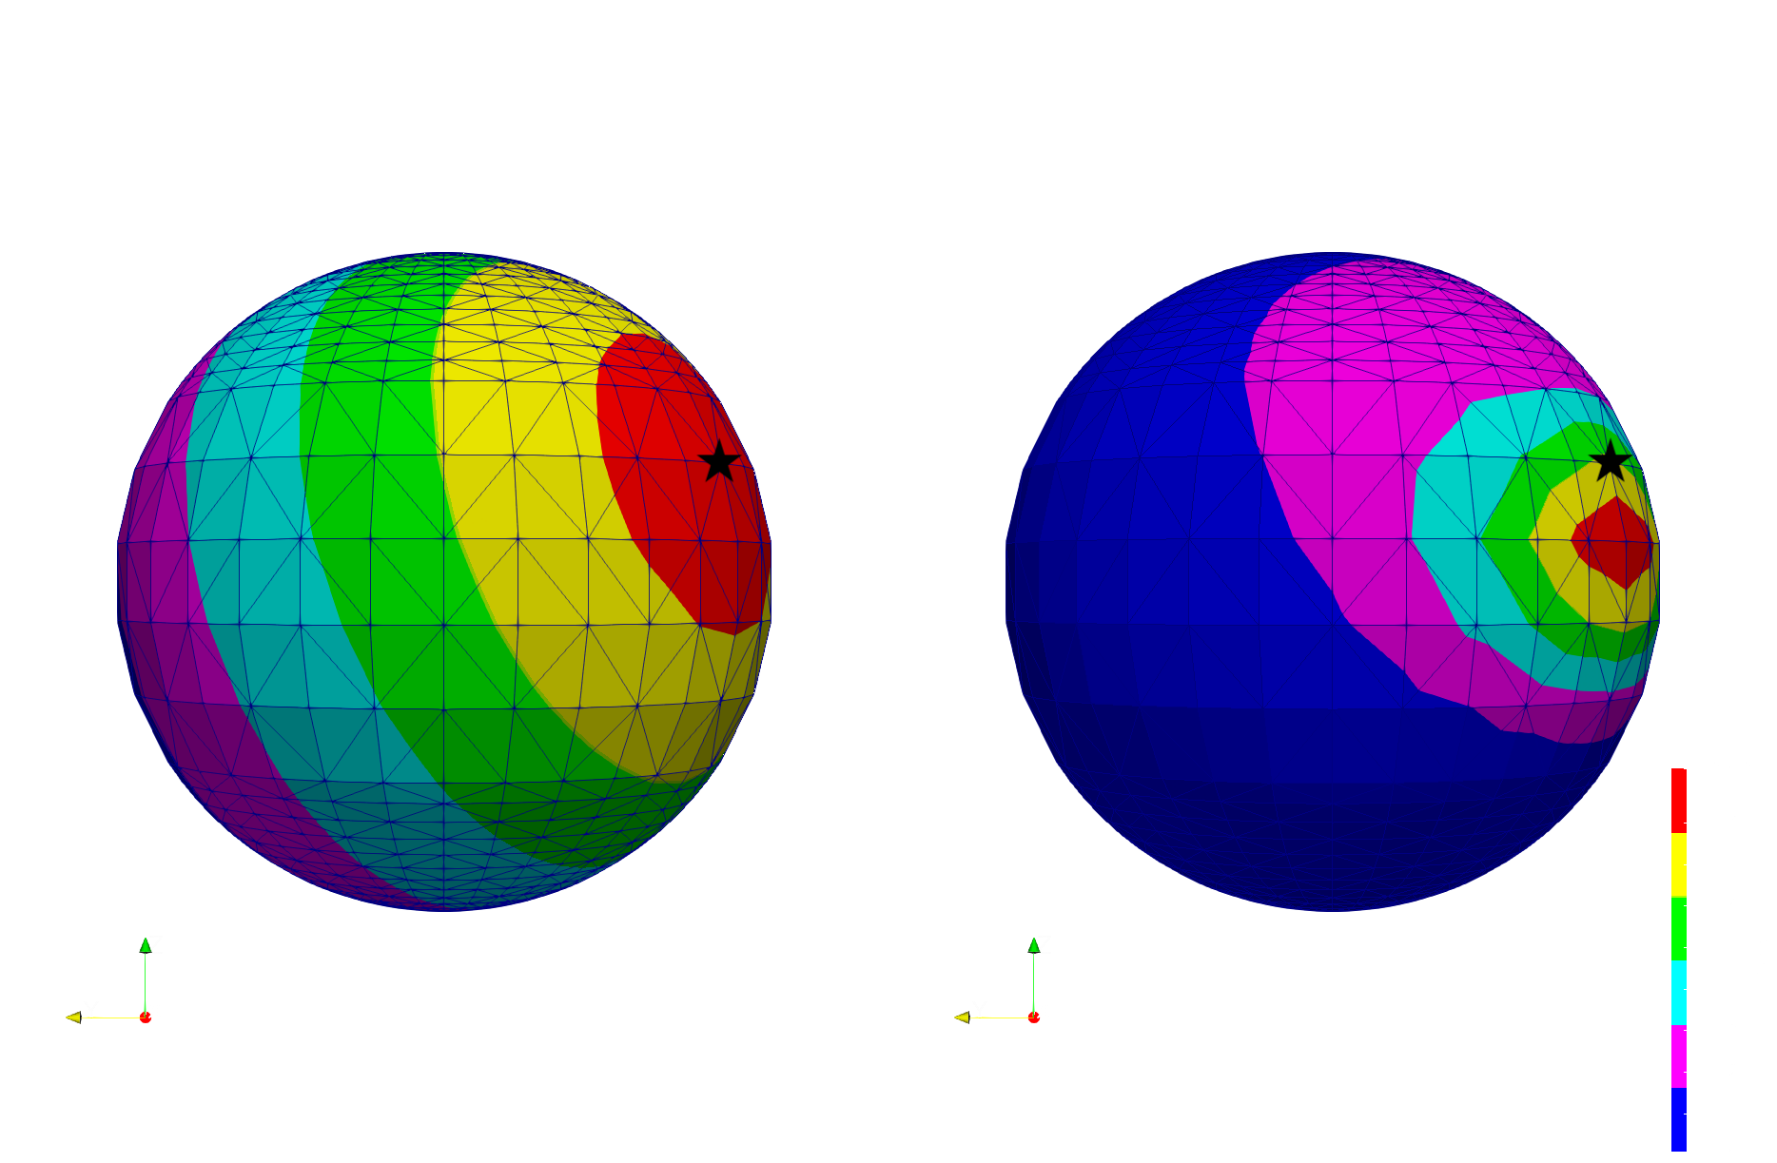
Non-equiarea sampling schemes
Figure: left, FEM diffusion of a point source signal. Right, diffusion obtained with the HKG Laplacian.
Notes:
we moved our attention to other sampling schemes of the sphere.
the HKG does not work well any more.
We need to find an alternative way

Slide 11
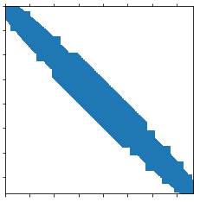
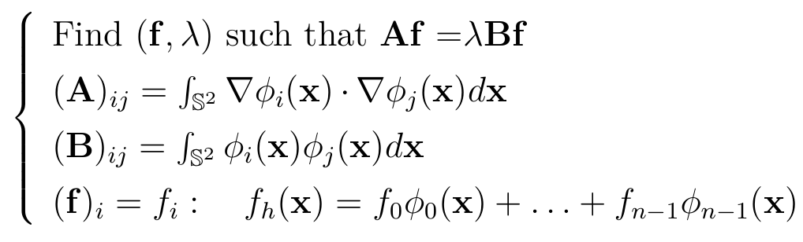
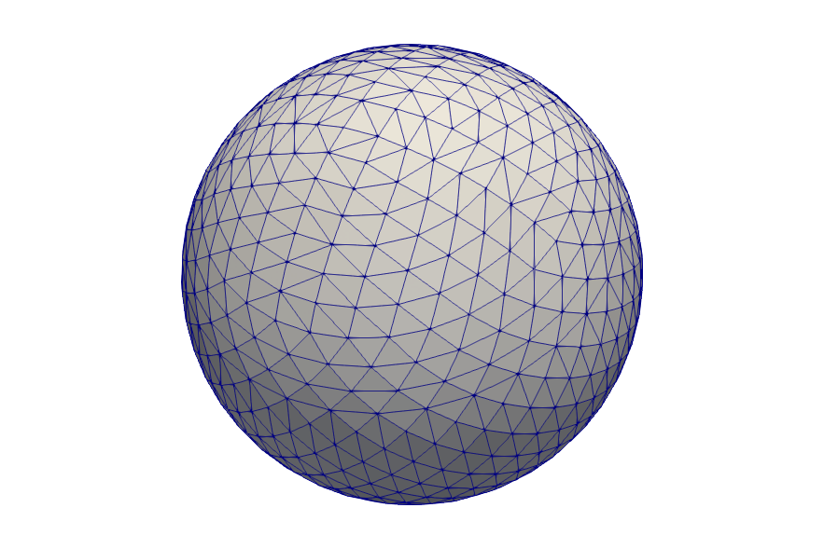
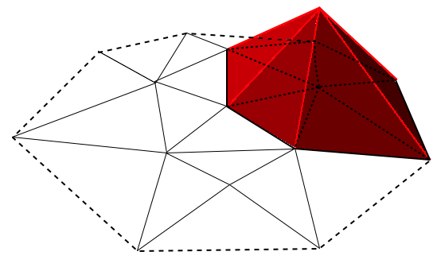


FEM polynomial filtering
is not symmetric.
is full.
.
Notes:
very high cost: B^{-1}A is full
O(n2), more than the FFT algorithms of O(n3/2).

Slide 12
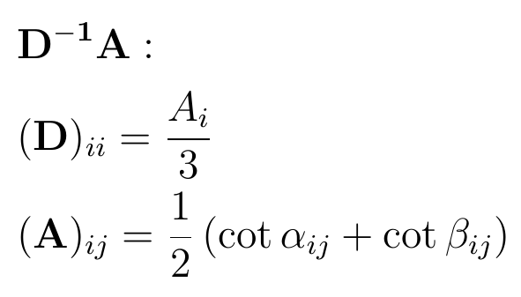
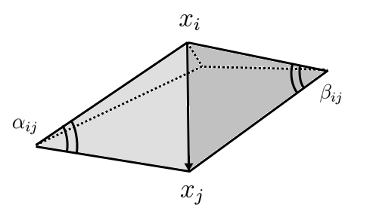
Lumped FEM Laplacian as a graph Laplacian
Notes:
FEM=DEC
irregularity of the sampling – need of a metric B -> B-1A full, not symmetric.
Recall convergence theorem.
DA: non equiarea-> non symmetric
other interesting connections can be made with Laplacians obtained through Discrete External Calculus, trying to answer at the question: when is it really necessary to have a non symmetric Laplacian? Work in progress

Slide 13
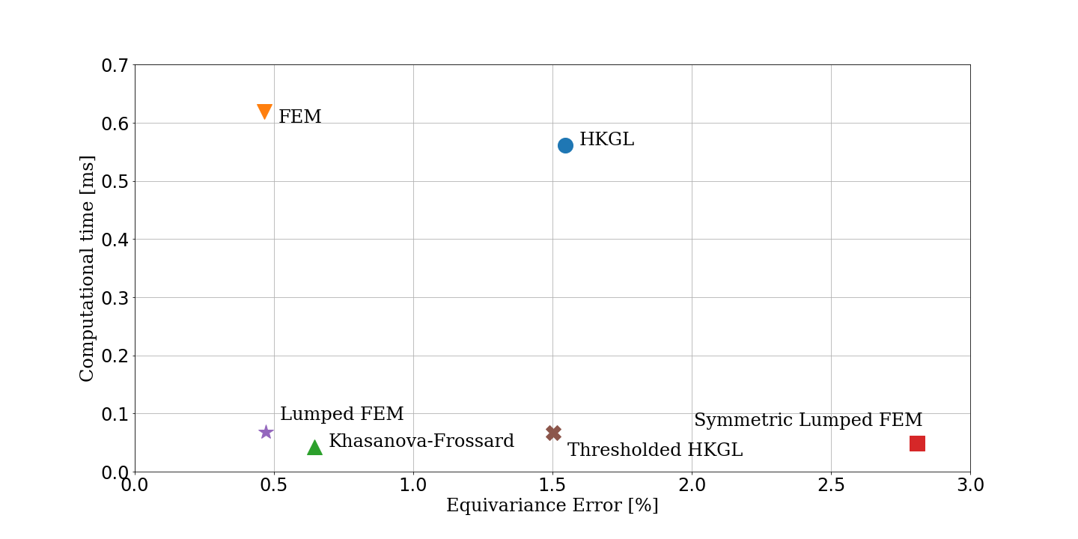
Equivariance error and computational time
Notes:
filter F(f) = Lf.
Future work: better comprehend the limitations of graph filtering, through the study of DEC and other Laplacians. Characterize when it is necessary to have of symmetry and sparsity.

Slide 14
Conclusions
We gained a better understanding of the HKG.
We put that knowledge in practice, improving the Equivariance Error of DeepSphere.
We investigated different Discrete Laplacians, from Differential Geometry to Numerical Mathematics
We used this knowledge to better understand the advantages and limitations of Graph Laplacians when it comes to non uniform sampling of the sphere.
Notes:
filter F(f) = Lf.
Future work: better comprehend the limitations of graph filtering, through the study of DEC and other Laplacians. Characterize when it is necessary to have of symmetry and sparsity.

