Slide 1
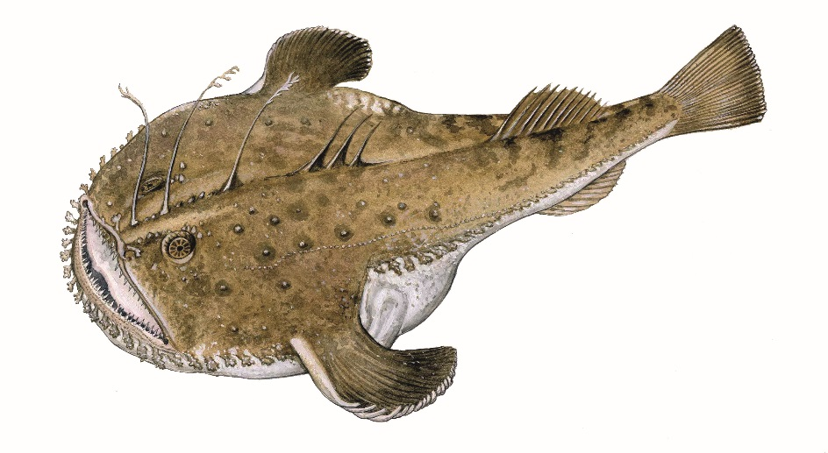

Preliminary analysis of assessment with spict for white anglerfish in Divisions 7, 8 abd
Authors: Agurtzane Urtizberea and Dorleta García

Slide 2
ASSESSMENT
A4A model is used in the assessment since 2018.
The transformation from length to age is done out of the model.
Some problems with the retrospective pattern although they are in the aceptable range for long live species.
Now we are trying other models: SS3 and Spict

Slide 3
Aplying Spict for white anglerfish 7,8, abd

Slide 4
DATA
Data
Catch data (landings+discards) without seasonal resolution.
Abundance indices
FR_IE_IBTS survey: the joint index of the French EVHOE survey and the Irish IBTS survey. Both are conducted between the third and forth quarter. The French EVHOE survey is conducted in the Bay of Biscay and the Irish IBTS in the Celtic Sea.
The Spanish survey in the Porcupine Bank began in 2001 and covers ICES Divisions VIIb-k corresponding to the Porcupine Bank and adjacent area in western Irish waters. The survey takes place in the third quarter (September).
Monkfish survey is in the beginning of the year, but is considered the end of the previous year and it’s conducted in the Celtic Sea.
In addition of the three surveys,here we also include the standarized LPUE from the trawlers of Vigo.

Slide 5
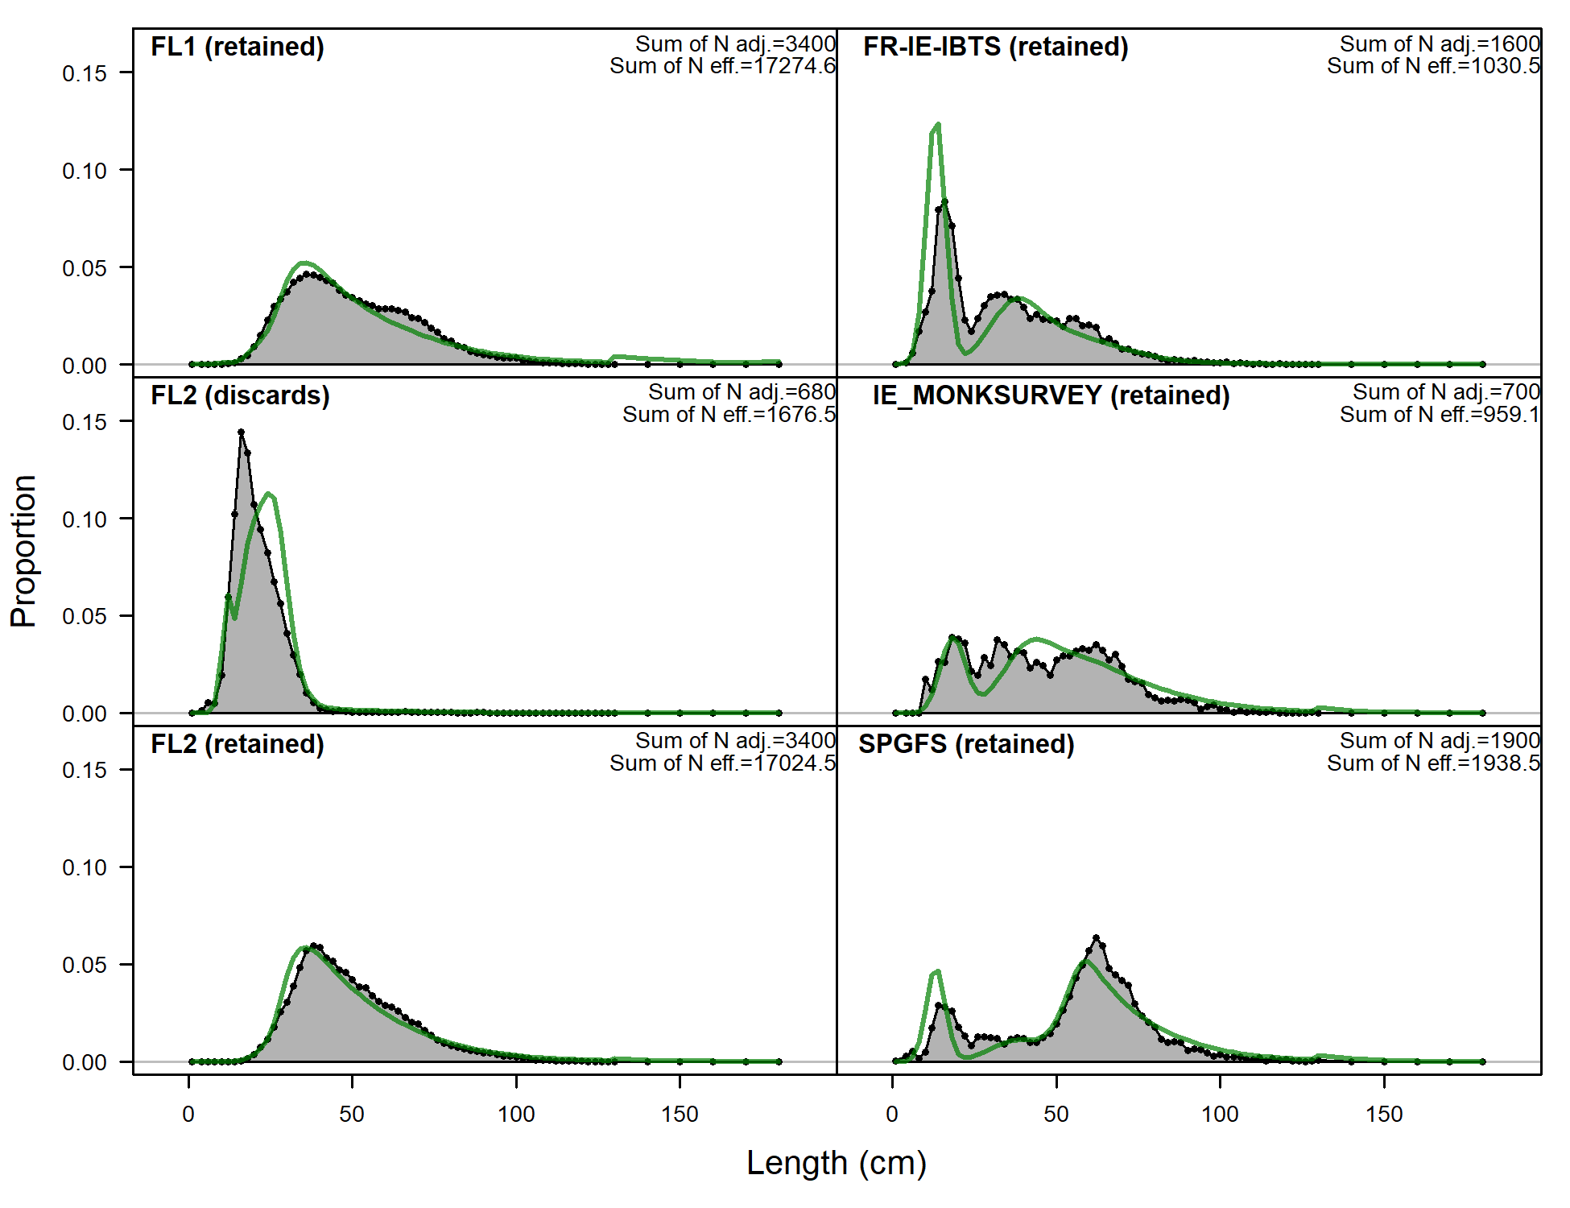
Length frequency, harvestable biomass?
FL1 – comercial fleet (landings) 1986-2003
FL2 – comercial fleet (landings/discards) 2003-2019
Indices: IR-FR-IBTS joint index, SP-Porc index, Irish monkfish survey

Slide 6
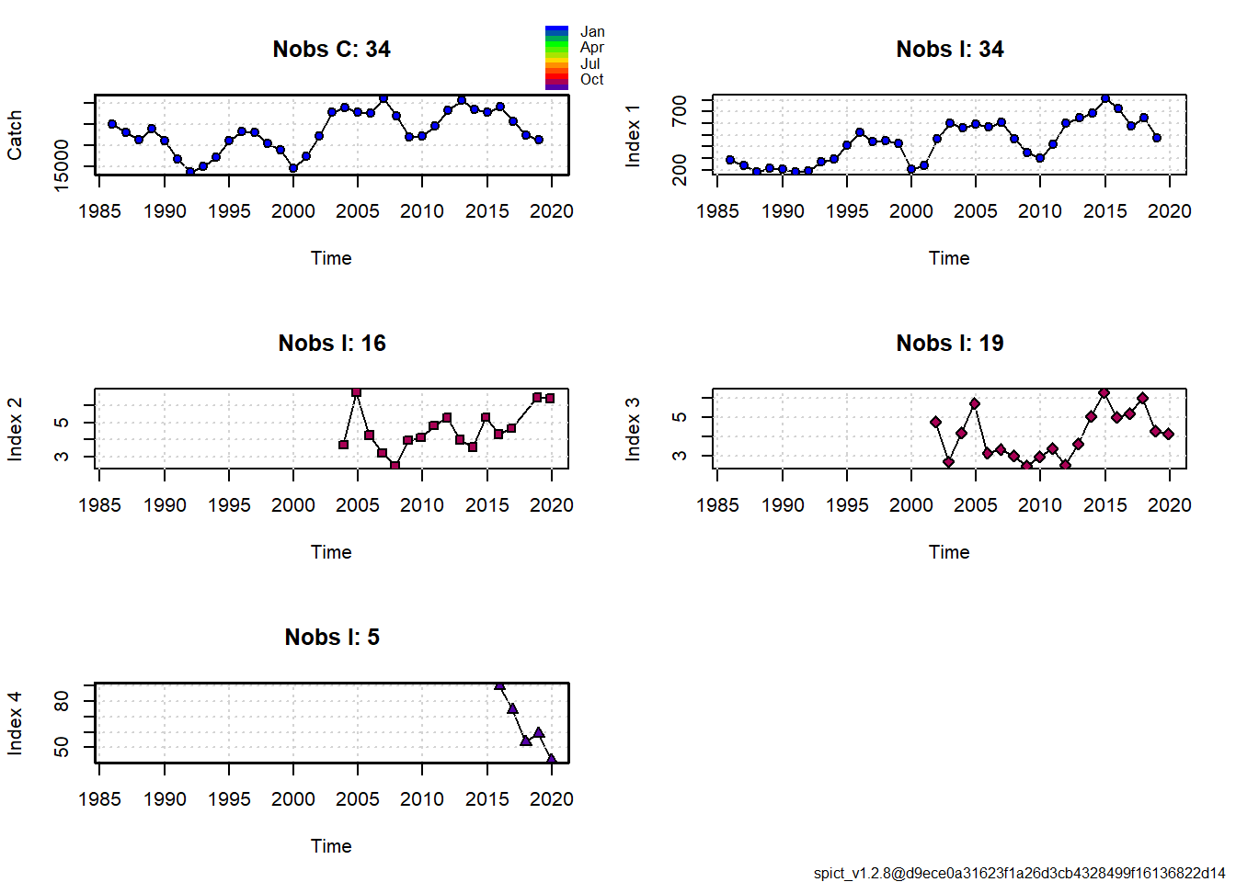
LPUE VIGO OTB fleet AND 3 SURVEYS

Slide 7
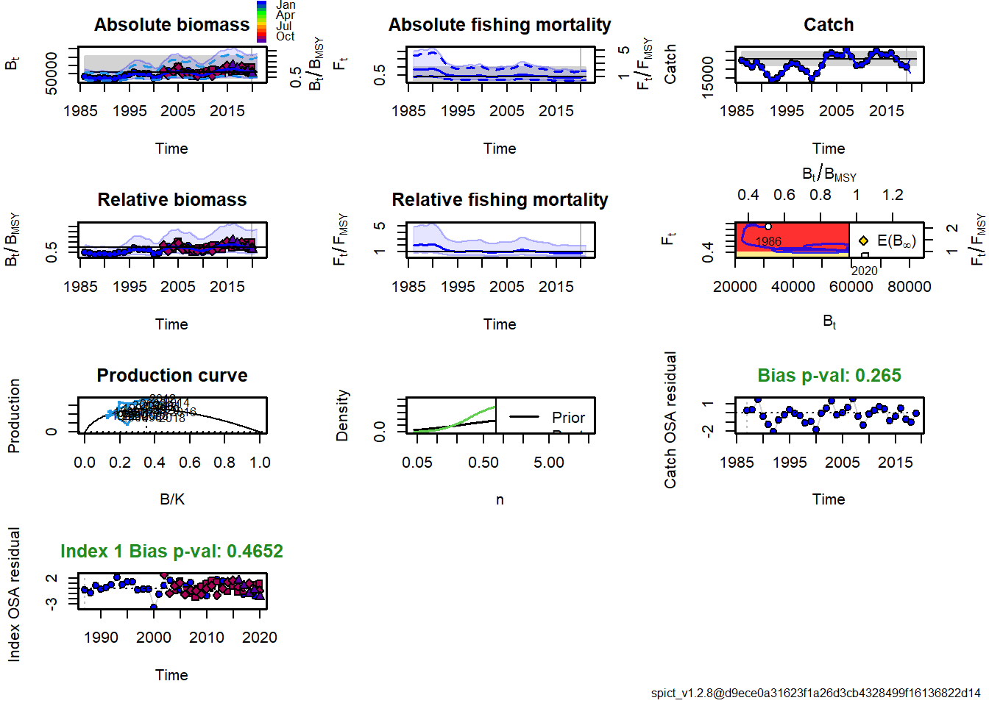
RESULTS SPICT

Slide 8
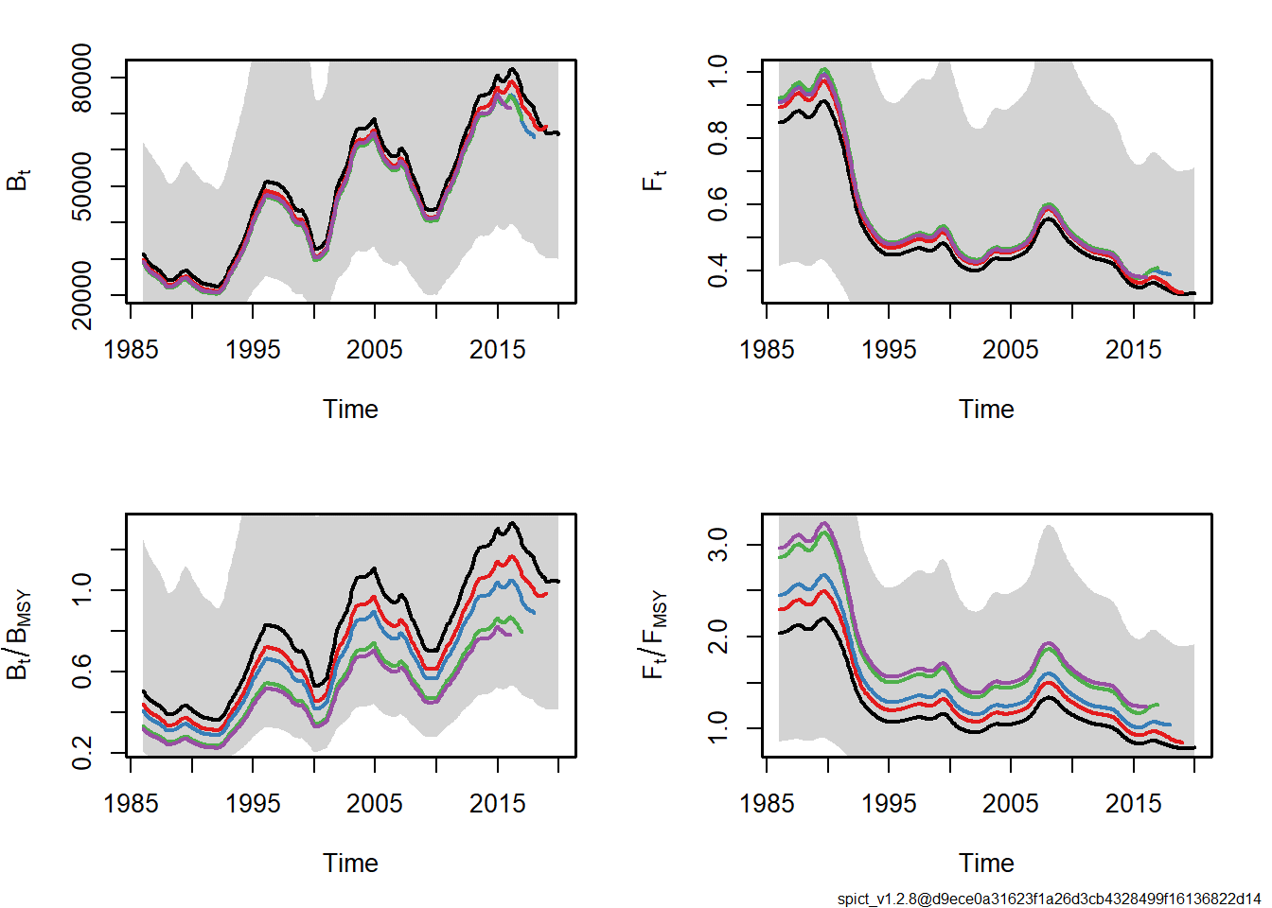
LPUE VIGO AND SURVEYS AND OUTPUT SPICT
Output of retrospective pattern of spict model

Slide 9
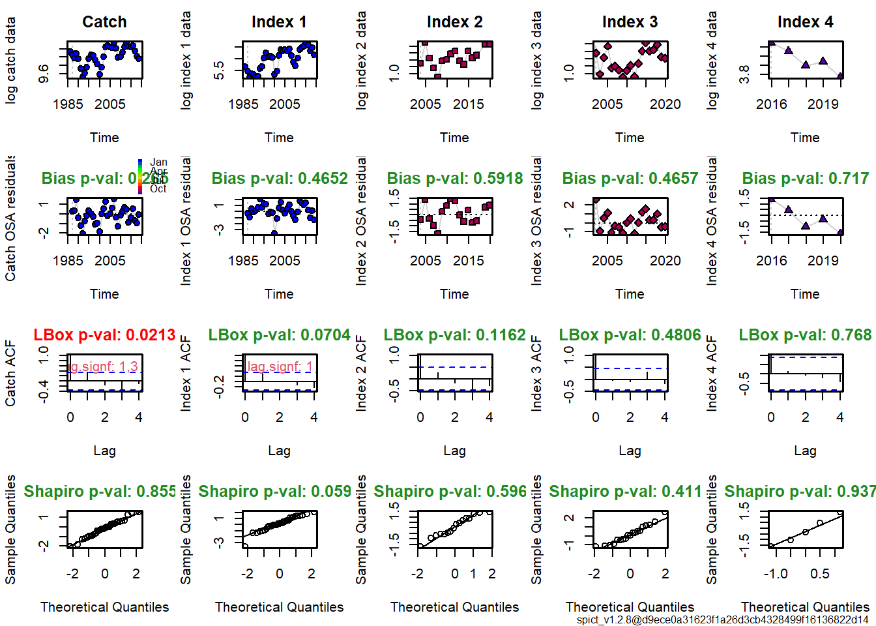
DIAGNOSTICS

Slide 10
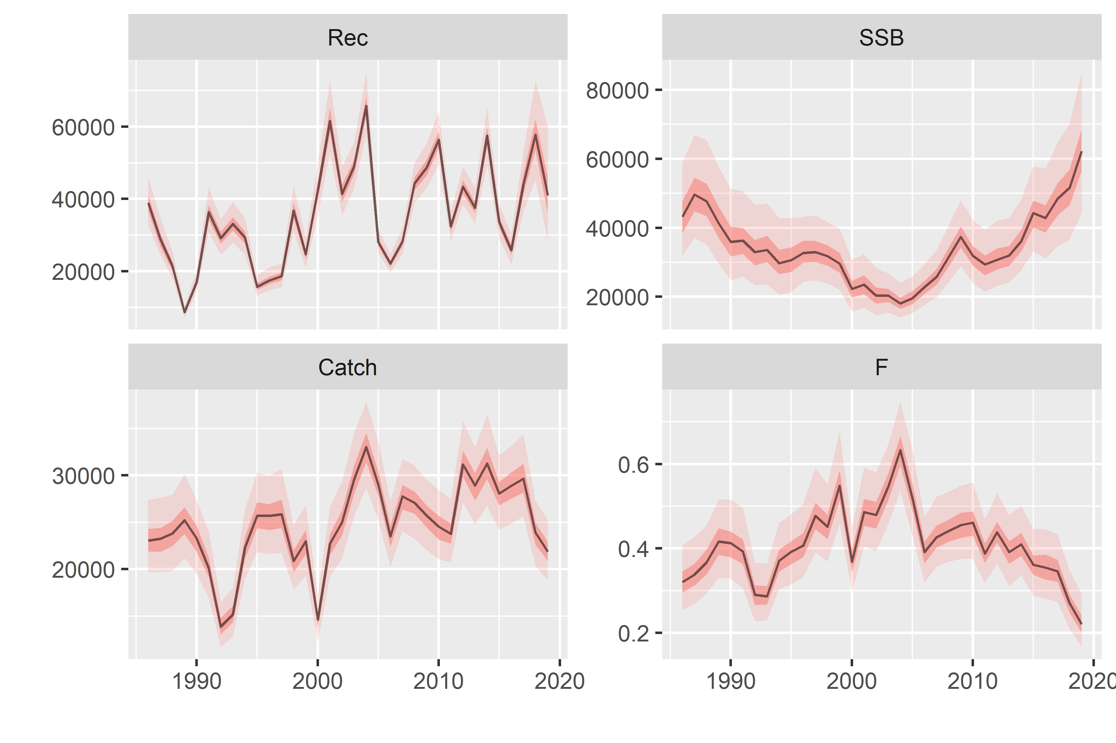
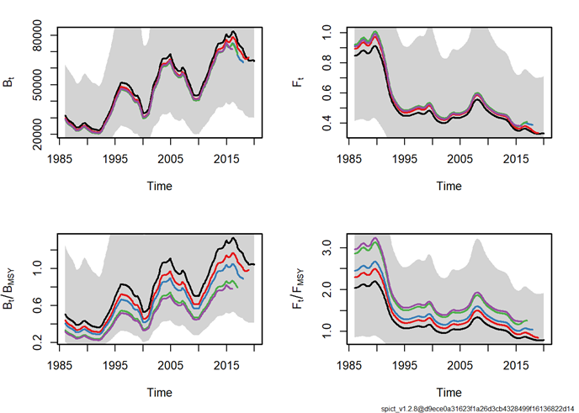
Comparison results of a4a and spict
Output a4a model
Output of retrospective pattern of spict model

Slide 11
DISCUSSION
Is it any problem including the surveys as an index of exploited stock biomass?
Why the same pattern as the LPUE?
Why the difference in the Bmsy and Fmsy in the retrospective pattern?

