Slide 1
Analyzing Data Analysis Salary
Houra Marta Taghavi

Slide 2
Agenda
Statement of goal
Dataset
Exploring and visualizing data
Prediction model
Results

Slide 3
Statement of Goal
Find the most relevant keywords to the data analyst salary
Predict the salary if its above or below the median salary using location, title, and company of the job listings
Predict the expected salaries from other listing to help negotiations

Slide 4
Dataset
Scrapping job listing from indeed.com
confine the search by putting location, level, and salary rage into it:
Levels: entry, mid, senior
Locations: Washington DC, New York, and San Francisco
Example:
scrap location, job title, and company name for each case
https://www.indeed.com/jobs?q=data+analyst+$60,000&l=Washington,+DC&radius=50&explvl=entry_level&limit=100
Salary
Location
Level
Job

Slide 5
Dataset
Data cleaning
Dropping duplicates and NaN values
Splitting location column (“city, state”) to two columns: city and state
Saving clean data to .CSV

Slide 6
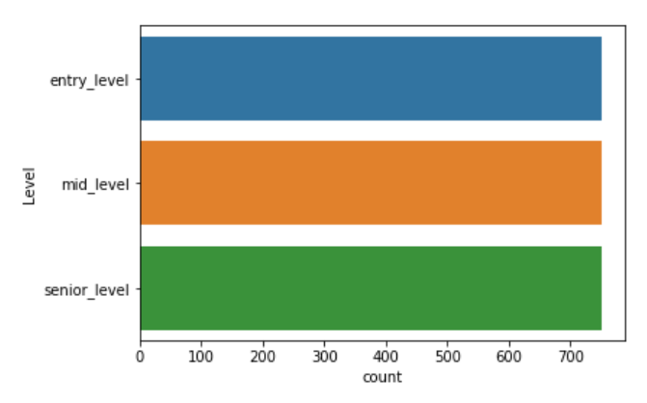
Data exploring (categorical feature distribution)
Number of job postings for each level

Slide 7
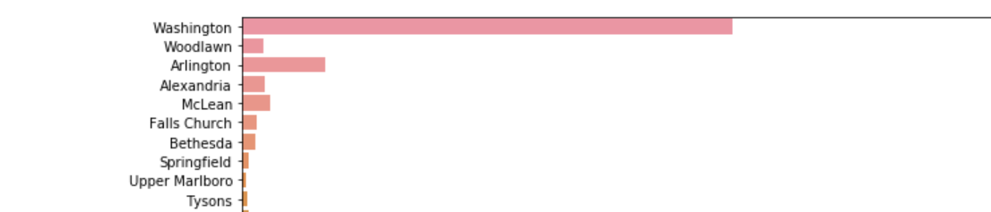
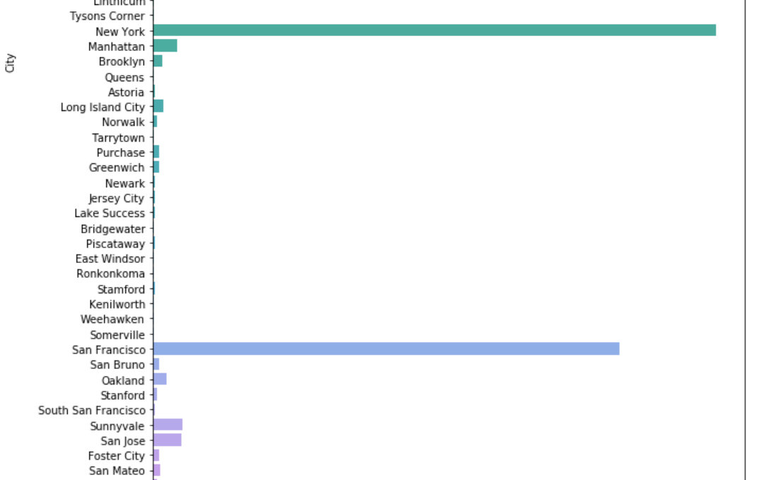
Data exploring (categorical feature distribution)
Number of jobs per city
....
....

Slide 8
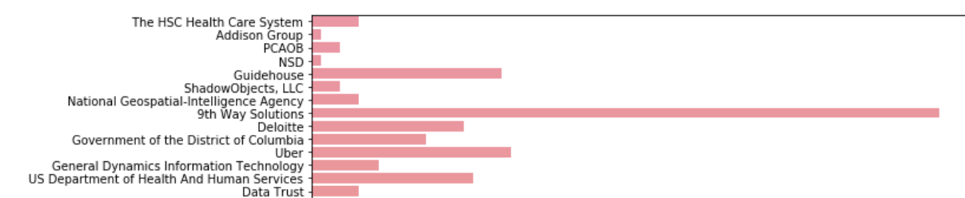

Data exploring (categorical feature distribution)
Number of job posting per company
....

Slide 9
Data exploring (Classification)
Classification based on the median salary
Median salary: $75k
Below median is considered as low pay (0)
Above median considered as high (1)

Slide 10
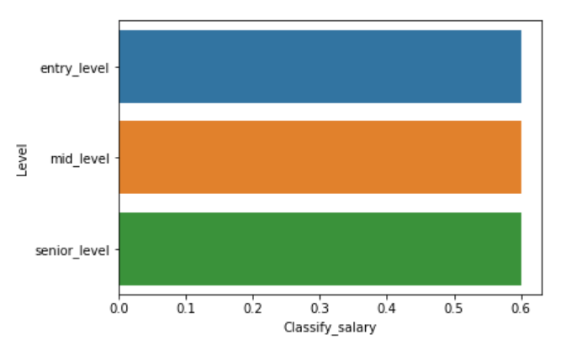
Data exploring (Classification)
Average of classified salary per level

Slide 11
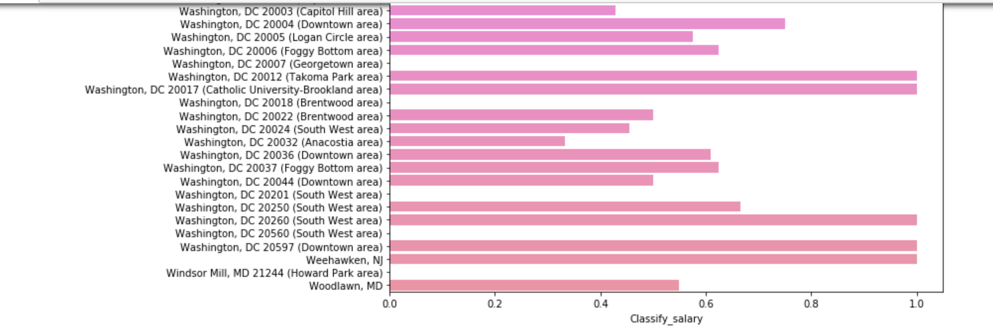
Data exploring (Classification)
Average of classified salary per city

Slide 12
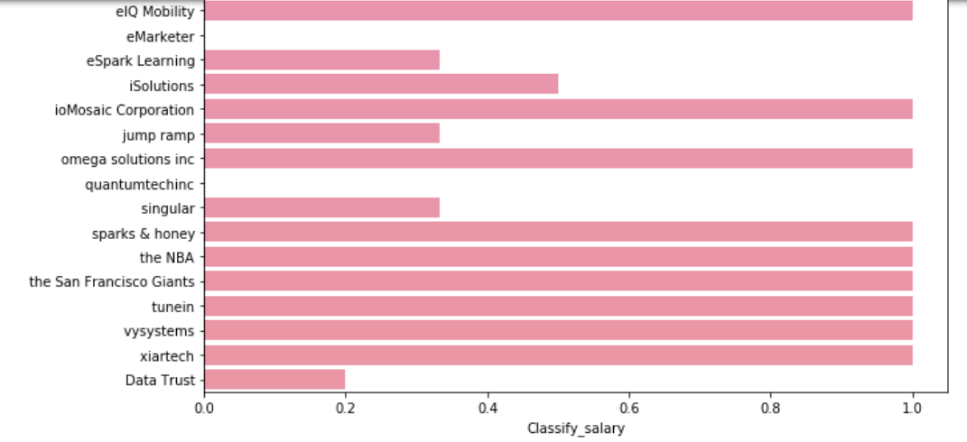
Data exploring (Classification)
Average of classified salary per company

Slide 13
Model prediction
Model used in this study:
Random Forest
Count Vectorizer
Logistic Regression
K_Nearest neighbor

Slide 14
Model evaluation
Model | Score
Random Forest | 0.579259
Count Vectorizer | 0.522207
Logistic Regression | 0.589502
K_Nearest neighbor | 0.609690

Slide 15
Results: most predictive keywords
Based on Count Vectorizer analysis, the most predictive keywords in job titles are:
Senior
Business
Scientist
Analytics
Quantitative
Operations
Research
Associate
strategy

Slide 16
Results: most predictive keywords
Based on Count Vectorizer analysis, the most predictive keywords in cities are:
Manhattan
San Francisco
Brooklyn
San Jose
Baltimore
Germantown
Largo
Astoria
Rockville
Palo Alto
Long Islan City
Foster City
McLean
Menlo Park

Slide 17
Conclusion
There are more job opportunities in NY than SF than DC
“9th Way Solutions” company has the highest number of hiring
Random Forest model gives the best prediction

