Slide 1
Studying Terrorism
Houra marta taghvai

Slide 2
agenda
Goal statement
Dataset
Prediction model
Results and suggestions

Slide 3
Goal of statement
The Global Terrorism Database (GTD) is an open-source database including information on terrorist attacks around the world from 1970 through 2015
GTD does not include information from 1993
Goal : predicting the number of killed in 1993

Slide 4
Data cleaning
To access data : (http://start.umd.edu/gtd/)
Dropping empty columns in the datasets
Some important features: number of killed, number of wounded, region, country, weapon type, target, and year

Slide 5
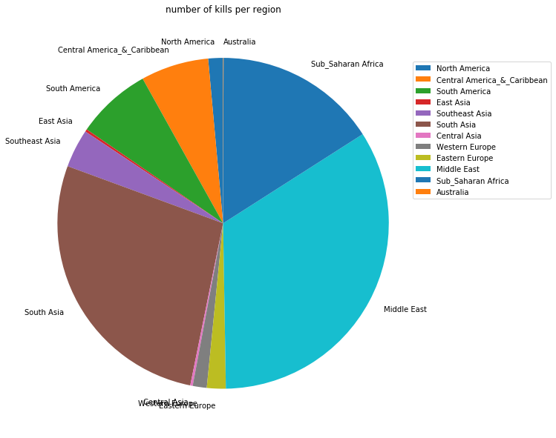
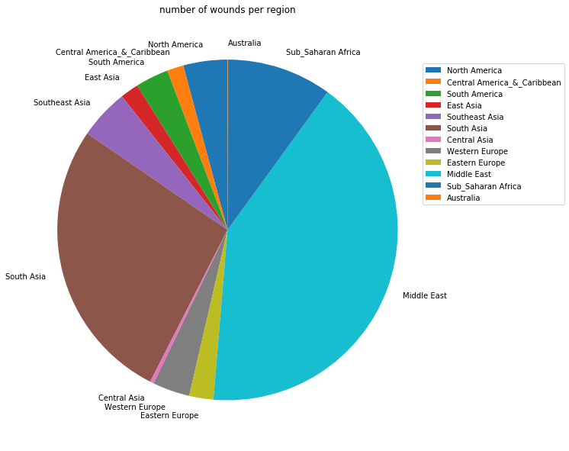
Data exploring
There are twelve regions, looking at the number of killed/wounded per region
Looking closer at the two regions with the highest number of killed/wounded: Middle East and South Asia

Slide 6
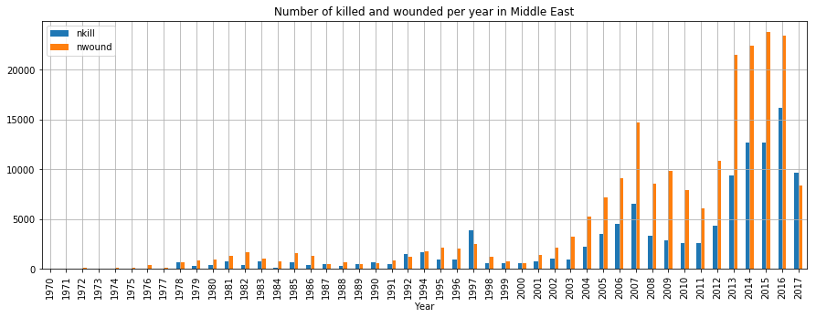
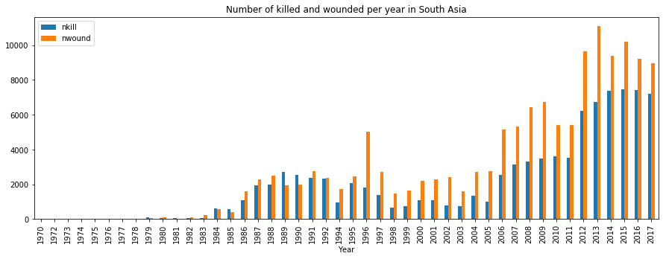
Data exploring
Victims of terrorism attack in Middle East and South Asia by year

Slide 7
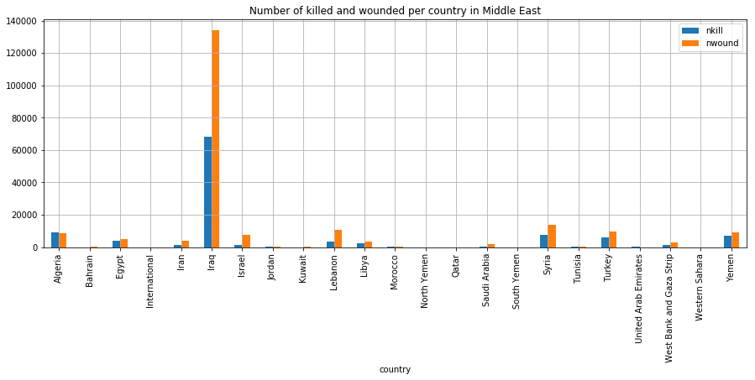
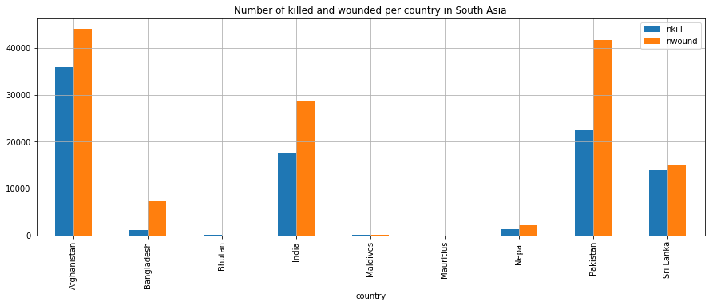
Data exploring
Victims of terrorism attack per country in each region

Slide 8
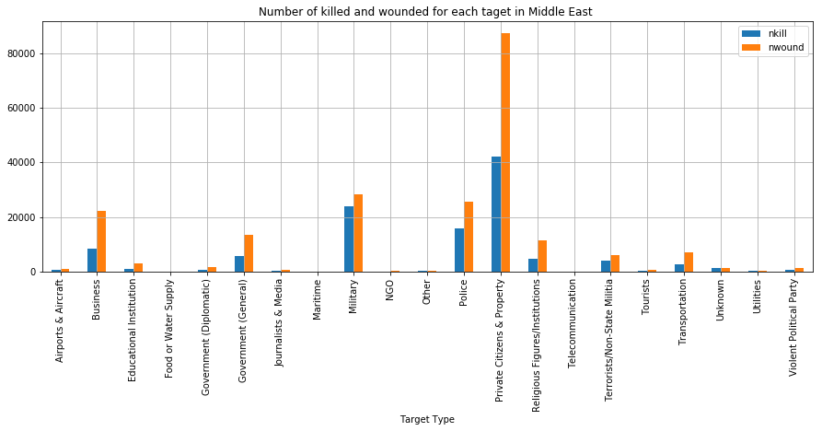
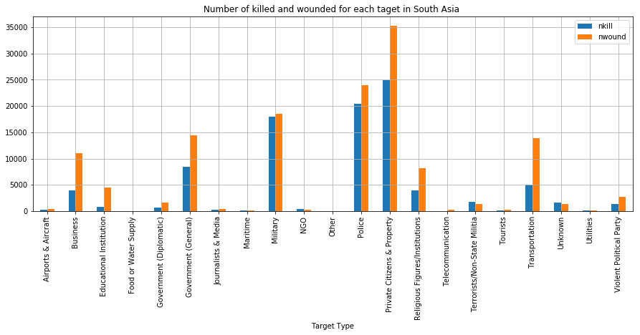
Data exploring
Victim type per region

Slide 9
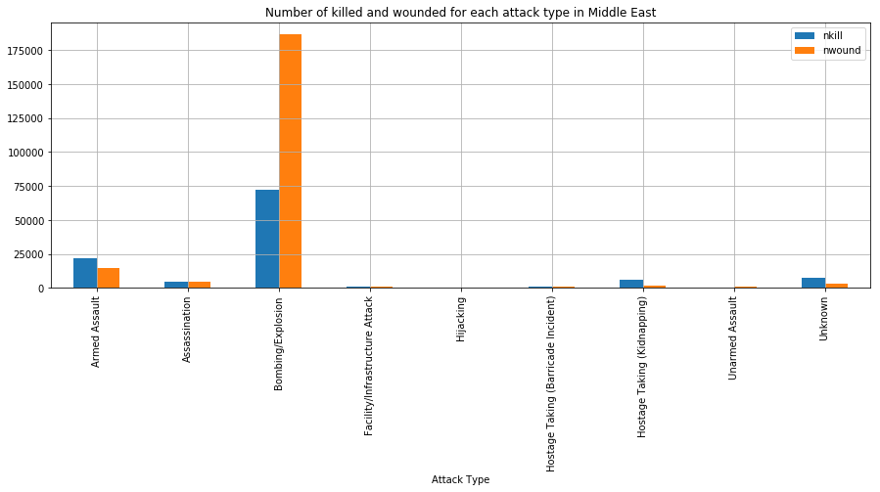
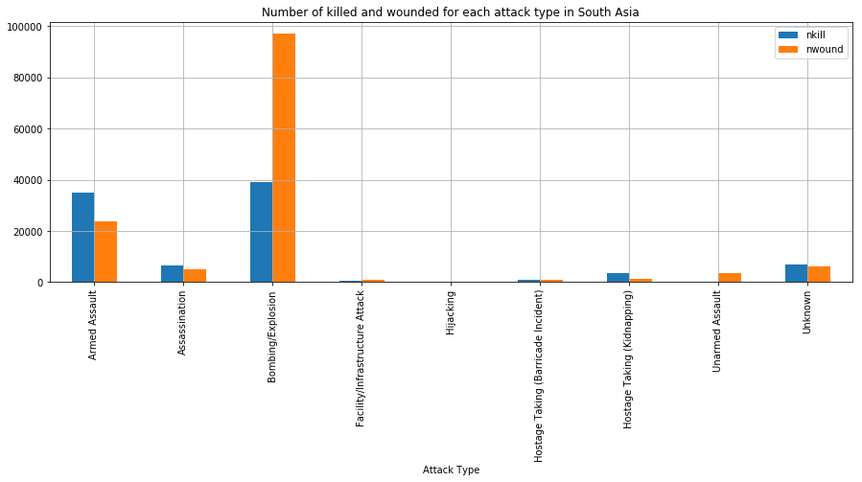
Data exploring
Attack type per region

Slide 10
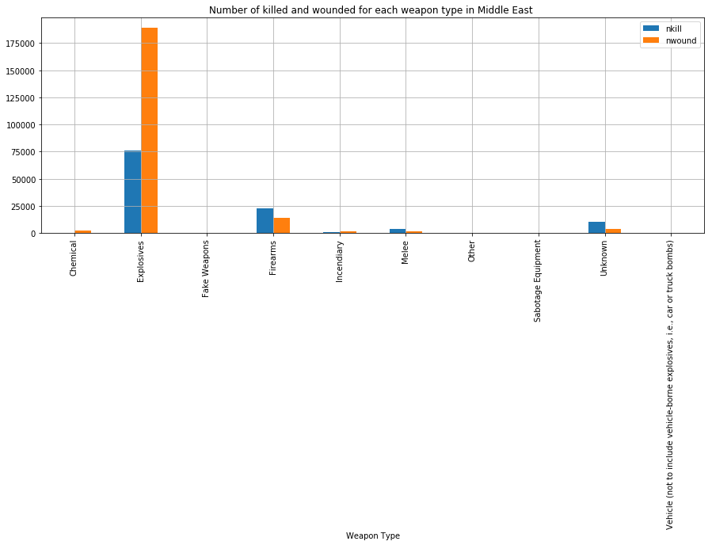
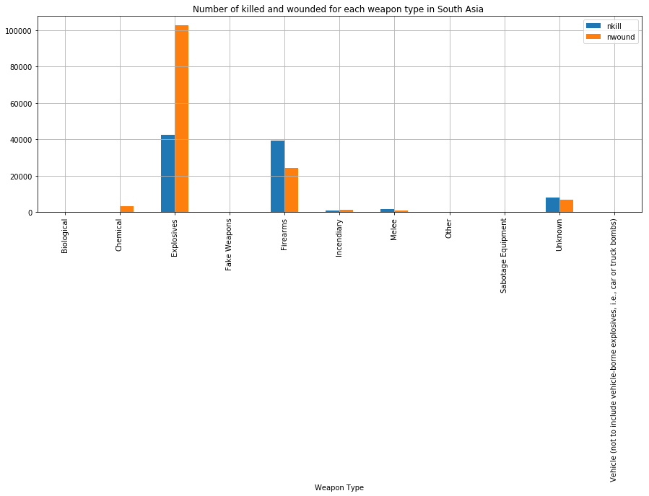
Data exploring
Weapon type used in terrorism attack per region

Slide 11
Prediction model
Predicting the number of killed in 1993 in Middle East and South Asia
Model: linear regression
Mean squared error : 0.004

Slide 12
results
The number of terrorism attack victims significantly increased in recent years
There should more protection around military, and police.
There should be more security to find weapons and equipment related to bombings and fire assaults.

