Slide 1


Chess snake puzzles
Group:
Carolina Cintra – up201906845
Marta Mariz – up201907020
Sara Sá – up201804838

Slide 2
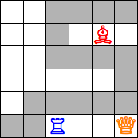
Definition of the game
Chess Snake Puzzles is a puzzle created by Erich Friedman, inspired by Snake and including rules from Chess.
The board can be either 5x5 or 6x6, includes 2 or 3 chess pieces that can’t be moved, and space so the snake can move to the end point.
The rules are the following:
  The snake can only move orthogonally.
  The snake cannot cross a chess piece.
  The snake cannot touch itself (even diagonally).
  In the result, each piece must attack an equal number of segments of the snake.

Slide 3
References
https://pedros.works/chess-snake?W=4&L=s0n5b8f11&A=Erich_Friedman&N=2&T=Set_I&U=https://erich-friedman.github.io/puzzle/snake/
https://erich-friedman.github.io/puzzle/snake/
https://realpython.com/pygame-a-primer/

Slide 4
Formulation of the search problem
Levels of difficulty
  5X5 - 2 Chess pieces
  6x6 - 3 Chess pieces
Representation of the game state
Matrix of objects in which we locate the Chess pieces – those have a vector of positions that they can eat.
Operators
  Up
  Down
  Left
  Right
Heuristics
  Distance from the snake’s head to the finish point
  Absolute difference between the number of times each piece eats a segment of the snake

Slide 5
operations, preconditions, effects, costs
Operations | Preconditions | Effects | Cost
Up | Y>0 & M[X, Y-2] ≠ snake & M[X-1, Y-1] ≠ snake & M[X+1, Y-1] ≠ snake & M[X-1, Y-2] ≠ snake & M[X+1, Y-2] ≠ snake & M[X, Y-1] = empty | M[X, Y-1] = snake Y = Y - 1 Update each piece with the number of times it attacks and if it does, remove that position from the vector Vector with the positions of the pieces/ pointer to the object piece | 1
Down | Y<5 & M[X, Y+2] ≠ snake & M[X-1, Y+1] ≠ snake & M[X+1, Y+1] ≠ snake & M[X-1, Y+2] ≠ snake & M[X+1, Y+2] ≠ snake & M[X, Y+1] = empty | M[X, Y+1] = snake Y = Y + 1 Update each piece with the number of times it attacks and if it does, remove that position from the vector Vector with the positions of the pieces/ pointer to the object piece | 1
Left | X>0 & M[X-2, Y] ≠ snake & M[X-1, Y-1] ≠ snake & M[X-1, Y+1] ≠ snake & M[X-2, Y-1] ≠ snake & M[X-2, Y+1] ≠ snake & M[X-1, Y] = empty | M[X-1, Y] = snake X = X - 1 Update each piece with the number of times it attacks and if it does, remove that position from the vector Vector with the positions of the pieces/ pointer to the object piece | 1
Right | X<5 & M[X+2, Y] ≠ snake & M[X+2, Y-1] ≠ snake & M[X+2, Y+1] ≠ snake & M[X+1, Y-1] ≠ snake & M[X+1, Y+1] ≠ snake & M[X+1, Y] = empty | M[X+1, Y] = snake X = X + 1 Update each piece with the number of times it attacks and if it does, remove that position from the vector Vector with the positions of the pieces/ pointer to the object piece | 1

Slide 6
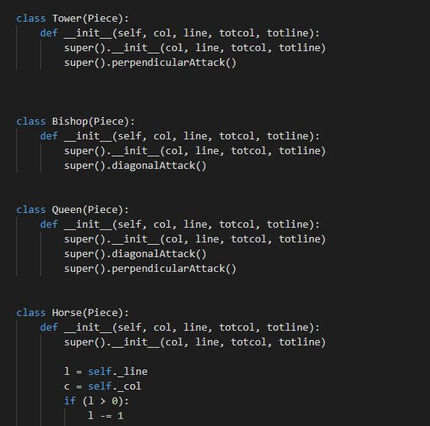
Work implemented
The project is being developed in Python 3 and the development environment chosen was Visual Studio Code
The data structures used so far are a list of lists (a matrix that represents the board), lists of tuples (to save the positions that each piece can attack)
We already implemented the board and the classes for each type of chess piece and their attack strategies
We plan on using PyGame in the development of the GUI

